Slide 1
Sections 9.1 – 9.3 Valence Bond Theory Hybrid Orbitals Sigma and Pi Bonding

Slide 2
Chemical Bonding Theories
Valence Bond Theory: Uses Lewis Structures
Bonds form using shared electrons between overlapping orbitals on adjacent atoms.
Orbitals arrange around central atom to avoid each other.
Two types of bonds: sigma and pi.
Molecular Orbital Theory: Uses MO Diagrams
Orbitals on atoms “mix” to make molecular orbtials, which go over 2 or more atoms.
Two electrons can be in an orbital.
Orbitals are either: bonding, antibonding, or nonbonding.
Bonds are either: sigma or pi.

Slide 3
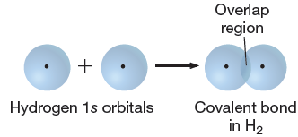
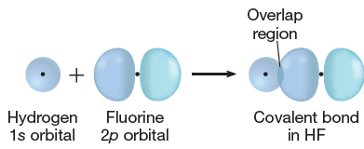
Sigma (s) Bonding
Orbitals on bonding atoms overlap directly between bonding atoms
Between
s orbitals
Between s and p orbitals
Between
p orbitals

Slide 4
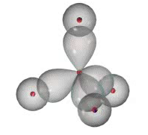
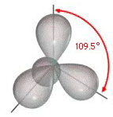
Sigma (s) Bonding
Consider VSEPR Shapes and bonding:

Slide 5
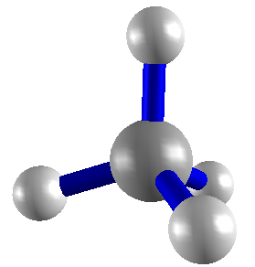
What’s wrong with this picture?
Atoms bond by having their
valence orbitals overlap

Slide 6
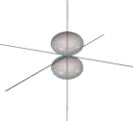
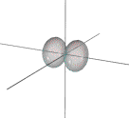
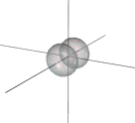
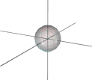
2p_{z} 2p_{x} 2p_{y}
2s
Orbitals on C
Orbitals in CH₄
Orbitals don’t go in same directions as atomic orbitals.
Conclusion: Atomic orbitals change shape when they
make molecules.

Slide 7
Hybrid Orbitals
Atomic valence orbitals “combine and mix” to form new “Hybrid Orbitals”
Hybrid orbitals go in the VSEPR electron geometry directions.

Slide 8
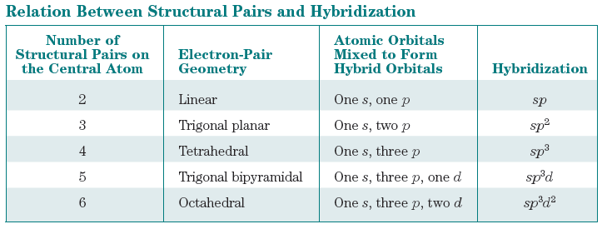
Types of Hybrid Orbitals

Slide 9
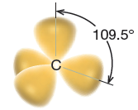
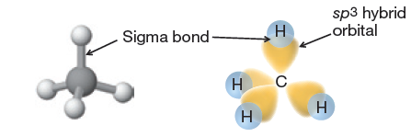
4 Pairs: sp³ hybrid orbitals

Slide 10
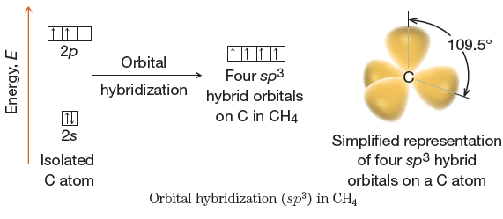
sp³ hybrid orbitals: energetics

Slide 11
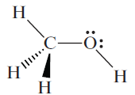
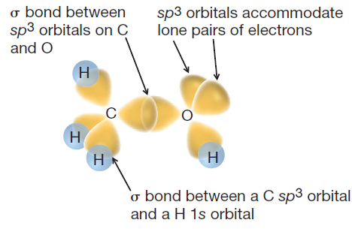
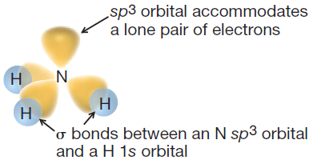
sp³ bonding examples

Slide 12
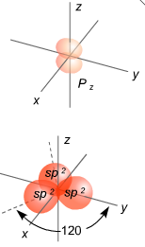
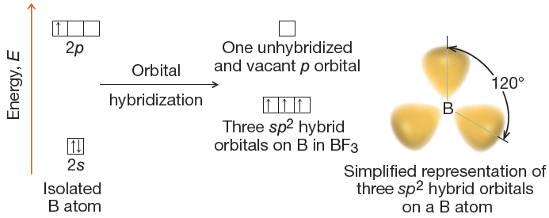
3 Pairs: sp² hybrid orbitals

Slide 13
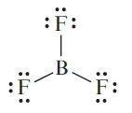
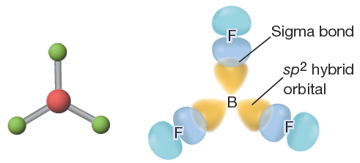
sp² bonding example: BF₃

Slide 14
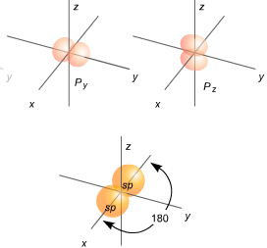
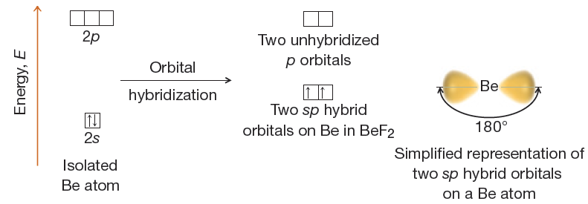
2 Pairs: sp hybrid orbitals

Slide 15
sp bonding example: BeF₂

Slide 16
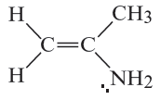
More complex example:

Slide 17
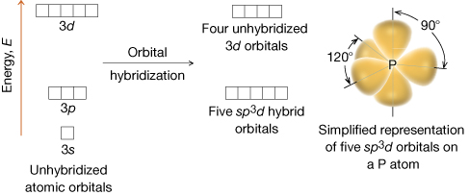
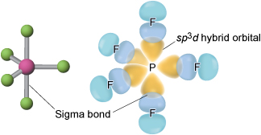
Expanded Valence Cases: 5 structural pairs

Slide 18
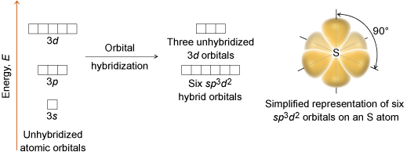
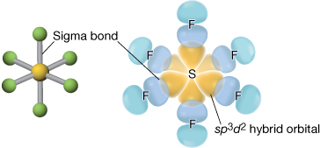
Expanded Valence Cases: 6 structural pairs

Slide 19
Summary

Slide 20
Bond
angles

Slide 21
Sigma vs. Pi Bonding
sigma Bonding involves:
-- hybrid orbitals
-- H 1s orbitals
-- terminal atom p orbitals
pi bonding involves unhybridized p orbitals

Slide 22
sigma bond formation
Orbitals overlap directly between two nuclei:

Slide 23
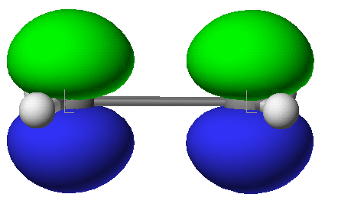
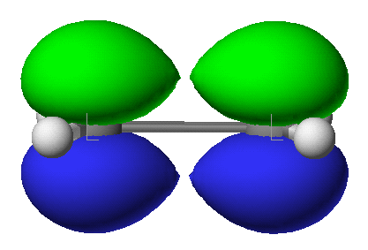
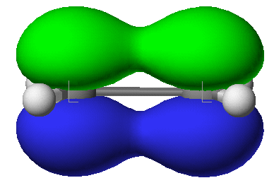
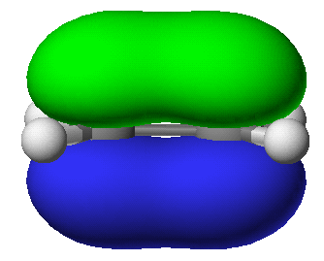
pi Bond Formation

Slide 24
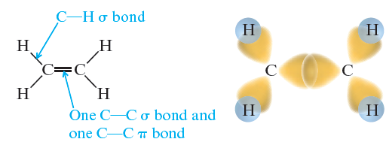
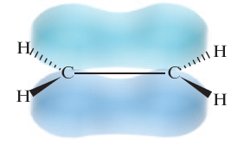
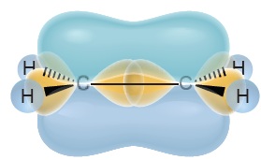
Bonding in Ethene

Slide 25
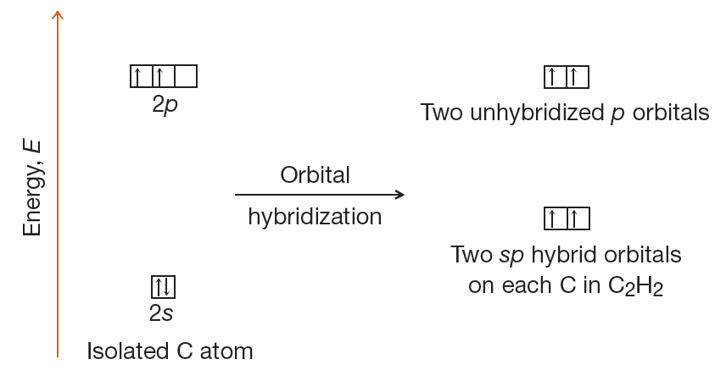
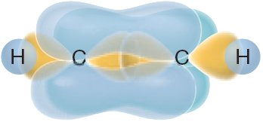
Bonding in Acetylene

Slide 26
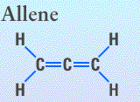
Advanced: Allene
Each end carbon is a flat trigonal.
Are they co-planar or perpendicular?

Slide 27
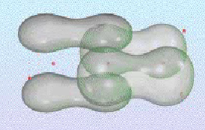
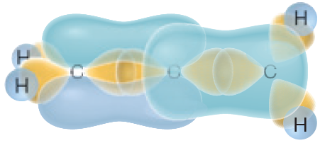
Bonding in Allene

Slide 28
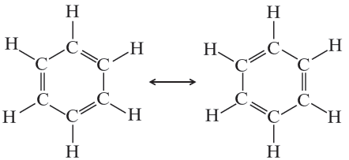
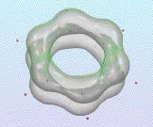
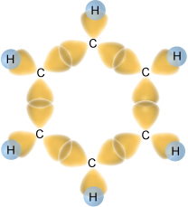
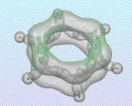
Bonding in Benzene

Slide 29
Summary

Slide 30
Conformations vs. Isomers
Isomers: Molecules with same formula but different structure
Conformers: Different temporary shapes of the same molecule

Slide 31
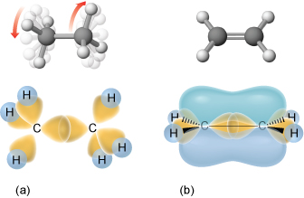
Bond Rotations
CAN happen around single bonds
Cannot happen around double bonds

Slide 32
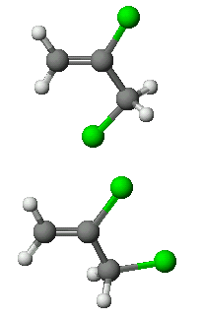
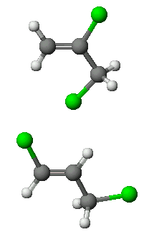
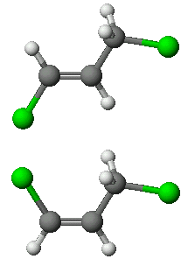

Slide 33
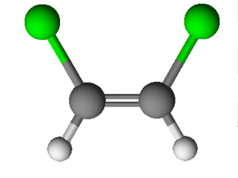
cis-trans Isomerization
When two groups are on a “side” of a molecule.
cis
trans

Slide 34
Can these molecules have cis-trans isomers?

