Slide 1
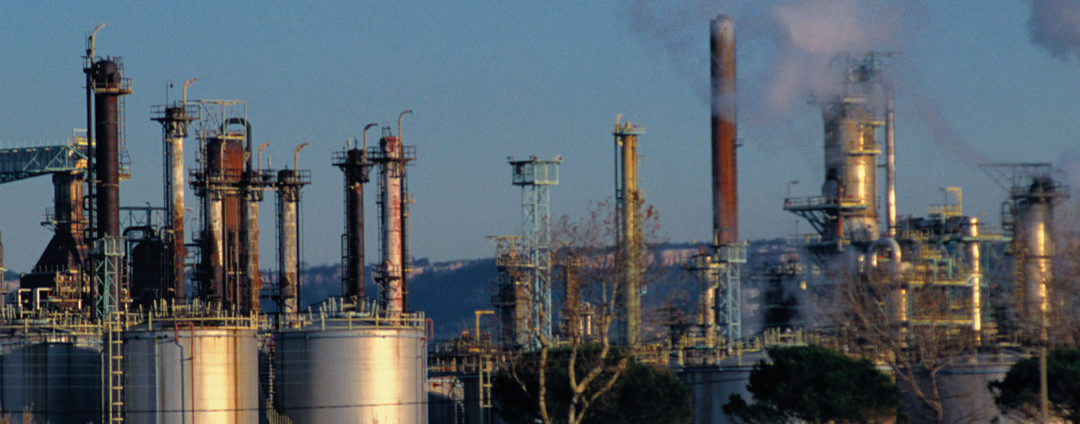
Chapter 2 : Alkanes and Cycloalkanes

Slide 2
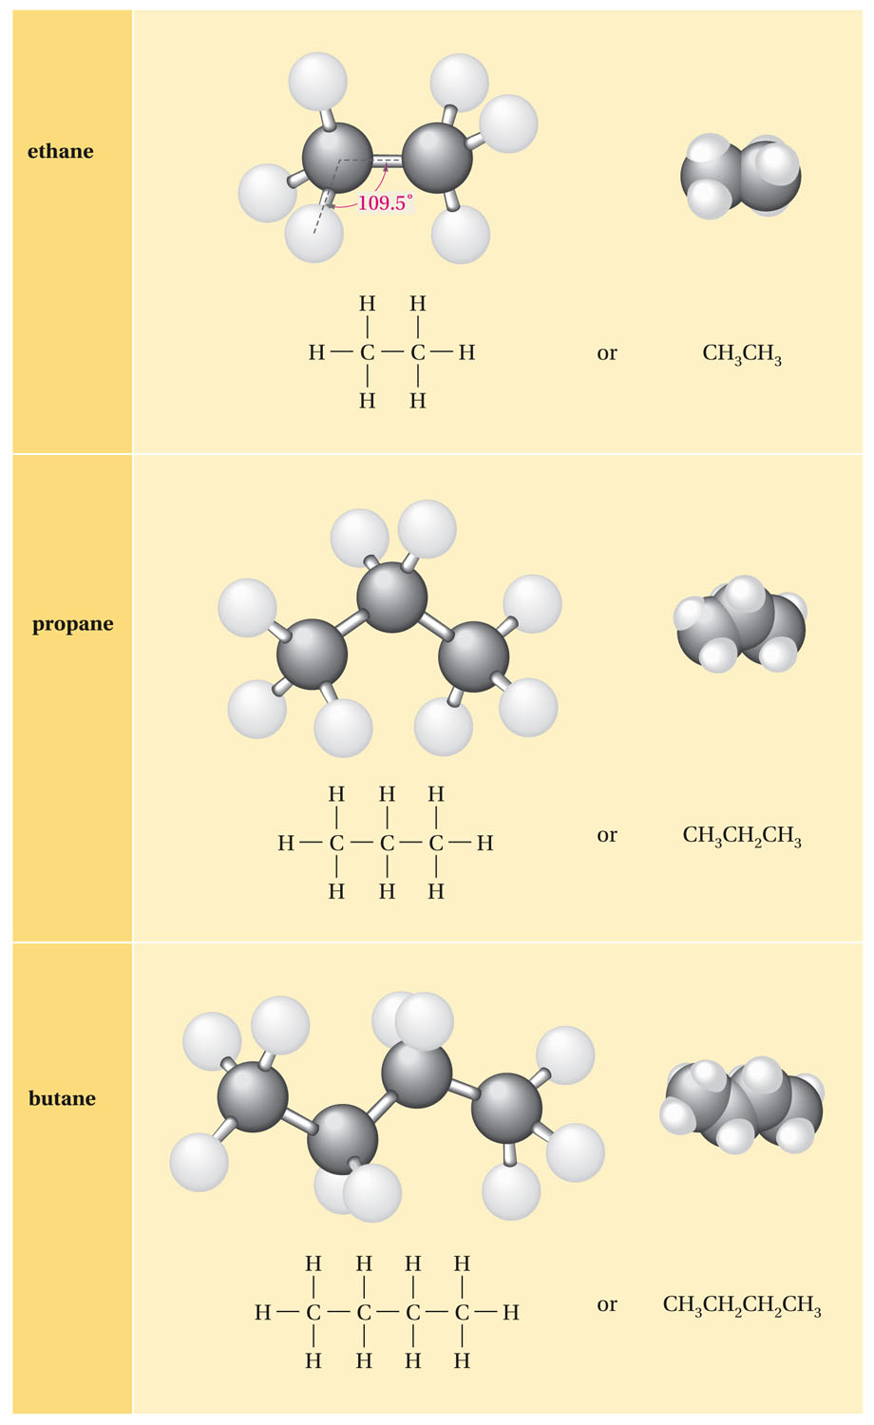
The Structure of Alkanes

Slide 3
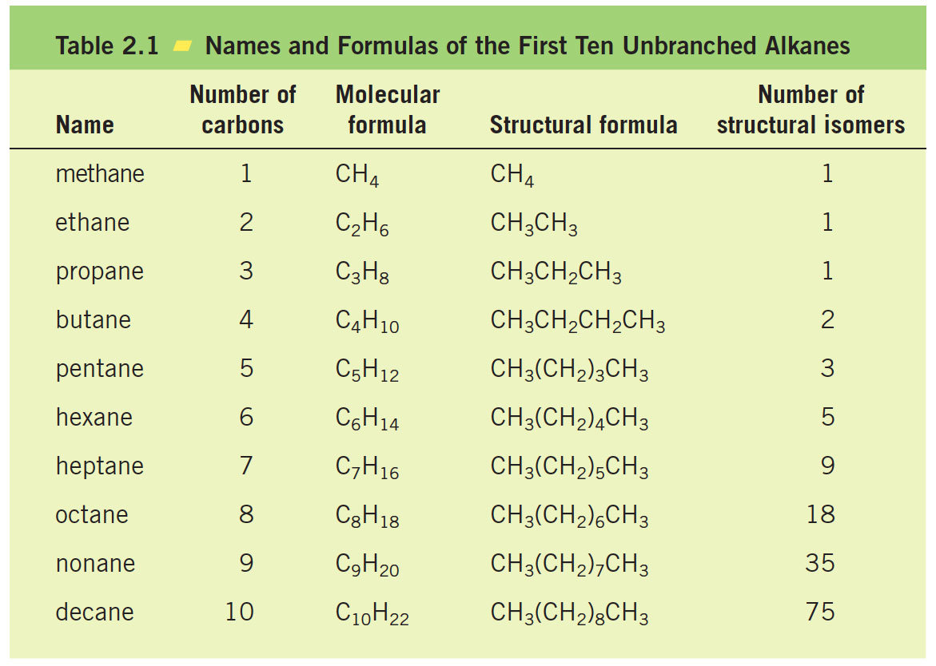

Slide 4
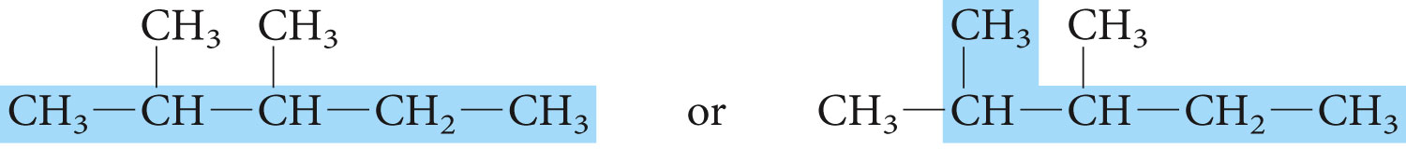
Nomenclature of Organic Compounds

Slide 5
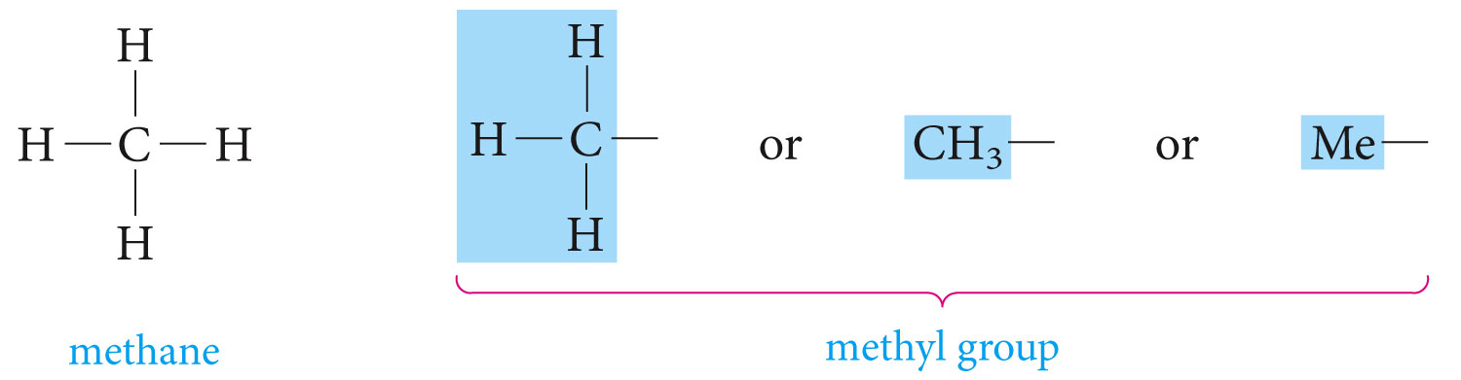
Alkyl groups

Slide 6
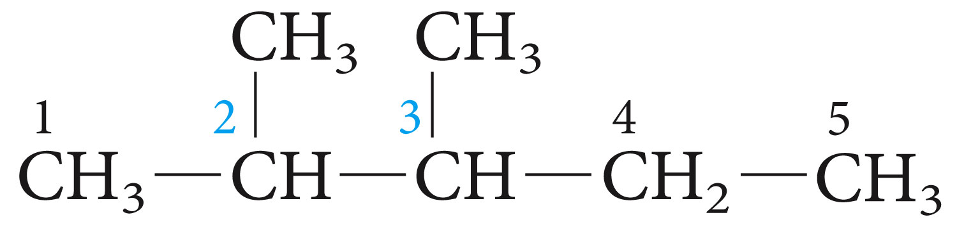

Slide 7
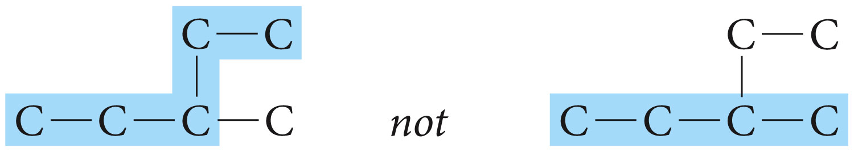
Numbering the parent carbon chain
The root name is that of the longest continuous carbon chain (parent carbon chain)
Groups attached to the main chain are called substituents. Saturated substituents that contain only carbon and hydrogen are called alkyl groups. Named by replacing the –ane of the alkane by -yl

Slide 8
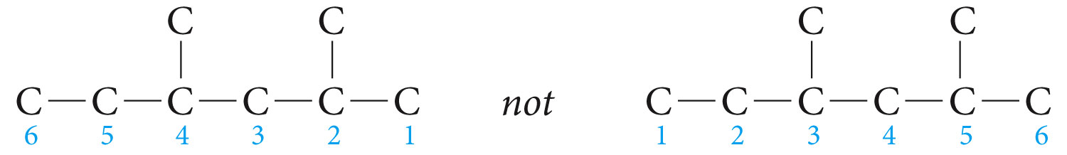
The main chain is numbered such that the first substituent encountered along the chain receives the lowest possible number.
Each substituent is then located by the number of the carbon to which it is attached.
When two or more identical groups are attached to the main chain, prefixes such as di- tri-, tetra-, are used.

Slide 9
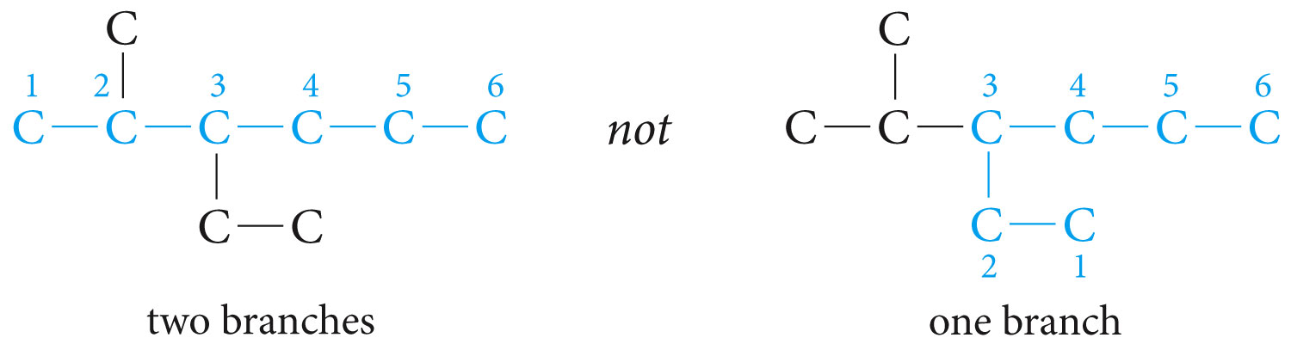
If there are two equally long continuous chains, select the one with the most branches.

Slide 10
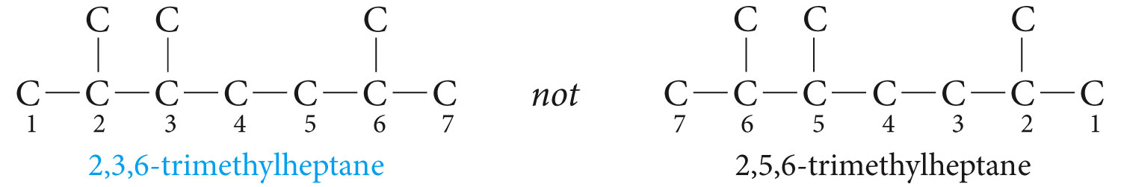
If there is a branch equidistant from each end of the longest chain, begin numbering nearest to a third branch.

Slide 11
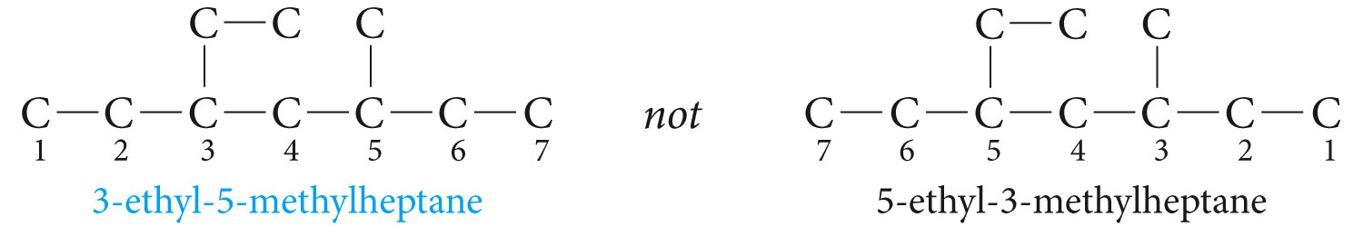
If there is no third branch, begin numbering nearest the substituent whose name has alphabetic priority;

Slide 12
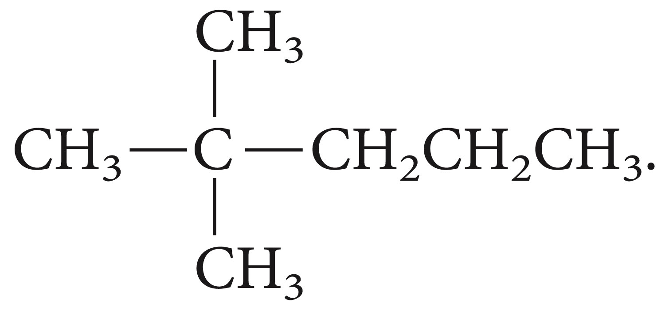
Give the IUPAC name for the compound shown?

Slide 13
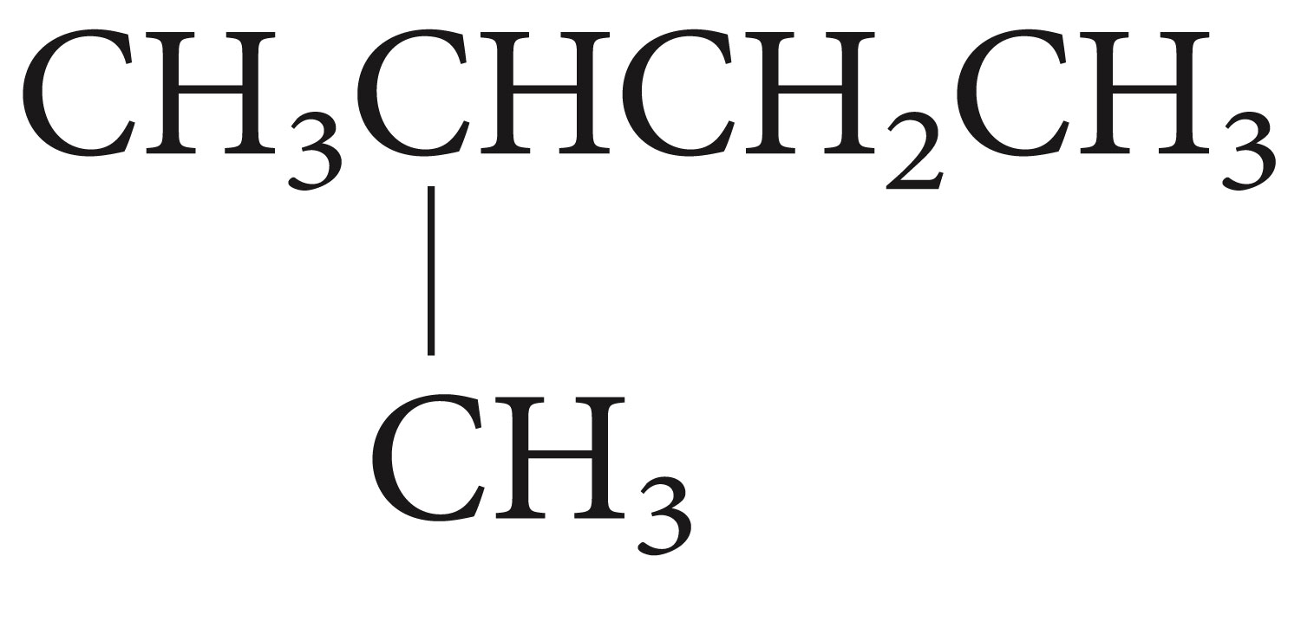
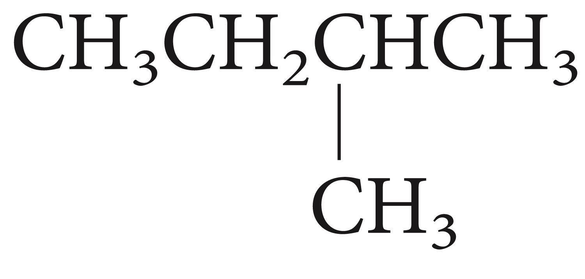
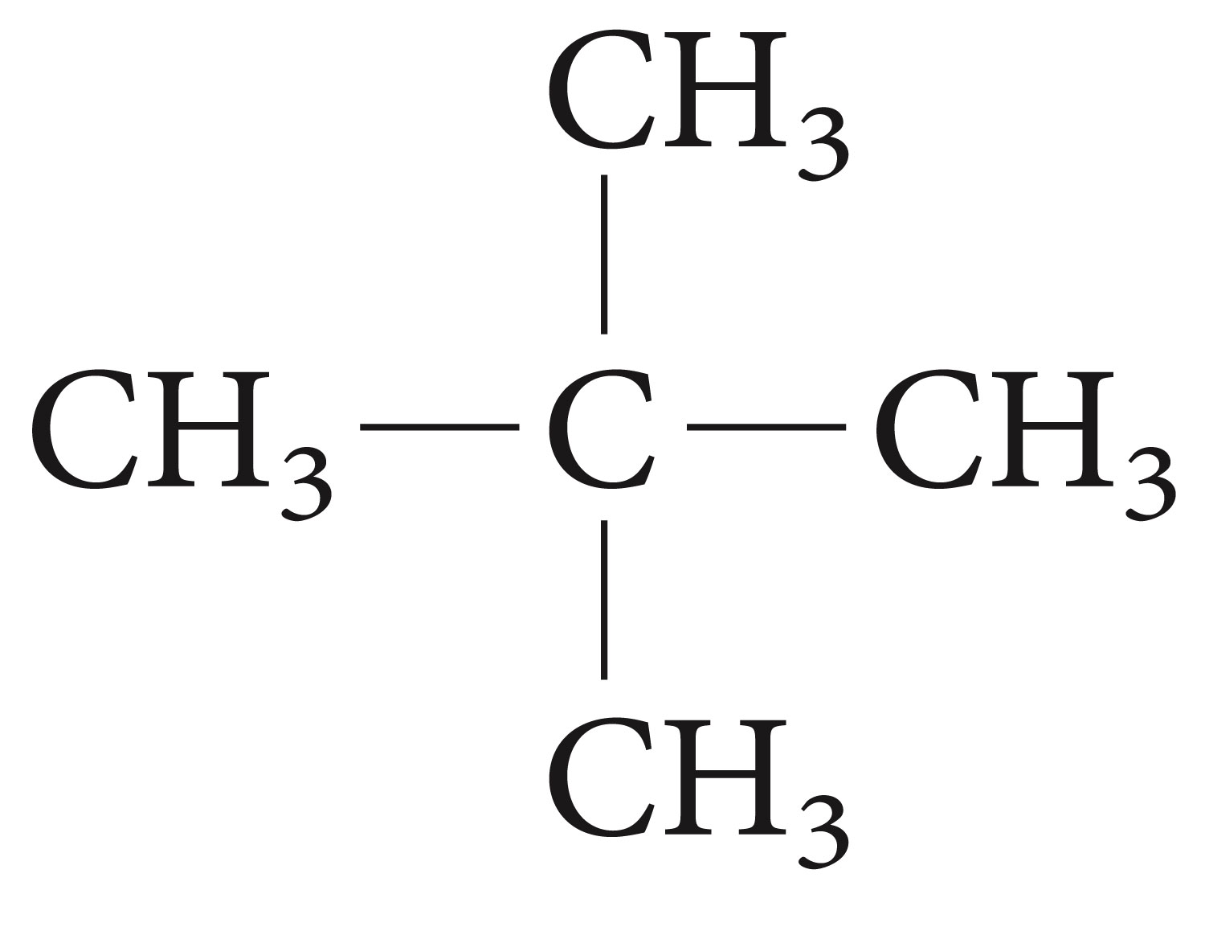
Give the IUPAC name of the following compounds:

Slide 14
Clicker Question
What is the correct IUPAC name of the compound below?
4-methylpentane
2-methylpentane
Methylbutane
Dimethylbutane

Slide 15
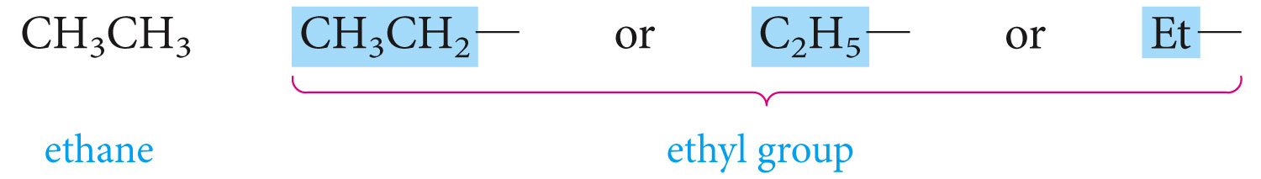
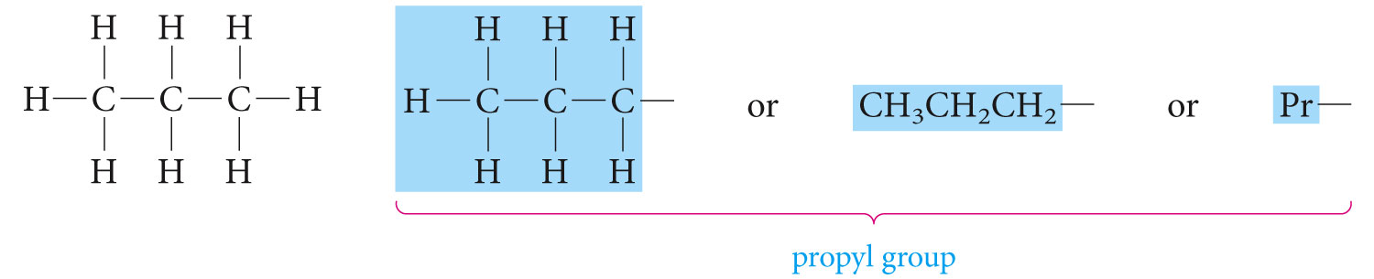
Alkyl and Halogen Substituents

Slide 16
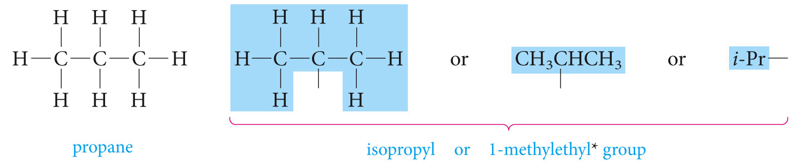

Slide 17
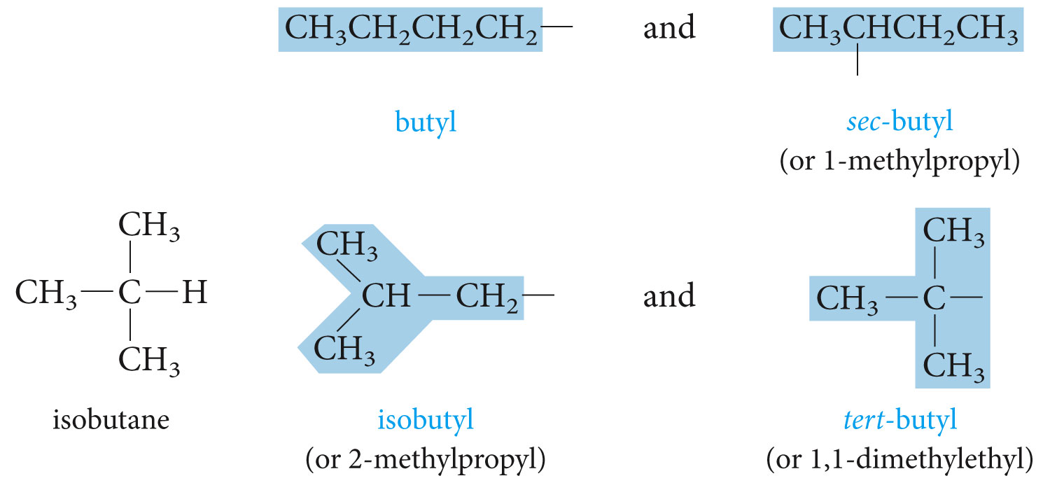
There are four different butyl groups

Slide 18
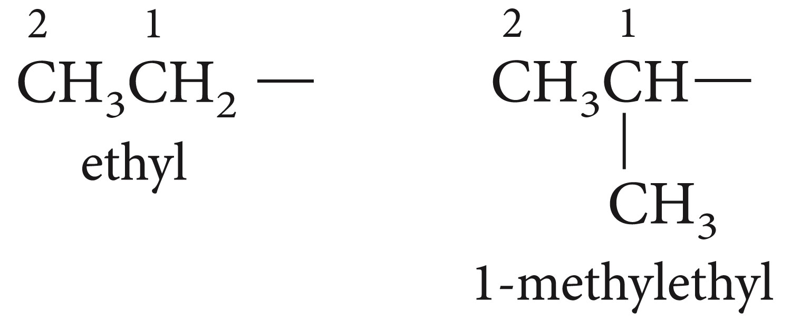
The letter R is used as a general symbol for an alkyl group.
R-H alkane
R-X X=F, Cl, Br, I (halogen) Alkyl halide
Named: F- (fluoro-), Cl- (chloro-), Br- (bromo-) I- (iodo-)

Slide 19
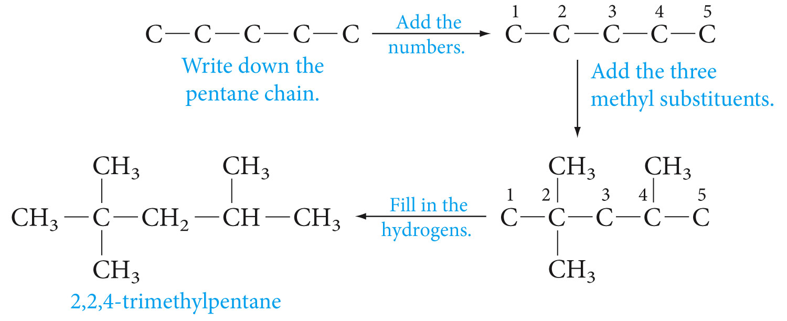
Write the formula for 2,2,4-trimethylpentane

Slide 20
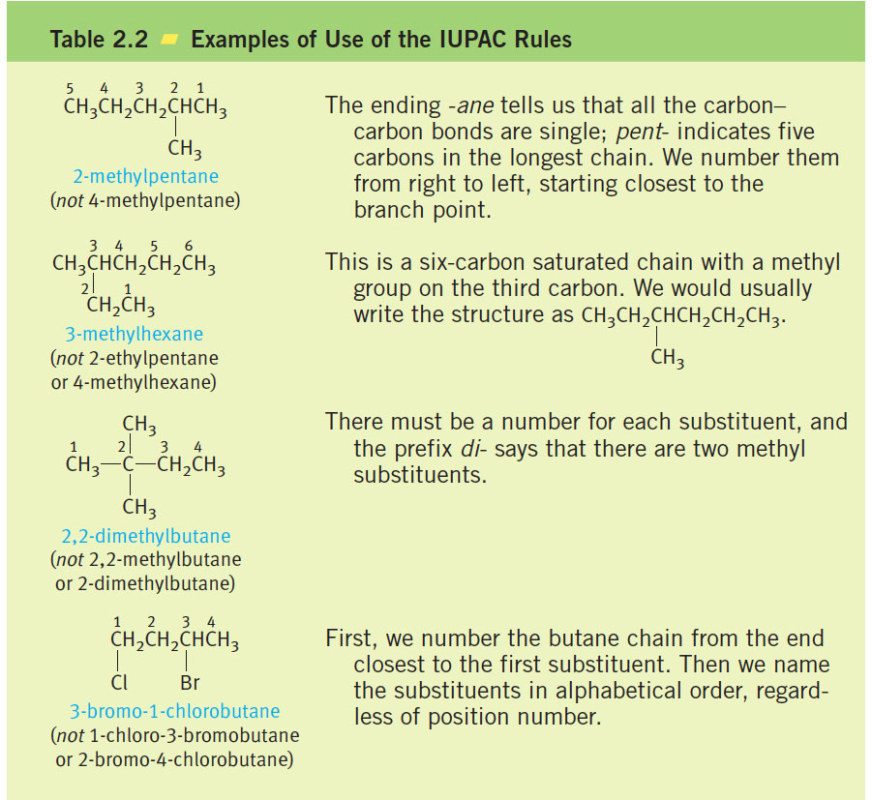

Slide 21
Clicker Question
A student named a hydrocarbon as
2-ethylpentane and was graded incorrect, what should the correct IUPAC name of the compound be?

Slide 22
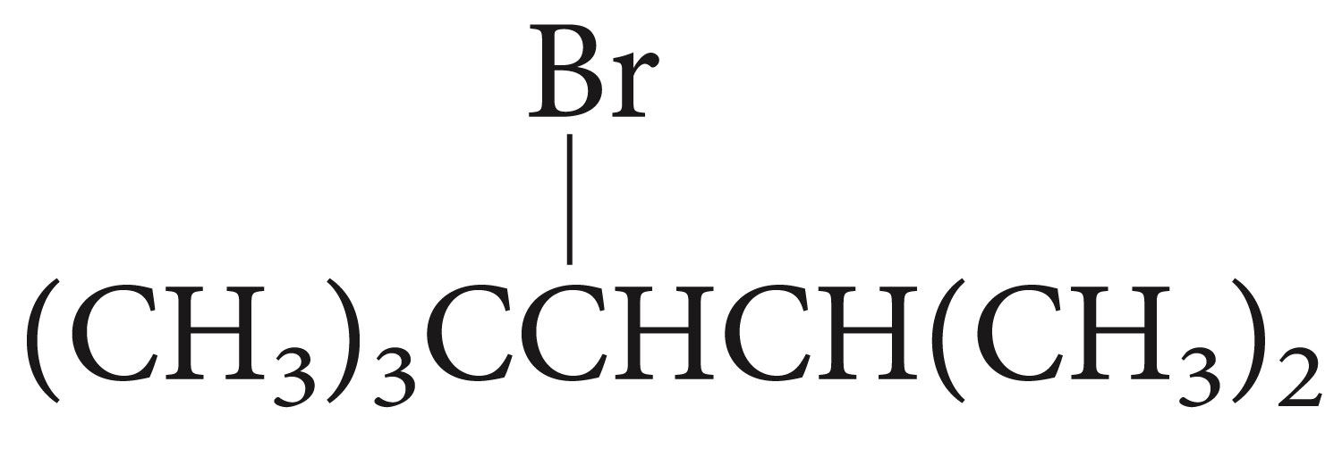
Name the following compounds by the IUPAC system:
CH₃CHFCH₂CH₃
Write the structure for 3,3-dimethyloctane

Slide 23
Name the following compounds by the IUPAC system:
CH₃CHFCH₂CH₃
Write the structure for 3,3-dimethyloctane

Slide 24
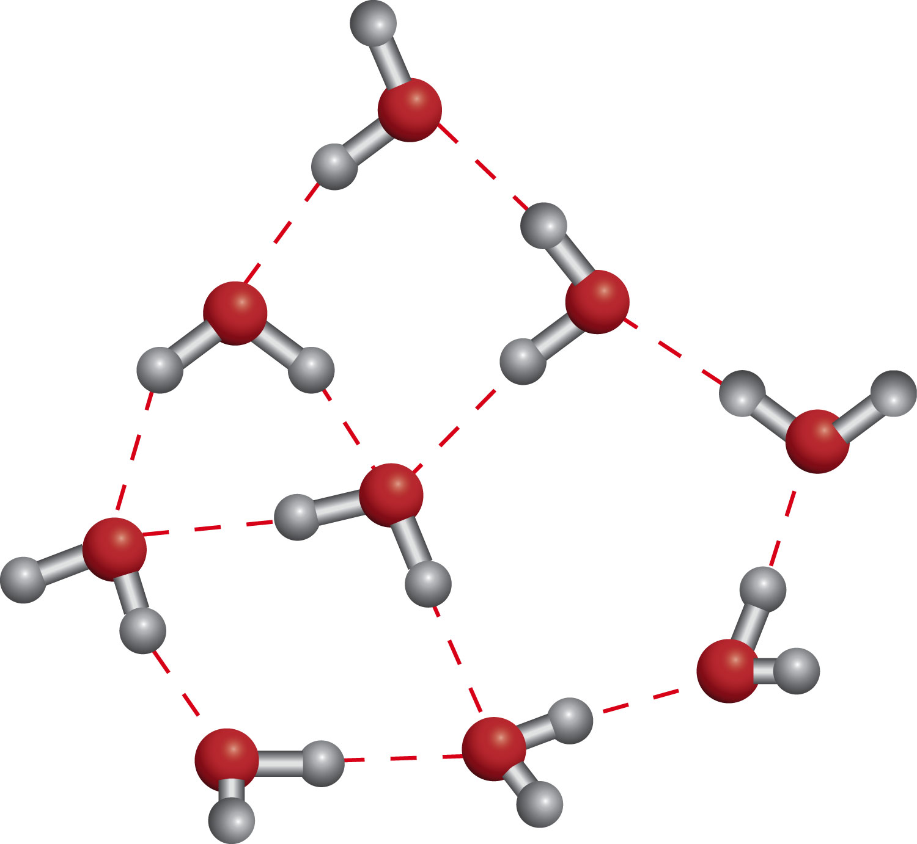
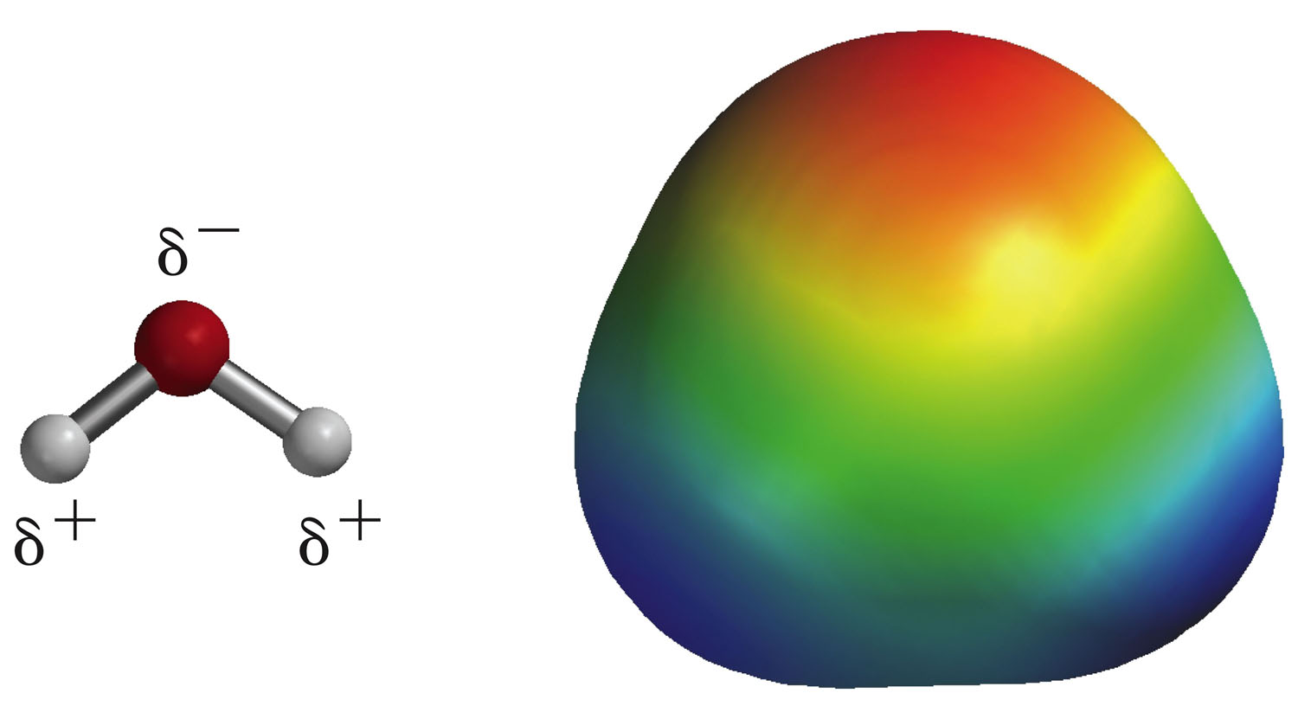
Physical Properties of Alkanes and Nonbonding Intermolecular Interactions
Water molecules are polar and they have special attractions called hydrogen bonding.
Alkanes are insoluble in water because they are non-polar (all the C-C and C-H are nearly purely covalent)

Slide 25
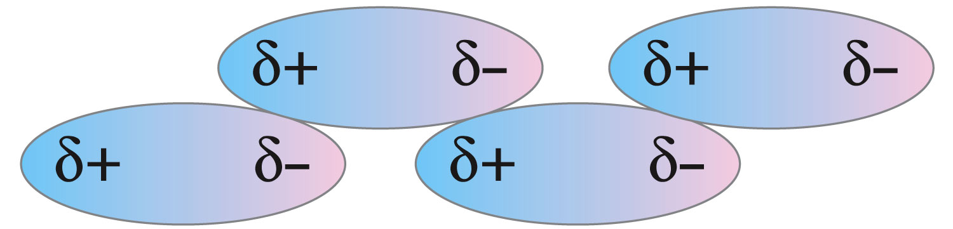
Van der Waals attractions
The boiling points of alkanes rise as the chain length increases and fall as the chains become branched and more nearly spherical in shape

Slide 26
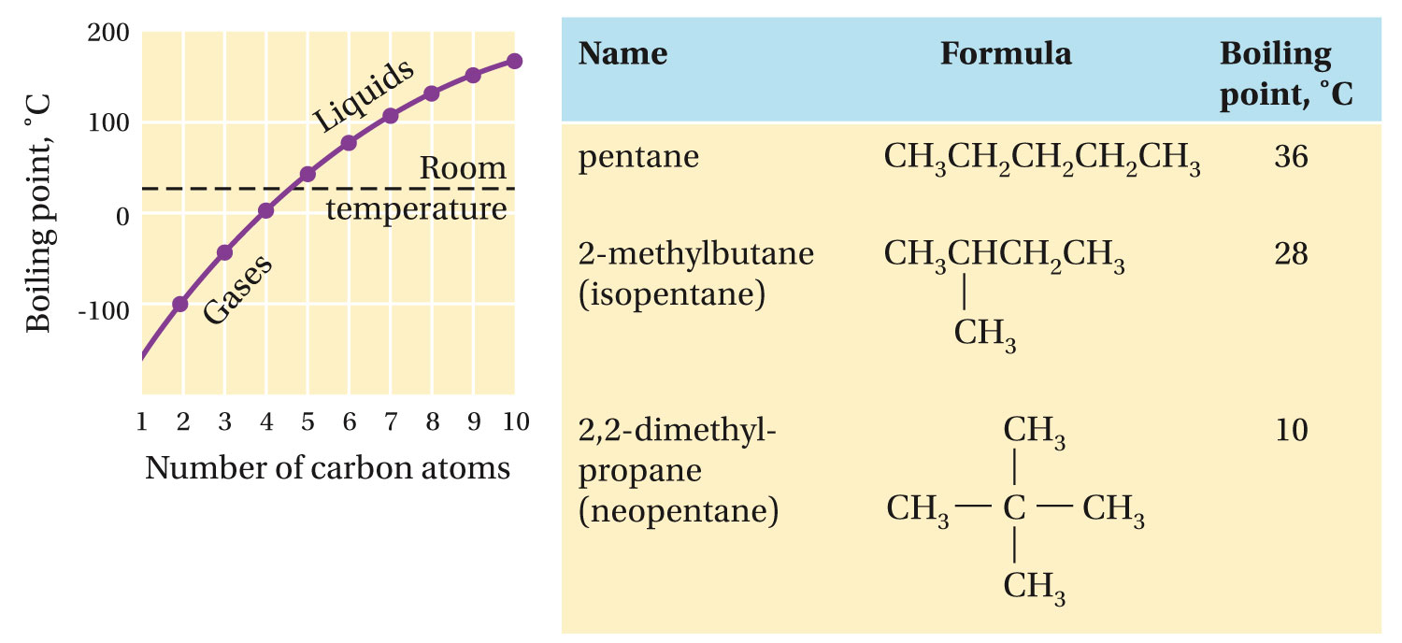
The effect of molecular shapes on van der Waals attractions

Slide 27
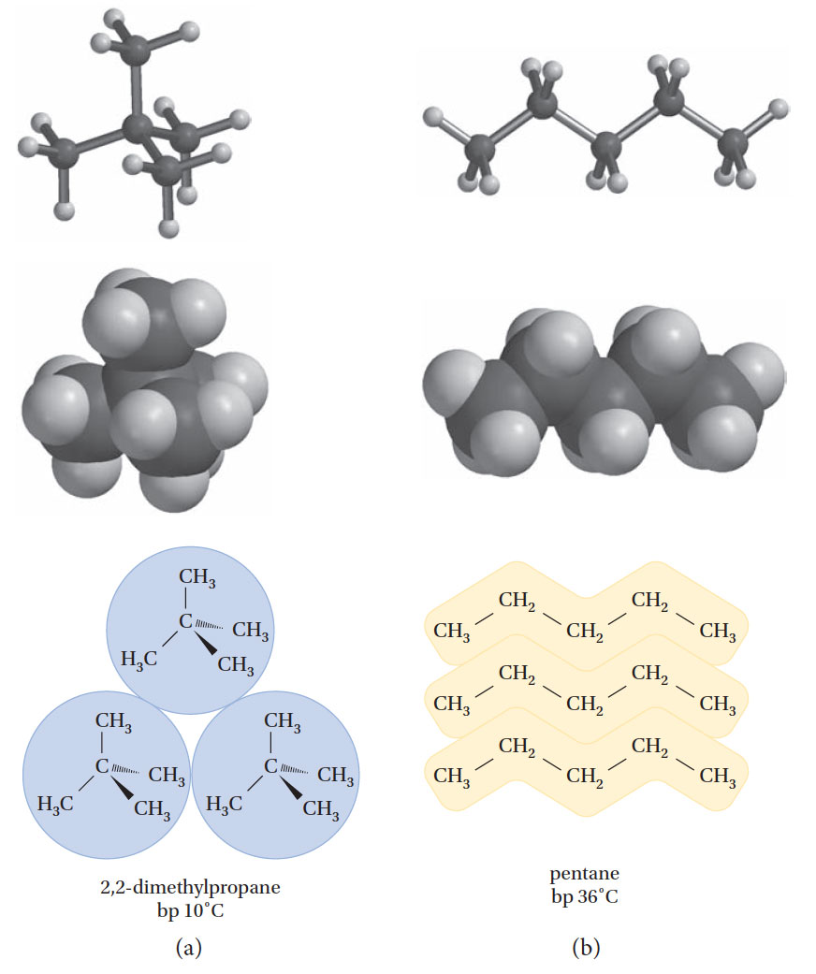

Slide 28
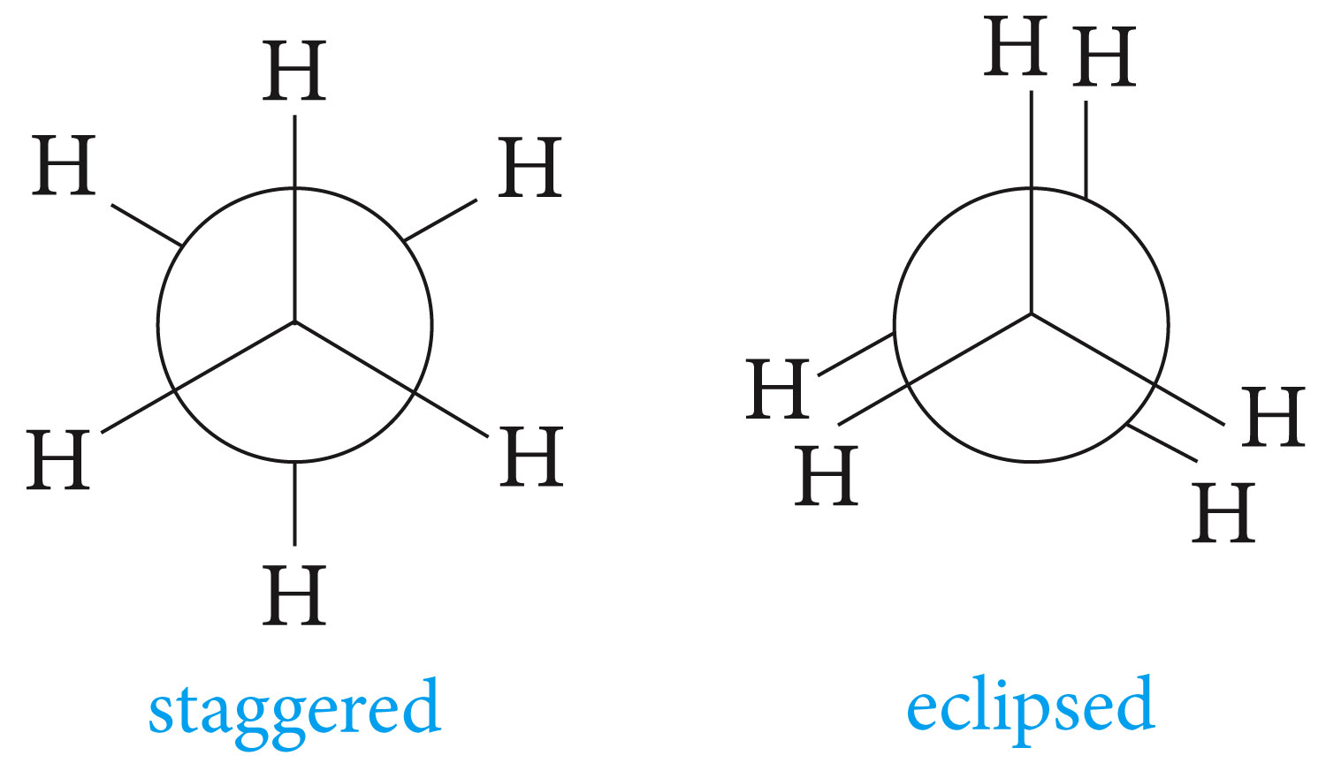
Conformations of Alkanes

Slide 29
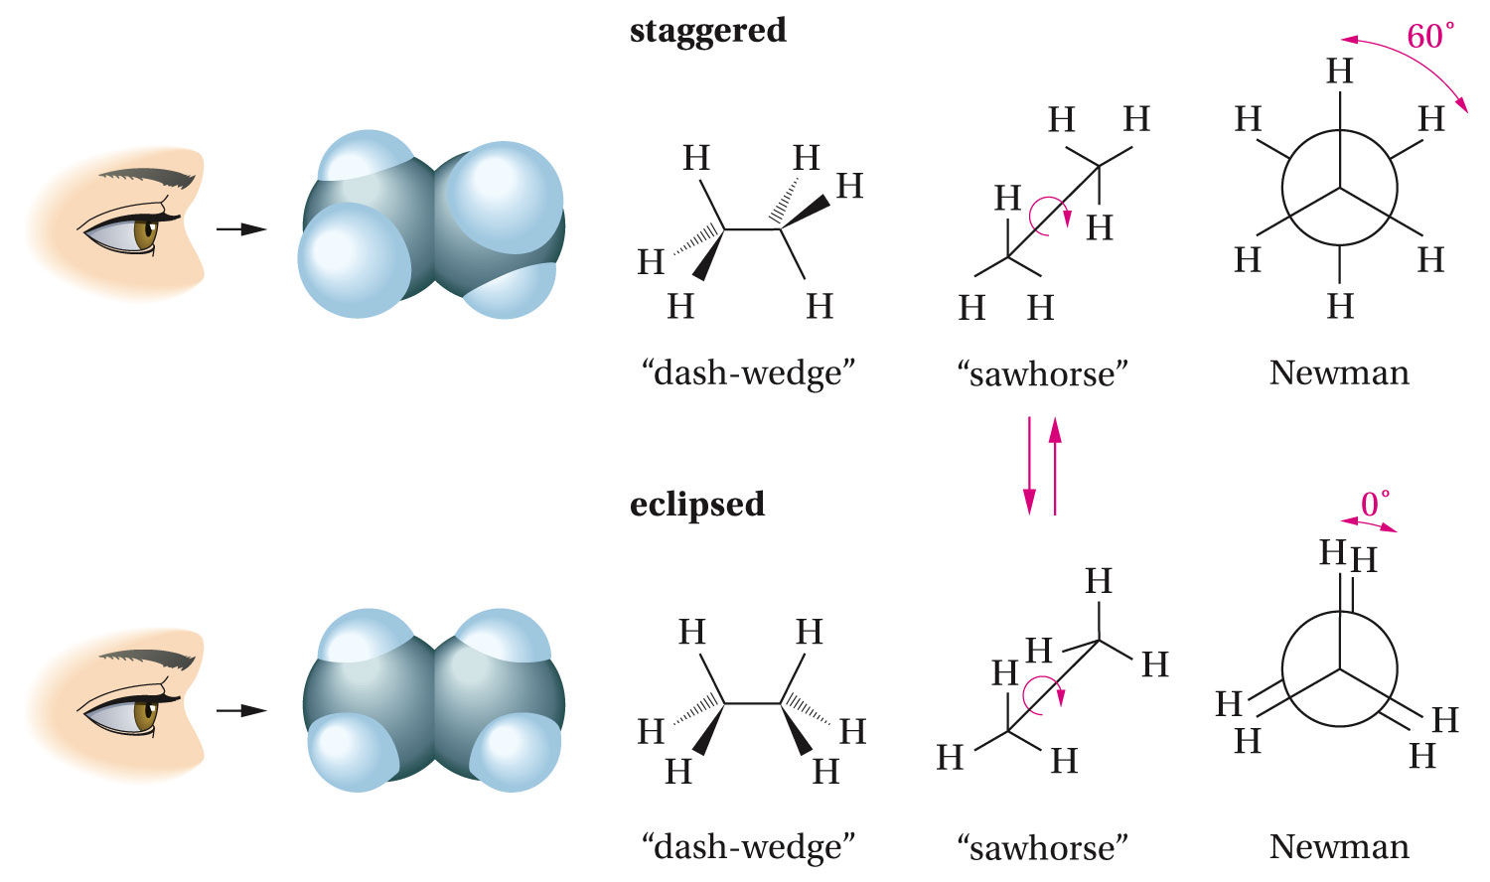

Slide 30
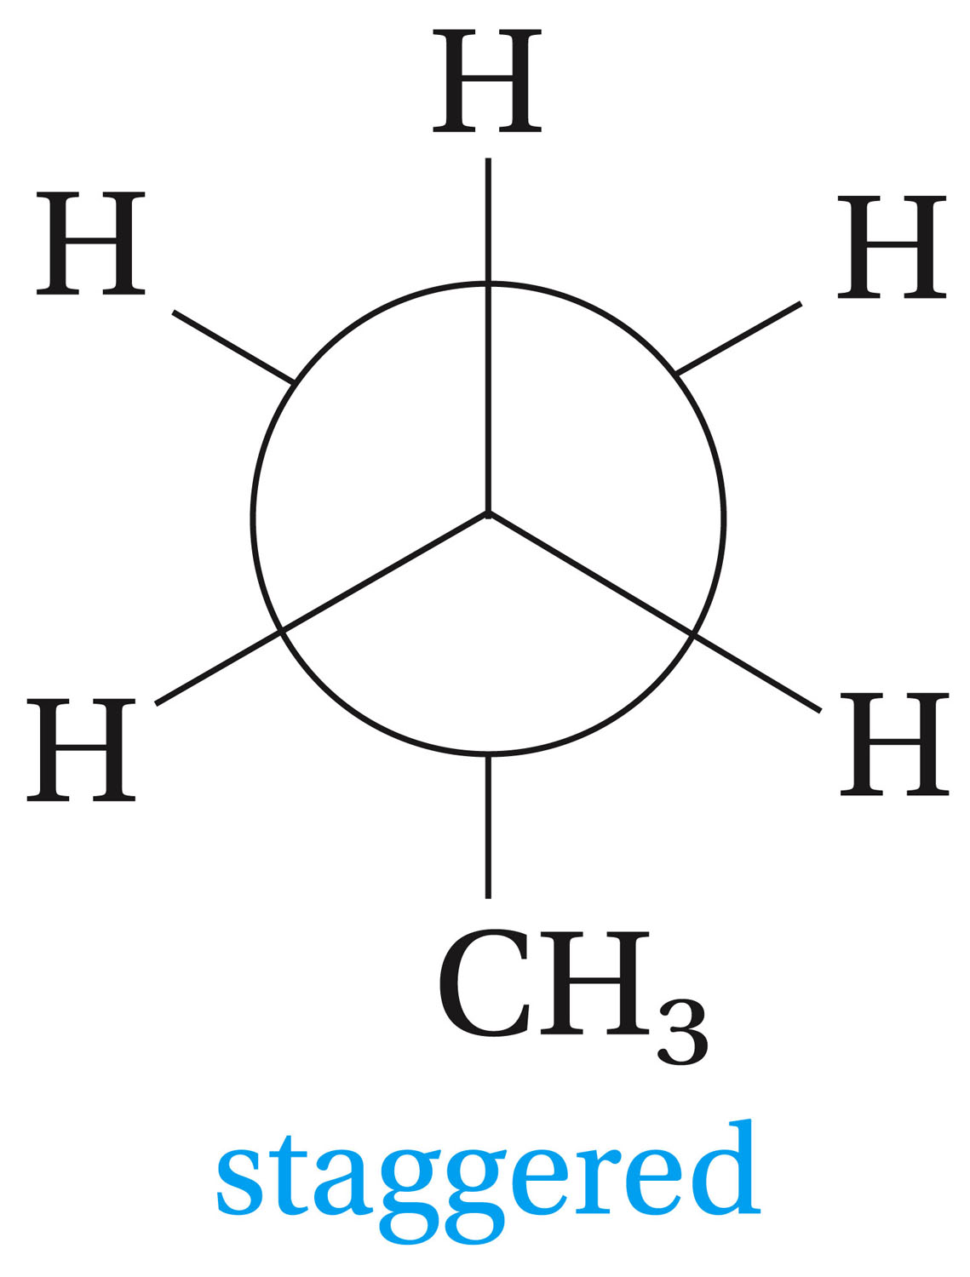
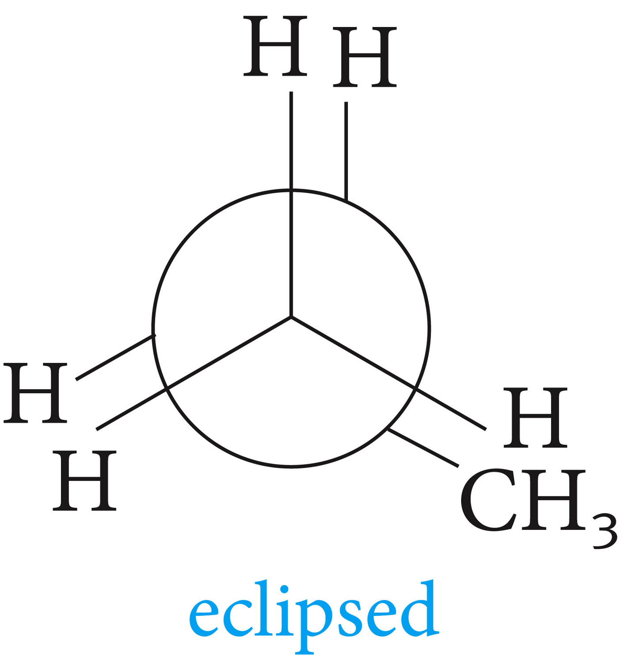

Slide 31
Clicker Question?
The most stable conformation of propane is:
Eclipsed
Planar
Boat
Staggered
chair

Slide 32
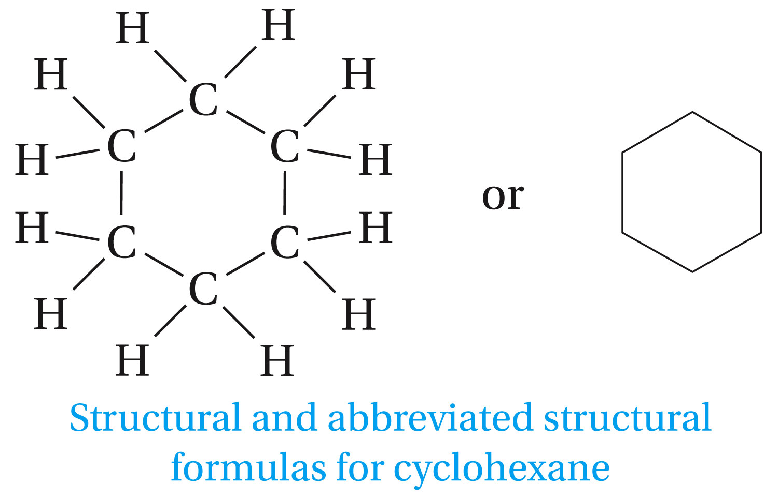
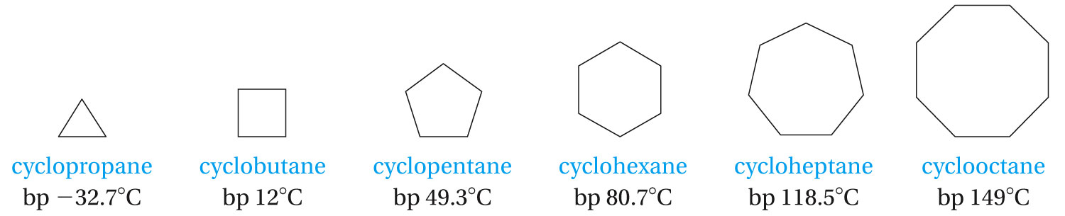
Cycloalkane Nomenclature and Conformation

Slide 33
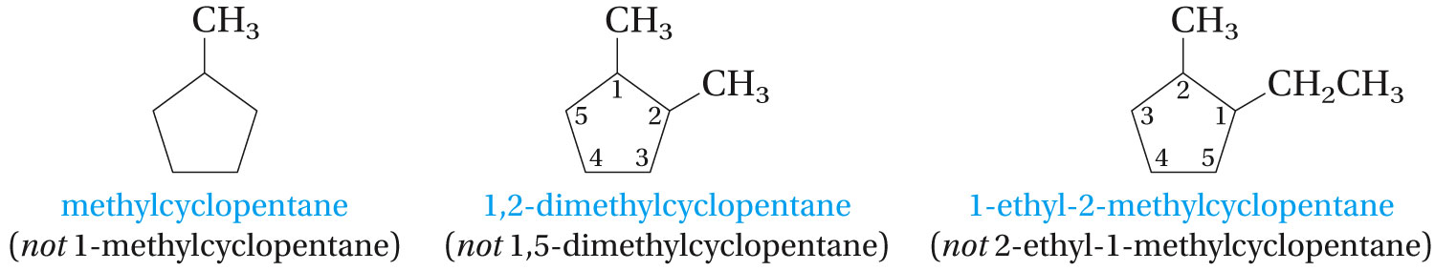
One substituent is always located at ring carbon numbered 1, the remaining carbons are then numbered consecutively in a way that gives the other substituents the lowest possible numbers. With different substituents, the one with highest alphabetic priority is located at carbon 1.

Slide 34

QR Codes
Or go to
http://bit.ly/14tF1qx
The molecular modeling lab:
Bring all iPads to lab this week
Read and practice before lab if you already have an iPad this week
Link to the iSpartan instructions is available on the lab website or you may use QR code readers from your smartphones or iPads

Slide 35

iSpartan Basics Video Tutorial
Or go to http://bit.ly/WFr8jz

Slide 36
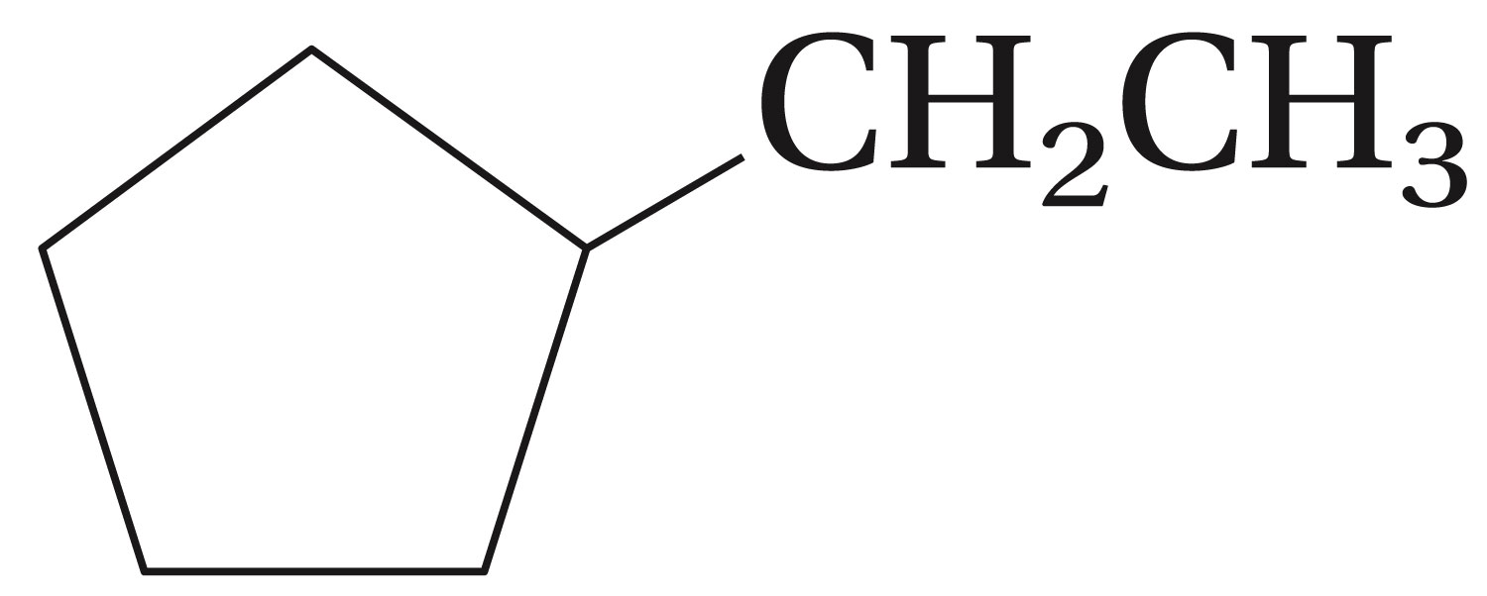
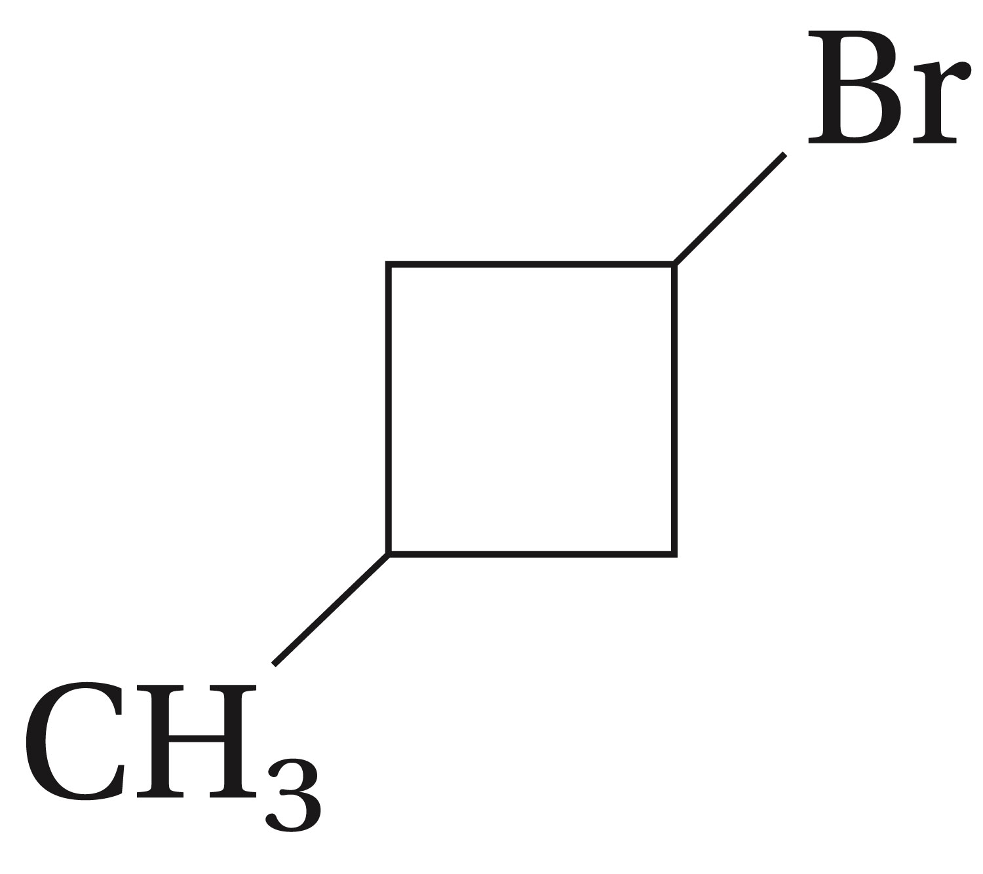
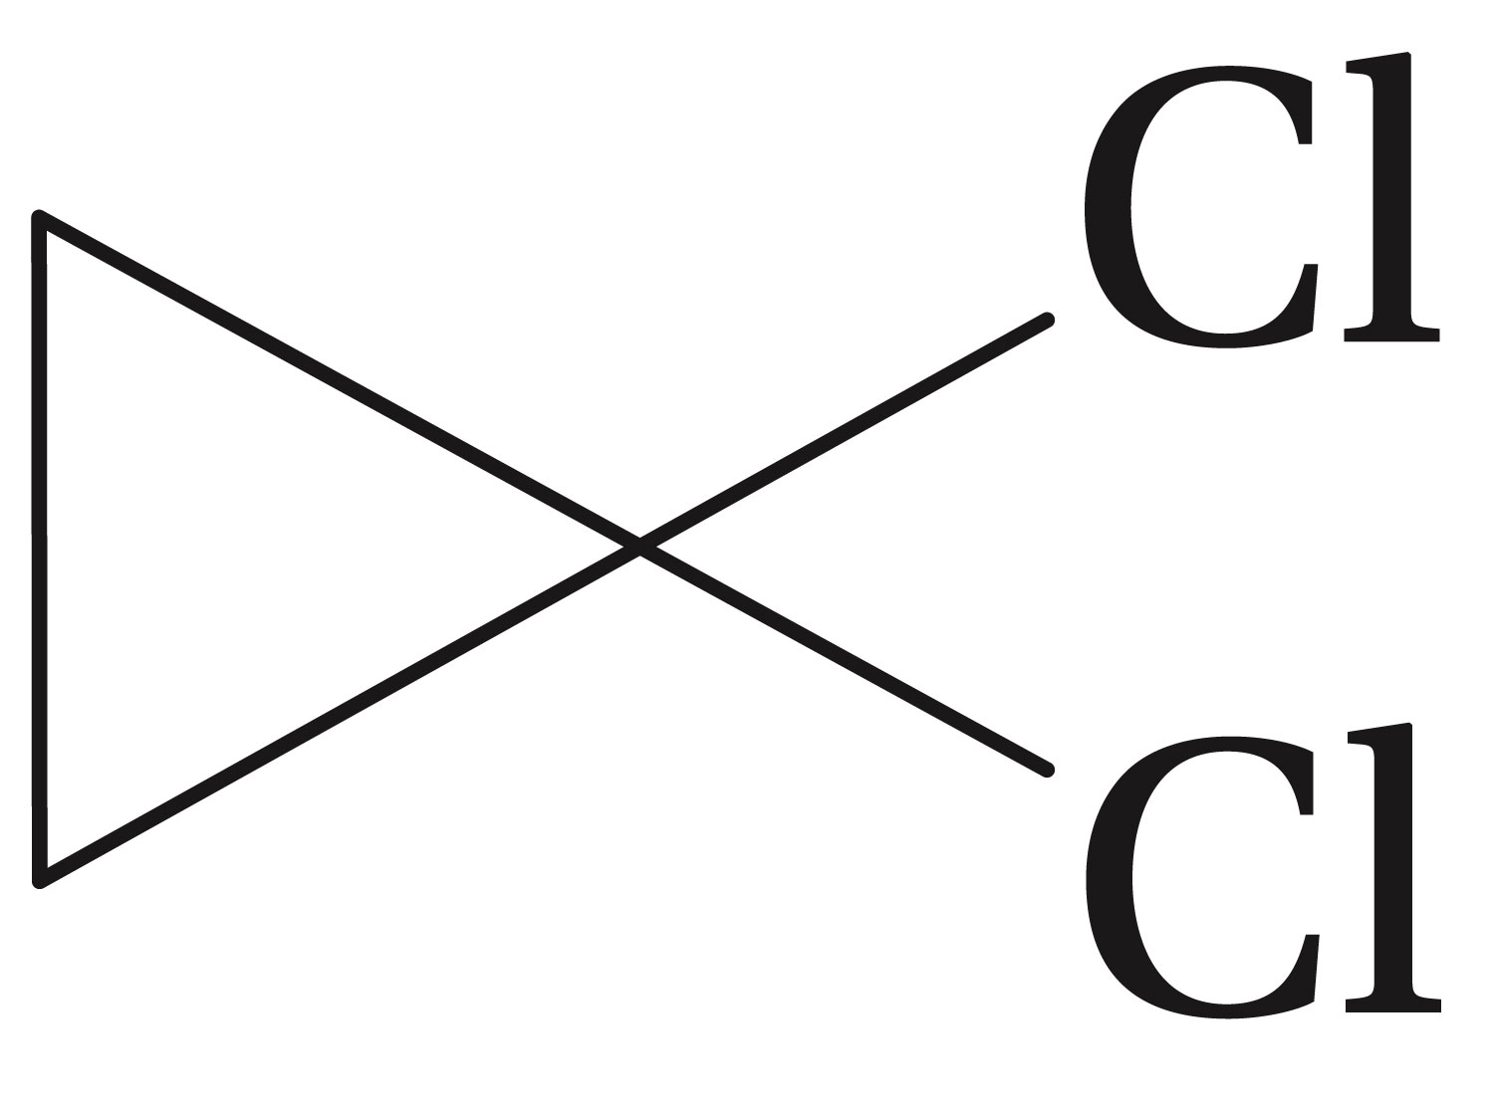
Give the IUPAC names for the following compounds

Slide 37
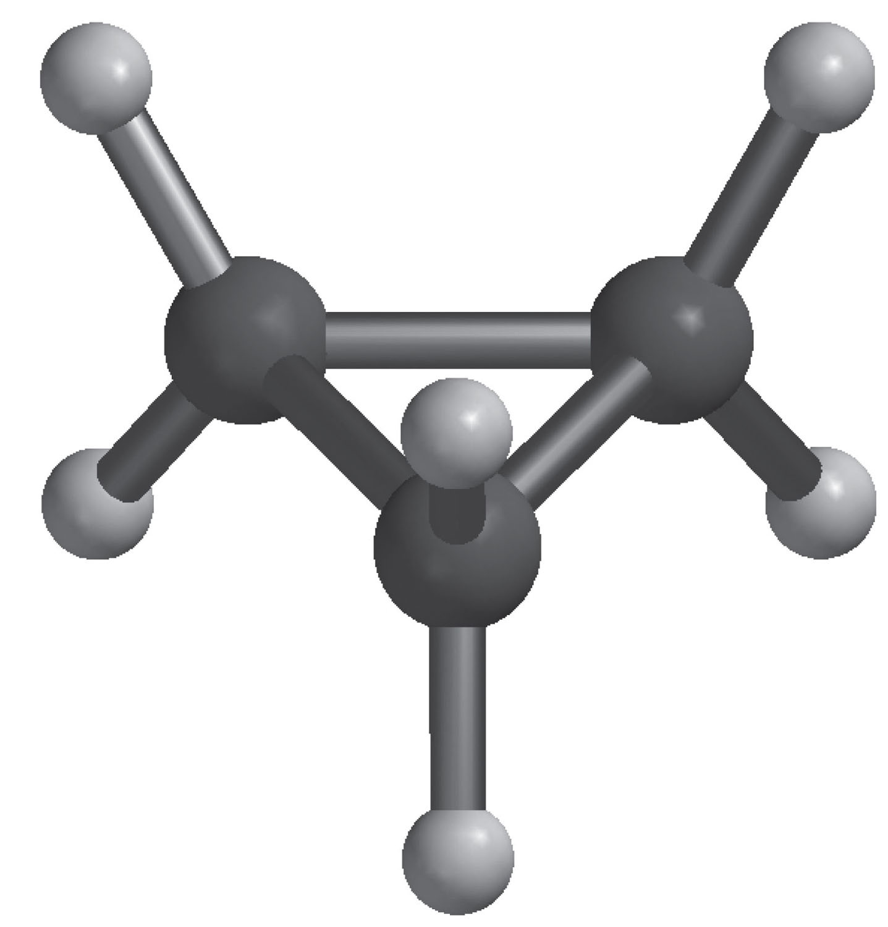
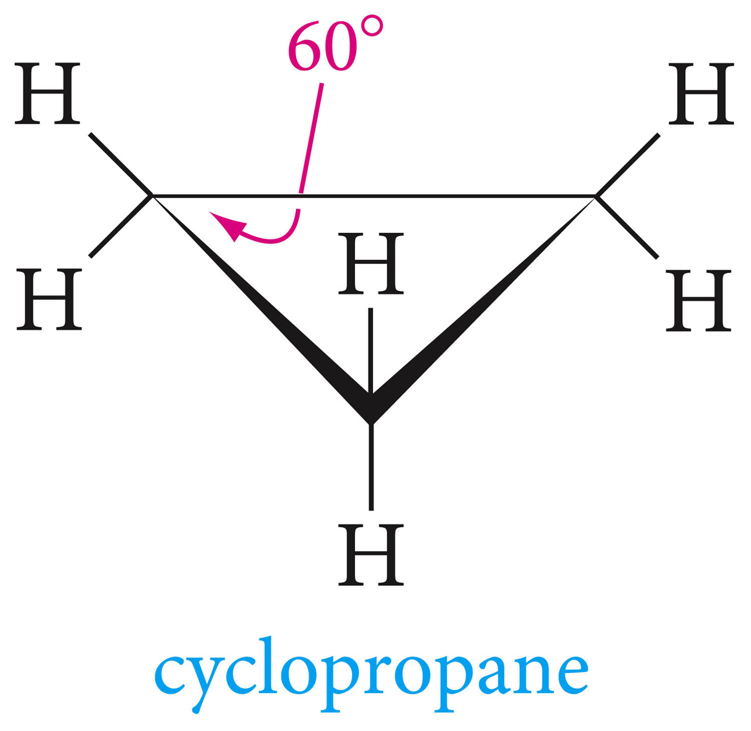
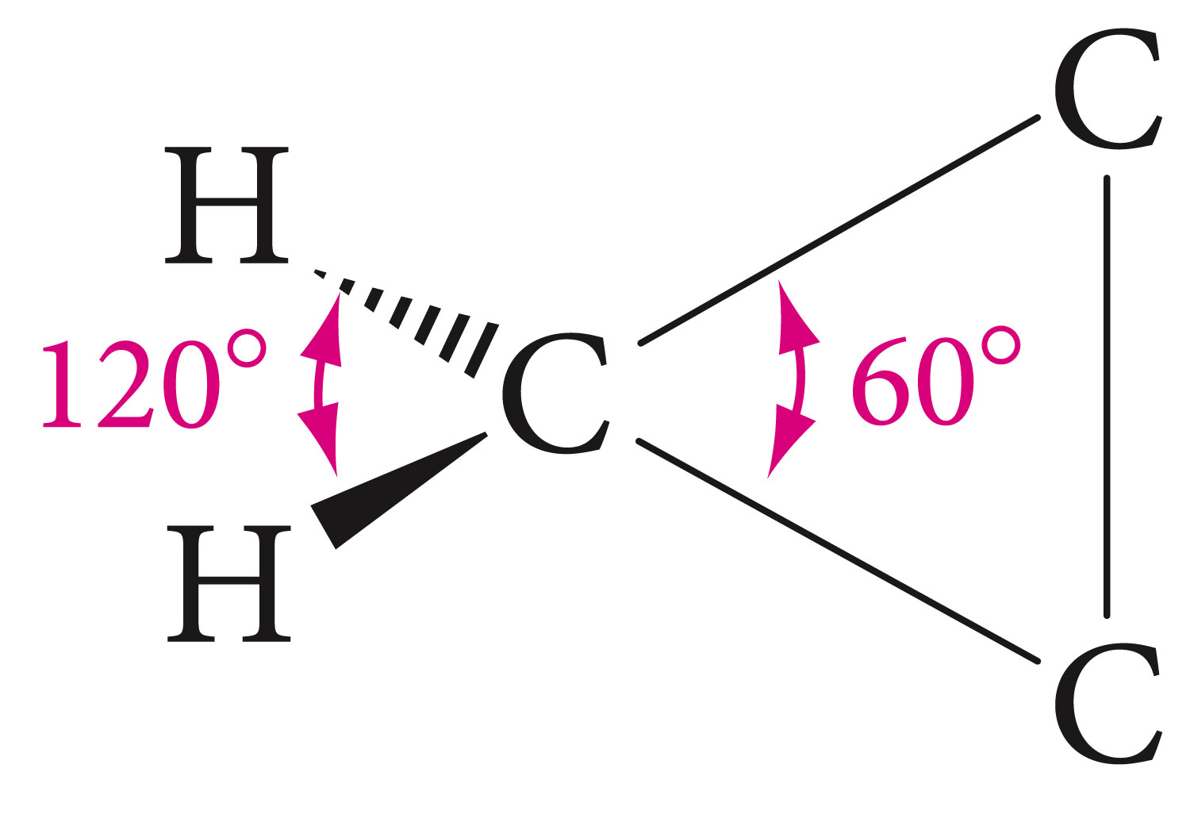
Cyclopropane

Slide 38
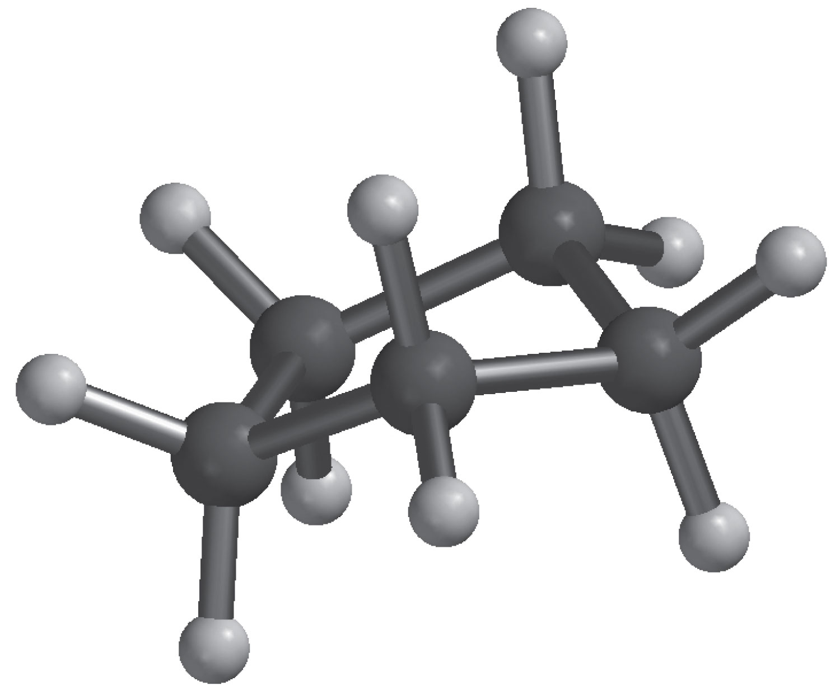
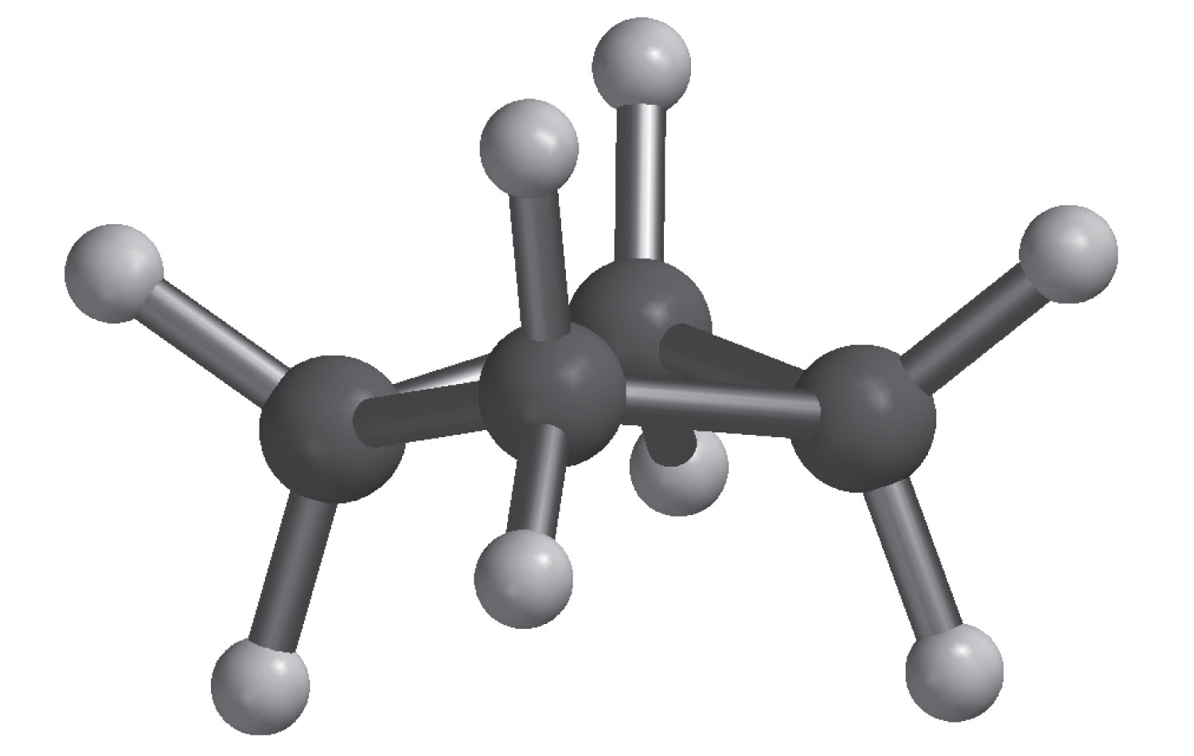
Cycloalkanes with more than three carbon atoms are nonpolar and have “ puckered” conformations.

Slide 39
Clicker Question?
What is the molecular formula of a cycloalkane that has six carbon atoms?
C₆H₁₄
C₆H₁₂
C₆H₁₀
C₆H₁₆
C₆H₇

Slide 40
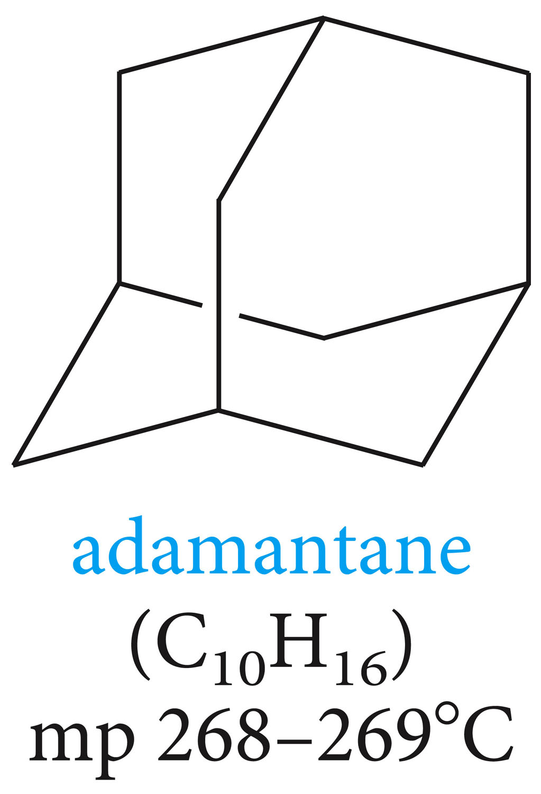
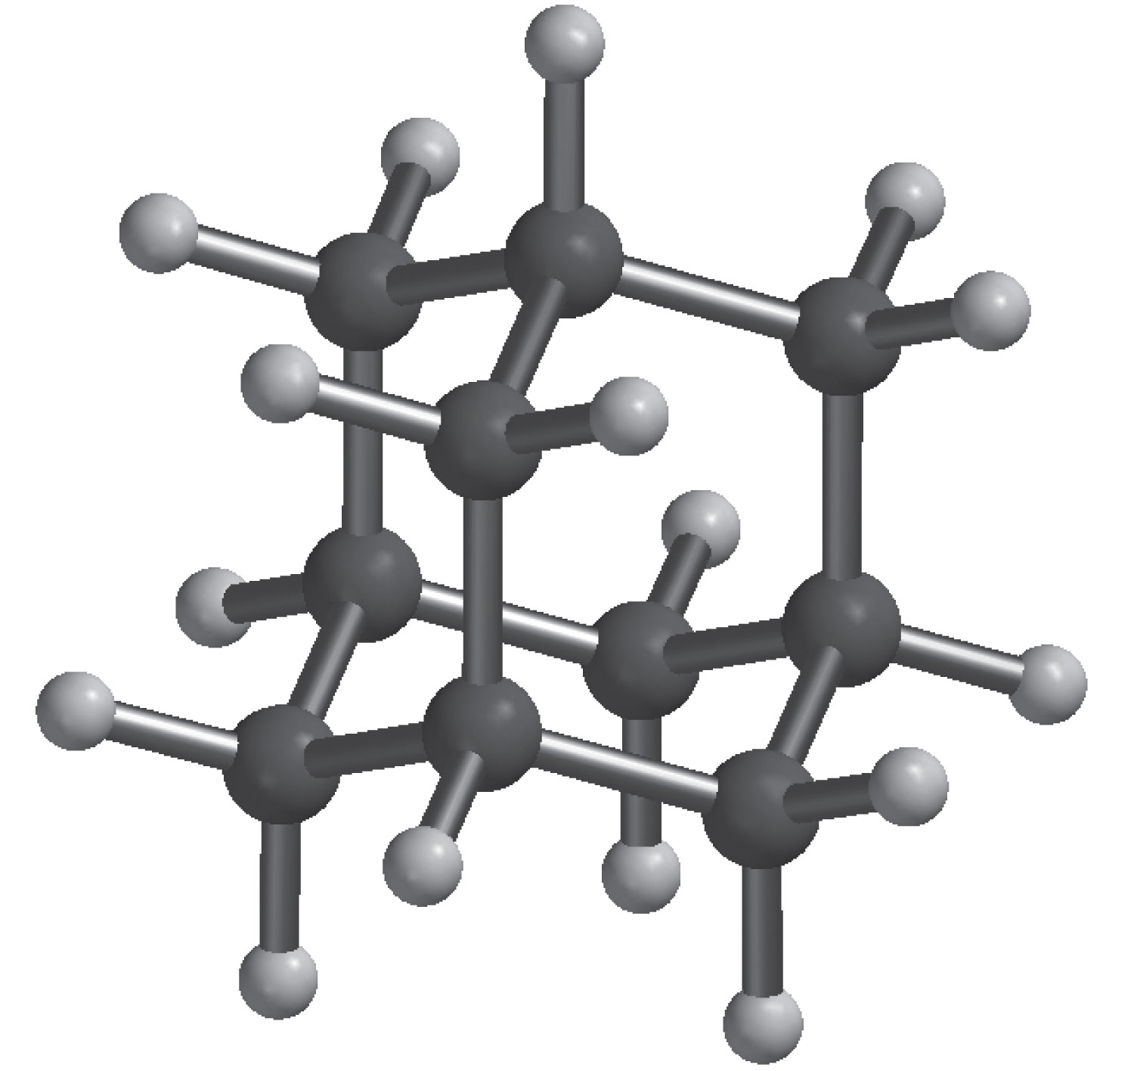

Slide 41
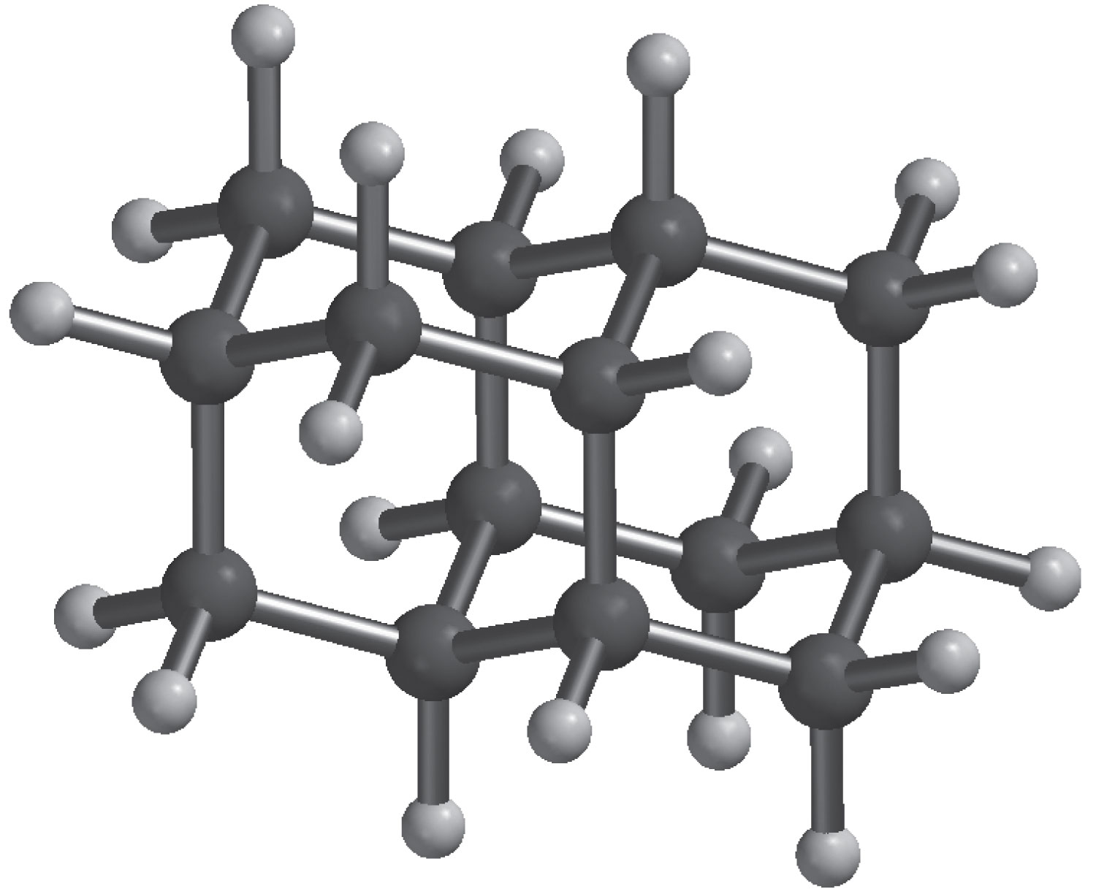
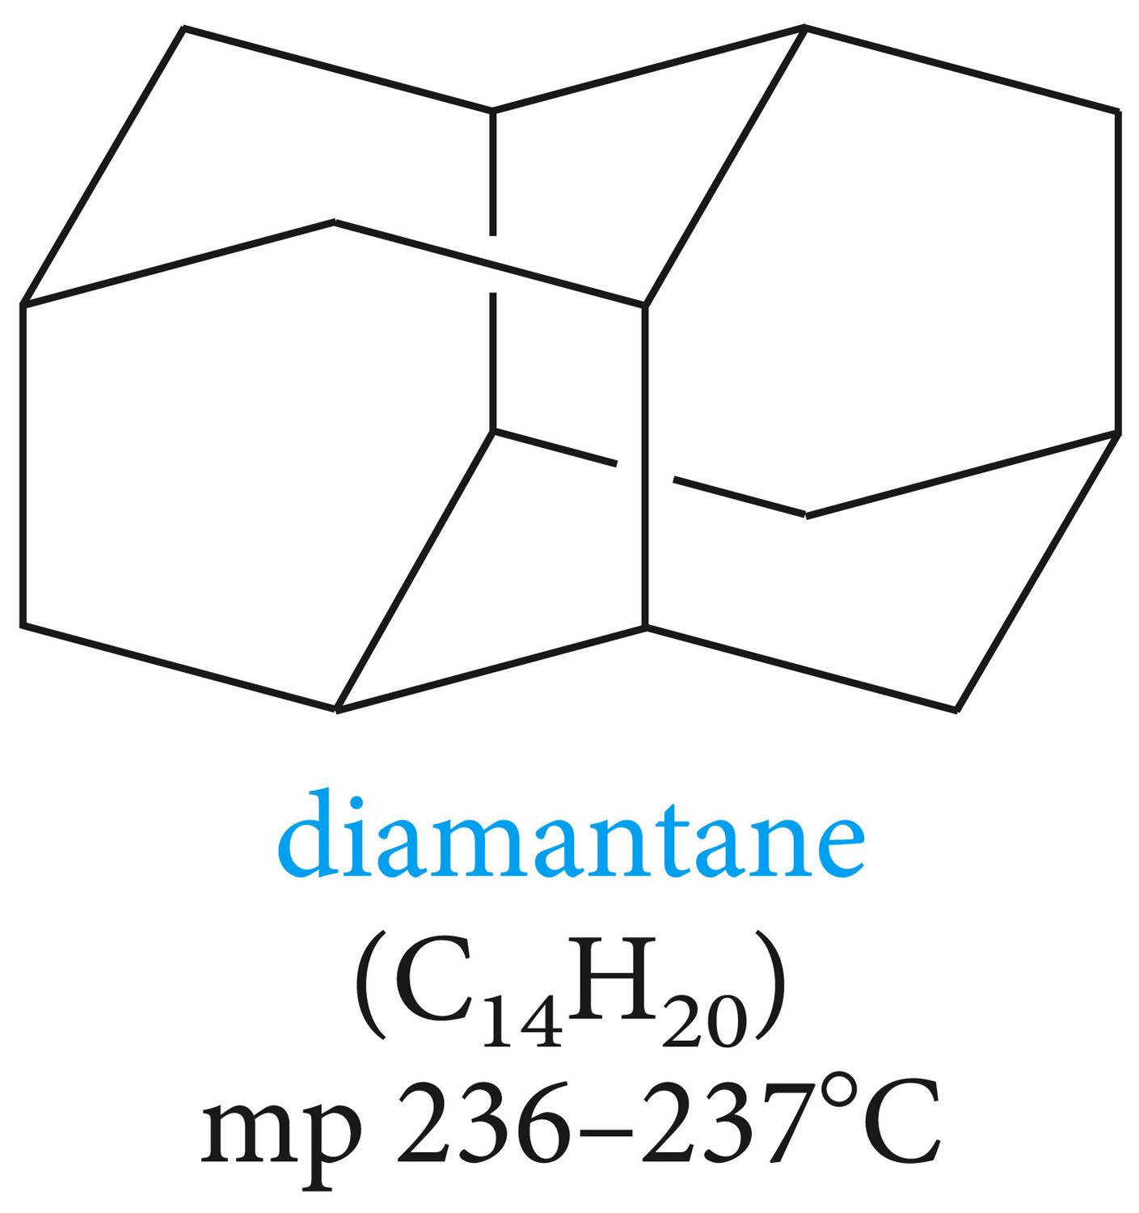

Slide 42
Clicker Question?
The bond angle of a normal, tetrahedral, sp³ hybridized carbon is 109.5°. What is the approximate C–C–C bond angle of cyclobutane?
109.5⁰
120⁰
60⁰
180⁰
90⁰

Slide 43
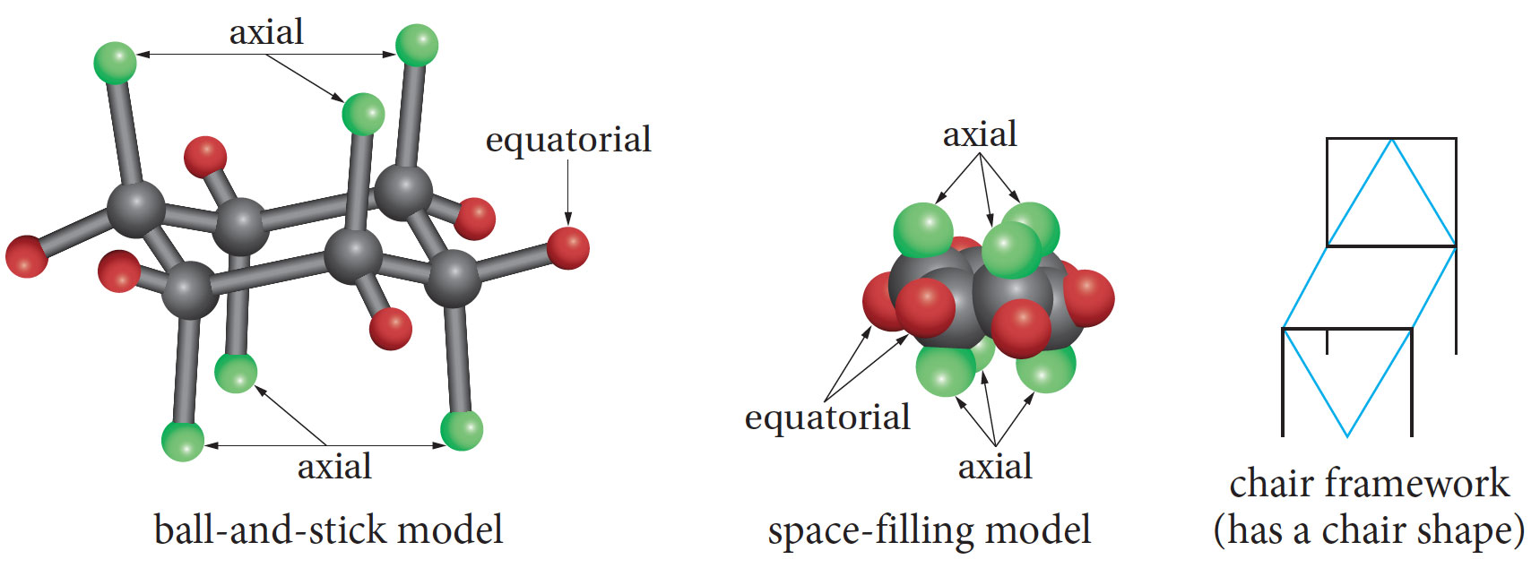
The chair conformation of cyclohexane

Slide 44
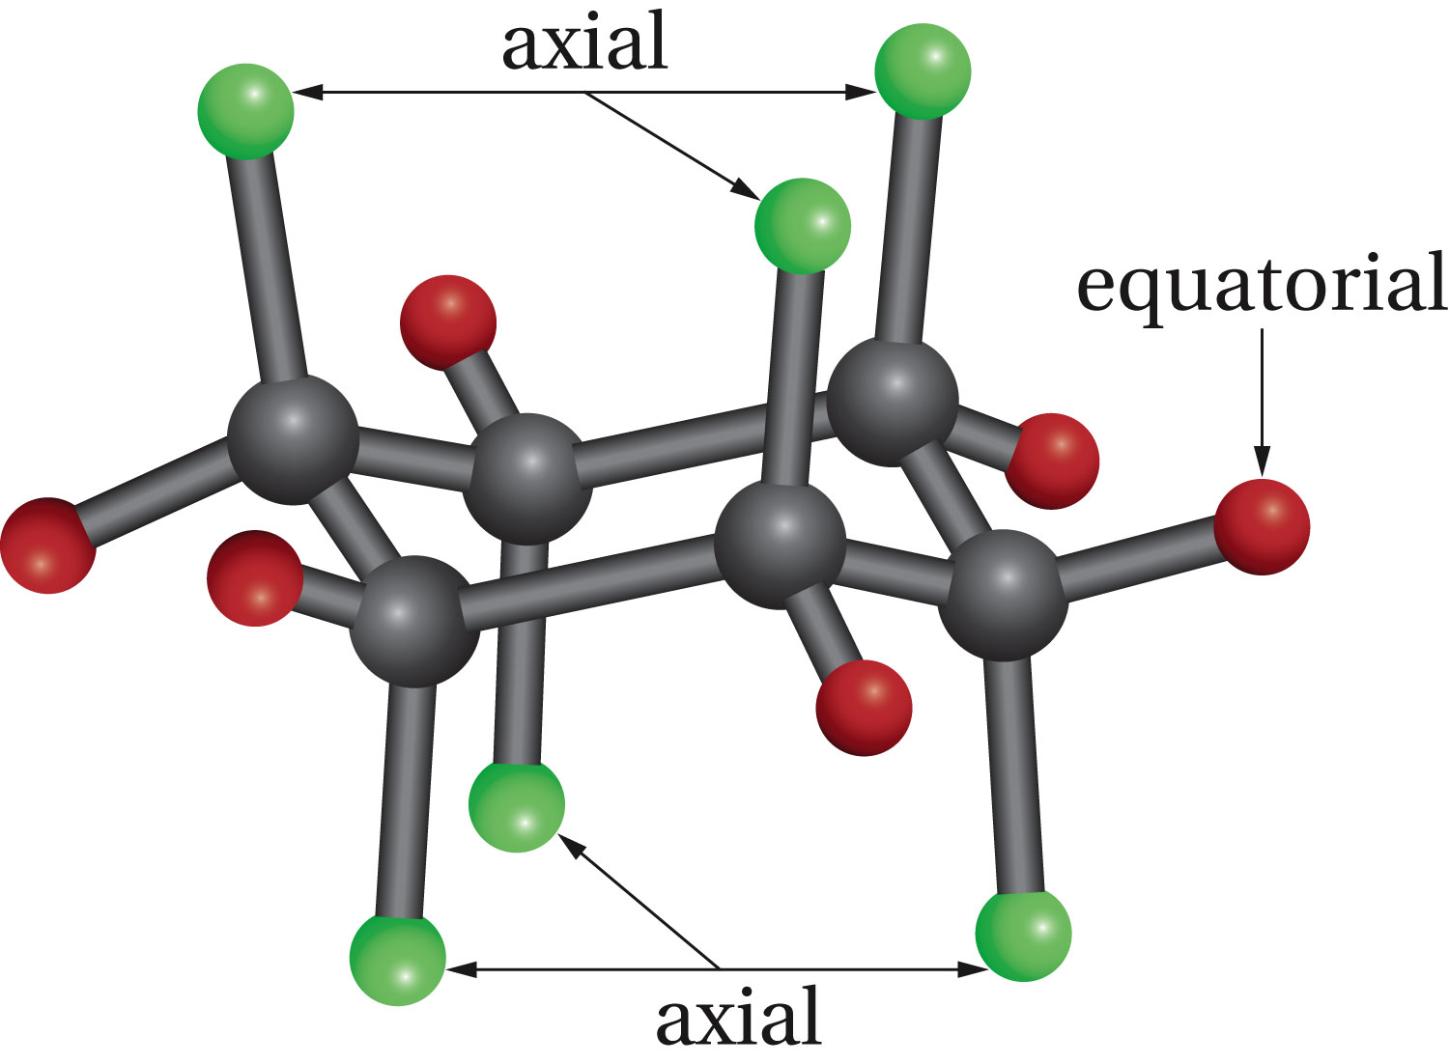

Slide 45
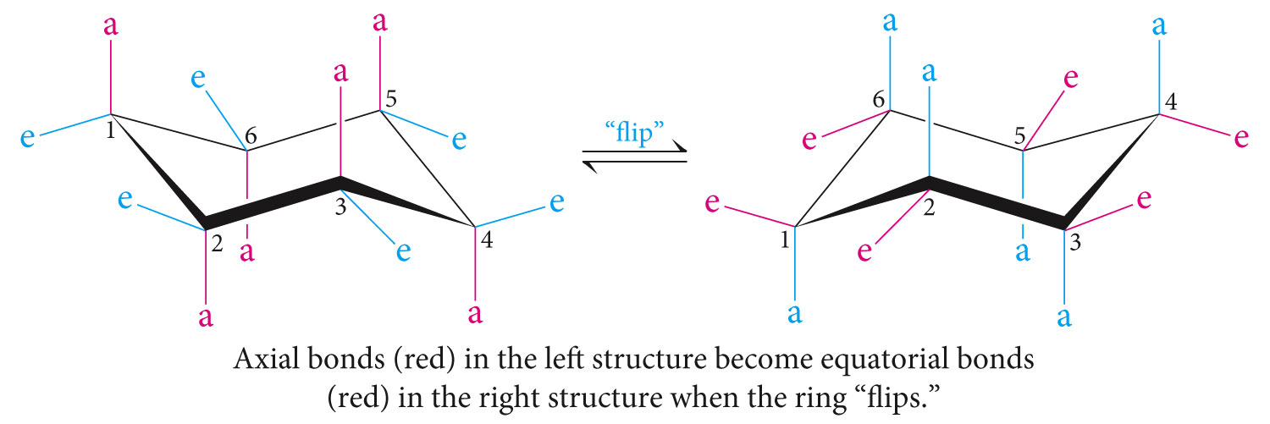

Slide 46

Larger substituents on cyclohexane (such as methyl group) are stable in the equatorial positions to avoid the axial crowding.

Slide 47

Boat Conformation

Slide 48

Glucose molecule (six-membered ring in the chair conformation.

Slide 49

Cis-Trans Isomerism of Cycloalkanes

Slide 50
Reactions of Alkanes
Single carbon-carbon bonds
Nonpolar therefore relatively inert and often used as solvents
Reacts with oxygen and halogens.

Slide 51


Slide 52

In which compound is carbon more oxidized, formaldehyde ( CH₂O) or formic acid( HCO₂H)?

Slide 53
Halogenation of Alkanes
When a mixture of alkane and chlorine is stored at low temperature in the dark, no reaction occurs. While in sunlight or at high temperature, however, an exothermic reaction occurs. Where one or more of the hydrogen atoms is replaced by chlorine.

Slide 54

Example for methane
The reaction is called chlorination and is a substitution reaction

Slide 55

Bromination

Slide 56

In excess halogen, the reaction can continue further to give polyhaloganated products.

Slide 57

A mixture of products may be obtained when longer chained alkanes are halogenated.

Slide 58

Unsubstituted cycloalkanes, where all the hydrogens are equivalent, a single organic product can be obtained.

Slide 59

Free-Radical Chain Reaction Mechanism of Halogenation

Slide 60


Slide 61


