Slide 1
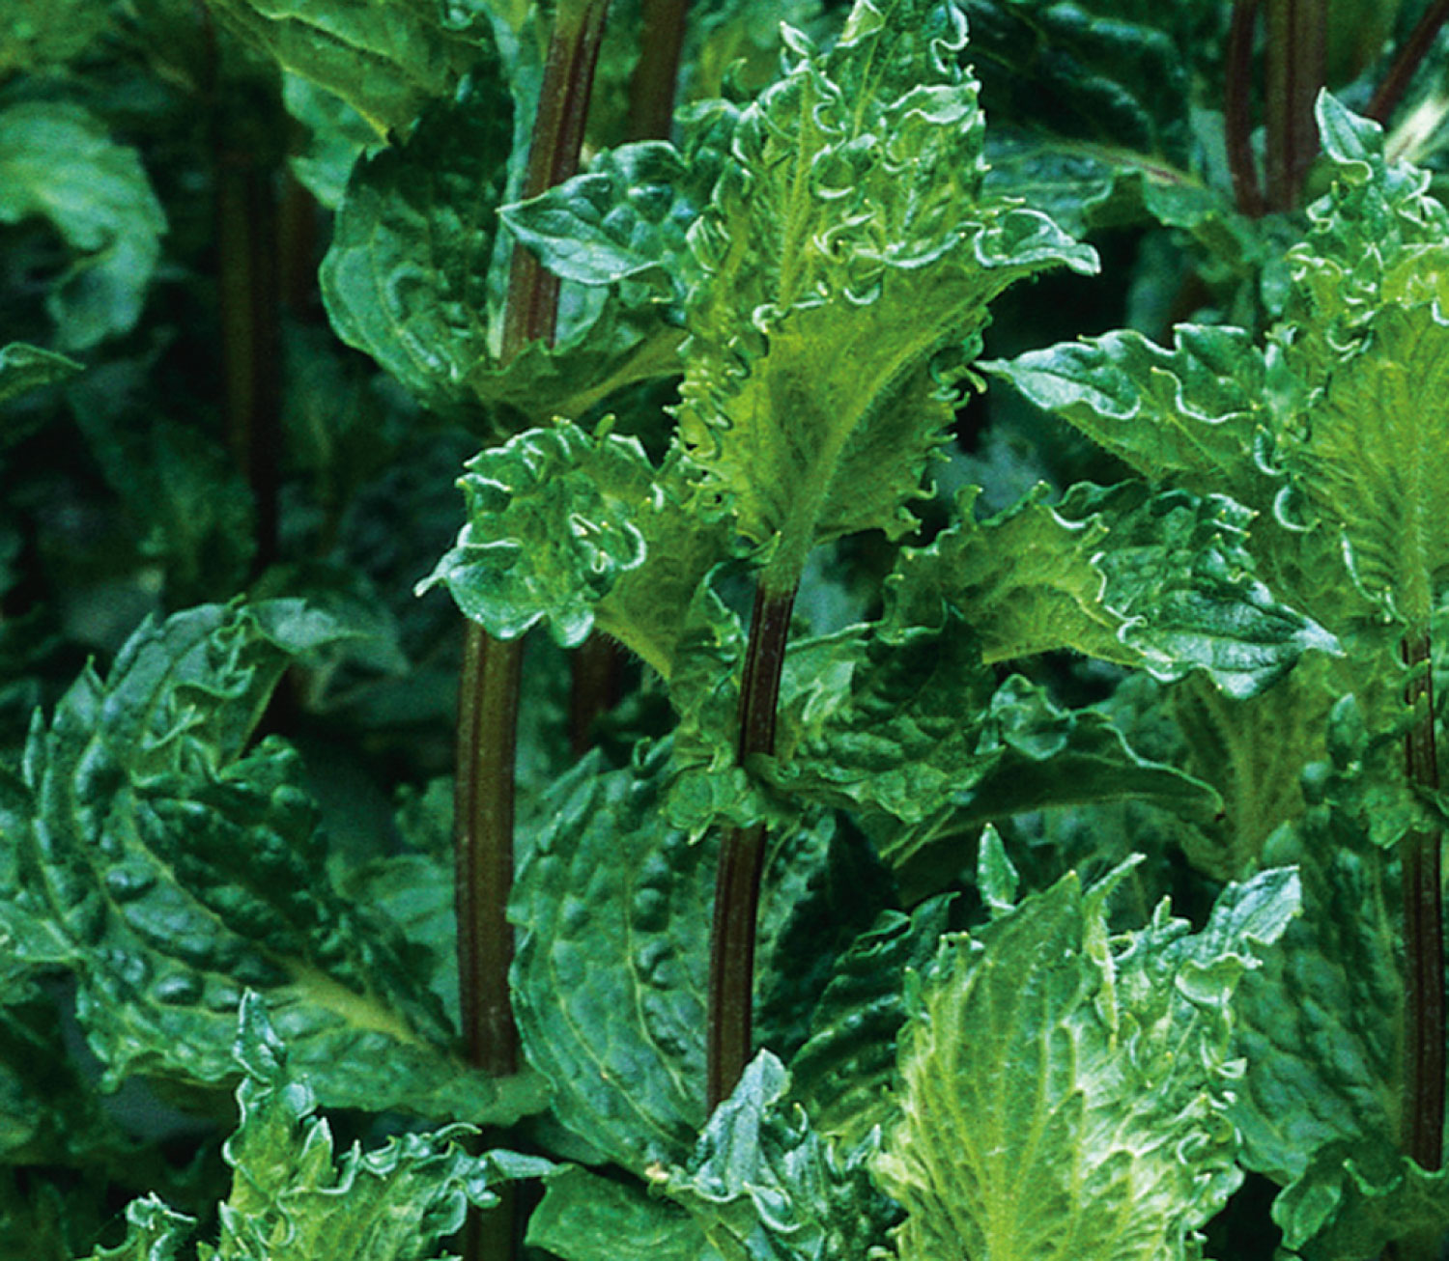
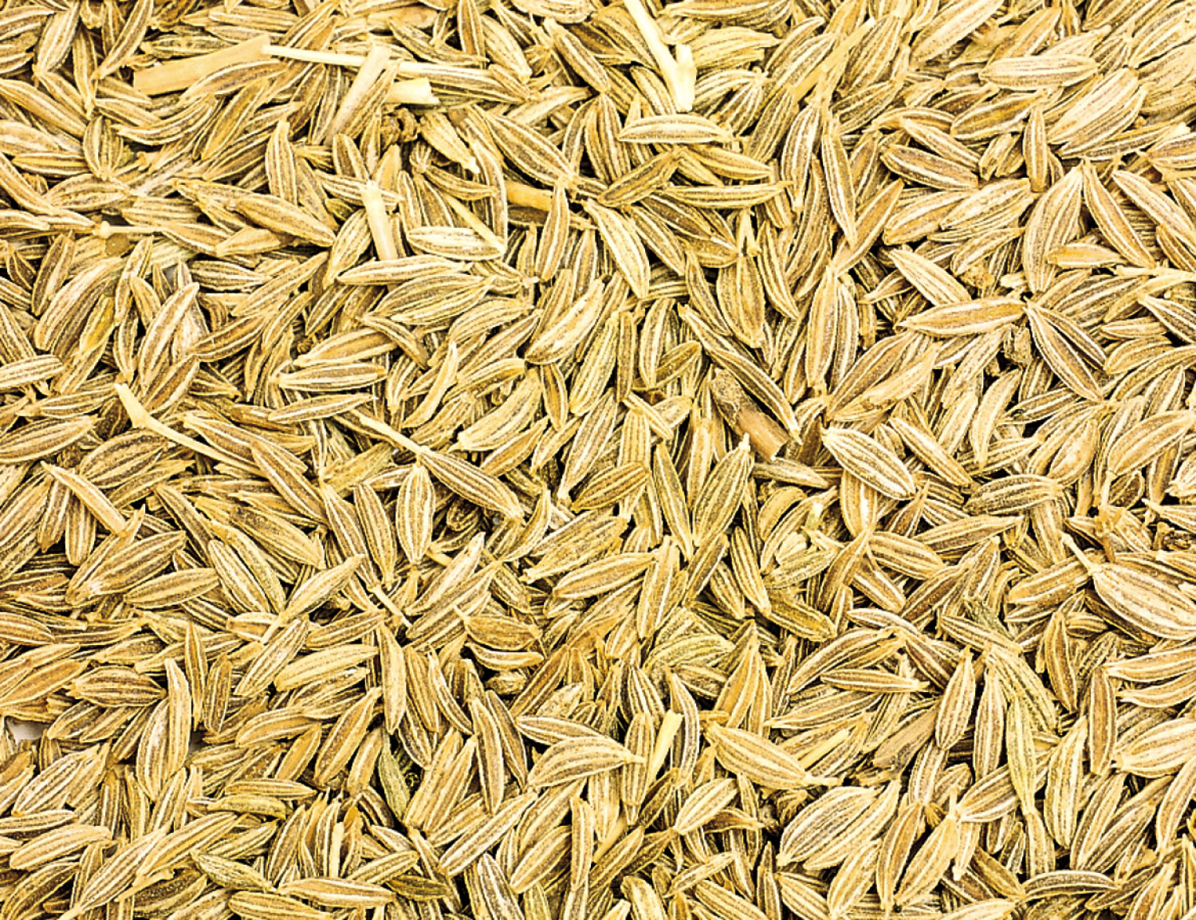
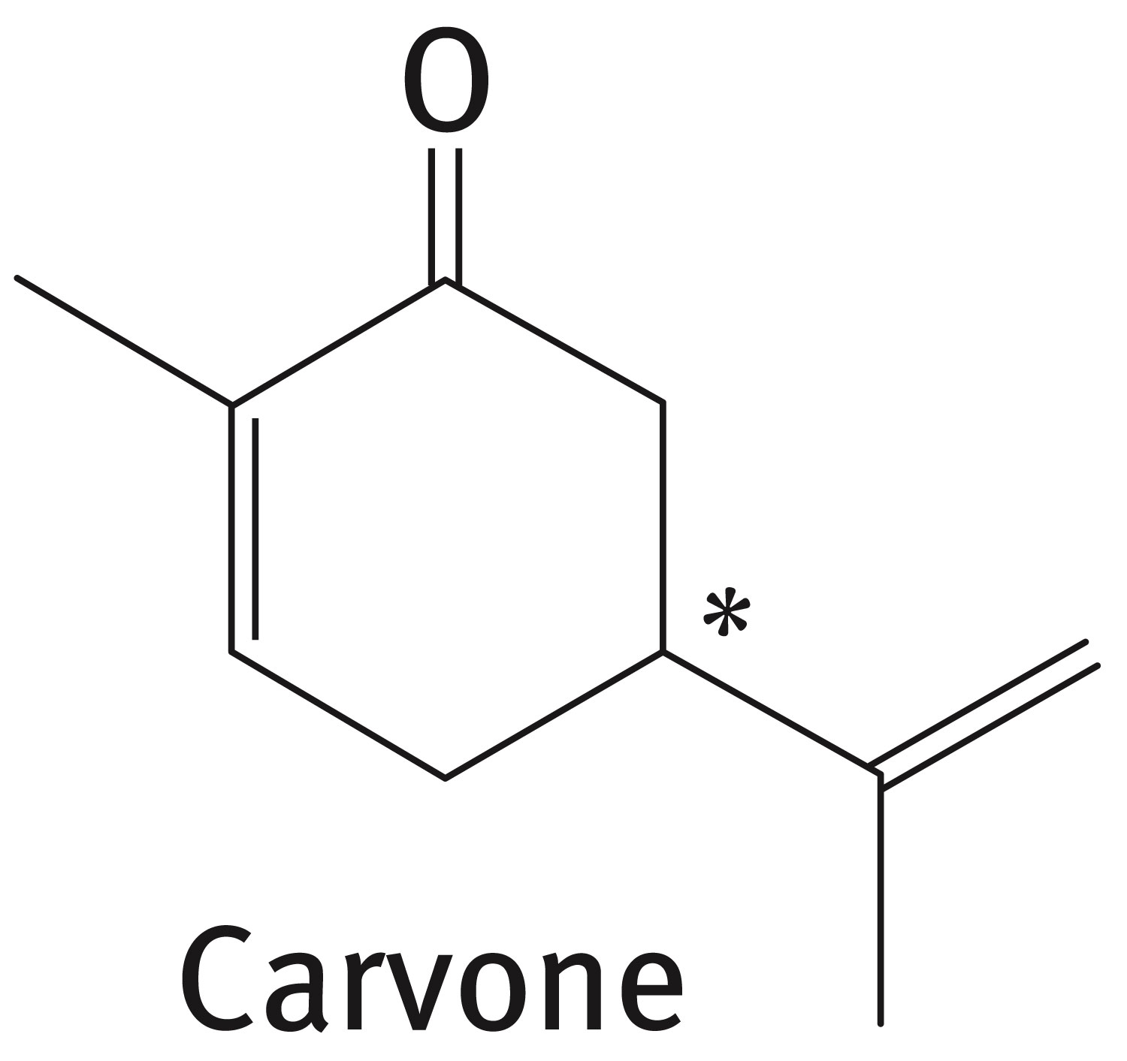
Chapter 5: Stereoisomerism
Stereoisomers are compounds that have the same structural formula in terms of order of attachment, but differ in arrangements of the atoms in space.
The difference in odor between caraway seeds and mint leaves arises from two stereoisomers of carvone due to different arrangement of atoms at the carbon (*)

Slide 2
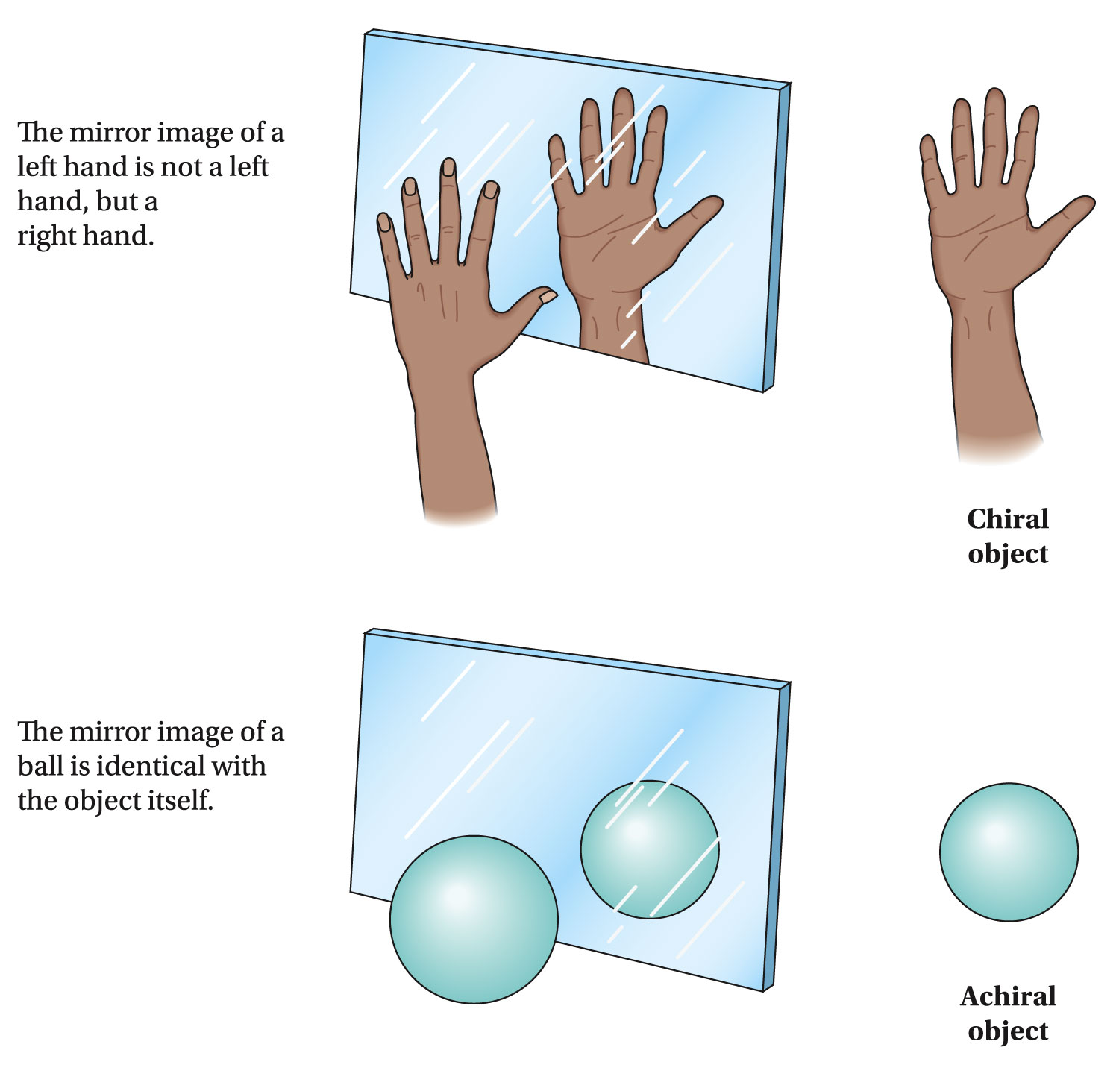
Mirror-image relationship of chiral and achiral objects

Slide 3
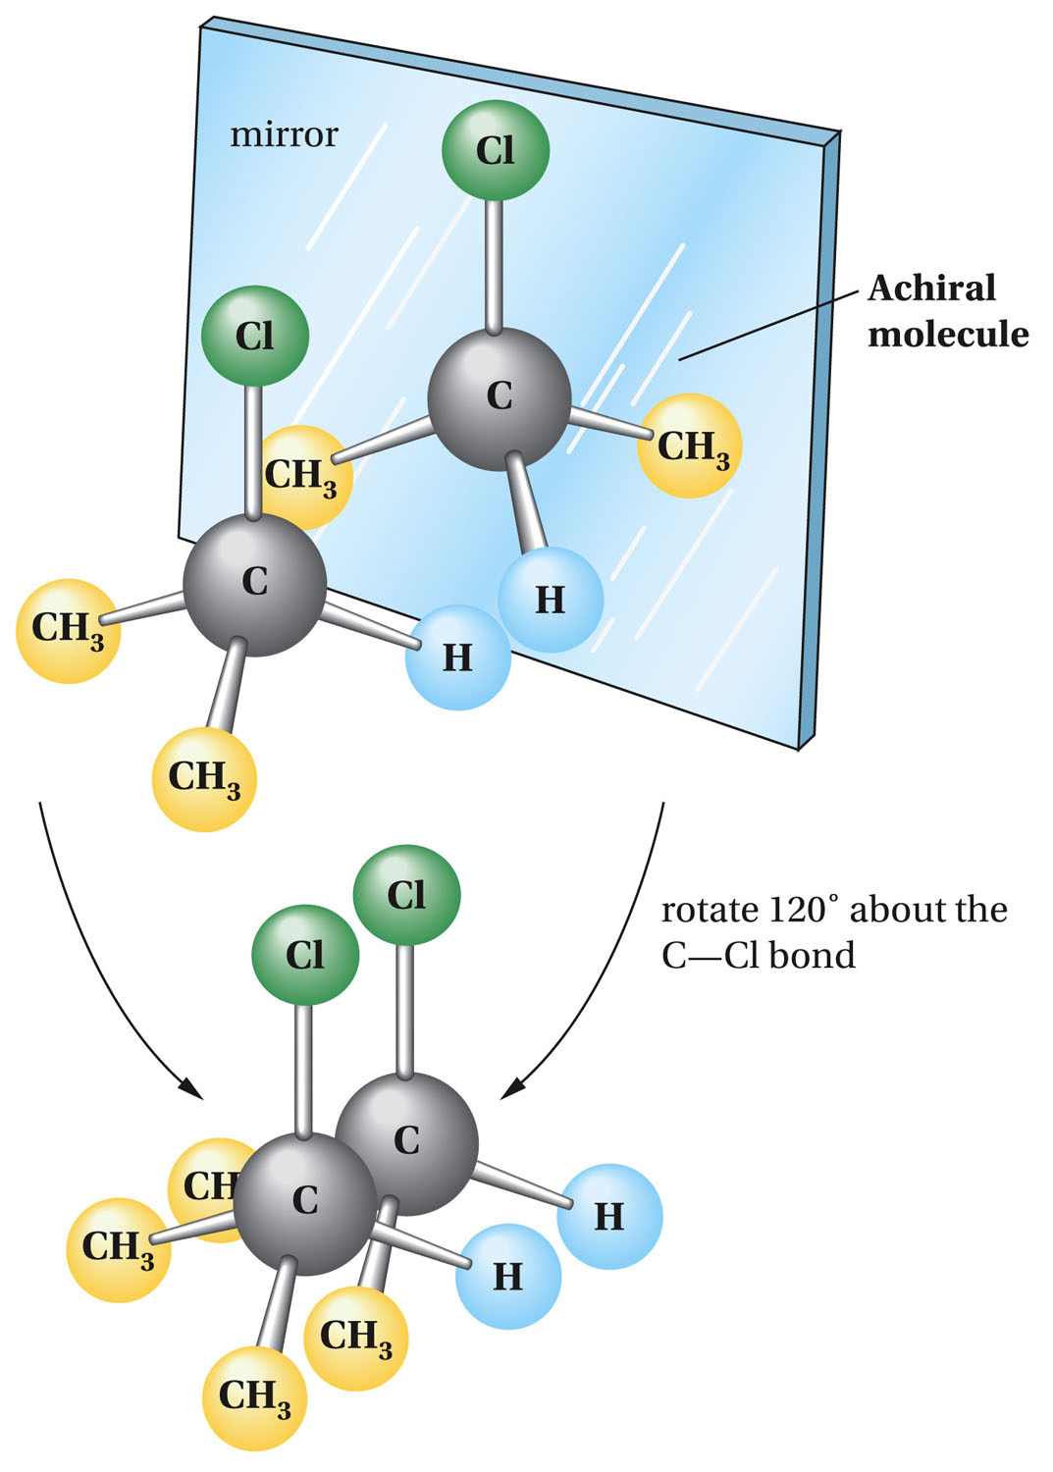

Slide 4
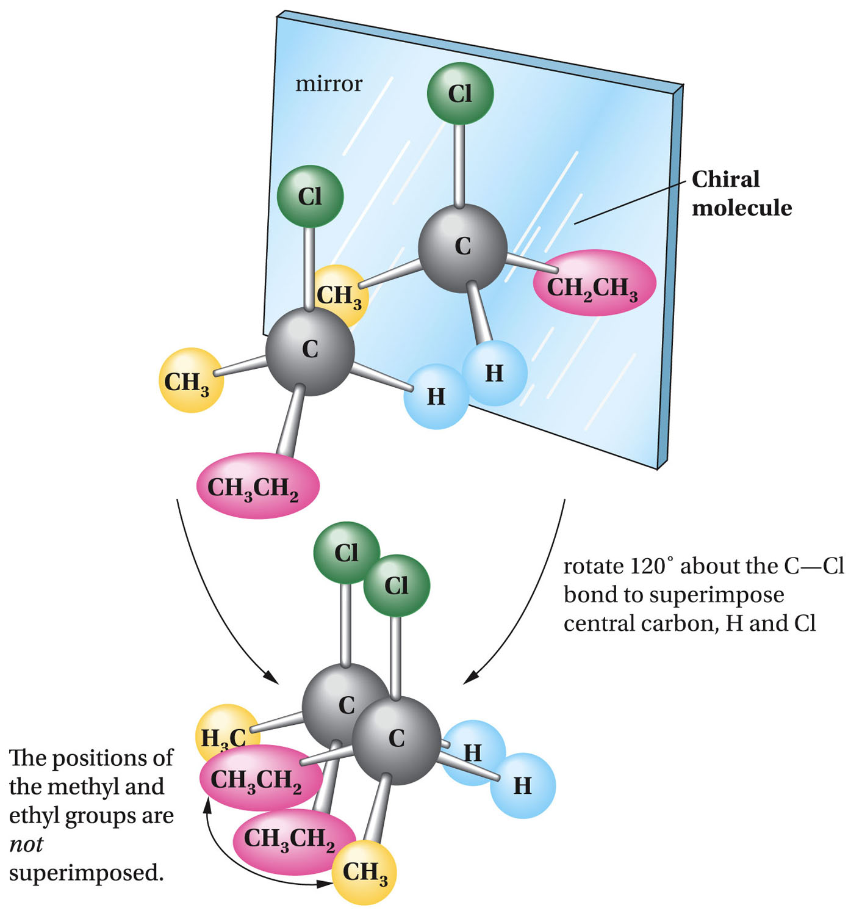

Slide 5
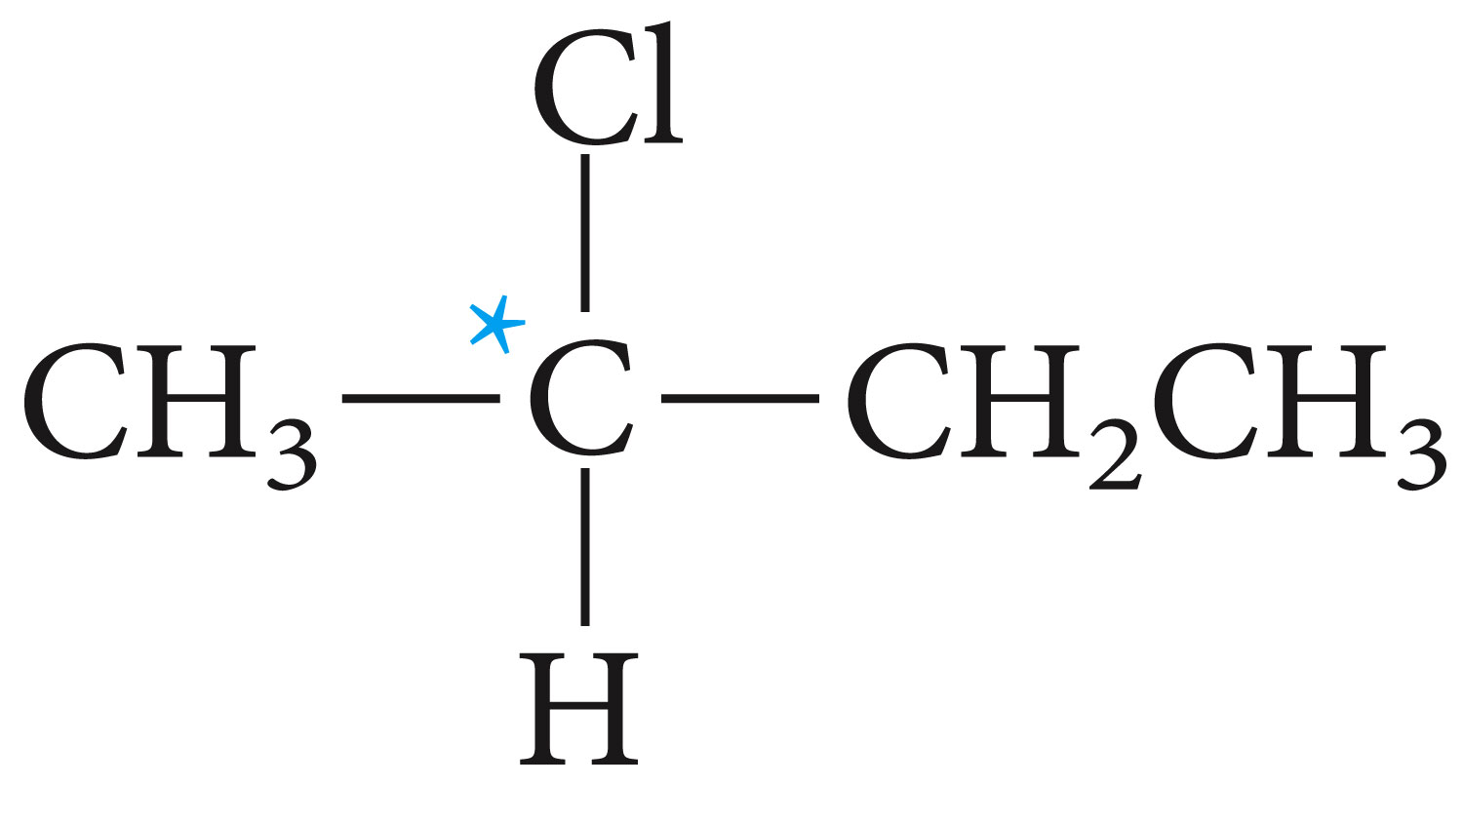
Stereogenic Centers: the Stereogenic Carbon Atom
Carbon atoms with four different groups attached to them are called stereogenic carbon atoms (also called chiral carbon)

Slide 6
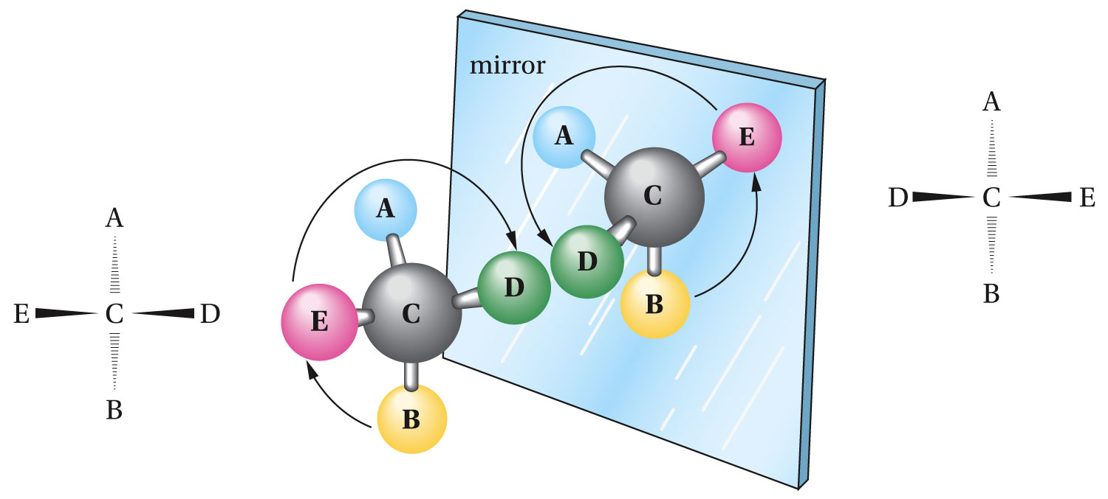

Slide 7
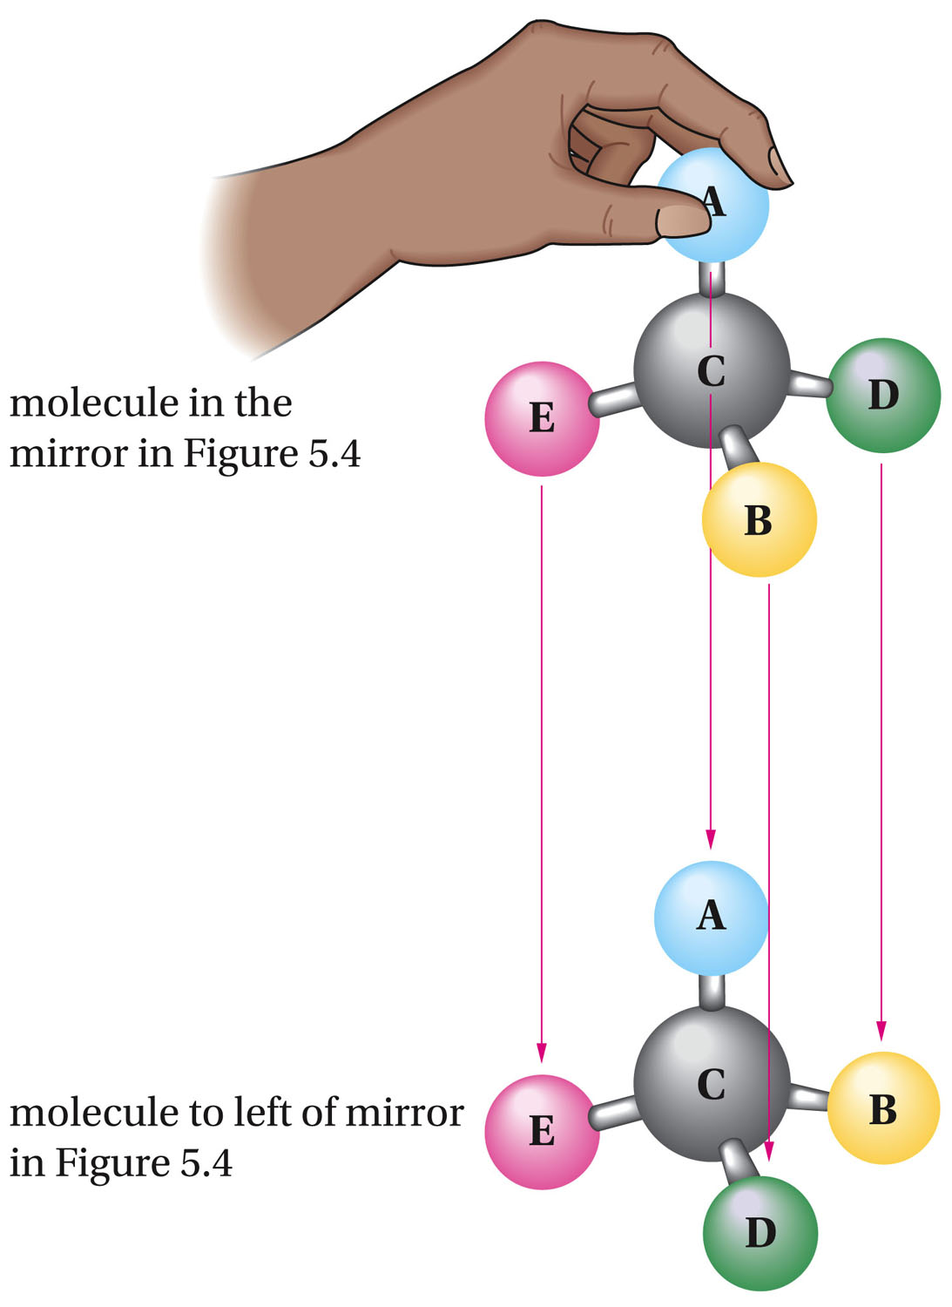

Slide 8
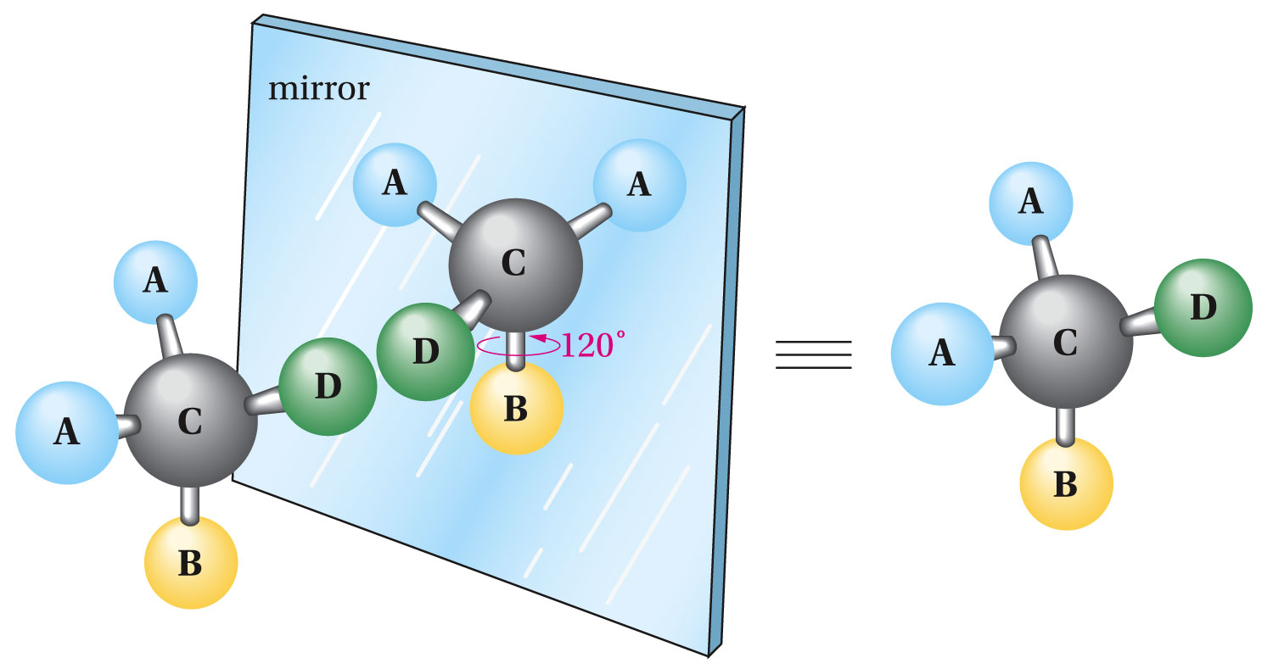

Slide 9
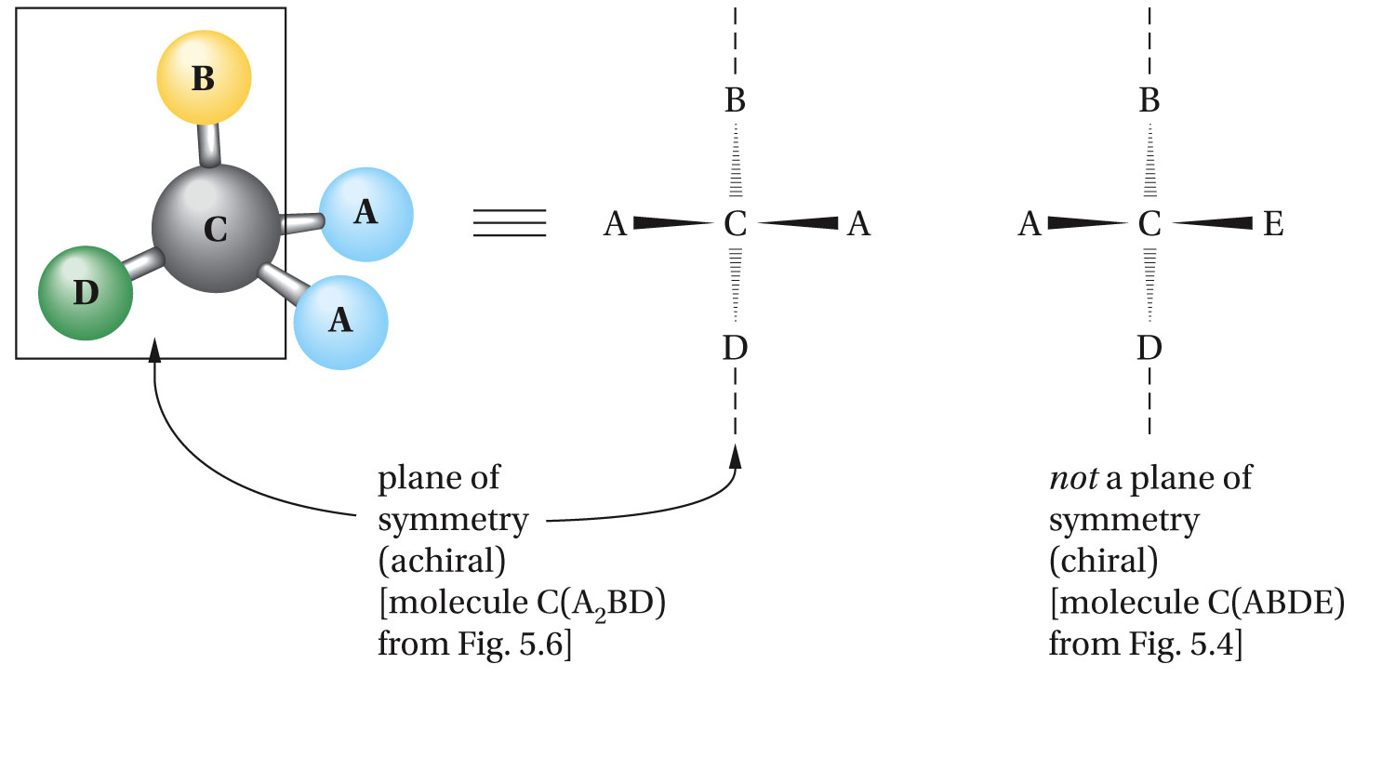

Slide 10
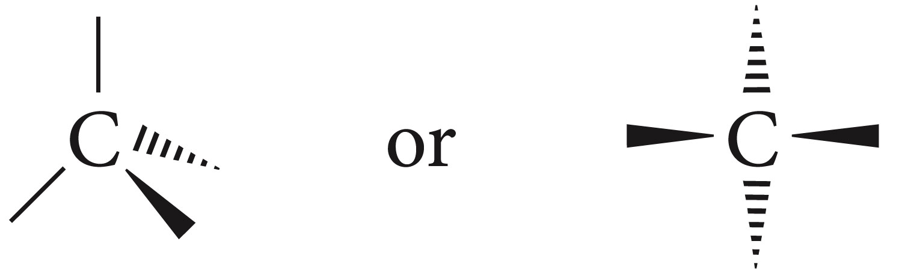
Clicker Question?
How many stereogenic carbons does 3-methylhexane have
Locate the stereogenic center in 3-methylhexane and draw the two enantiomers of 3-methylhexane.

Slide 11
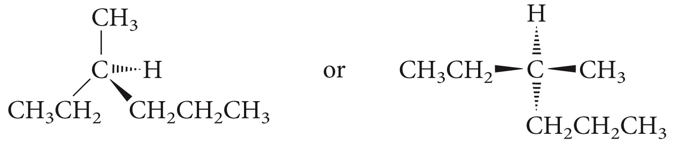

Slide 12
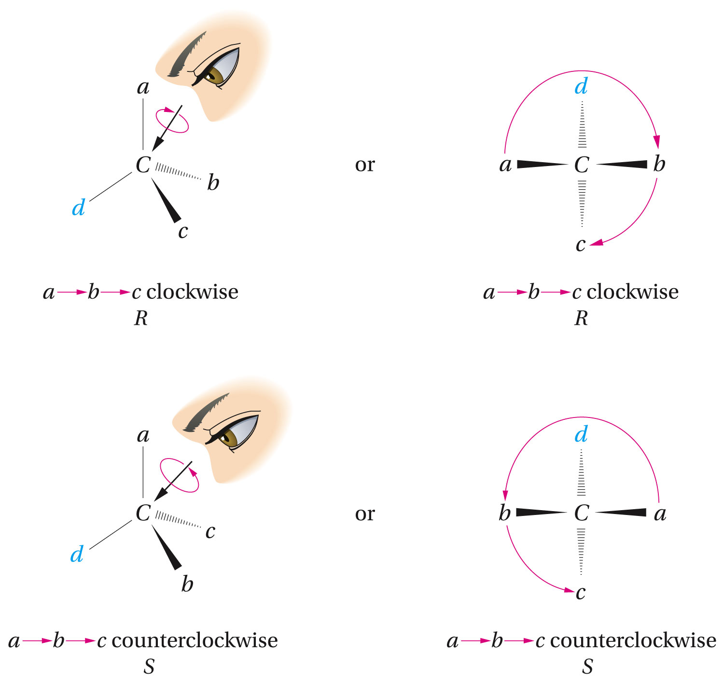
Configuration and the R-S Convention

Slide 13
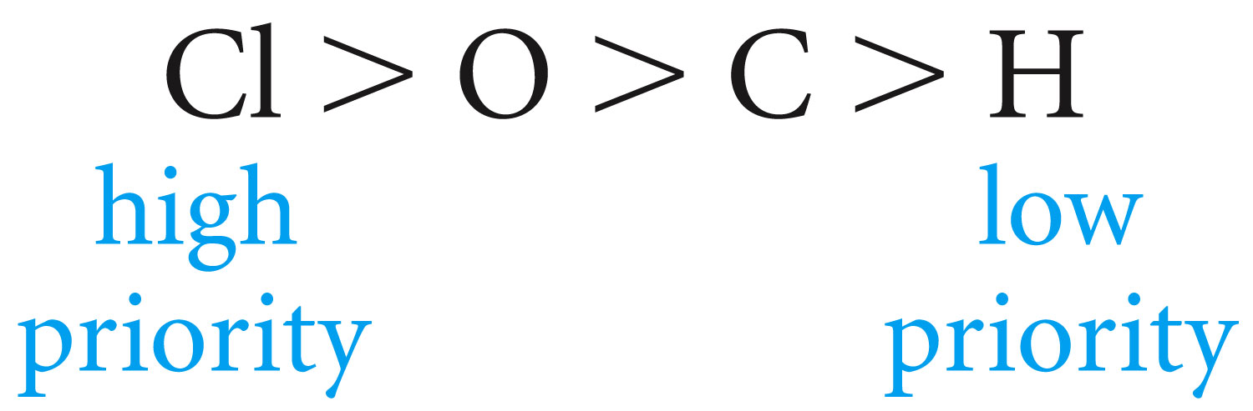
Rule 1
The atoms directly attached to the stereogenic center are ranked according to atomic number. The higher the atomic number, the higher the priority

Slide 14
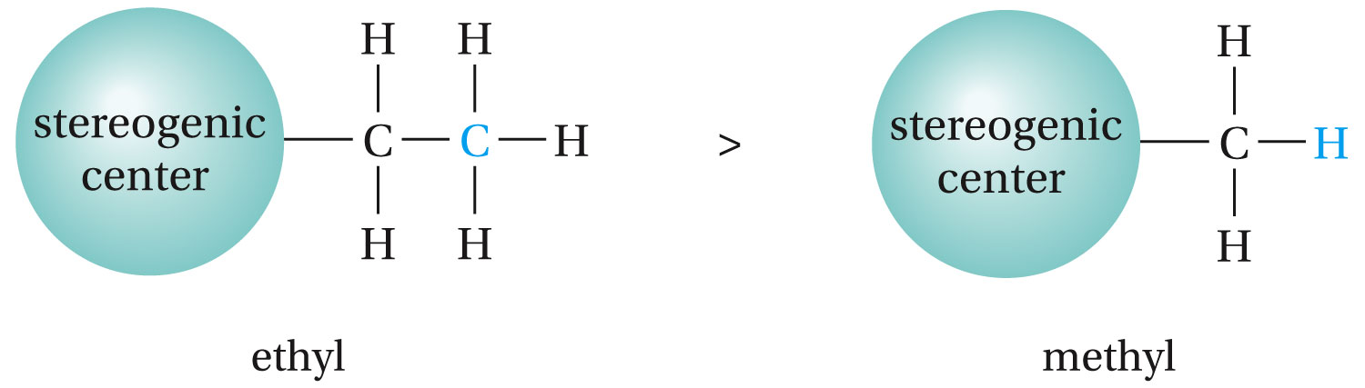
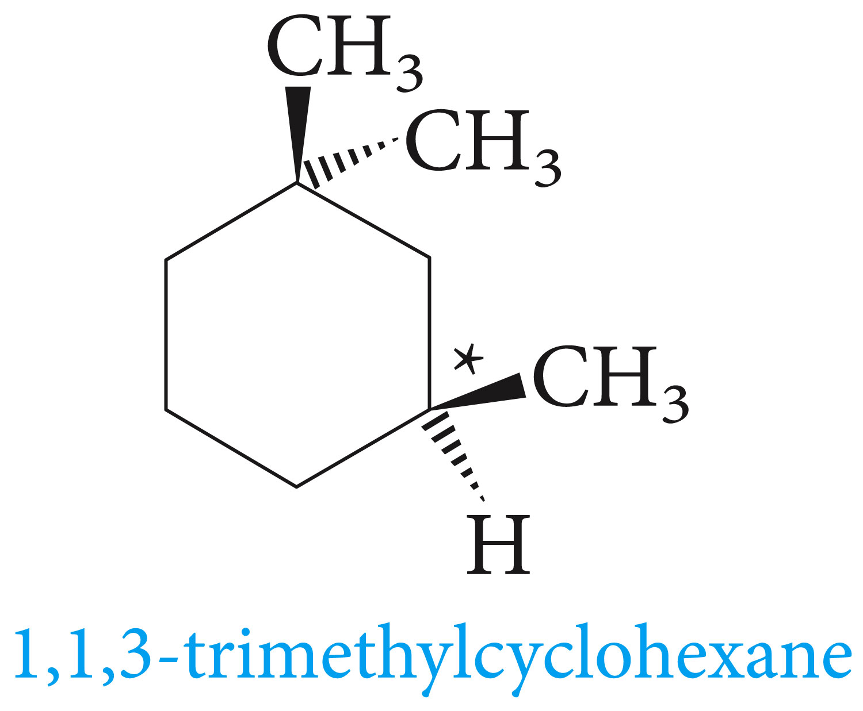
Rule 2
If a decision cannot be reached with rule 1, work outward from the stereogenic center until a decision is made. Example of ethyl and methyl below.

Slide 15
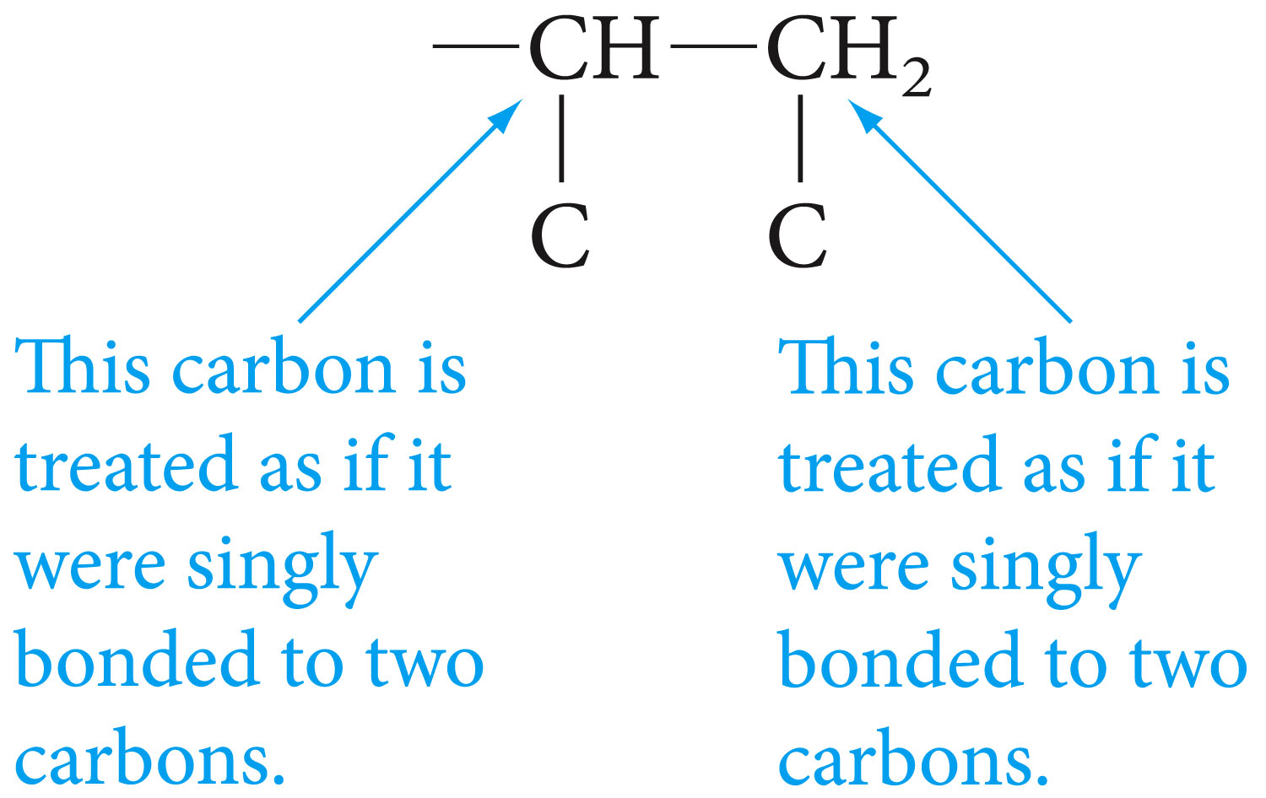
Rule 3
Multiple bonds are treated as if they were an equal number of single bonds.

Slide 16
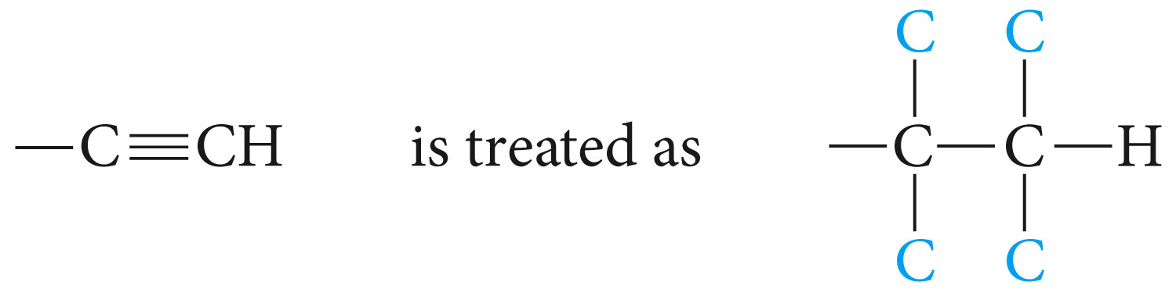
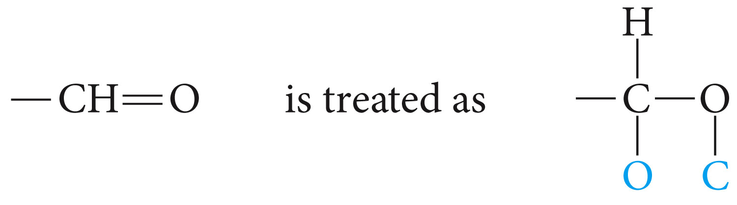

Slide 17
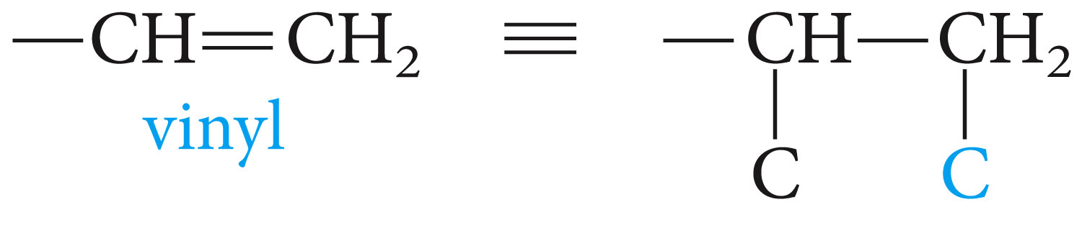
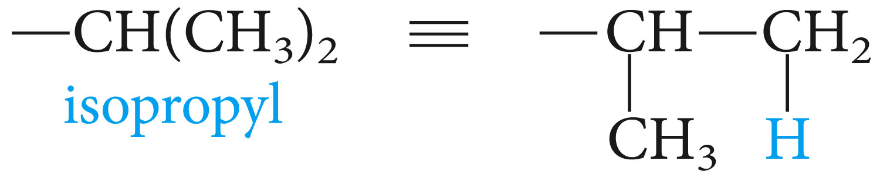
Which group has the higher priority, isopropyl or vinyl?

Slide 18
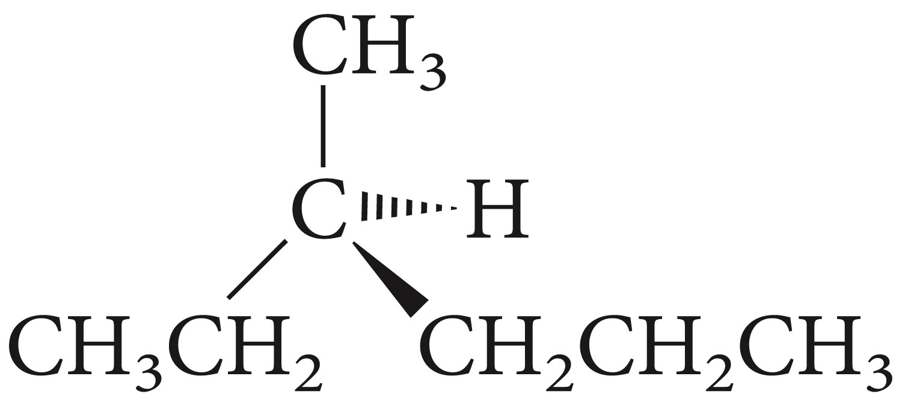
Assign the configuration (R or S) to the following enantiomer of 3-methylhexane

Slide 19
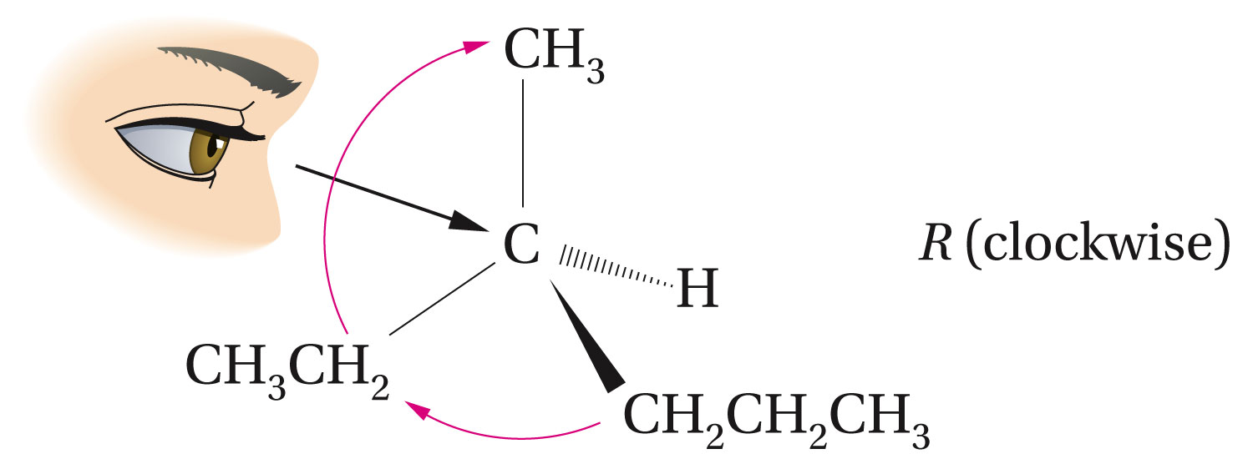

Slide 20
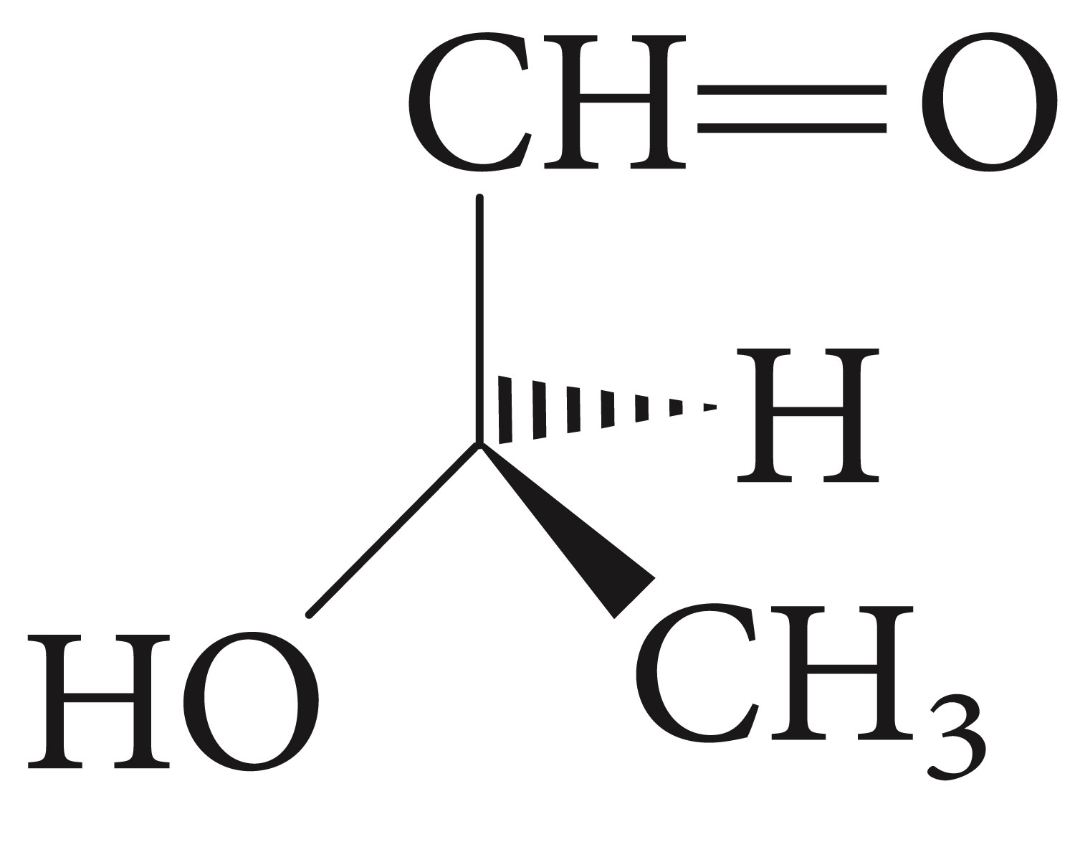
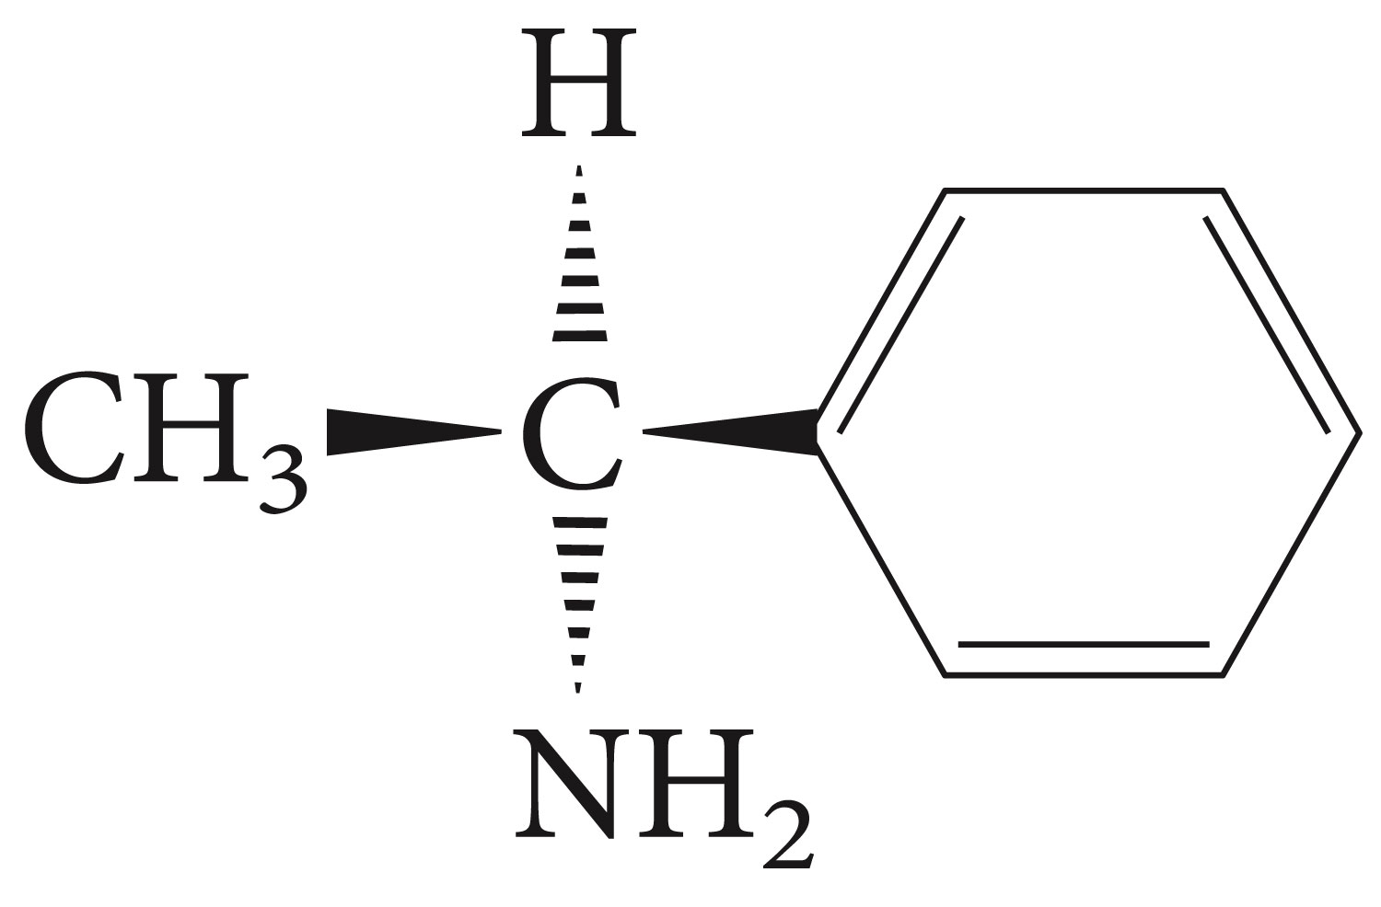
Clicker Question
What is absolute configuration for each of the stereogenic center shown in the following compounds?

Slide 21
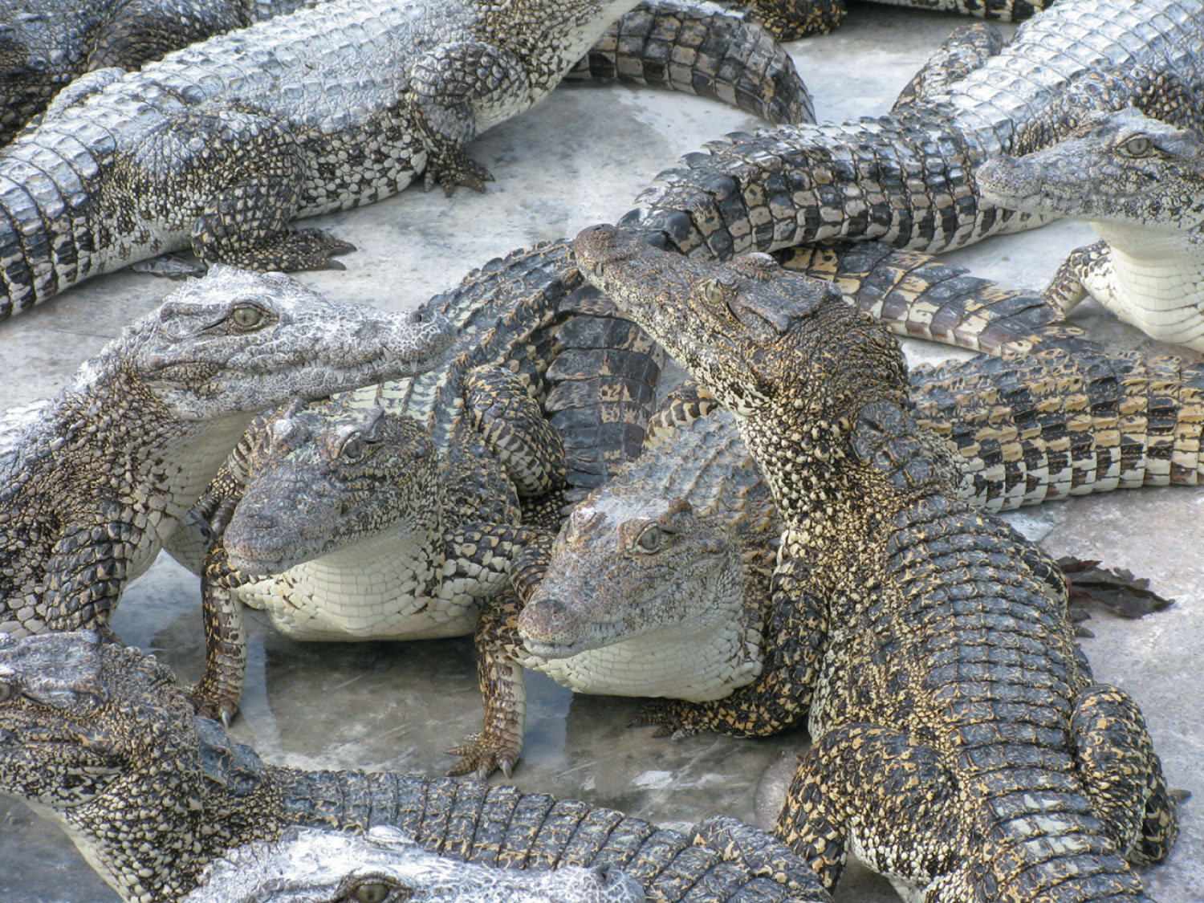
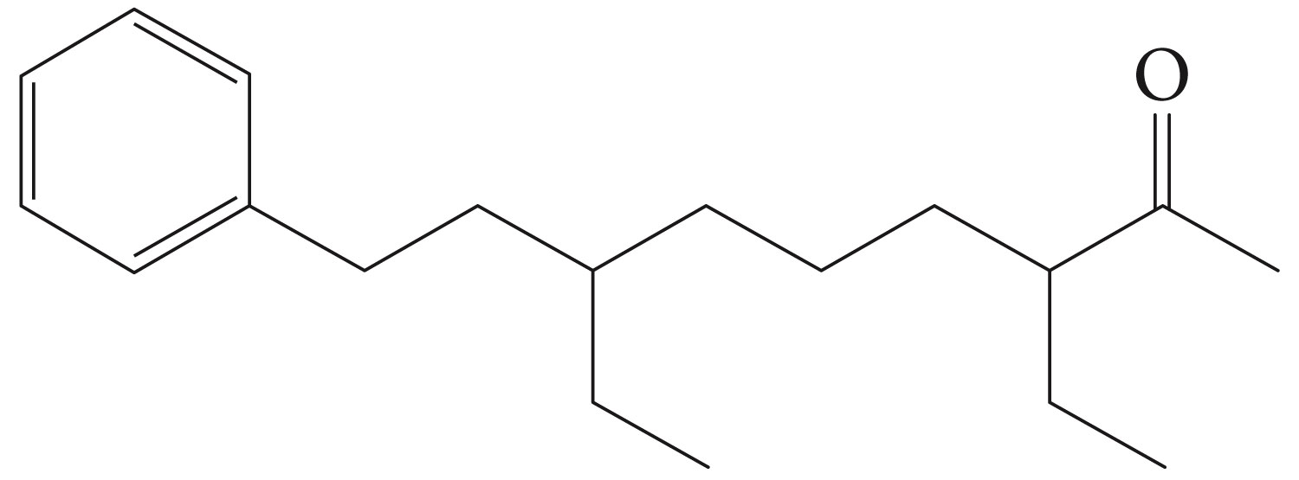
Mature crocodiles secrete from their skin glands the compound with the following structure. The compound is thought to be a communication pheromone for nesting and mating.
How many stereogenic centers are in the compound? Mark then with an asterisk.
How many stereoisomers of this compound are possible.

Slide 22
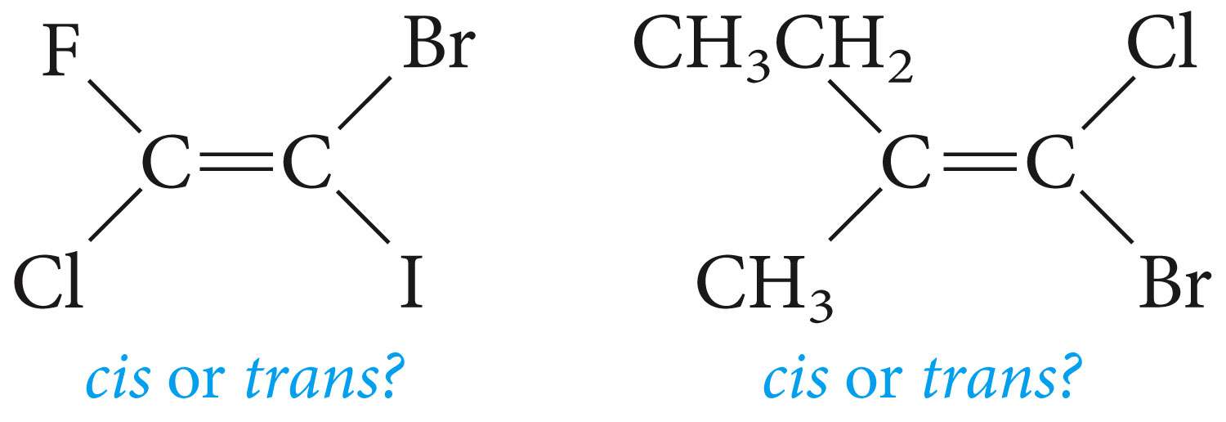
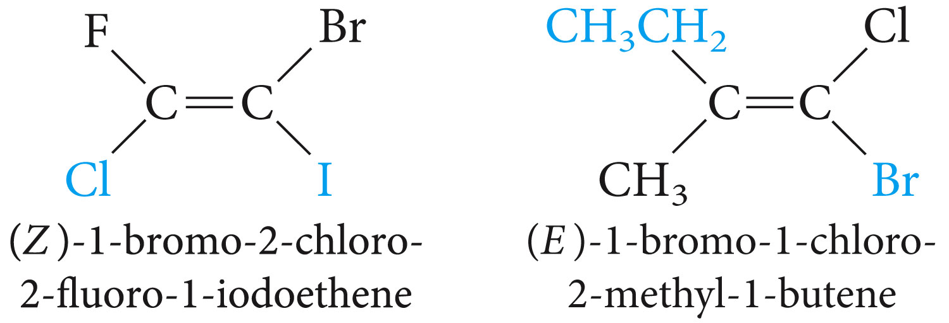
The E-Z convention for Cis-Trans Isomers

Slide 23
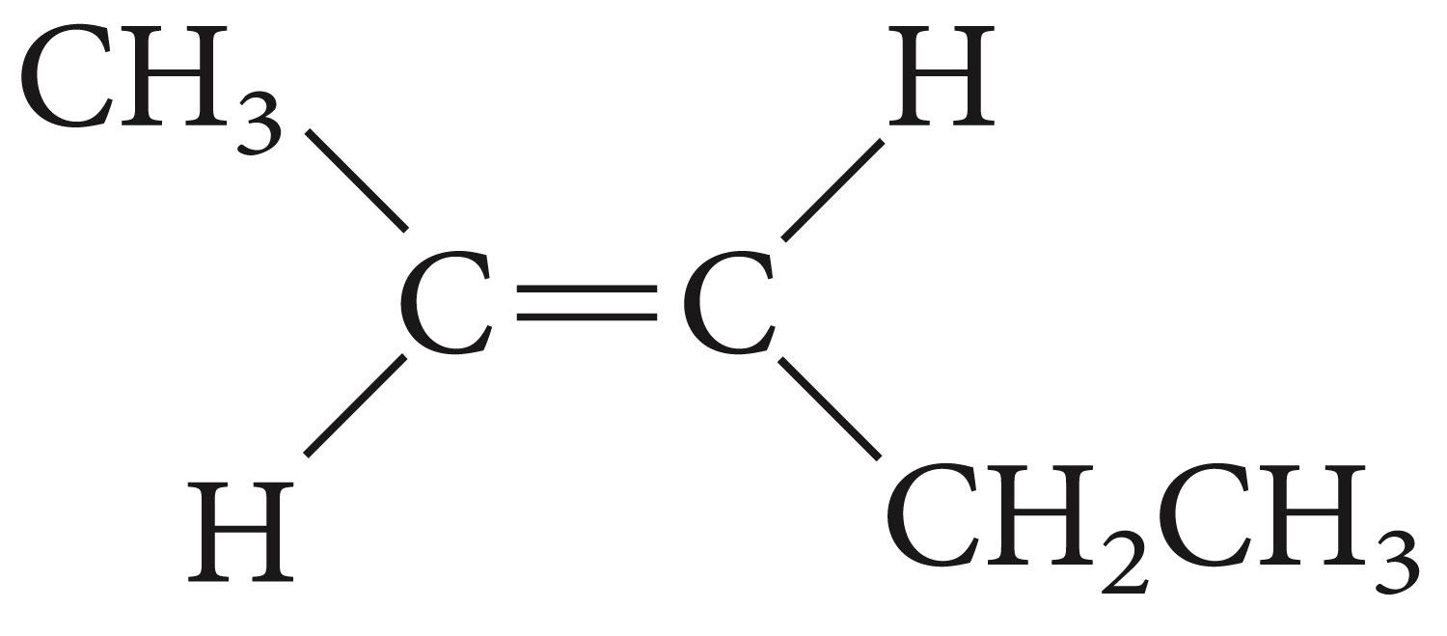
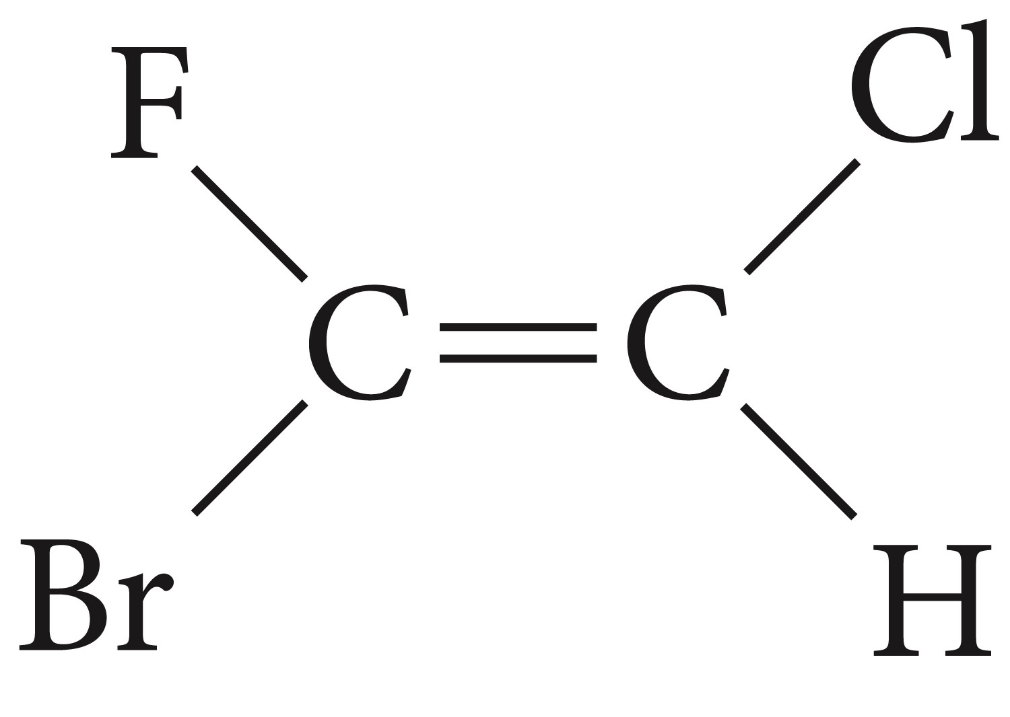
Name each compound by the E-Z system

Slide 24
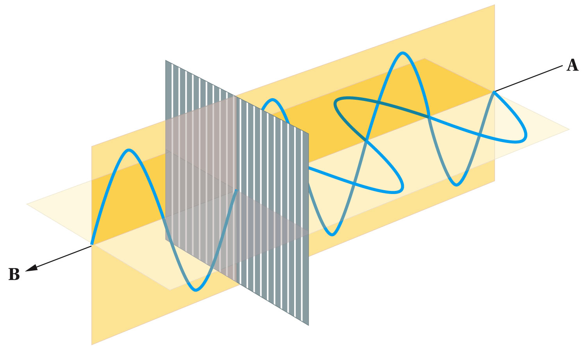
Polarized Light and Optical Activity

Slide 25
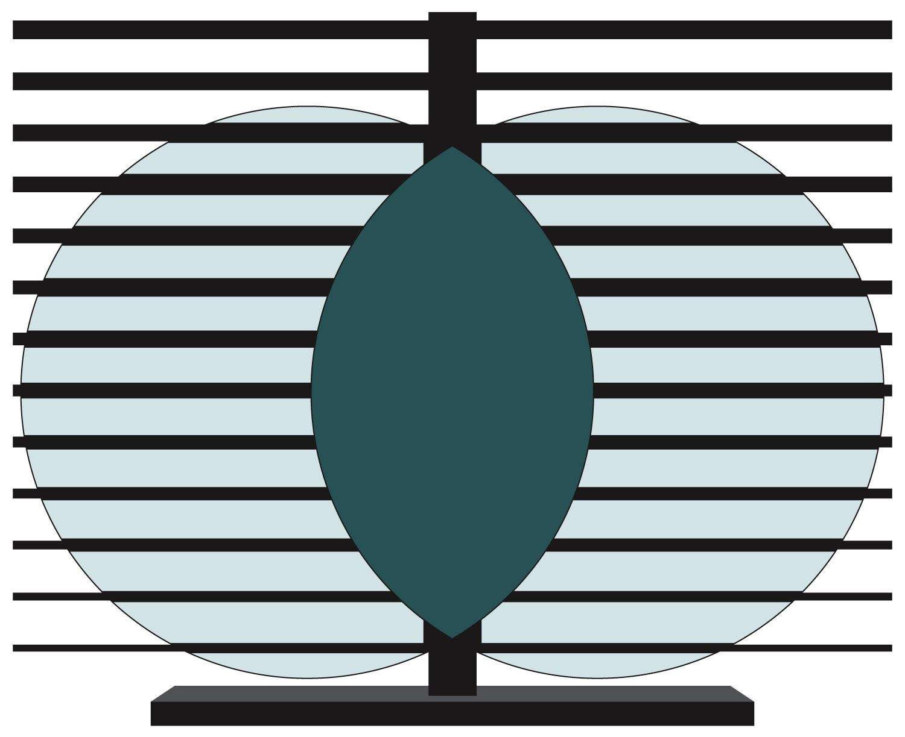
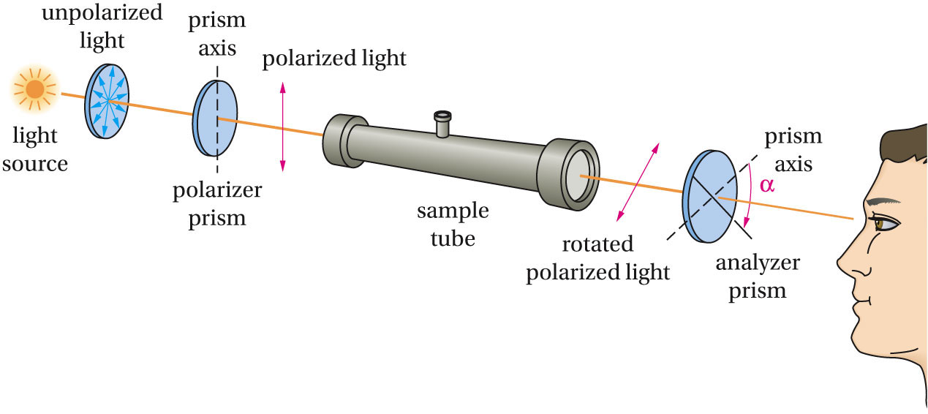

Slide 26

Example (problem5.14)
Camphor is optically active. A camphor sample (1.5g) dissolved in ethanol (optically inactive) to a total volume of 50 mL, placed in a 5-cm polarimeter sample tube, gives an observed rotation of +0.66⁰ at 20⁰C (using the sodium D-line). Calculate and express the specific rotation of camphor.

Slide 27
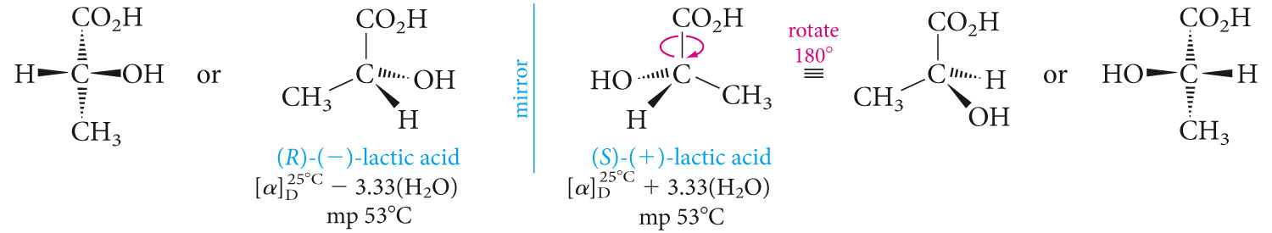
Properties of Enantiomers

Slide 28
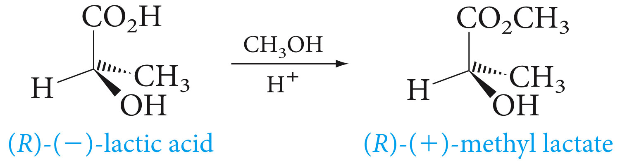
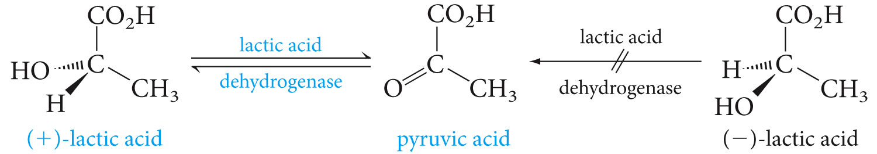

Slide 29
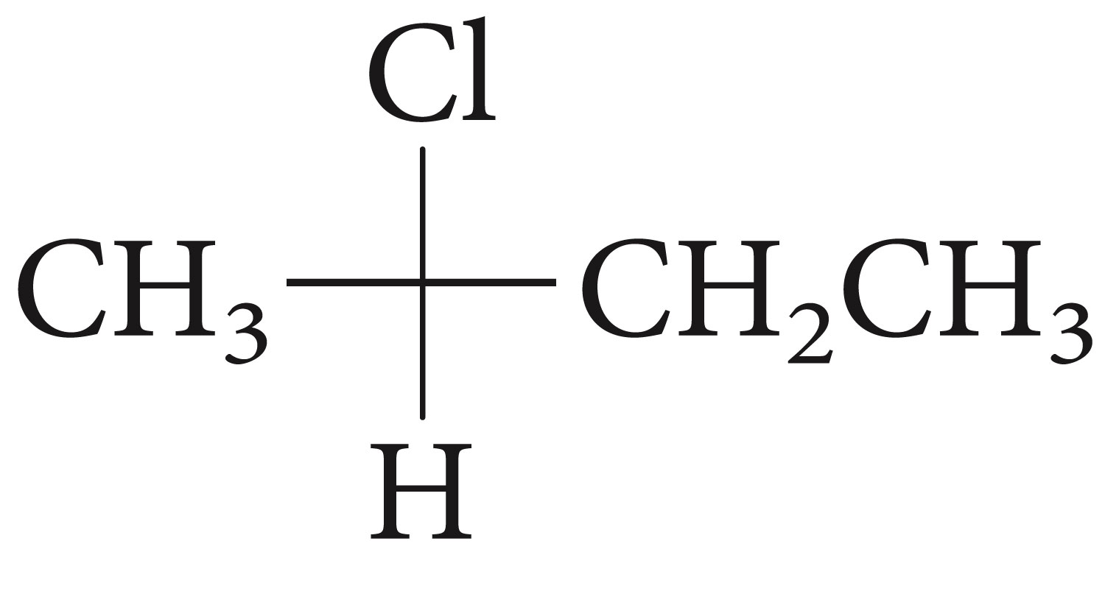
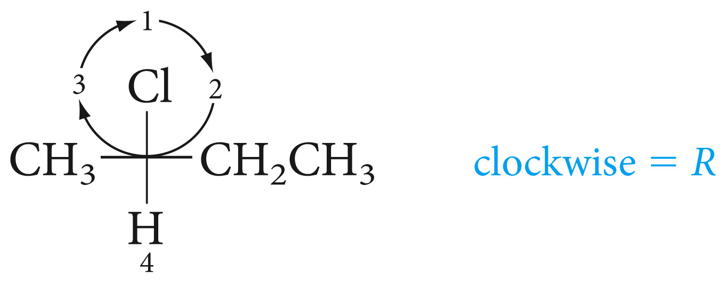
Fischer Projection Formulas

Slide 30
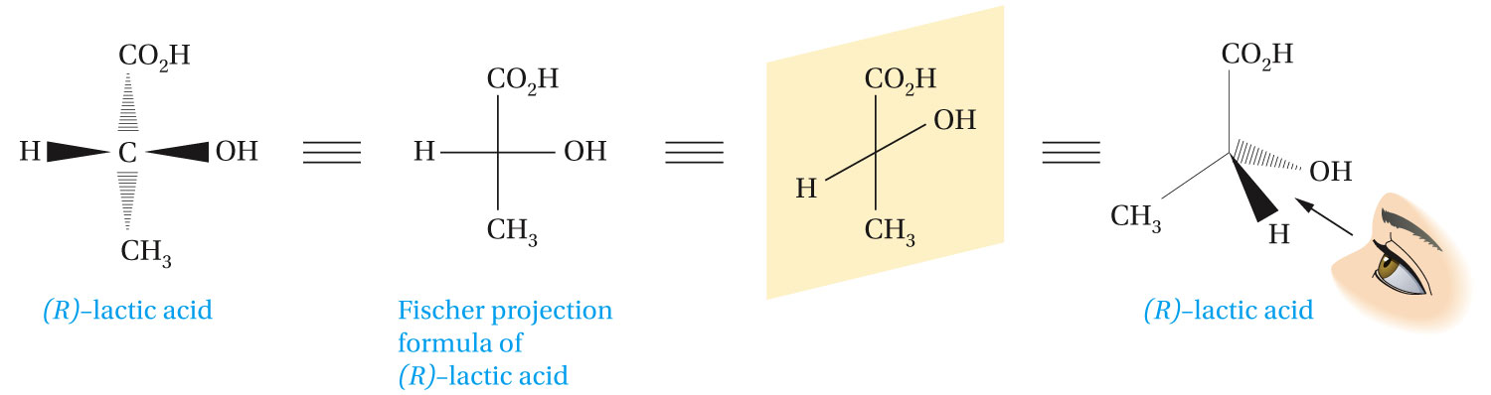

Slide 31
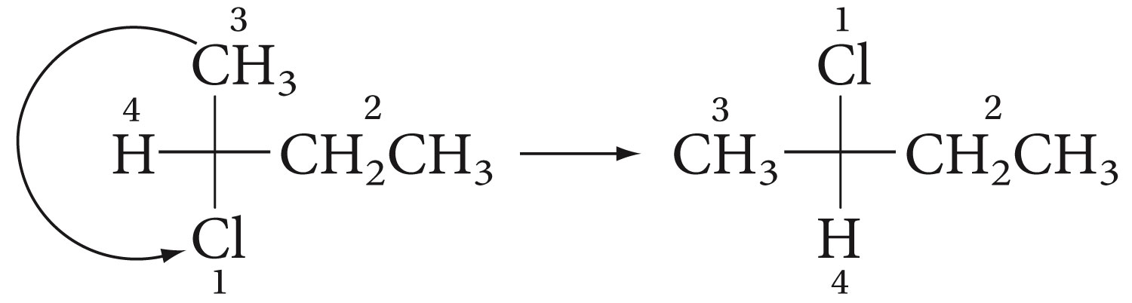
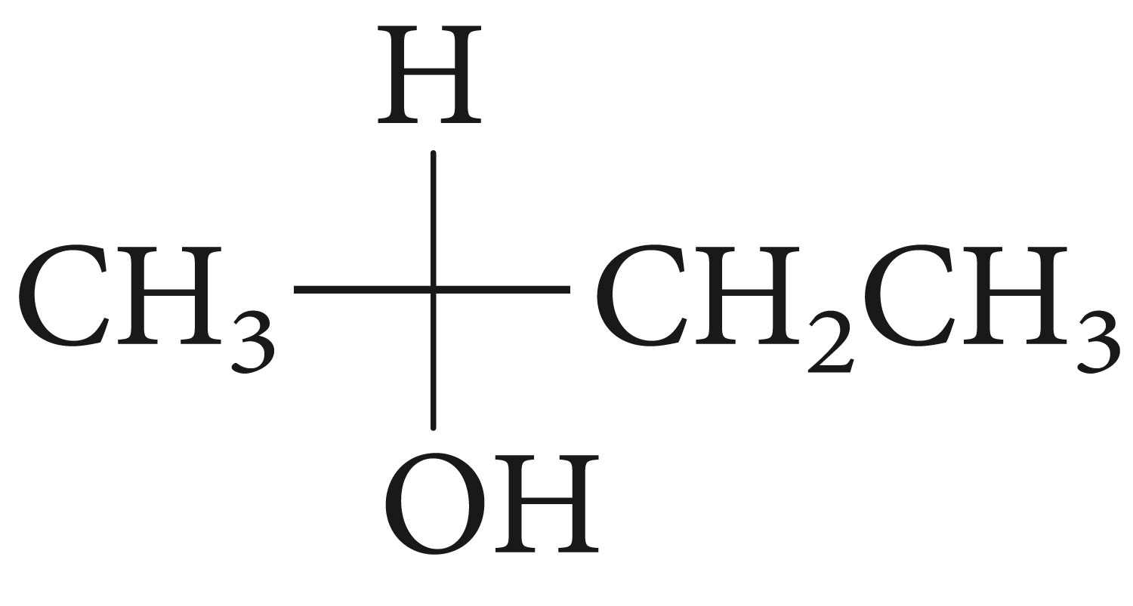
Determine the absolute configuration of of the following enantiomer of 2-butanol from its Fischer projection

Slide 32
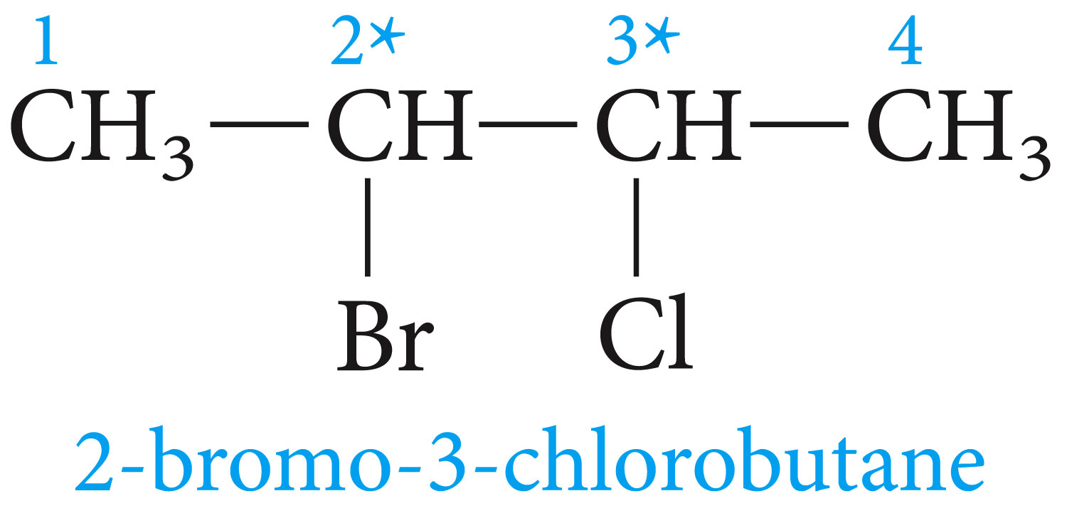
Compounds with More Than One Stereogenic Center; Diastereomers

Slide 33
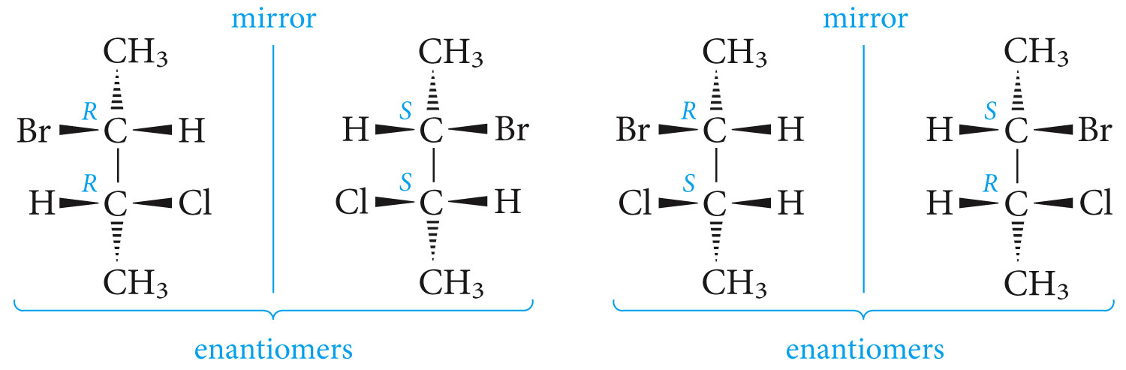
The four stereoisomers of 2-bromo-3-chlorobutane a compound with two stereogenic centers

Slide 34
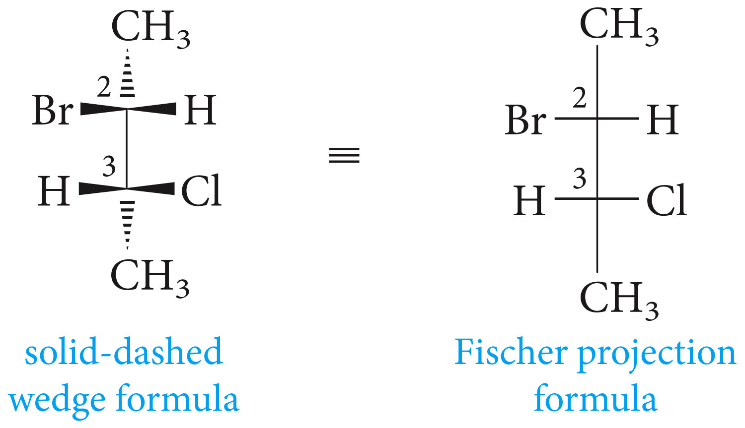

Slide 35
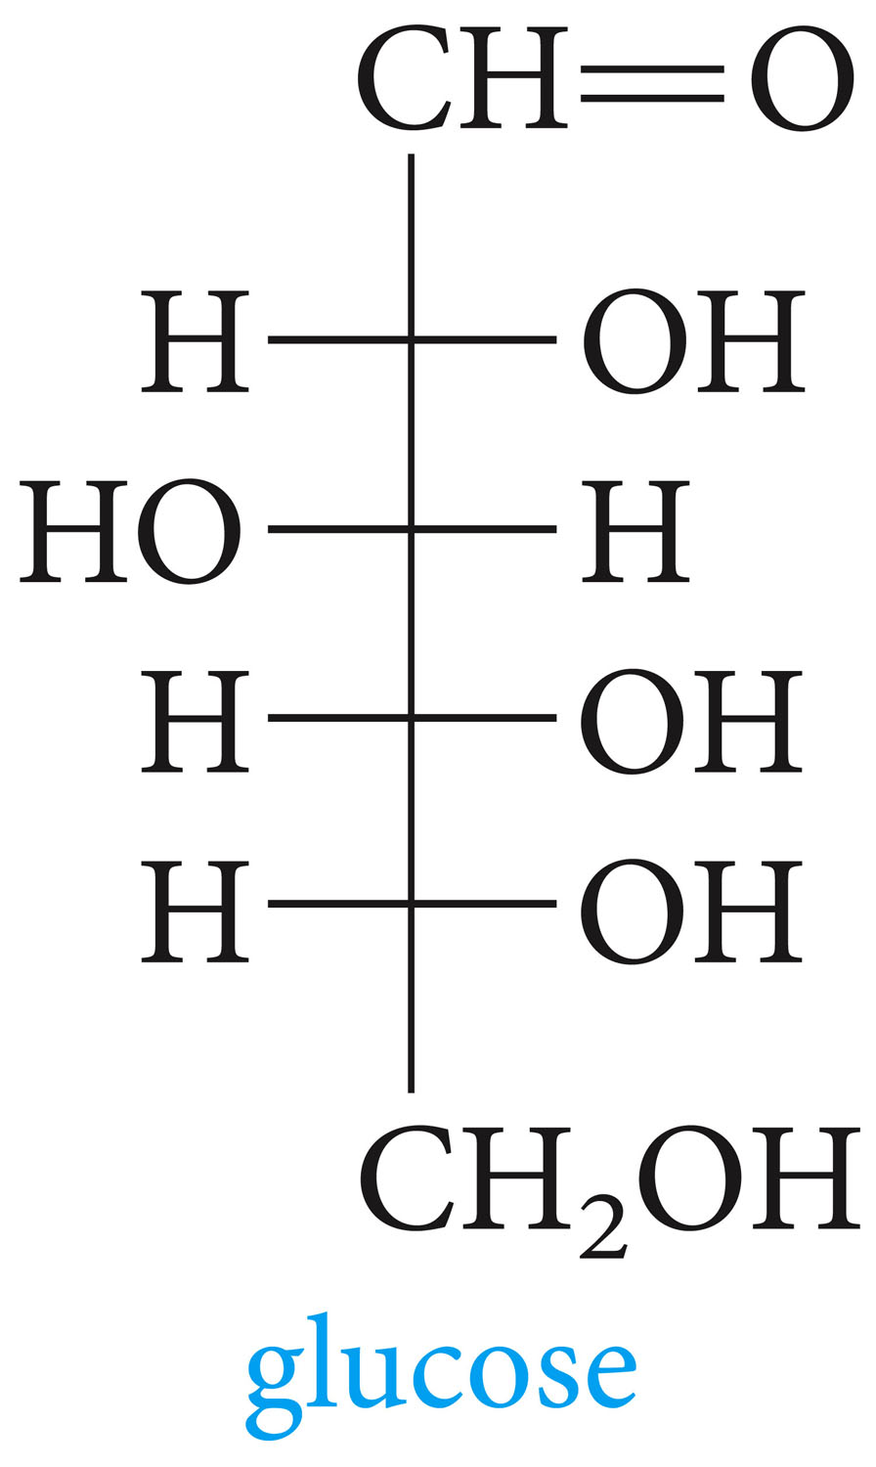
Given is the Fischer projection of glucose (blood sugar), how may stereoisomers of this sugar are possible?

Slide 36
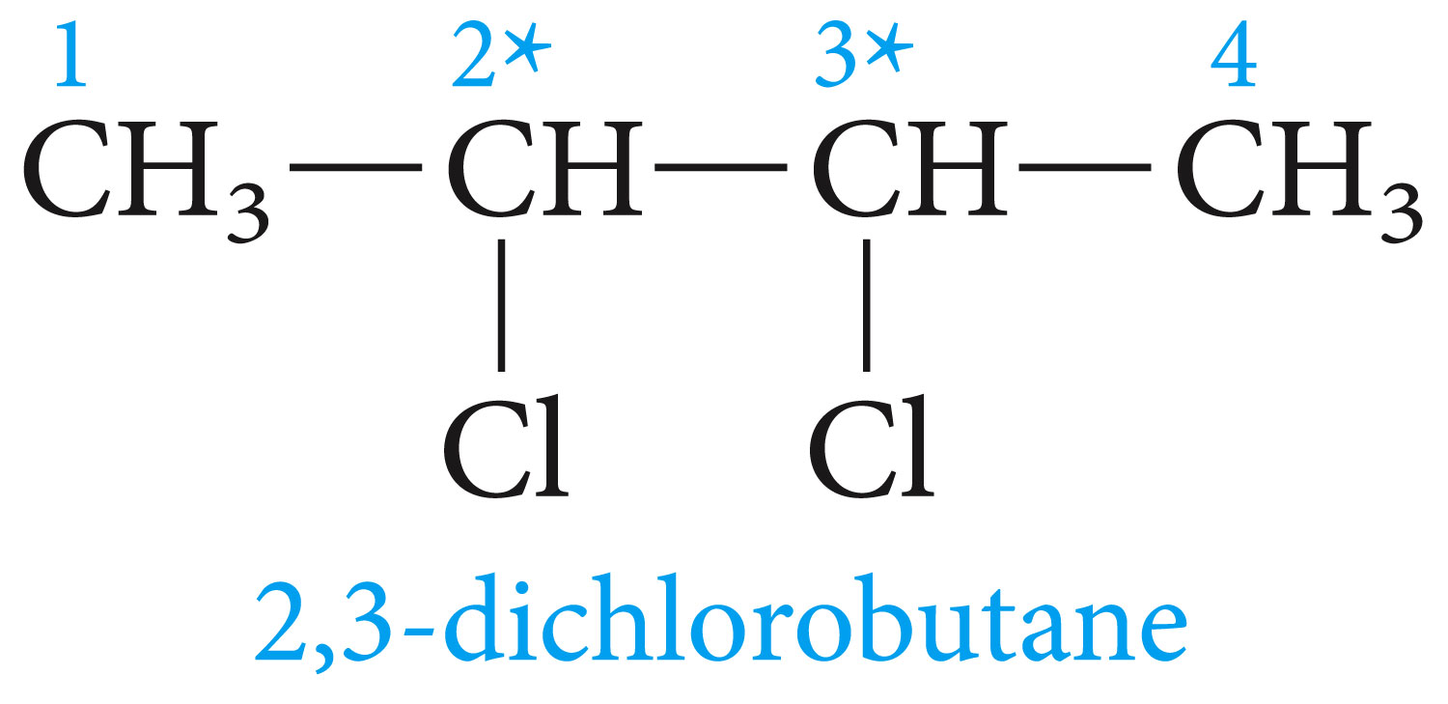
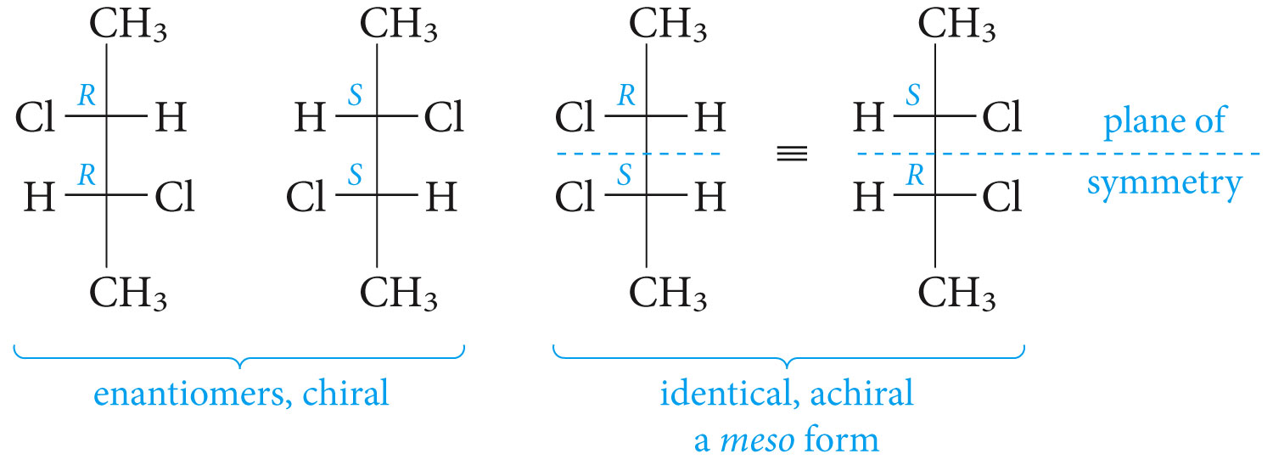
Meso Compounds; the Stereoisomers of Tartaric Acid

Slide 37
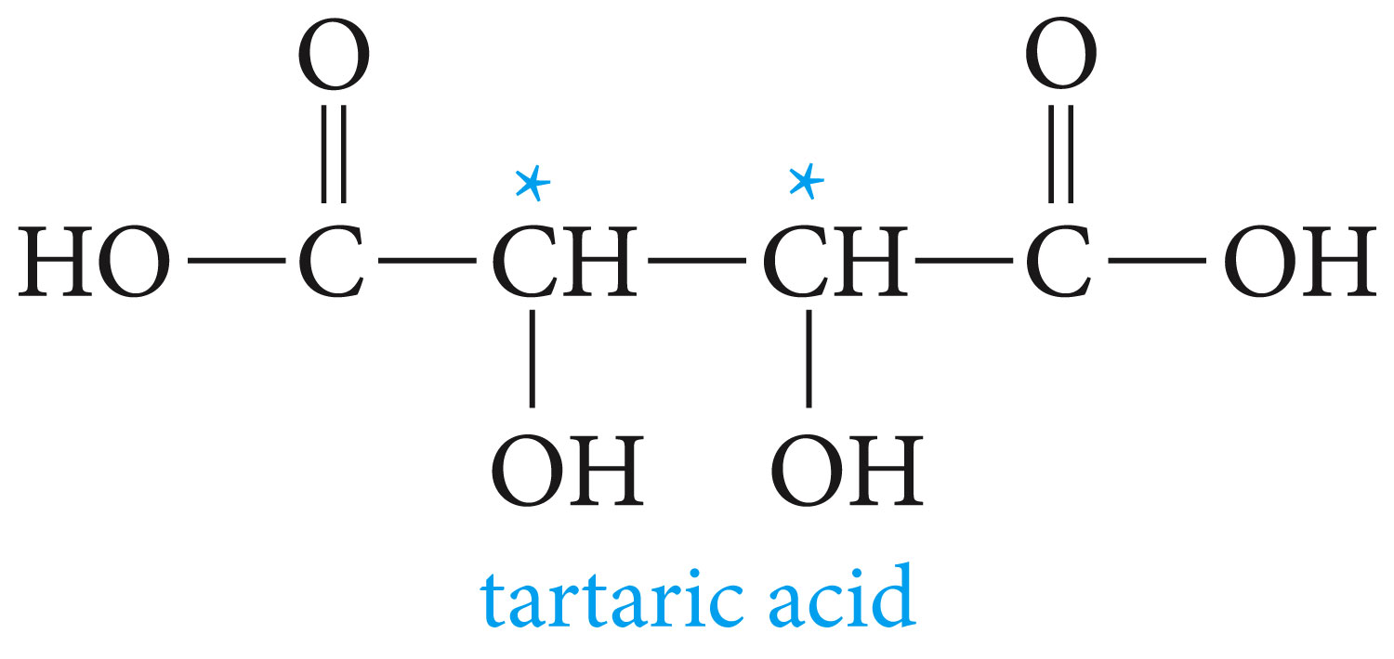


Slide 38

Stereochemistry A Recap of Definitions
Cis-trans 2-butene (Z and E notation)

Slide 39


Staggered and eclipsed
(R)- and (S)-lactic acids

Slide 40


Meso- and (RR)-tartaric acids
Tartaric acid crystals under polarized light

Slide 41


Stereochemistry and Chemical Reactions

Slide 42

When chiral products are obtained from achiral reactants, both enantiomers are formed at the same rates, in equal amounts.

Slide 43

Reaction of a chiral regent with an achiral reagent when it creates a new stereogenic center, leads to diastereomeric products at different rates and in unequal amounts.

Slide 44

Reaction of a chiral reagent with an achiral reagent, when it creates a new stereogenic center, leads to diastereomeric products at different rates and in unequal amounts.

Slide 45

Resolution of a Racemic Mixture
To separate a racemic mixture, we first react with a chiral reagent. The product will be a pair of diastereomers. These, differ in all types of physical properties and can therefore be separated by ordinary methods.

Slide 46




Slide 47


