Slide 1
Integration
Integrating Word, Excel, Access, and PowerPoint

Slide 2
Objectives
Merge Access data with a Word document
Complete an entire mail merge process for form letters
Preview and print a merged document
Create a Word outline

Slide 3
Objectives
Create PowerPoint slides from a Word outline
Copy and paste an Access query into a PowerPoint presentation
Link an Excel chart to a PowerPoint presentation

Slide 4
Planning the Form Letter
A form letter is a Word document that contains standard paragraphs of text and a minimum of variable text
  Main document
  Merge fields
  Data source
The process of combining the main document with the data source is called a merge
  Mail merge

Slide 5
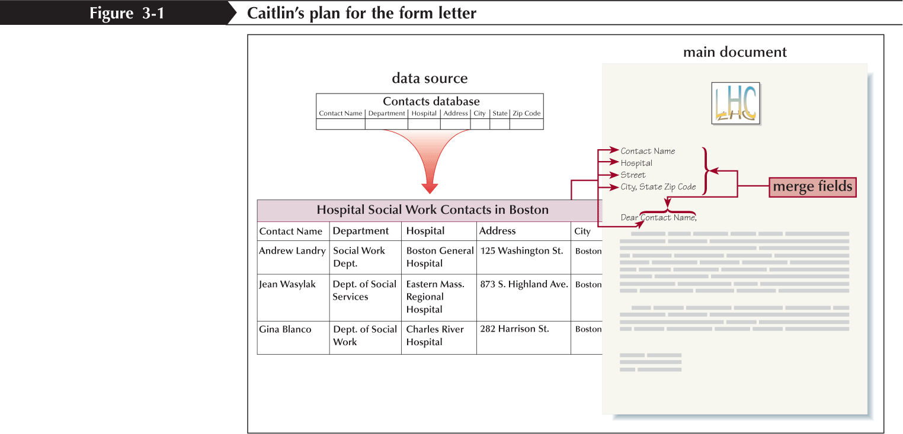
Planning the Form Letter

Slide 6
Merging Access Data with a Word Document
Open the main document in Word, and then click the Mailings tab on the Ribbon
Click the Start Mail Merge button, and then click the type of document you want to use as the main document
Click the Select Recipients button, click Use Existing List, select the database in the Select Data Source dialog box, and then click the Open button
If the Select Table dialog box opens, click the table or query in the database that you want to use, and then click the OK button
Click the Edit Recipient List button, filter the list in the Mail Merge Recipients dialog box, and then click the OK button

Slide 7
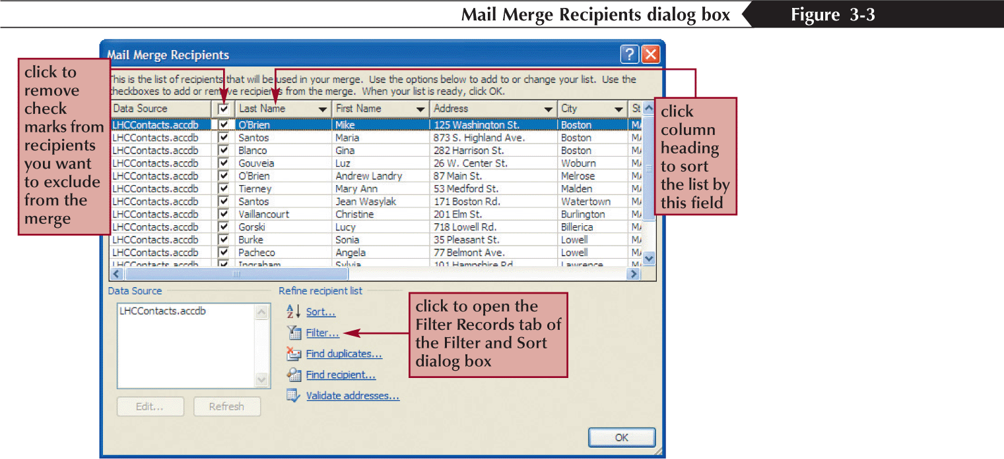
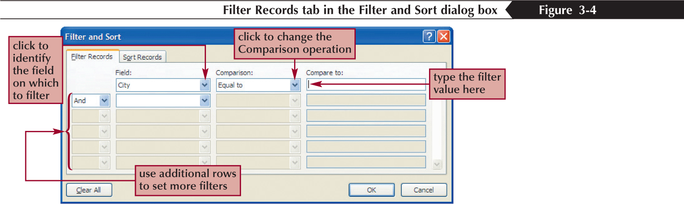
Merging Access Data with a Word Document

Slide 8
Merging Access Data with a Word Document
Position the insertion point in the document where you want the merge field to appear, in the Write & Insert Fields group, click the Address Block, Greeting Line, or Insert Merge Field button, and then set options and match fields as necessary in the dialog box that opens or click the Insert Merge Field button arrow, and then select the merge field you want to insert from the menu that opens
Click the Preview Results button, and then click the Next Record button to scroll through the merged documents
Click the Auto Check for Errors button, click the Simulate the merge and report errors in a new document option button, click the OK button, and then respond to any errors found or click the OK button in the dialog box that reports that no errors were found

Slide 9
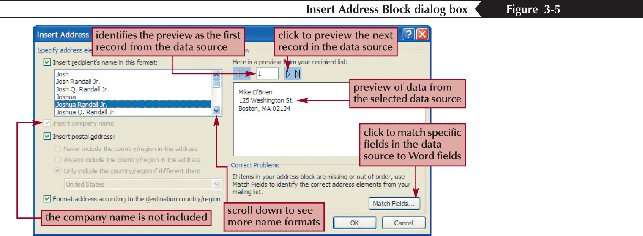
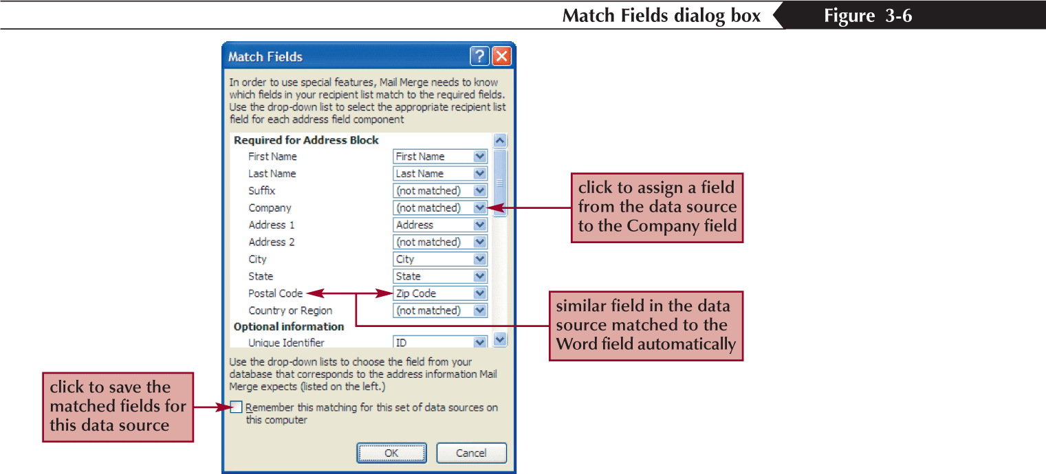
Merging Access Data with a Word Document

Slide 10
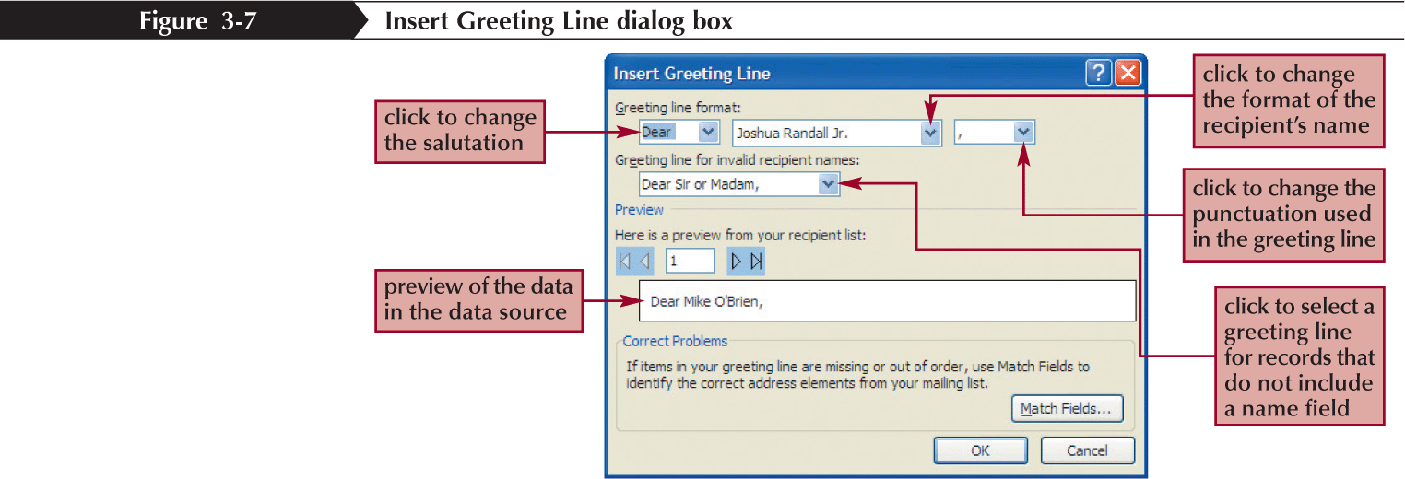
Merging Access Data with a Word Document

Slide 11
Merging Access Data with a Word Document
To print the merged documents, in the Finish group, click the Finish & Merge button, click Print Documents, click the appropriate option button in the Merge to Printer dialog box, click the OK button, and then click the OK button in the Print dialog box
To edit individual letters or to save a copy of the merged documents, in the Finish group, click the Finish & Merge button, click Edit Individual Documents, click the appropriate option button in the Merge to New Document dialog box, click the OK button, edit any letters as needed, and then save the merged document

Slide 12
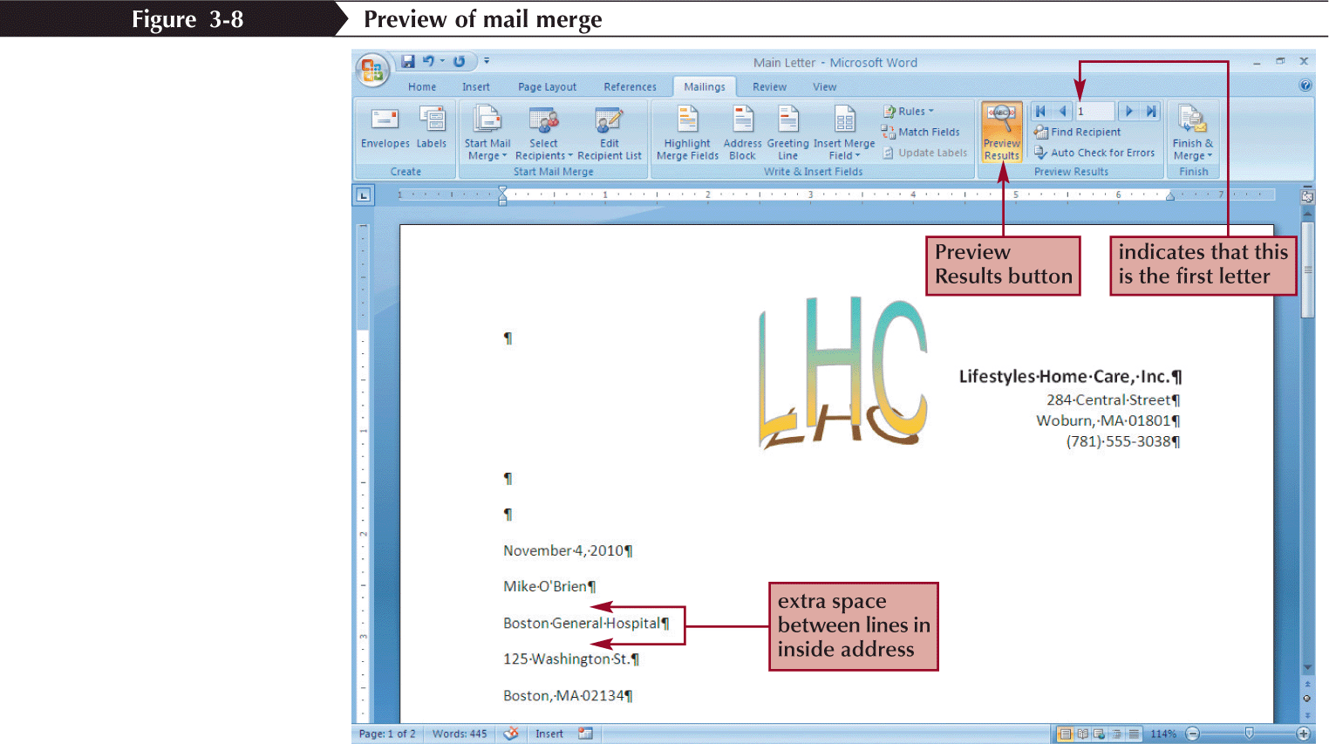
Merging Access Data with a Word Document
Preview of mail merge

Slide 13
Creating a Word Outline
You can create an outline in Word by typing text directly in Outline view in a new document
To format text as an outline, you use the Promote and Demote buttons on the Outlining toolbar
  The Promote button promotes, or moves up, the selected paragraph to the next higher outline level
  The Demote button demotes, or moves down, the selected paragraph to the next lower outline level

Slide 14
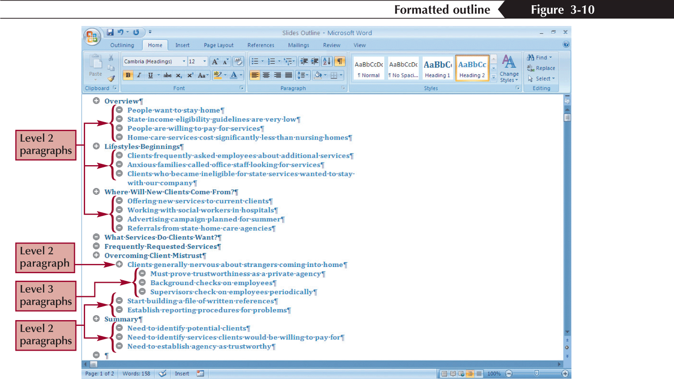
Creating a Word Outline

Slide 15
Creating PowerPoint Slides from a Word Outline
When you create slides from a Word outline, PowerPoint uses the heading styles in the Word document to determine how to format the text
In the Slides group on the Home tab, click the New Slide button arrow, and then click Slides from Outline
Locate the file containing the outline, and then click the Insert button

Slide 16
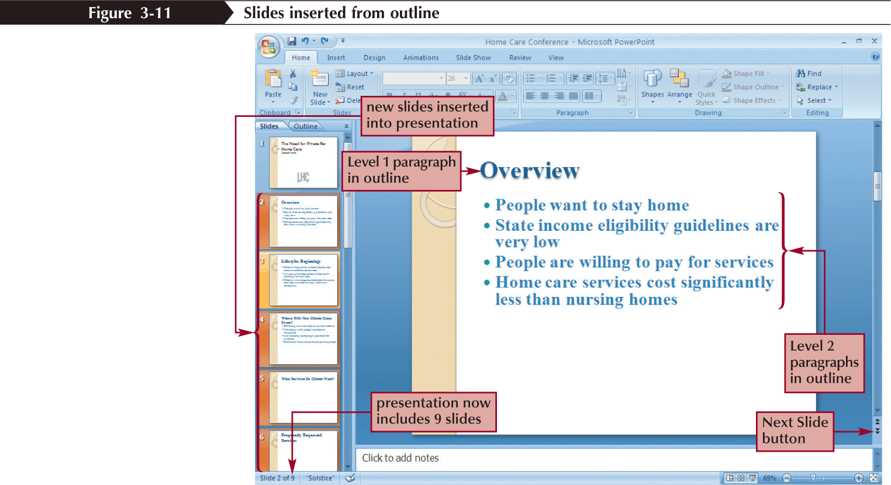
Creating PowerPoint Slides from a Word Outline

Slide 17
Copying and Pasting an Access Query into a PowerPoint Presentation
Open the slide to contain the query
Open the Access database containing the Query
In the Navigation Pane, double-click Updated Services Requested Query
Click the selector to the left of the column heading
Click the Copy button
Return to the presentation
Click the Paste button

Slide 18
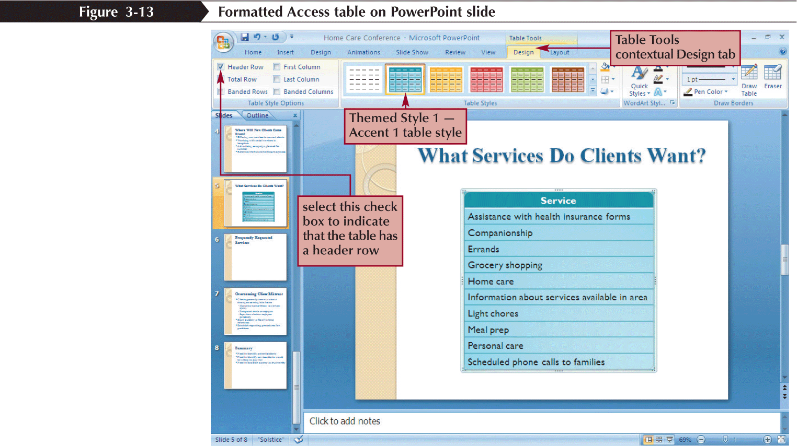
Copying and Pasting an Access Query into a PowerPoint Presentation

Slide 19
Linking an Excel Chart to a PowerPoint Presentation
In Excel, select the data or chart that you want to insert into a PowerPoint presentation, and then click the Copy button
To link Excel data or a graph, in PowerPoint, click where you want to insert the data or graph, click the Paste button arrow, and then click Paste Special. In the Paste Special dialog box, click the Paste link option button, click Microsoft Office Excel Worksheet Object or Microsoft Office Excel Chart Object, if necessary, and then click the OK button
Or
To link an Excel graph, in PowerPoint, click where you want to insert the graph, and in the Clipboard group, click the Paste button. In the slide, near the lower-right of the pasted object, click the Paste Options button, and then click the Chart (linked to Excel data) option button, if necessary

Slide 20
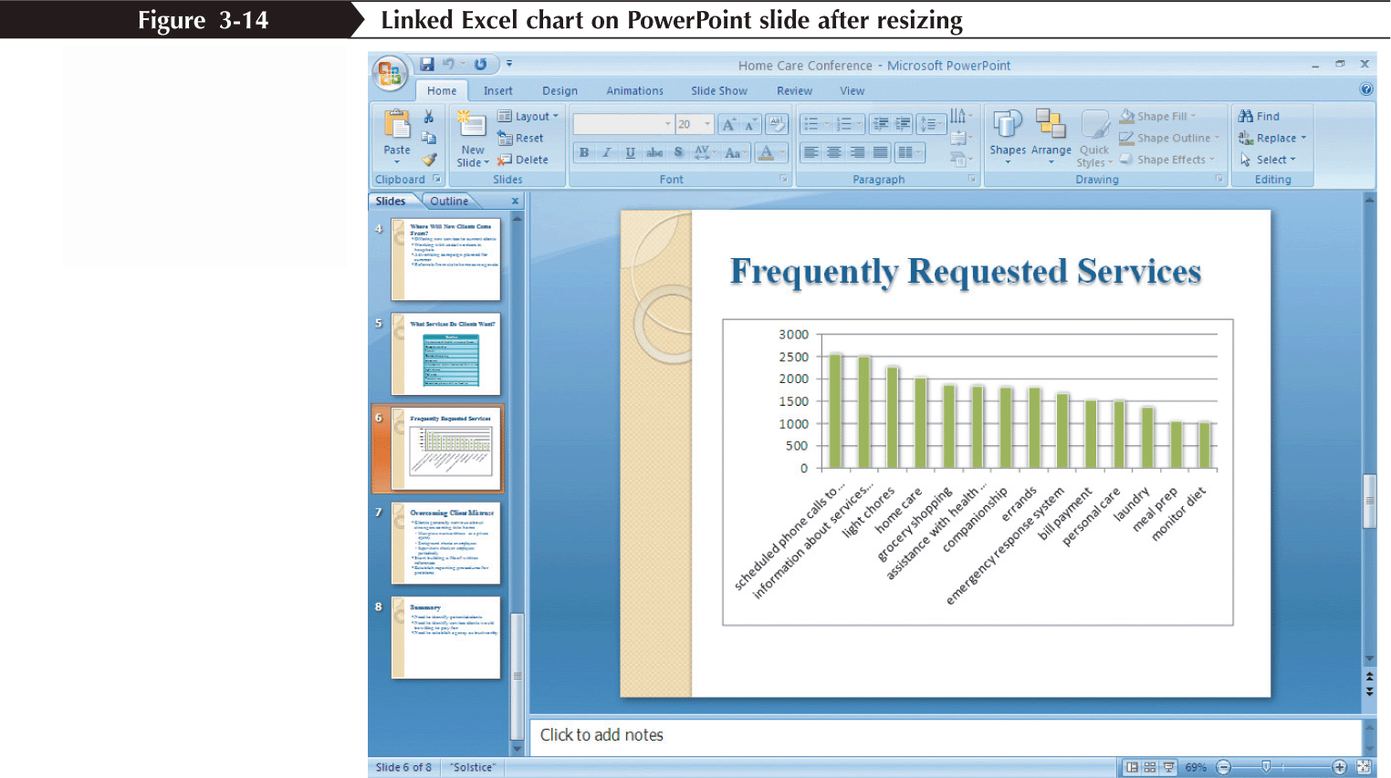
Linking an Excel Chart to a PowerPoint Presentation

