Slide 1
Molecular Polarity

Slide 2
H₂O NH₃
CO₂ CH₄

Slide 3
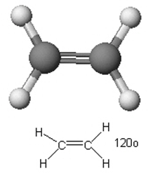
Is this molecule polar or nonpolar?
Polar
Nonpolar

Slide 4
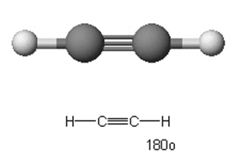
Is this molecule polar or nonpolar?
Polar
Nonpolar

Slide 5
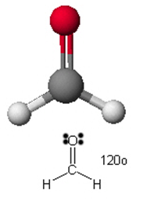
Is this molecule polar or nonpolar?
Polar
Nonpolar

Slide 6
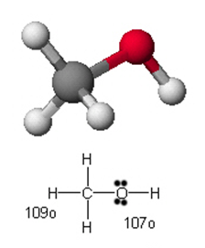
Is this molecule polar or nonpolar?
Polar
Nonpolar

Slide 7
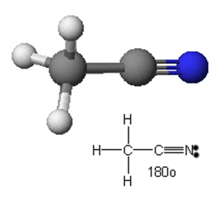
Is this molecule polar or nonpolar?
Polar
Nonpolar

Slide 8
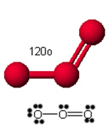
Is this molecule polar or nonpolar?
Polar
Nonpolar

Slide 9
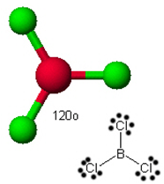
Is this molecule polar or nonpolar?
Polar
Nonpolar

Slide 10
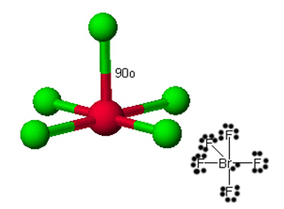
Is this molecule polar or nonpolar?
Polar
Nonpolar

Slide 11
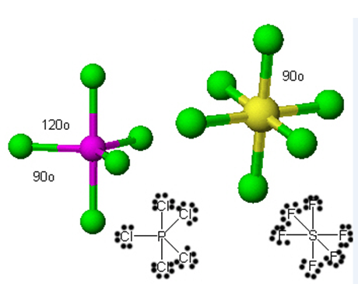
Is these molecules polar or nonpolar?
Polar
Nonpolar

Slide 12
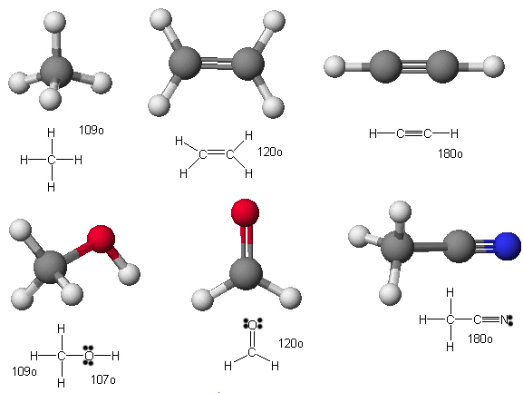
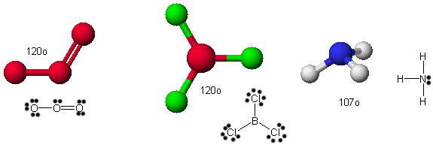

Slide 13
