Slide 1
Section 1.1 – 1.2 What is Chemistry Classification of Matter
Bill Vining
SUNY College at Oneonta

Slide 2
What is Chemistry Classification of Matter
In this section…
Scale of chemistry
Measuring matter
Pure matter on the macroscopic scale
Mixtures on the macroscopic scale

Slide 3
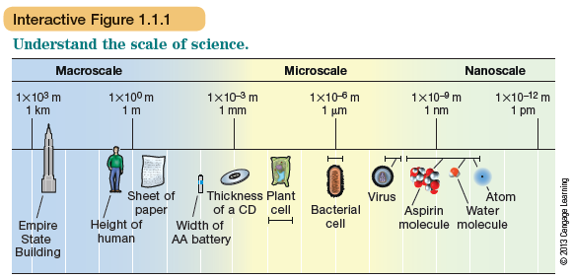
The Scale of Chemistry
Chemistry is the study of matter on the atomic/
molecular scale. Also called nanoscale.

Slide 4
The Scale of Chemistry
Macroscopic: can be seen with unaided eye.
Microscopic: can only be seen with an optical microscope
Atomic: too small to be seen even with optical microscope
Examples:
soccer ball: methanol molecule:
sand grain: bacterium:

Slide 5
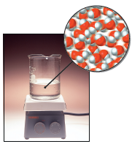
The Scale of Chemistry
Chemistry is the study of matter on the atomic/
molecular scale. Also called nanoscale.

Slide 6
How We Measure Matter
Bulk scale:
Mass
Attraction to magnets
Atomic scale:
Interaction with electromagnetic radiation--
-- VIS and UV
-- IR
-- Xray
-- Radio + Magnetic field

Slide 7
How We Measure Matter
Key feature of chemical study:
We can’t see individual atoms and molecules, so
all our knowledge is implied by measurements,
mostly of bulk samples.

Slide 8
Classification of Matter
Lot’s of ways:
solid, liquid, gas
composition
magnetism
color
hardness

Slide 9
Classification of Matter
As chemists, we do this on
atomic scale and macroscopic scale
Atomic Scale: atoms vs. molecules
Macroscopic Scale: elements vs. compounds

Slide 10
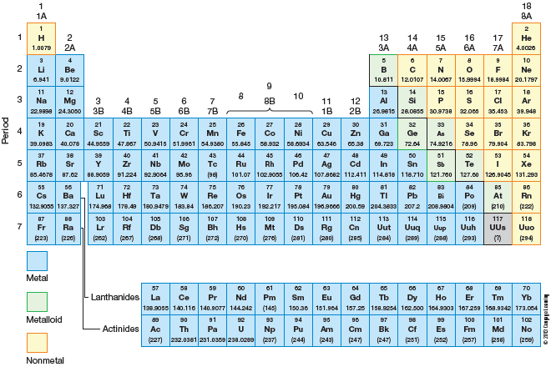
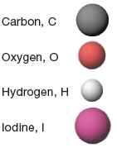
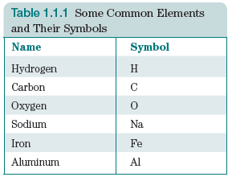
Classification of Matter
Atomic Scale: atoms vs. molecules
Atoms

Slide 11
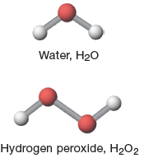
Classification of Matter
Atomic Scale: atoms vs. molecules
Molecules: collections of atoms that are held together
by chemical bonds.
Atoms

Slide 12
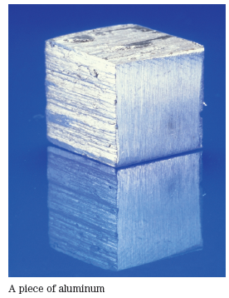
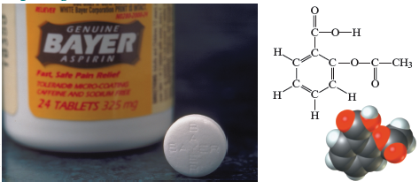
Classification of Matter
elements vs. compounds
Compound: formed when two or more elements are combined in a defined ratio
Pure Element: collection of atoms of a single element

Slide 13
Classification of Matter
Notes 1: Both elements and compounds
can form molecules
Notes 2: Compounds can be collections of
molecules, or large extended structures

Slide 14
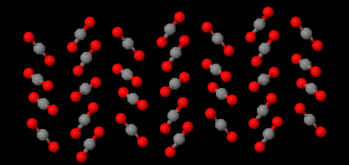
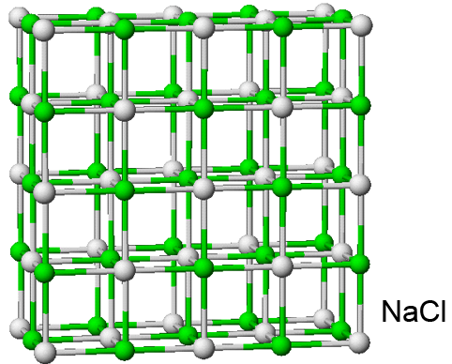
Classification of Matter
Notes 2: Compounds can be collections of
molecules, or large extended structures
solid CO₂; “dry ice”

Slide 15
Classification of Matter
Pure Substances vs. Mixtures
Pure substance: only one type of
element of compound
Mixtures: multiple types of elements or
compounds

Slide 16
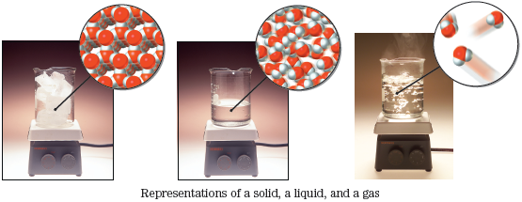
Classification of Change
Physical change vs. Chemical change
Physical change: changes the state but not
the chemical composition

Slide 17
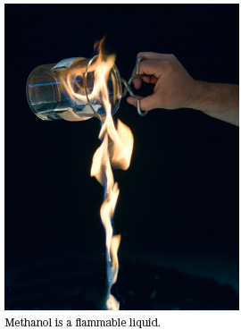
Classification of Change
Physical change vs. Chemical change
Chemical change:
changes the
chemical composition

Slide 18
Classification of Change
Physical change vs. Chemical change
Physical change:
same stuff,
different state
Chemical change:
different stuff

Slide 19
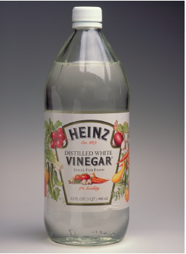
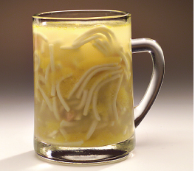
Classification of Mixtures
Heterogeneous vs. Homogeneous
Homogeneous mixture:
composition constant
throughout
Heterogeneous mixture:
non-uniform
composition

Slide 20
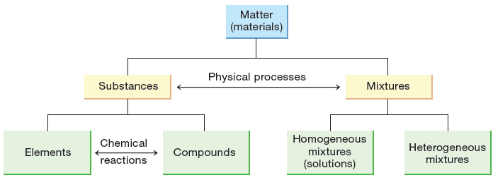
Classification of Matter Chart
Examples: filtered air: salt water:
filtered water: gold bar:

Slide 21
Classification of Matter Chart
-- mixtures can be separated by physical means
-- compounds can be “separated” by chemical means

