Slide 1
Section 3.3 Stoichiometry and Chemical Reactions

Slide 2
In this section: a. Chemical reactions and equations b. Balancing equations c. Reaction stoichiometry

Slide 3
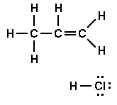
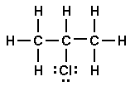
Chemical reactions and equations Reactants Products
CH₃CHCH₂ + HCl
CH₃CHClCH₃

Slide 4
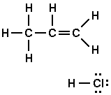
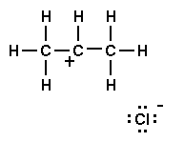
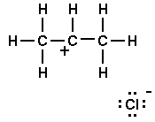
Chemical equation: before and after Mechanism: how you get there
Step 1.
Step 2.

Slide 5
The most important thing: It’s the same atoms Reactants Products
CH₃CHCH₂ + HCl
CH₃CHClCH₃

Slide 6
The Law of Conservation of Matter It’s the same atoms Stoichiometric Coefficients:
CH₃CHCH₂ + HCl
CH₃CHClCH₃
C₂H₂ + 2 H₂
CH₃CH₃

Slide 7
Balancing Chemical Equations Goal: same number of atoms of each element on both sides Rule: you can change stoichiometry coefficients, not the molecular formulas
CH₄ + O₂
CO₂ + H₂O

Slide 8
A bit harder
Another Example:
Mg + O₂ MgO
C₄H₁₀ + O₂
CO₂ + H₂O

Slide 9
Big misconception: stoichiometric coefficients are NOT how much reacts/forms
CH₄ + 2 O₂
CO₂ + 2 H₂O

Slide 10
Balancing Equation = mol to mol conversion factor
CH₄ + 2 O₂
CO₂ + 2 H₂O

Slide 11
Amounts tables: If 0.46 mol O₂ react, how much CO₂ and H₂O are formed, and how much CH₄ reacts?
CH₄ + 2 O₂
CO₂ + 2 H₂O
change:

Slide 12
Real experiments use mass, not moles. gram gram conversions Path: grams A moles A moles B grams B

Slide 13
25.0 g of O₂ react. What mass of CH₄ reacts and what masses
of CO₂ and H₂O are formed?
CH₄ + 2 O₂
CO₂ + 2 H₂O

Slide 14
25.0 g of O₂ react. What mass of CH₄ reacts and what masses
of CO₂ and H₂O are formed?
CH₄ + 2 O₂
CO₂ + 2 H₂O

