Slide 1
Sections 5.4 – 5.6 Energy and Chemical Reactions

Slide 2
In these Sections: a. Enthalpy change for reactions b. Thermochemical equations c. Determining enthalpy change: calorimetry d. Hess’s Law e. Enthalpy of Formation

Slide 3
Review: Lots of different types of energy. We use Enthalpy because it’s easy to measure: Heat exchanged under constant pressure.

Slide 4
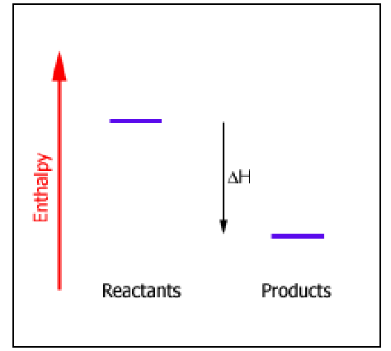
Review: Energy/Enthalpy Diagrams

Slide 5
Some Examples of Enthalpy Change for Reactions: Thermochemical Equations:
C₁₂H₂₂O₁₁(s) + 12 O₂(g) → 12 CO₂(g) + 11 H₂O(l) ΔH = -5645 kJ
C₁₂H₂₂O₁₁(s) + 12 O₂(g) → 12 CO₂(g) + 11 H₂O(l) + 5645 kJ
2 C(s) + 2 H₂(g) → C₂H₄(g) ΔH = +52 kJ
2 C(s) + 2 H₂(g) + 52 kJ → C₂H₄(g)

Slide 6
Calculating Heat Production
C₃H₈(g) + 5 O₂(g) → 3 CO₂(g) + 4 H₂O(l) ΔH = -2220 kJ
If we burn 0.25 mol propane, what quantity of heat is produced?
If 1.60 mol of CO₂ are produced, what quantity of heat is produced?

Slide 7
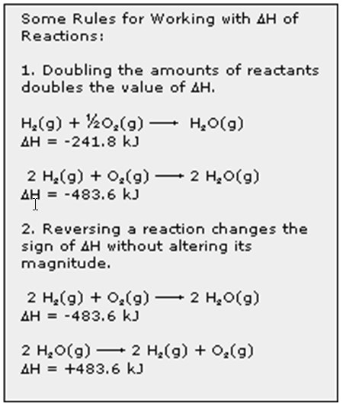

Slide 8
SO₂ + ½ O₂ → SO₃ ΔH = -98.9 kJ 2 SO₃ → 2 SO₂ + O₂ ΔH = ?

Slide 9
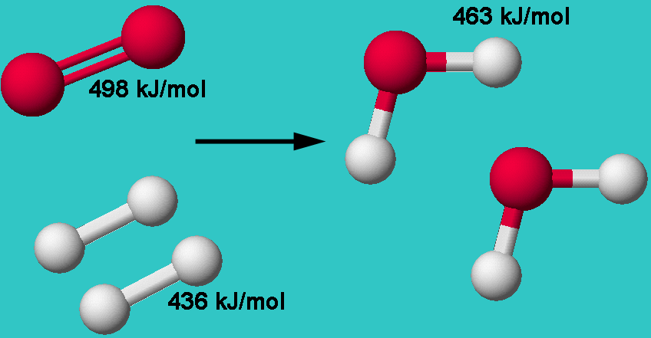
Where does Enthalpy Change come from: Bond Energies
ΔH = energy needed to break bonds – energy released forming bonds Example: formation of water:
ΔH = [498 + (2 x 436)] – [4 x 436] kJ = -482 kJ

Slide 10
Bond energies can predict ΔH for gas phase reactions only.
ΔH for reactions not in the gas phase is more complicated,
due to solvent and solid interactions.
So, we measure ΔH experimentally.
Calorimetry
Run reaction in a way that the heat exchanged
can be measured. Use a “calorimeter.”

Slide 11
Calorimetry: General Idea
Perform reaction in a way that measures heat gained
or lost by the system.
Two types:
Constant pressure: “coffee cup calorimetry” measures ΔH
Constant volume: “bomb calorimetry” measures ΔE

Slide 12
Constant Pressure Calorimetry:
When 4.50 g NH₄Cl is dissolved in 53.00 g of water in a styrofoam
cup, the temperature of the solution decreases from
20.40 °C to 15.20 °C. Assume that the specific heat of the solution is
4.18 J/g • °C. Calculate ΔH for the reaction.

Slide 13
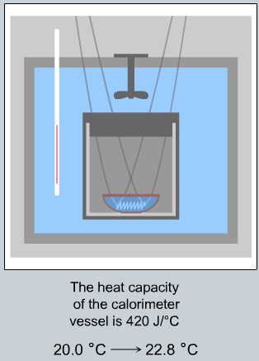
Bomb Calorimetry Experiment
N₂H₄ + 3 O₂ → 2 NO₂ + 2 H₂O
Energy released = E absorbed by water +
E absorbed by calorimeter
E_{water} =
E_{calorimeter} =
Total E =
ΔE = energy/moles =
0.500 g N₂H₄
600 g water
420 J/ºC

Slide 14
Hess’s Law
General Rule:
If a series of reactions can be added to give a net reaction, the enthalpy change for the net reaction equals the sum of enthalpy changes for the constituent reactions.

Slide 15
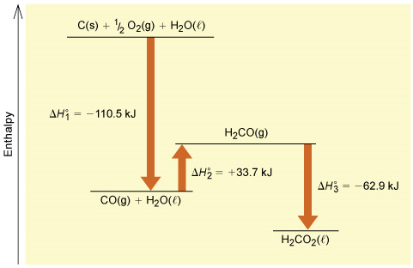
Hess’s Law
Enthalpy is a
State Function.

Slide 16
Using Hess’s Law
Given the following two reactions,
Reaction 1: SnCl₂(s) + Cl₂(g) → SnCl₄(ℓ) ΔH(1) = –195 kJ
Reaction 2: TiCl₂(s) + Cl₂(g) → TiCl₄(ℓ) ΔH(2) = –273 kJ
calculate the enthalpy change for the following chlorine
exchange reaction.
Reaction 3: SnCl₂(s) + TiCl₄(ℓ) → SnCl₄(ℓ) + TiCl₂(s) ΔH_{net} = ?

Slide 17
Enthalpy (heat) of Formation: ΔH_{f}º
Enthalpy change for a reaction to form 1 mol of a compound
from its elements in their standard states.
N₂(g) + 5/2 O₂(g) → N₂O₅(g) ΔH° = ΔH_{f}° = –43.1 kJ/mol
2 NO(g) + O₂(g) → N₂O₄(g) ΔH° = –171.3 kJ

Slide 18
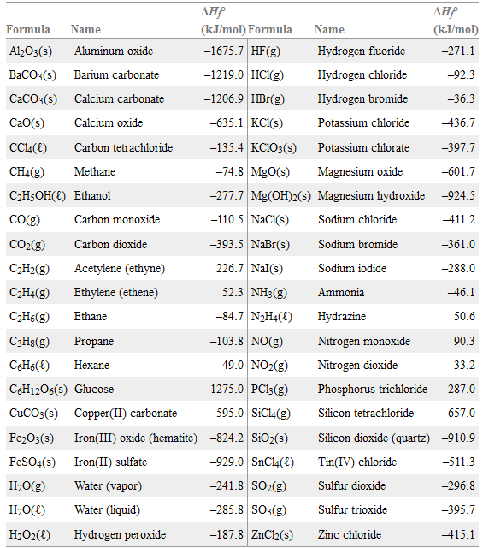

Slide 19
Potassium chlorate, KClO₃, has ΔH_{f}º = -397.7 kJ/mol. Write the thermochemical equation for the formation reaction.

Slide 20
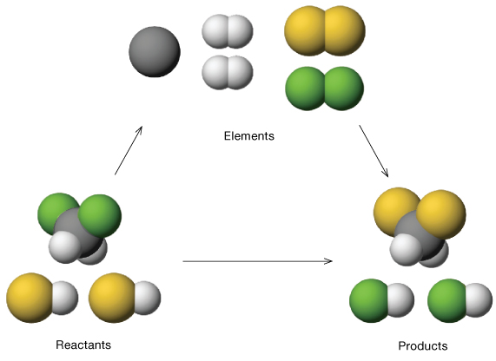
Using Heat of Formation: The general idea
CH₂F₂ + 2 HCl → CH₂Cl₂ + 2 HF
ΔH°_{rxn} = ∑ΔH_{f}°(products) – ∑ΔH_{f}°(reactants)

Slide 21
