Slide 1
Which is the stronger acid?
HNO₂
HNO₃

Slide 2
Which is the stronger base?
SO₃²⁻
SO₄²⁻

Slide 3
Acid-Base Reactions
strong acid + strong base
strong acid + weak base
weak acid + strong base
weak acid + weak base

Slide 4
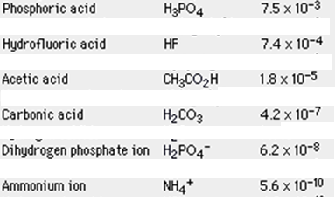
pK_{a} and Acid Strength
pK_{a} = -log K_{a}
K_{a} pK_{a}
Trends:

Slide 5
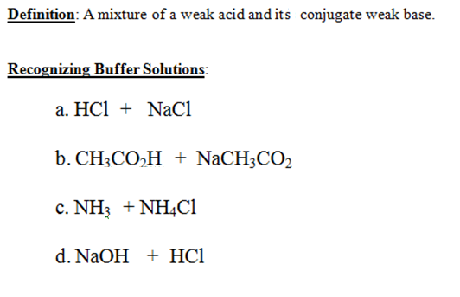
Buffers

Slide 6
How Buffers Minimize pH Changes
NH₄⁺/NH₃ buffer
If an acid is added:
If a base is added:

Slide 7
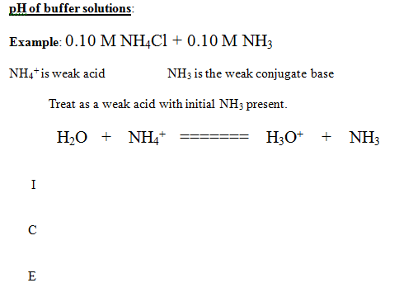
What controls pH of a buffer?

Slide 8
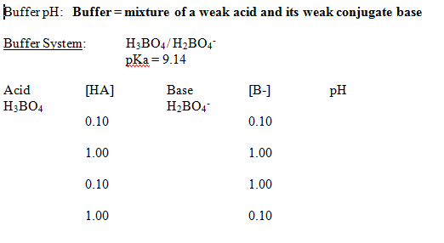

Slide 9
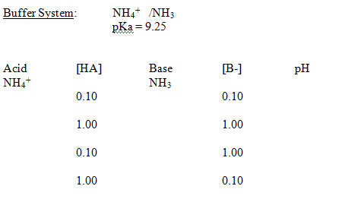

Slide 10
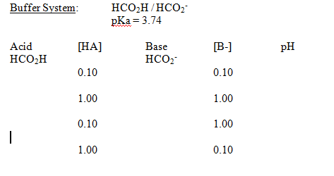
What controls pH of a buffer?

Slide 11
Buffer pH
Two cases:
When the acid and base of interest are in bulk and control the pH
When other acids and bases are in bulk and the acid/base state of the
species of interest is controlled by the pH (ex: indicators)

Slide 12
1a. Buffer pH
What is the pH of a solution with [H₂CO₃] = 0.25 M and [HCO₃⁻] = 0.25 M?

Slide 13
1b. Buffer pH
What is the pH of a solution with [H₂CO₃] = 0.25 M and [HCO₃⁻] = 0.11 M?

Slide 14
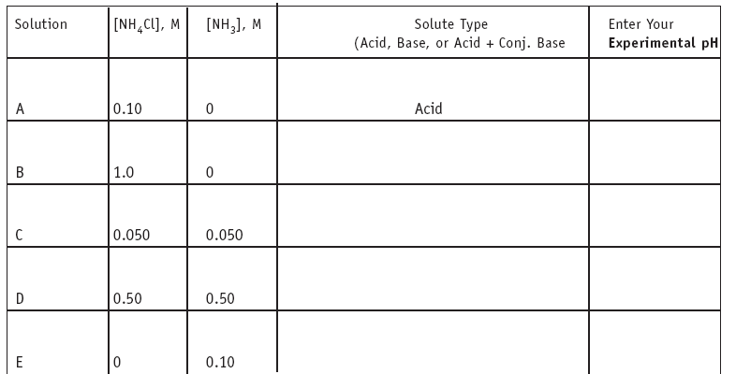

Slide 15
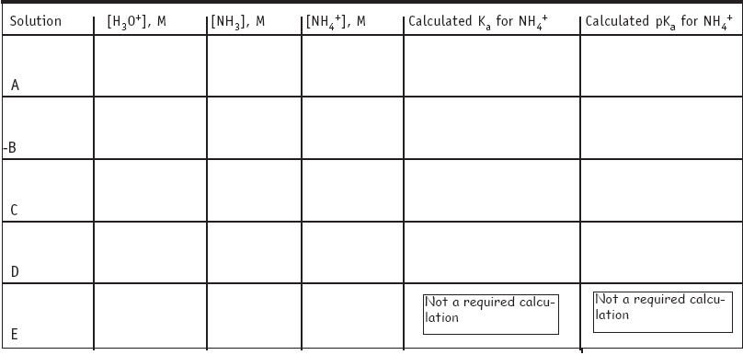

Slide 16
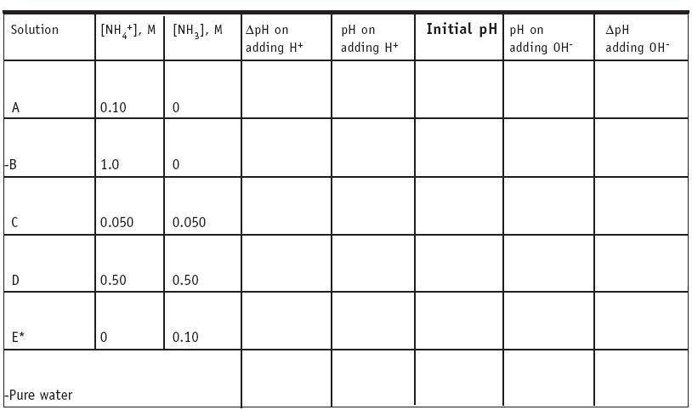

Slide 17
pH Titration Curves
Strong Acid – Strong Base
Strong Base – Strong Acid

Slide 18
pH Titration Curves
Weak Acid – Strong Base: Finding Ka

Slide 19
pH Titration Curves
Strong Acid – Weak Base: Finding Ka

Slide 20
Polyprotic pH Titration Curves

Slide 22
When pH Controls Acid-Base State: Amino Acids
Situations where an acid-base species is a minor component in a solution where other things control the pH. Henderson-Hasselbalch and Alpha plots.

Slide 23

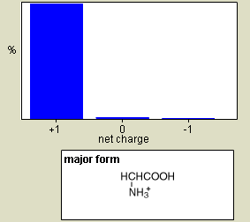
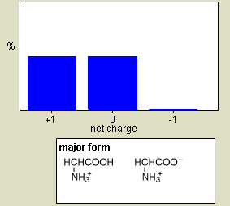
When pH Controls Acid-Base State: Amino Acids
Situations where an acid-base species is a minor component in a solution where other things control the pH.
pH = 0.00 pH = 2.34

Slide 24
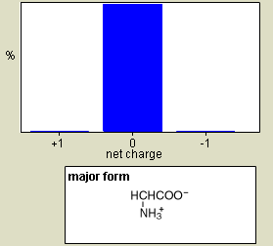
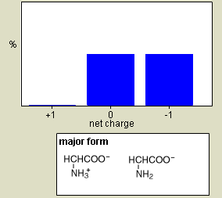
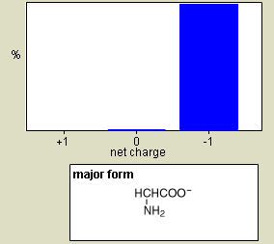
pH = 0.00 pH = 2.34 pH = 7.00
pH = 9.60 pH = 13.00

Slide 25
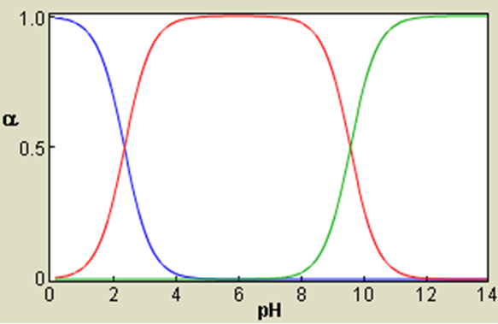
Alpha Plots

