Slide 1
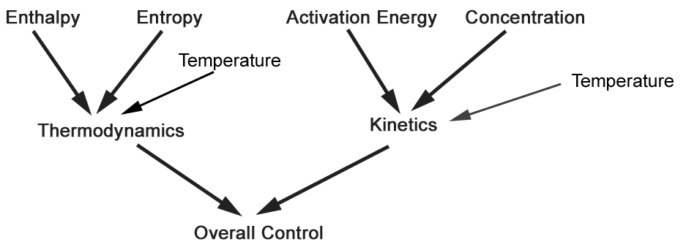
Control of Chemical Reactions

Slide 2
Thermodynamic Control of Reactions
Enthalpy
Bond Energies
  Forming stronger
  bonds favors
  reactions.
  Molecules with
  strong bonds are
  more stable.
Entropy
Randomness
  Reactions that
  increase random-
  ness are favored.
  Forming gases
  favors reactions.

Slide 3
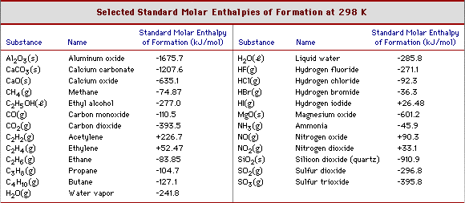
Remember Enthalpy?
Enthalpy of formation for elements in their natural states = 0.

Slide 4

H₂O(g) Gaseous water -242

Slide 5
The Laws of Thermodynamics
1st Law: Energy is Conserved
2nd Law: Any “spontaneous” process leads to an increase in entropy of the universe.

Slide 6
Entropy
A measure of randomness. Units of J/K.

Slide 7
Trends in entropy

Slide 8
Entropy Change
First define:
    System Surroundings

Slide 9
Entropy Change
    For the System
If the system gets more random,
ΔS is positive. (Favors the reaction)
If the system gets more ordered,
ΔS is negative. (Disfavors the reaction)

Slide 10
Calculating ΔS
Chemical Reactions
C₃H₈(g) + 5 O₂(g) → 3 CO₂(g) + 4 H₂O(l)

Slide 11
Calculating ΔS
Special Case: Phase Changes
Heat of fusion (melting) of ice is 6000 J/mol. What is the entropy
change for melting ice at 0 ºC?

Slide 12
Calculate entropy change for formation of rain:
H₂O(g) → H₂O(l)

Slide 13
What types of reactions lead to increased entropy?

Slide 14
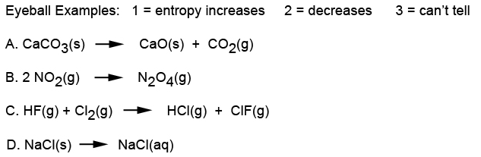

Slide 15
Entropy vs. Enthalpy Control of Reactions
Second law of thermodynamics:
ΔS_{universe} = ΔS_{system} + ΔS_{surroundings}

Slide 16
Question: How can rain form?
H₂O(g) → H₂O(l)

Slide 17
Calculate ΔS_{universe} for H₂O(l) → H₂O(g) at:
90 ºC
110 ºC

Slide 18
Putting ΔS, ΔH and Temperature Together
Gibb’s Free Energy: ΔG = ΔH - TΔS
When ΔG is negative, reaction is favored.
When ΔG is positive, reaction is disfavored.

Slide 19
2 Fe₂O₃(s) + 3 C(s) → 4 Fe(s) + 3 CO₂(g)
ΔH = +468 kJ
ΔS = +561 J/K ΔG = ΔH - TΔS
What is ΔG at 25 ºC and at 1000 ºC?

Slide 20
Enthalpy vs. Entropy Control of Reactions
ΔG = ΔH - TΔS
At high temperatures:
At low temperatures:

Slide 21
Temperature Domains and Reaction Favorability
ΔH
+ -
+
ΔS
-

Slide 22
2 Fe₂O₃(s) + 3 C(s) → 4 Fe(s) + 3 CO₂(g)
ΔH = +468 kJ
ΔS = +561 J/K
In what temperature range
will this reaction be favored?
High or low?
What temperature?

Slide 23
Free Energy vs. Temperature Curves

Slide 24
Catalytic Converters
Nitrogen oxides cause smog.
N₂(g) + O₂(g) → 2 NO(g) ΔH = +180 kJ
ΔS = +25 J/K

Slide 25

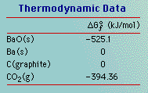
Free Energy of Formation: Only used at 25 ºC
2 BaO(s) + C(s) → 2 Ba(s) + CO₂(g)

