Slide 2
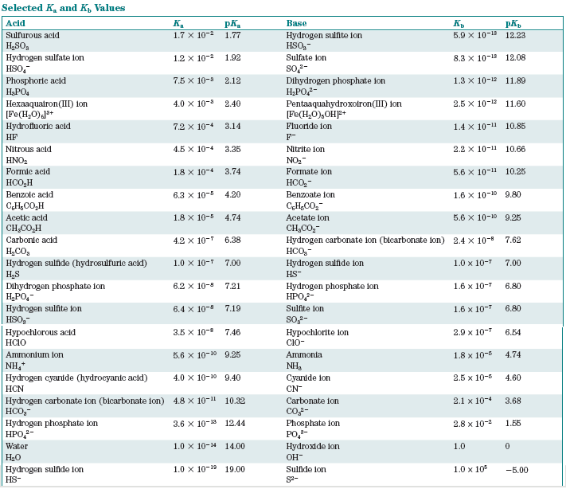

Slide 3
Which is the stronger acid?
HNO₂
HNO₃

Slide 4
Which is the stronger base?
NO₂⁻
NO₃⁻

Slide 6
Acid-Base Reactions
strong acid + strong base
strong acid + weak base
weak acid + strong base
weak acid + weak base

Slide 7
Extent of Weak Acid-Weak Base Reactions

Slide 8
Extent of Weak Acid-Weak Base Reactions

Slide 10
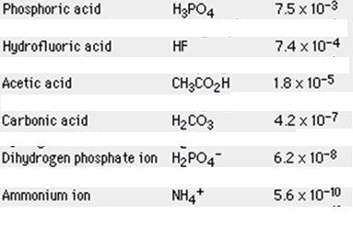
pK_{a} and Acid Strength
pK_{a} = -log K_{a}
K_{a} pK_{a}
Trends:

Slide 11
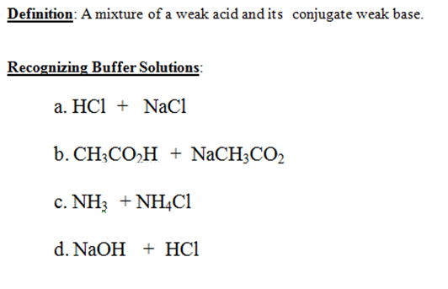
Buffers

Slide 12
How Buffers Minimize pH Changes
NH₄⁺/NH₃ buffer
If an acid is added:
If a base is added:

Slide 14
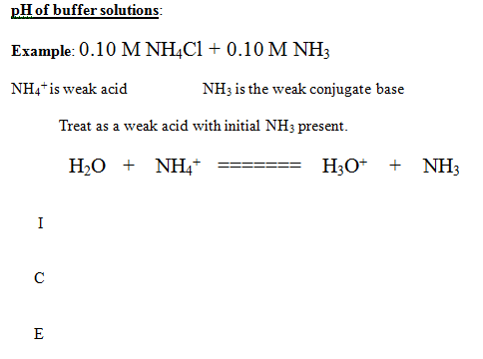
What controls pH of a buffer?

Slide 15
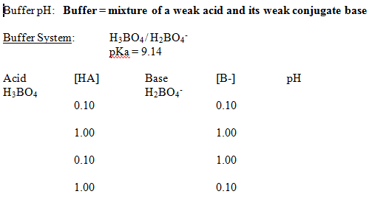

Slide 16
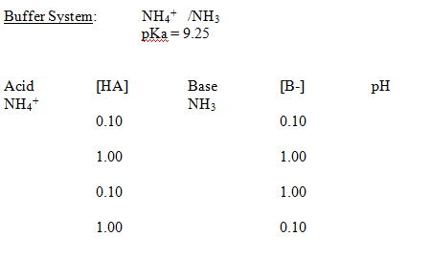

Slide 17
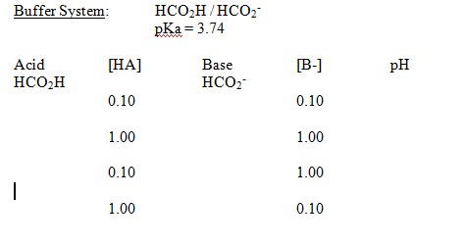
What controls pH of a buffer?

Slide 19
Buffer pH
Two cases:
When the acid and base of interest are in bulk and control the pH
When other acids and bases are in bulk and the acid/base state of the
species of interest is controlled by the pH (ex: indicators)

Slide 20
1a. Buffer pH
What is the pH of a solution with [H₂CO₃] = 0.25 M and [HCO₃⁻] = 0.25 M?

Slide 21
1b. Buffer pH
What is the pH of a solution with [H₂CO₃] = 0.25 M and [HCO₃⁻] = 0.11 M?

Slide 22
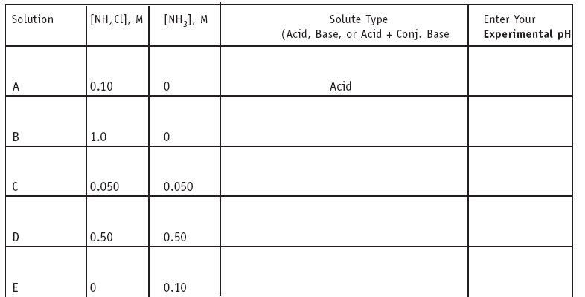

Slide 23
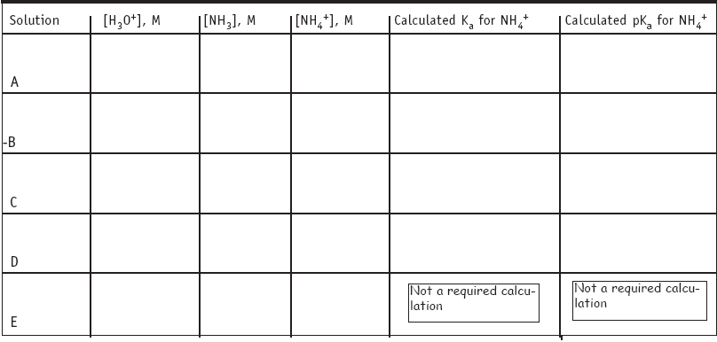

Slide 24
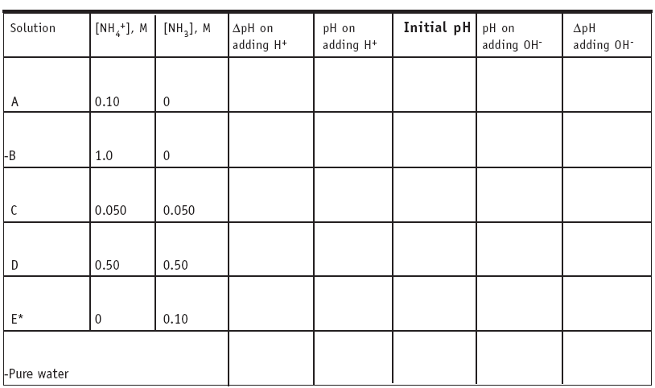

Slide 25
Review
Buffer components
pH of a buffer solution
-- Question: if dilute a buffer, does the pH change?
Preparing a buffer by “direct addition”
Now: Preparing a buffer by an acid-base reaction

Slide 26
Preparing Buffer Solutions
Make a buffer of pH = 3.6

Slide 28
Preparing Buffer Solutions by Reaction
Make a buffer of pH = 5.00 using sodium acetate and 1.0 M HCl

Slide 29
Preparing Buffer Solutions by Reaction
Make a buffer of pH = 5.00 using sodium acetate and 1.0 M HCl

Slide 30
Alpha Plots

Slide 31
Alpha Plots

Slide 32
pH Titration Curves
Strong Acid – Strong Base
Strong Base – Strong Acid

Slide 33
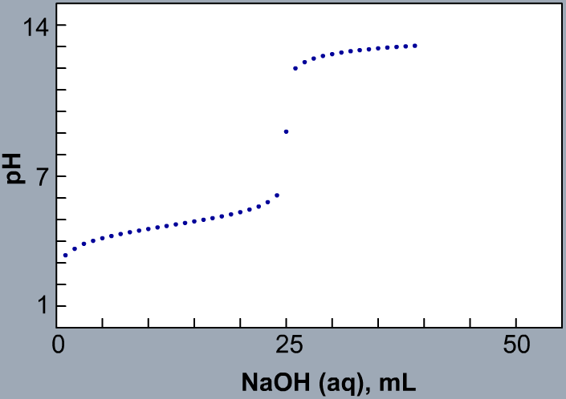
pH Titration Curves
Weak Acid – Strong Base: Finding K_{a}

Slide 35
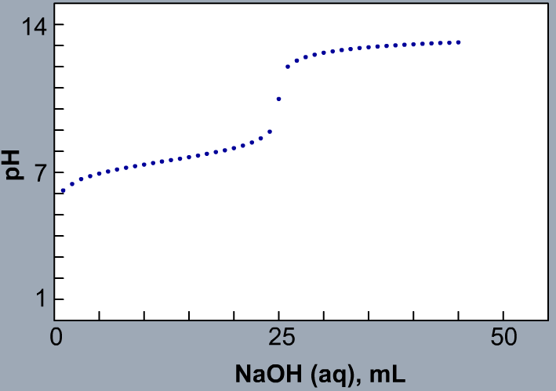
pH Titration Curves
Weak Acid – Strong Base: Finding K_{a}

Slide 36
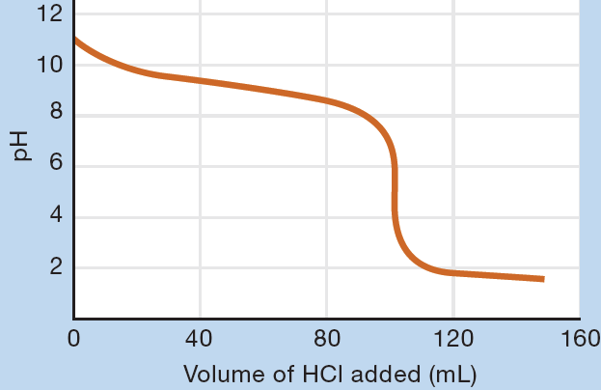
pH Titration Curves
Strong Acid – Weak Base: Finding K_{b}

Slide 38
Polyprotic Acids
K_{a1} = 4.2 x 10⁻⁷
K_{a2} = 4.8 x 10⁻¹¹
H₂CO₃ HCO₃⁻ CO₃²⁻
What is the pH of a 0.10 M solution of H₂CO₃?
What is [CO₃²⁻] in this solution?

Slide 39
Polyprotic Acids
K_{a1} = 4.2 x 10⁻⁷
K_{a2} = 4.8 x 10⁻¹¹
H₂CO₃ HCO₃⁻ CO₃²⁻

Slide 40
Polyprotic pH Titration Curves

Slide 42
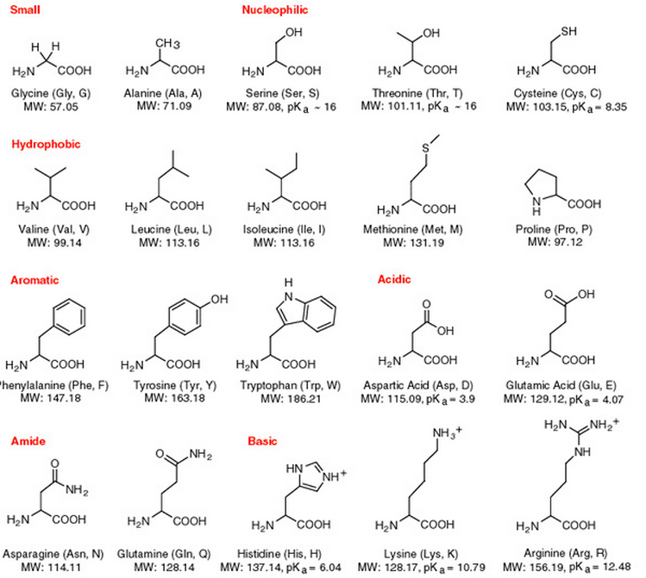
Amino
Acids

Slide 43
When pH Controls Acid-Base State: Amino Acids Situations where an acid-base species is a minor component in a solution where other things control the pH. Henderson-Hasselbalch and Alpha plots.

Slide 45
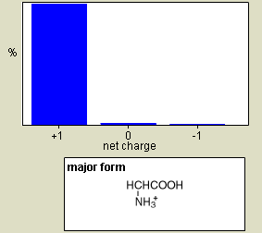
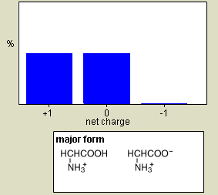
When pH Controls Acid-Base State: Amino Acids Situations where an acid-base species is a minor component in a solution where other things control the pH.
pH = 0.00 pH = 2.34

Slide 46
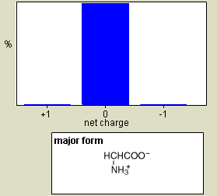
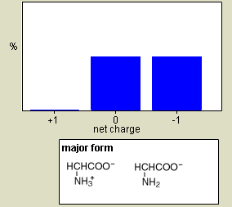
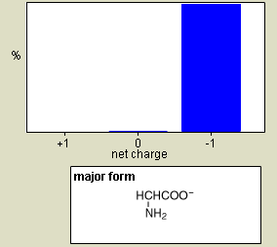
pH = 0.00 pH = 2.34 pH = 7.00
pH = 9.60 pH = 13.00

Slide 47
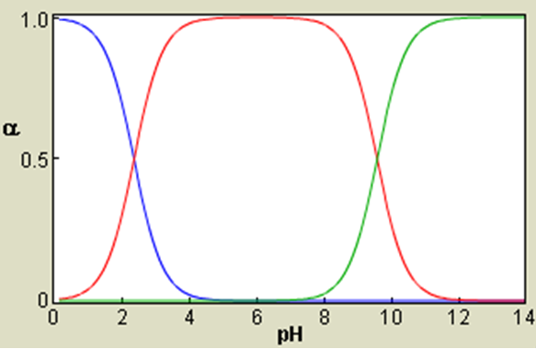
Alpha Plots

