Slide 1
Section 12.3 Ionic Solids
Bill Vining
SUNY Oneonta

Slide 2
Types of Solids and Metallic Solids
In these sections…
Ionic solid unit cells and formulas
Holes in unit cells of anions
Cesium chloride, sodium chloride and zinc blend
What controls which shape a solid takes?
Calculations related to unit cell dimensions

Slide 3
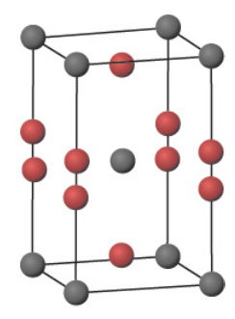
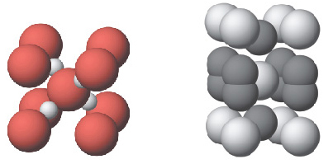
Ionic Solids and Formulas
cesium oxide (Cs on cornder, O on edges)

Slide 4
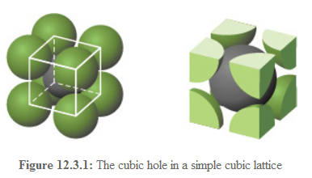
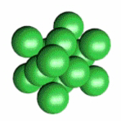
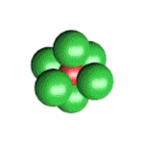
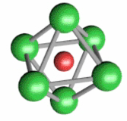
Ionic Compound Anion Unit Cells with Cations Occupying Holes

Slide 5
Cubic Holes in Simple
Cubic Unit Cells

Slide 6
Octahedral and Tetrahedral Holes
in FCC Unit Cells

Slide 7
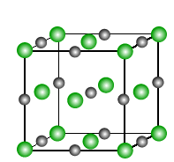
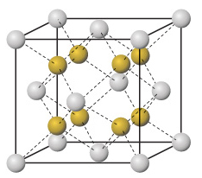
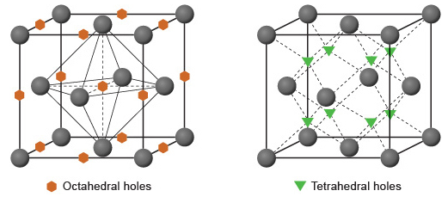
Octahedral and Tetrahedral Holes
in FCC Unit Cells

Slide 8
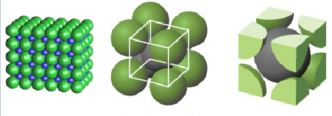
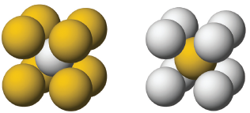
Three Important Ionic Unit Cells: cesium chloride

Slide 9
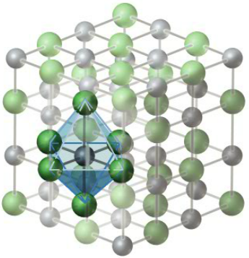
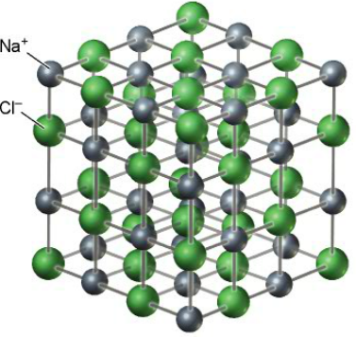
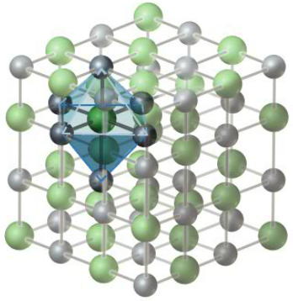
Three Important Ionic Unit Cells: sodium chloride

Slide 10
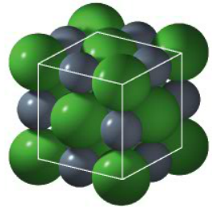
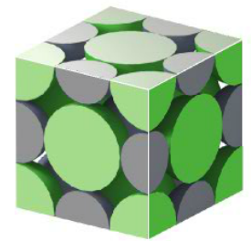
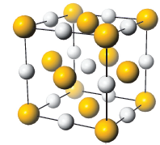
Three Important Ionic Unit Cells: sodium chloride

Slide 11
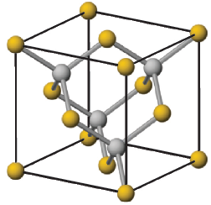
Three Important Ionic Unit Cells: zinc blend

Slide 12
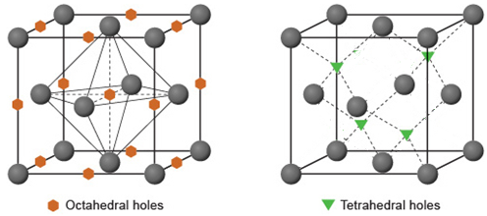
Review of Anion Lattices and Holes in
NaCl and zinc blend Unit Cells

Slide 13
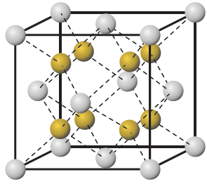
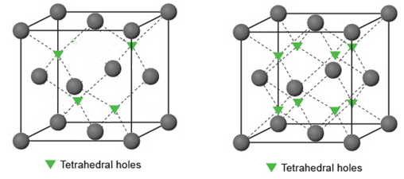
Comparison of ZnS and SrCl₂ Unit Cells

Slide 14
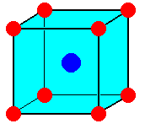
Why do different solids of the same formula type adopt different unit cell structures?
Stable arrangement has the greatest coordination number without
leaving gaps between the cation and the surrounding ions
As r₋/r₊ increases,
coordination # decreases

Slide 15
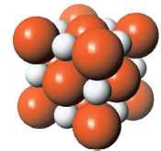
Determine an ionic radius from unit cell dimensions
Magnesium oxide crystallizes with the sodium chloride structure. If the edge length
of the unit cell is determined to be 420 pm and the O²⁻ ion is assigned a radius of
126 pm, what is the radius of the Mg²⁺ ion?

Slide 16
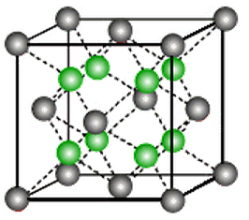
CdF₂ crystallizes with the CaF₂ structure which is represented in the following
model, with the anions in green. If the edge length of the unit cell is 540 pm, what is the density of crystalline
CdF₂ in g/cm³?

