Slide 1
Section 14.6 Reaction Mechanisms and Catalysis
Bill Vining
SUNY Oneonta

Slide 2
Reaction Mechanisms and Catalysis
In this section…
Elementary steps and reaction mechanisms
Reaction mechanisms and rate laws
More complex mechanisms
Catalysis

Slide 3
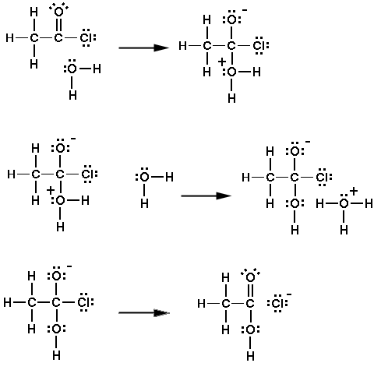
A reaction mechanism is a series of elementary steps

Slide 4
Reaction Mechanisms: The pathway by which a reaction
proceeds from reactants to products.
Each discrete chemical event is an “elementary step.”
The reaction is a series of elementary steps.
Steps are usually unimolecular or bimolecular.
The overall reaction is the sum of the steps.
Each elementary step goes at its own rate.
The rate of the overall reaction is the rate of the slowest (rate determining) step.

Slide 5
Overall Reactions, Intermediates and Catalysts
Overall reaction: sum of all the elementary steps
Intermediate: Formed in one step, and then used in a later step
Catalyst: Used in one step, and then reproduced in a later step
Overall Reactions:

Slide 6
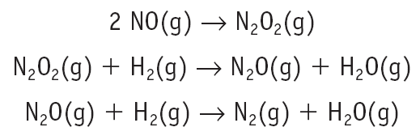
Intermediates and Catalysts
Overall Reaction:
Intermediates:
Catalysts:

Slide 7
Intermediates and Catalysts
Step 1. H₂O₂(aq) + I⁻(aq) IO⁻(aq) + H₂O(l)
Step 2. H₂O₂(aq) + IO⁻(aq) I⁻(aq) + H₂O(l) + O₂(g)
Overall Reaction:
Intermediates:
Catalysts:

Slide 8
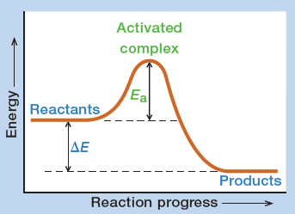
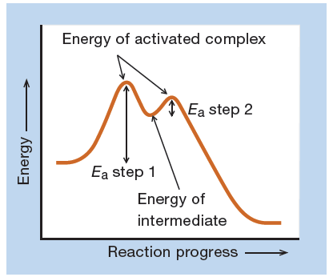
Intermediates vs. Transition States/Activated Complex
Step 1. H₂O₂(aq) + I⁻(aq) IO⁻(aq) + H₂O(l)
Step 2. H₂O₂(aq) + IO⁻(aq) I⁻(aq) + H₂O(l) + O₂(g)

Slide 9
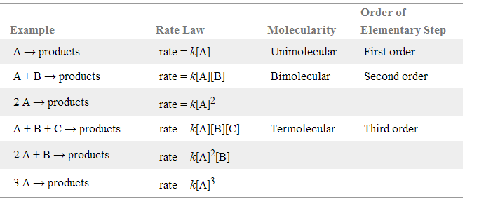
Mechanisms and Rate Laws: Rate Laws for Elementary Steps
Unlike an overall reaction, the rate law for a single elementary step
can be discerned from the reaction equation:
Overall rate = Rate of the slowest step (rate determining step: RDS)

Slide 10
Mechanisms and Rate Laws: Predicting Rate Law from Mechanisms
Overall rate = Rate of the slowest step (rate determining step: RDS)
Step 1. H₂O₂(aq) + I⁻(aq) IO⁻(aq) + H₂O(l) (slow)
Step 2. H₂O₂(aq) + IO⁻(aq) I⁻(aq) + H₂O(l) + O₂(g) (fast)

Slide 11
Mechanisms and Rate Laws: Testing Mechanisms
Predict the rate law for a mechanism and see if it matches the experimental rate law.
If the two disagree, the mechanism is incorrect.
If the two agree, the mechanism might be correct, but you never really know for sure

Slide 12
Mechanisms and Rate Laws: Testing Mechanisms Example
Overall reaction and experimental rate law:
NO₂(g) + CO(g) → NO(g) + CO₂(g) Rate = k[NO₂]²
Two proposed mechanisms:

Slide 13
Catalysts and Rate Laws
Step 1. Cl(g) + O₃(g) ClO(g) + O₂(g)
Step 2. ClO(g) + O₃(g) Cl(g) + O₂(g)
Overall Reaction:
Rate Law:

Slide 14
Rate Laws for Complex Mechanisms:
Experimental rate law can’t use intermediates
Key: In step 1, the forward and reverse rates are equal (they are in equilibrium)

Slide 15
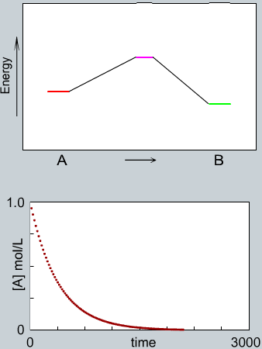
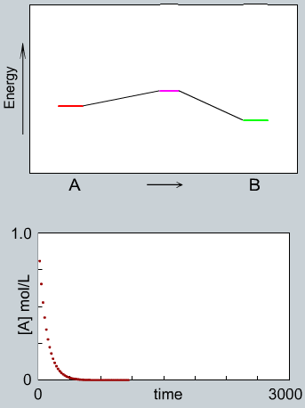
Catalysis for Increasing Reaction Rate
Alternative mechanism is provided with a lower activation energy.
uncatalyzed reactions
catalyzed reactions

Slide 16
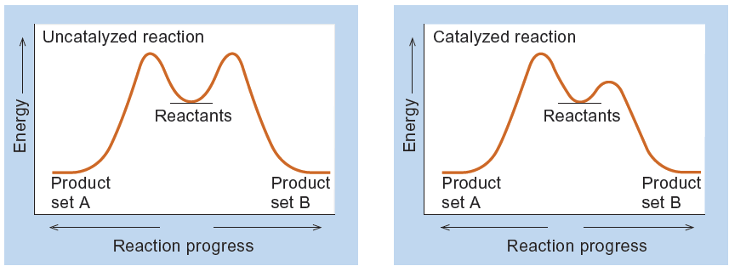
Catalysis for Increasing Selectivity
Favor one pathway (and therefore one product) over another:

Slide 17
Homogeneous vs. Heterogeneous Catalysis
Homogeneous: catalyst and reactants in solution
Heterogeneous: reaction occurs on a catalytic surface

