Slide 1
Section 15.4 Disturbing a Chemical Equilibrium Le Chatelier’s Principle
Bill Vining
SUNY Oneonta

Slide 2
Equilibrium and the Equilibrium Constant
In this section…
Le Chatelier’s Principle
Adding or removing a reactant or product
Changing the volume of the system
Changing the temperature

Slide 3
Le Chatelier’s Principle
General Idea:
If a chemical system at equilibrium is disturbed so that it is no longer at
equilibrium, the system will respond by reacting in either the forward or
reverse direction so as to counteract the disturbance, resulting in a new
equilibrium composition.

Slide 4
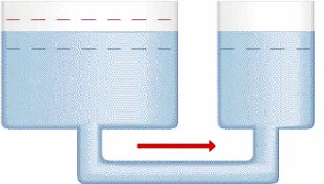
Le Chatelier’s Principle: Water Tank Analogy
perturbation
response of
the system
system at
equilibrium
system NOT at
equilibrium
system at NEW
equilibrium

Slide 5
Addition or Removal of a Reactant or Product: Concept
NOTE: K does not change when volume changes.

Slide 6
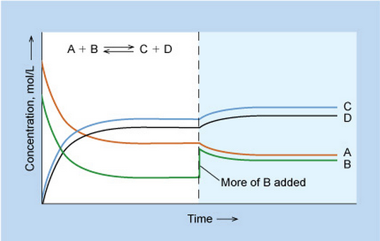
Addition or Removal of a Reactant or Product: Graphical

Slide 7
Addition or Removal of a Reactant or Product: Example
Some FeSCN²⁺ is allowed to dissociate into Fe³⁺ and SCN– at 25 °C. At equilibrium,
[FeSCN²⁺] = 0.0768 M
[Fe³⁺] = [SCN–] = 0.0232 M.
Additional Fe³⁺ is added so that [Fe³⁺]_{new} = 0.0300 M and the system is allowed to once again reach equilibrium.
What happens?
Fe³⁺(aq) + SCN–(aq) FeSCN²⁺(aq) K = 142 at 25 °C
a. In which direction will the system shift to re-attain equilibrium?

Slide 8
Addition or Removal of a Reactant or Product: Example
Initial concentrations: [FeSCN²⁺] = 0.0768 M, [Fe³⁺] = [SCN–] = 0.0232 M.
Additional Fe³⁺ is added so that [Fe³⁺]_{new} = 0.0300 M
b. What will the concentrations be when equilibrium is reestablished?
Fe³⁺(aq) + SCN–(aq) FeSCN²⁺(aq) K = 142 at 25 °C
Pathway:
Write equilibrium expression
Construct ICE table
Express equilibrium concentrations in terms of initial concentrations and “x” (the amount reacting)
Insert into equilibrium expression and solve for the numerical value of x
Use x and initial concentrations to determine equilibrium concentrations

Slide 9
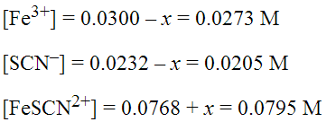
Initial concentrations: [FeSCN²⁺] = 0.0768 M, [Fe³⁺] = [SCN–] = 0.0232 M.
Additional Fe³⁺ is added so that [Fe³⁺]_{new} = 0.0300 M
b. What will the concentrations be when equilibrium is reestablished?
Fe³⁺(aq) + SCN–(aq) FeSCN²⁺(aq) K = 142 at 25 °C
initial 0.0300 0.0232 0.0768
change
equilibrium

Slide 10
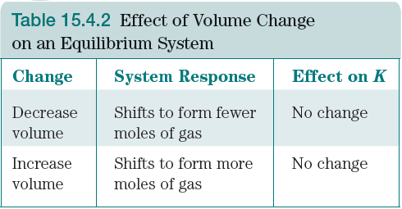
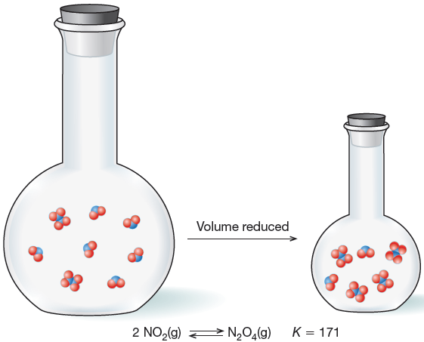
Changing the Volume: Concept
NOTE: K does not change when volume changes.
[N₂O₂] increases when volume is reduced
because it has fewer moles.

Slide 11
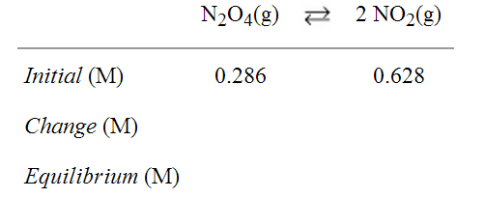
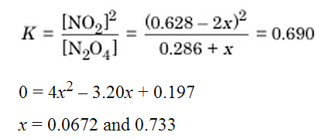
Changing the Volume: Example
NO₂ and N₂O₄ are in equilibrium with
in a 2-L container with concentrations:
[NO₂] = 0.314
[N₂O₄] = 0.413
What will the concentrations be if the
sample is transferred to a 1-L flask and
equilibrium is reestablished?
System shifts:

Slide 12
Changing the Temperature: Concept
When Temperature Increases:
When Temperature Decreases:

Slide 13
Changing the Temperature: Qualitative Example
What will happen if Temperature Increases?

Slide 14
Changing the Temperature: Calculating how K Changes with Temperature
van’t Hoff Equation (not related to van’t Hoff factor):
Sulfur dioxide reacts with oxygen to form sulfur trioxide. The equilibrium constant, K_{p}, for
this reaction is 0.365 at 1150 K.
a. What will happen to O₂ concentration when the temperature of an equilibrium system is increased?
b. Estimate the value of the equilibrium constant at 1260 K.
ΔHº = –198 kJ/mol

