Slide 2
Electrochemisty Electron Transfer Reaction
Section 20.1

Slide 3
Oxidation-Reduction Reactions
Oxidation: loss of electrons, increase in oxidation state
Reduction: gain of electrons, decrease in oxidation state
Zn(s) + Cu²⁺(aq) → Zn²⁺(aq) + Cu(s)
Oxidizing Agent: species reduced
Reducing Agent: species oxidized

Slide 4
Oxidation-Reduction Reactions
Half-reactions and Balancing Redox Equations
Zn(s) + Ag⁺(aq) → Zn²⁺(aq) + Ag(s)
oxidation half-reaction:
reduction half-reaction:
overall equation: balance half-reactions to eliminate all electrons:

Slide 5
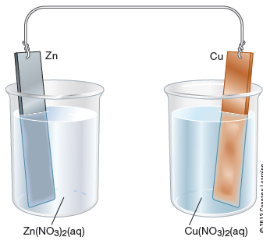
Electrochemical Cells: Performing redox reactions with separated reactants
Zn(s) + Cu²⁺(aq) → Zn²⁺(aq) + Cu(s)

Slide 6
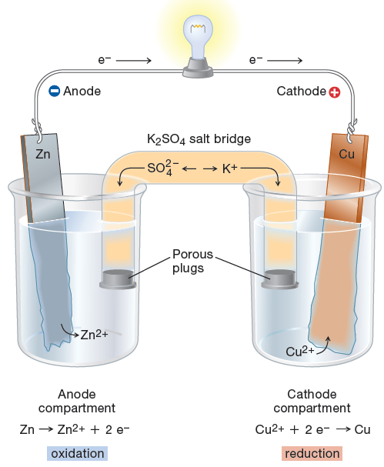
Electrochemical Cells:
Zn(s) + Cu²⁺(aq) → Zn²⁺(aq) + Cu(s)
oxidation occurs at “anode”
reduction occurs at “cathode”

Slide 7
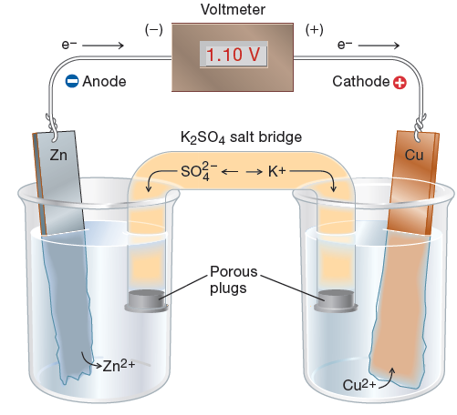
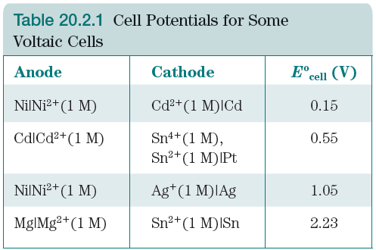
Section 20.2: Cell Potentials

Slide 9
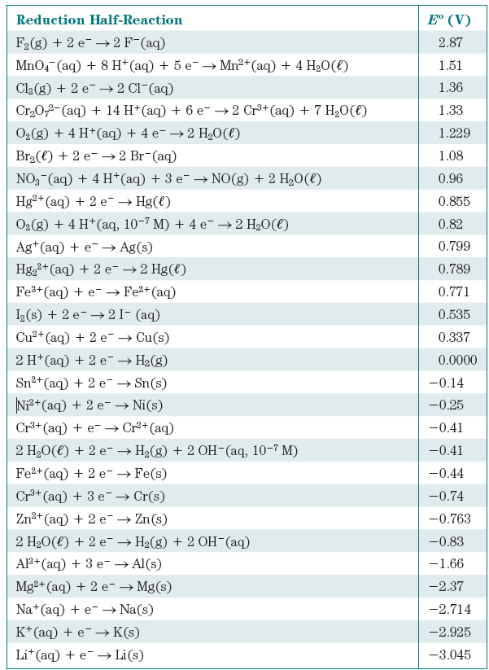
Determining Cell Potentials
Reduction Potentials
(a measure of ease of reduction)

Slide 10
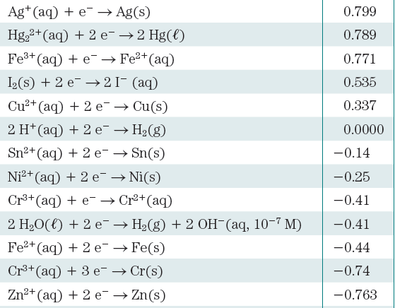
Cell Potentials:
Strength of oxidizing and
reducing agents

Slide 11
Cell Potentials: using reduction potentials to determine cell potentials
Eº_{cell} = Eº_{red}(cathode) – Eº_{red}(anode)
Determine the cell potential for a
cell using the reaction:
Cu²⁺(aq) + Fe(s) → Fe²⁺(aq) + Cu(s)
oxidation occurs at anode
reduction occurs at cathode

Slide 12
Cell Potentials: using reduction potentials to determine cell potentials
Eº_{cell} = Eº_{red}(cathode) – Eº_{red}(anode)
Determine the cell potential for a
cell using the reaction:
3 Ag⁺(aq) + Cr(s) → Cr³⁺(aq) + 3 Ag(s)
oxidation occurs at anode
reduction occurs at cathode

Slide 13
Positive Eº_{cell} means the reaction is thermodynamically product-favored
Eº_{cell} = Eº_{red}(cathode) – Eº_{red}(anode)
Which reaction is favored:
Cu²⁺(aq) + Fe(s) → Fe²⁺(aq) + Cu(s)
or
Fe²⁺(aq) + Cu(s) → Cu²⁺(aq) + Fe(s)
oxidation occurs at anode
reduction occurs at cathode

Slide 14
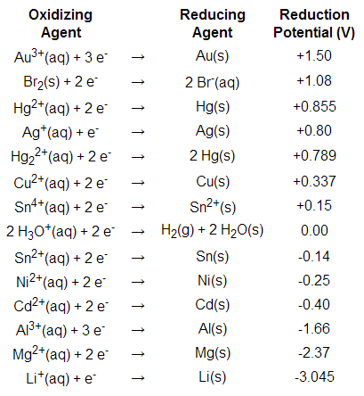
Positive Eº_{cell} means the reaction is thermodynamically product-favored
For a favored reaction:
Choose an oxidizing agent that is
___________________________
from the reducing agent.

Slide 15
Cell Potential (Eº_{cell )} and Free Energy Change (ΔGº)
ΔGº = -nFEº F= Faraday’s Constant = 96485 J/V⋅mol e⁻
Positive Eº_{cell} means:
ΔGº =
K_{c} =
System is ____________ - Favored

Slide 16
ΔGº = -nFEº F= Faraday’s Constant = 96485 J/V⋅mol e⁻
Calculate ΔGº for:
2 Cu²⁺(aq) + Ni(s) → 2 Cu⁺(aq) + Ni²⁺(aq)
Eº_{red}(Ni²⁺/Ni) = -0.250 V
Eº_{red}(Cu²⁺/Cu⁺) = 0.153 V

Slide 17
Electrolysis: Using electrical energy to drive reactions
Electrical Relationships (Part 1):
1 C = 1 amp x 1 second
96485 C = 1 mol e⁻
Copper is electroplated onto a metal spoon from a solution of Cu(NO₃)₂. If a
current of 0.460 Amps is run for 15 minutes, what mass of Cu(s) is deposited?

Slide 18
Electrical Relationships (Part 2):
1 C = 1 amp x 1 second 1 Watt = 1 V x 1 A
96485 C = 1 mol e⁻ electricity ~ 8 cents/kWh
1 C x 1 V = 1 W⋅sec
Aluminum is produced by reduction of Al³⁺ ions at a voltage of 4.5 V. What is
the cost of producing a 1-pound roll of aluminum foil?

Slide 19
1 C = 1 amp x 1 second 1 Watt = 1 V x 1 A
96485 C = 1 mol e⁻ electricity ~ 8 cents/kWh
1 C x 1 V = 1 W⋅sec
Aluminum is produced by reduction of Al³⁺ ions at a voltage of 4.5 V. What is
the cost of producing a 1-pound roll of aluminum foil?

Slide 20
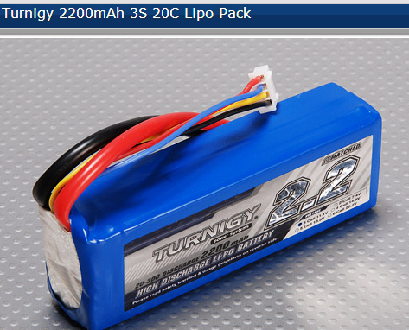
Batteries: Quantitative Analysis
This battery provides 2200 mAh of electricity. How many moles of electrons is this?

