Slide 1
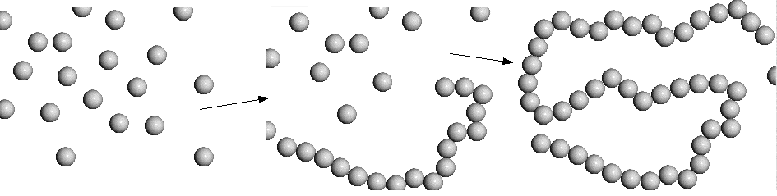
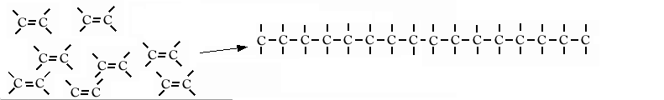
Introduction to Polymers
Polymers are long molecules made of repeating units, called monomers.
In general:
Specific example:

Slide 2
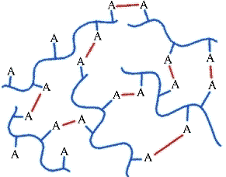
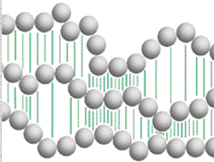
Forces between polymer chains: Crosslinks
Weak: Intermolecular
force crosslinks
Strong: Colvalent
bond crosslinks

Slide 3
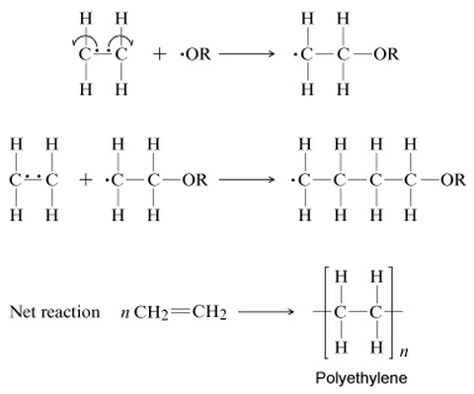
Addition Polymers

Slide 4
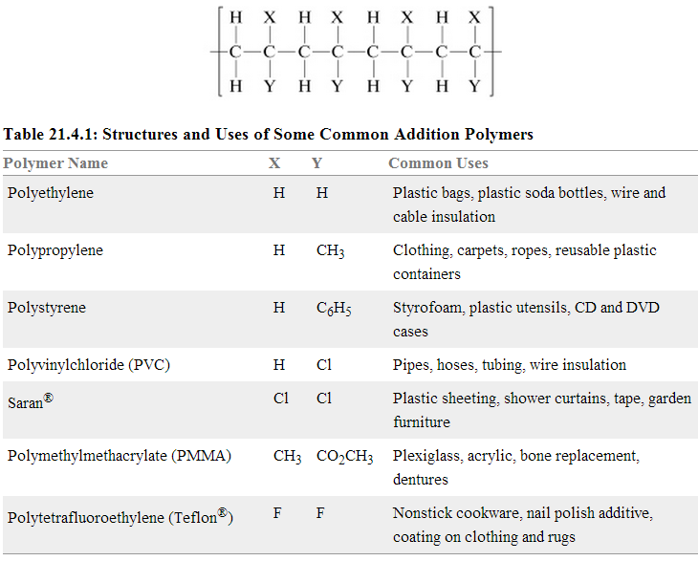
Common Addition Polymers

Slide 5
Polar Whites! and Drug Delivery

Slide 7
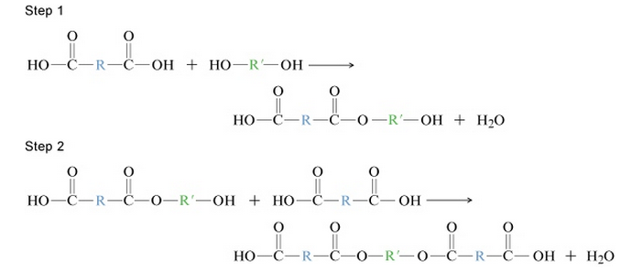
Condensation Polymers:
General Idea

Slide 8
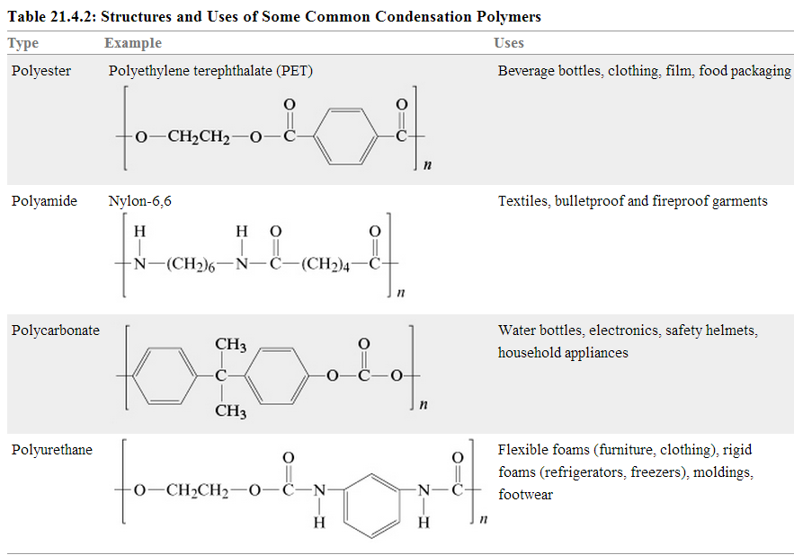
Common Condensation Polymers

Slide 9
How plastics are made
monomers → polymers → melt → form → cool and sometimes set
blow molding
injection molding
extrusion

