Slide 1
Section 14.1 and 14.2 Introduction to Kinetics and Reactions Rates
Bill Vining
SUNY Oneonta

Slide 2
Control of Solubility
In these sections…
Control of Reactivity:
Thermodynamic control
Kinetic control: Collision Theory
Describing Reaction Rates:
Average rate
Instantaneous rate
Initial rate
Relation to reaction stoichiometry

Slide 3
Control of Reactivity: Thermodynamics and Kinetics
Thermodynamics: are the products more stable (lower in energy) than the reactants?
Kinetics: does the reaction proceed at a significant rate?
For a reaction to occur, it must be favored by both thermodynamics and kinetics.

Slide 4
Thermodynamic Control: Enthalpy and Entropy
Enthalpy: (Bond strength) stronger bonds = lower enthalpy = more stable
Entropy: (Free motion of atoms) freer mobility = higher entropy = more stable
Formation of strong bonds and or more
independent particles favor reactions.
For many systems these counteract and
overall thermodynamic favorability depends
on temperature.

Slide 5
Kinetic Control: Activation Energy, Concentration and Temperature
Activation Energy: the energy barrier reactants must overcome to react
Concentration: greater concentration usually increases the chances
reactants will meet and react
Temperature: higher temperature increases the number of collisions and
the fraction overcoming the activation energy

Slide 6
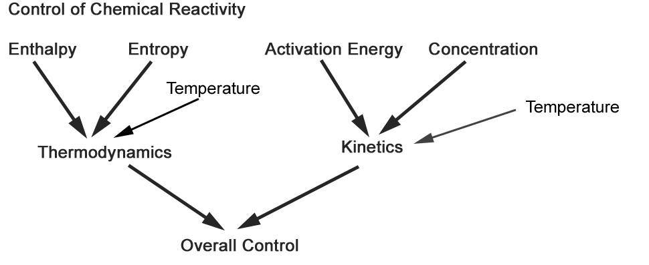
Control of Reactivity

Slide 7
Kinetic Control: Collision Theory
For a reaction to take place:
- Molecules must collide
- They must do so in the correct orientation
- They must collide with an energy greater than the “activation” energy
Consider: NO + O₃ → NO₂ + O₂
Molecules collide
product molecules
separate
Bonds are
formed and
break

Slide 8
So, what controls the rate of a reaction?
Number of collisions
How often they collide with an orientation that allows new bonds to form
The energy of the colliding reactant molecules

Slide 9
So, what controls the rate of a reaction?
$$rate=Ae^{−\frac{E_{a}}{RT}}{[reactants]}^{order}$$

Slide 10
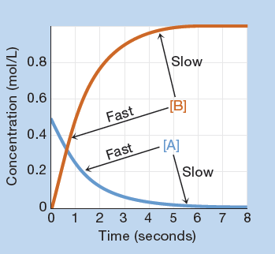
Expressing the Rate of a Reaction: Graphically
Reaction: A → 2 B
Reactant concentration decreases
Product concentration increases
Steeper slope = faster reaction

Slide 11
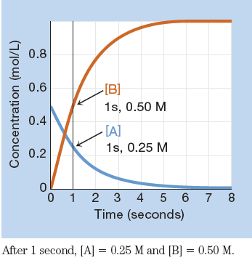
Expressing the Rate of a Reaction: Numerically: Average Rate
$$Rate=\frac{∆concentration}{∆time}$$
Reaction: A → 2 B
After 1 second:
[A] dropped from 0.50 M to 0.25 M
[B] increased from 0 M to 0.50 M

Slide 12
Rates and Stoichiometry
In general for a reaction: a A + b B → c C + d D
Relative rate of each species is proportional
to its stoichiometric coefficient.

Slide 13
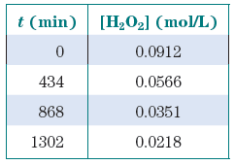
Rates and Stoichiometry
Reaction: 2 H₂O₂(aq) → 2 H₂O(l) + O₂(g)
Experimental data:
What are the rates of change of H₂O₂
and O₂ during the first 434 minutes?
Rate of disappearance of H₂O₂:
Rate of appearance of O₂:

Slide 14
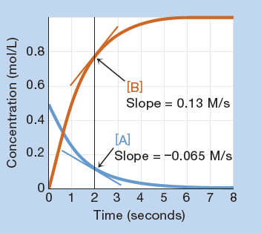
Expressing the Rate of a Reaction: Numerically: Instantaneous Rate
$$Rate=\frac{∆concentration}{∆time}$$
Reaction: A → 2 B
Instantaneous rate =
slope of the concentration-time curve at any particular time

Slide 15
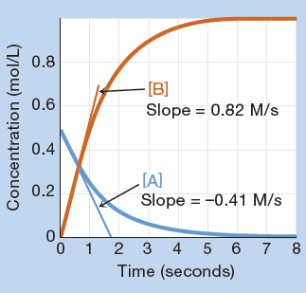
Expressing the Rate of a Reaction: Numerically: Initial Rate
$$Rate=\frac{∆concentration}{∆time}$$
Reaction: A → 2 B
Initial rate = Instantaneous rate at time = 0

