Slide 1
Enthalpy Change and Chemical Reactions

Slide 3
Some Examples of Enthalpy Change for Reactions: Thermochemical Equations:
C₁₂H₂₂O₁₁(s) + 12 O₂(g) → 12 CO₂(g) + 11 H₂O(l) ΔH = -5645 kJ
C₁₂H₂₂O₁₁(s) + 12 O₂(g) → 12 CO₂(g) + 11 H₂O(l) + 5645 kJ
2 C(s) + 2 H₂(g) → C₂H₄(g) ΔH = +52 kJ
2 C(s) + 2 H₂(g) + 52 kJ → C₂H₄(g)

Slide 4
Some Examples of Enthalpy Change for Reactions: Thermochemical Equations:
C₁₂H₂₂O₁₁(s) + 12 O₂(g) → 12 CO₂(g) + 11 H₂O(l) ΔH = -5645 kJ
C₁₂H₂₂O₁₁(s) + 12 O₂(g) → 12 CO₂(g) + 11 H₂O(l) + 5645 kJ
2 C(s) + 2 H₂(g) → C₂H₄(g) ΔH = +52 kJ
2 C(s) + 2 H₂(g) + 52 kJ → C₂H₄(g)

Slide 5
Calculating Heat Production
C₃H₈(g) + 5 O₂(g) → 3 CO₂(g) + 4 H₂O(l) ΔH = -2220 kJ
How much water can a 1-pound propane canister bring to
95 ºC, starting from 10 ºC?

Slide 6
Where does Enthalpy Change come from: Bond Energies
simulation

Slide 7
Calculating Heat Production
C₃H₈(g) + 5 O₂(g) → 3 CO₂(g) + 4 H₂O(l) ΔH = -2220 kJ
How much water can a 1-pound propane canister bring to
95 ºC, starting from 10 ºC?

Slide 8
Where does Enthalpy Change come from: Bond Energies
simulation

Slide 9
When bonds break…
Energy is released
Energy is absorbed

Slide 10
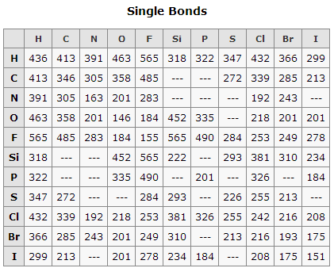
Calculating Enthalpy Change from Bond Energies
ΔH = Σenergy needed to break bonds – Σenergy released forming bonds Example: Formation of hydrogen peroxide
H₂(g) + O₂(g) → H₂O₂(g)
O=O = 498 kJ/mol

Slide 11
Calculating Enthalpy Change from Bond Energies
3 H₂(g) + N₂(g) → 2 NH₃ (g)
O=O = 498 kJ/mol
N≡N = 945 kJ/mol

Slide 12
You make a different question about bond energies.

Slide 13
Will this equation: ΔH = Σenergy needed to break bonds – Σenergy released forming bonds Work for reactions in solution?

Slide 14
Manipulating Reaction Equations
Reverse a reaction equation: Change the sign of ΔH
Multiply a reaction by a factor: Multiply Δ H by the factor

Slide 16
Calorimetry (rxn in class)

Slide 18
Calorimetry (rxn in class, sim)

Slide 20
Calorimetry (rxn in class)

Slide 21
Bomb Calorimetry
500 mg citric acid (molar mass 192.1 g/mol) are combusted in a bomb calorimeter. The calorimeter has a calorimeter constant of 420 J/ºC and contains 700 g water. The temperature rises from 20.0 ºC to _____ ºC. What is ΔH_{combustion}?

Slide 22
Manipulating Reaction Equations
Reverse a reaction equation: Change the sign of ΔH
Multiply a reaction by a factor: Multiply Δ H by the factor

Slide 23
Hess's Law: ΔHº for a reaction that is the sum of constituent reactions is the sum
of their ΔHº values.
Given the standard enthalpy changes for the following two reactions: (1) 2 NO₂(g) → N₂(g) + 2 O₂(g) ...... ΔHº = -66.4 kJ (2) 2 N₂O(g) → 2 N₂(g) + O₂(g) ...... ΔHº = -164.2 kJ what is the standard enthalpy change for the reaction: (3) 2 N₂O(g) + 3 O₂(g) → 4 NO₂(g) ...... ΔHº = ?

Slide 24
(1) 2 NO₂(g) → N₂(g) + 2 O₂(g) ...... ΔHº = -66.4 kJ (2) 2 N₂O(g) → 2 N₂(g) + O₂(g) ...... ΔHº = -164.2 kJ what is the standard enthalpy change for the reaction: (3) 2 N₂O(g) + 3 O₂(g) → 4 NO₂(g) ...... ΔHº = ?

Slide 25
Formation Reactions: Reaction to form 1 mol of a
compound from its elements
Write the formation reaction for Fe₂(SO₄)₃.
Write the formation reaction for C₂H₅OH.

Slide 26
Standard Enthalpy of Formation

Slide 27
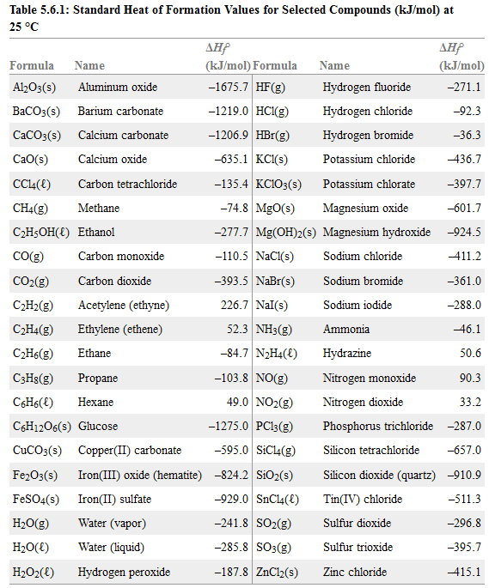

Slide 28
Enthalpy of Formation:
The bond energy for a Cl-Cl bond is 242 kJ/mol. What is ΔH_{f}º of Cl(g)?

Slide 29
Using enthalpy of formation:
A special case of Hess’s Law: Develop the equation

Slide 30
Using enthalpy of formation:
Ca(OH)₂(aq) + 2 HCl(aq) → CaCl₂(aq) + 2 H₂O(l)
Ca(OH)₂ = -1002.8 kJ/mol
HCl(aq) = -167.2 kJ/mol
CaCl₂(aq) = -795.8 kJ/mol
H₂O(l) = -285.8 kJ/mol

Slide 32
Using enthalpy of formation:
Compare the energy output per kg for burning
coal, natural gas and propane.
And energy per gram CO₂ released.

