Slide 1
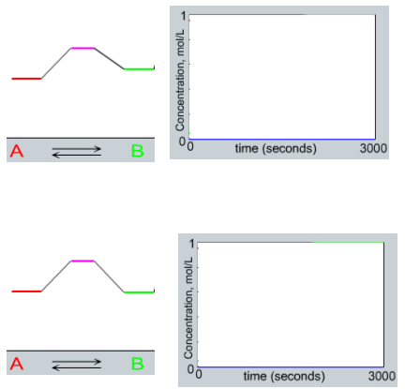
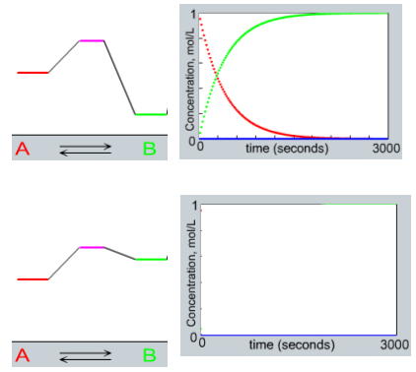
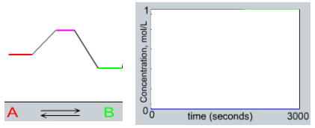
Chapter 15: Chemical Equilibria

Slide 2
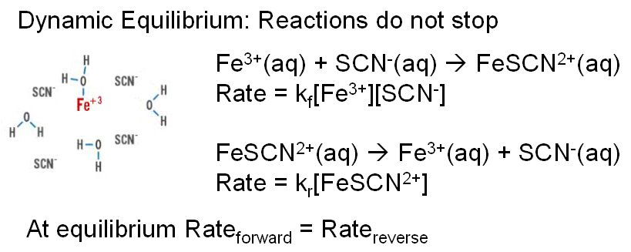

Slide 3
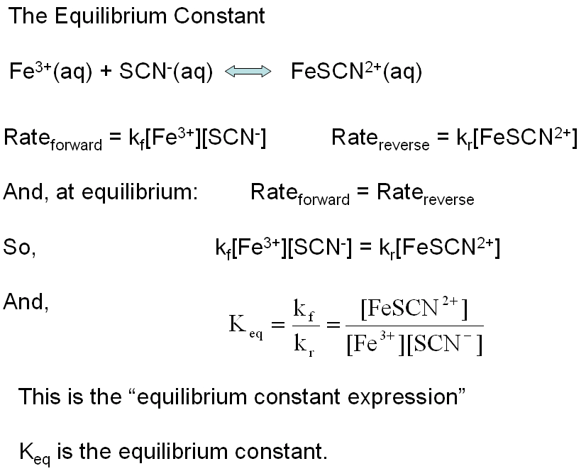

Slide 4
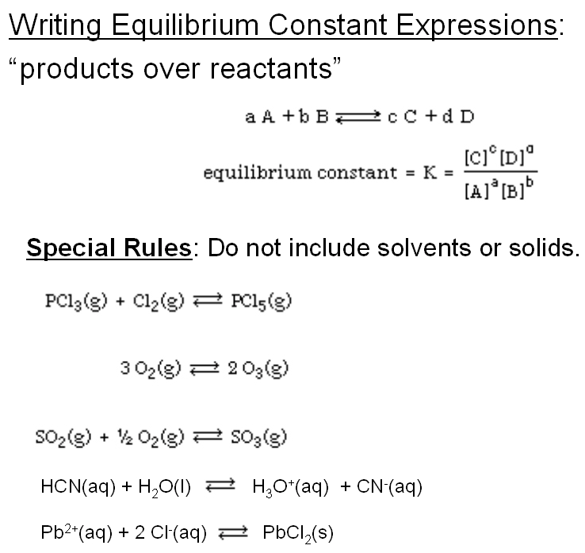

Slide 5
What is the equilibrium expression for
Fe₂S₃(s) 2 Fe³⁺(aq) + 3 S²⁻(aq)
1:
2:
3:
4:

Slide 6
Manipulating Equilibrium Expressions:
N₂(g) + 3 H₂(g) ⇔ 2 NH₃(g) K = =5.5 x 10⁵
Reversing Reactions
2 NH₃(g) ⇔ N₂(g) + 3 H₂(g) K =
Multiplying by a Factor
½ N2(g) + 3/2 H2(g) ⇔ NH3(g) K =

Slide 7
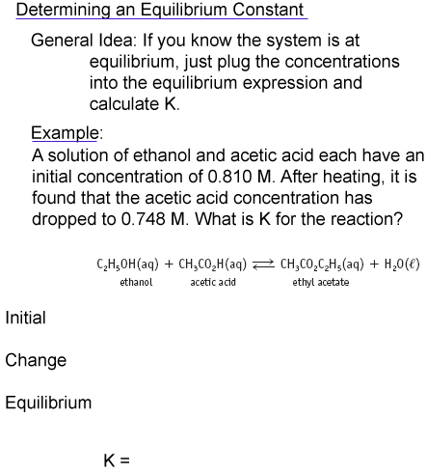

Slide 8
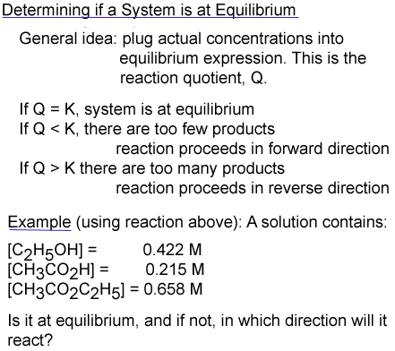


Slide 9
Cu(NH₃)₄²⁺(aq) ⇔ Cu²⁺(aq) + 4 NH₃(aq) K = 8.5 x 10⁻¹³
If [Cu²⁺] = 1.0 x 10⁻⁶ , [NH₃] = 1.0 x 10⁻³, [Cu(NH₃)₄²⁺], then …
It is at equilibrium
Reaction goes forwards
Reaction goes backwards

Slide 10
Equilibrium Calculations: Your Pathway to Happiness
Write the equilibrium expression
Determine Q
  if Q = K, it’s at equilibrium
  if Q < K, reactants go to form products
  if Q > K, products go to form reactants
Call the amount reacting “x”
Solve for x in the equilibrium expression
Use x to determine equilibrium concentrations

Slide 11

Given these initial concentrations, what will the final
concentrations be when equilibrium is reached?
K = 0.11

Slide 12
Which is it?
It’s at equilibrium
It’s not and will react to make more products
It’s not and will react to make more reactants

Slide 14
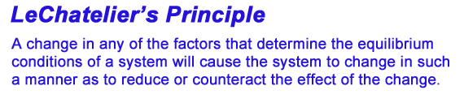
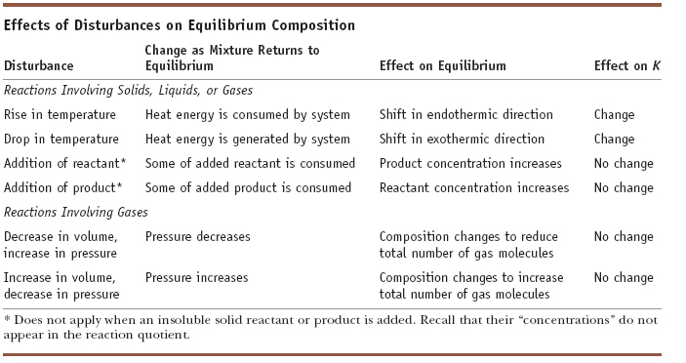

Slide 15
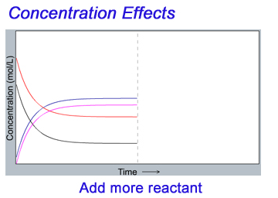

Slide 16
If we add more C, [B] will…
Increase
Decrease
Not change

Slide 17
If we remove B, [D] will…
Increase
Decrease
Not change

Slide 18
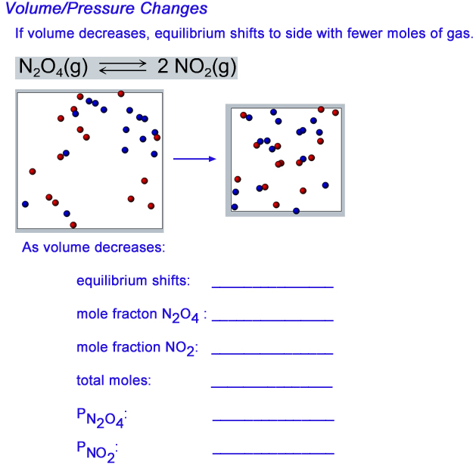

Slide 19
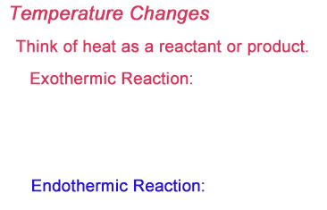

Slide 20

LeChatelier’s Principle: Doing the math
1-Liter flask contains 0.50 mol butane and 1.25 mol isobutane (at equilibrium).
0.50 mol butane are added. What happens, and what is the result?

