Slide 1
Chapter 13 Organometallic Chemistry Structure and Bonding

Slide 2
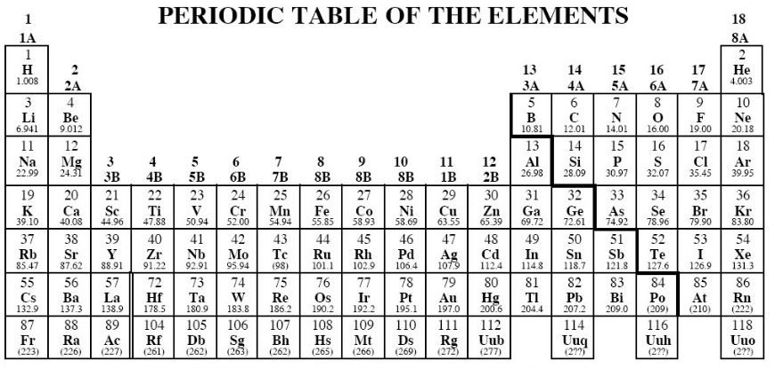

Slide 4
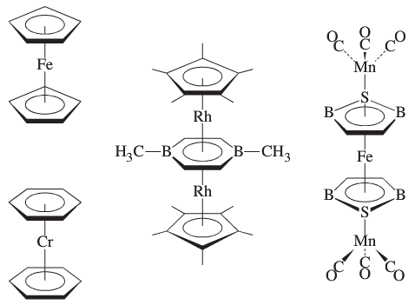
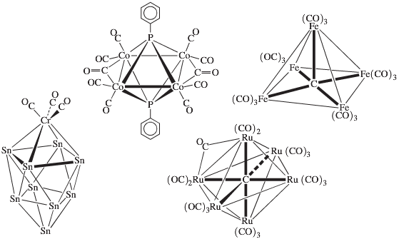
Sandwich Compounds
Cluster Compounds

Slide 5
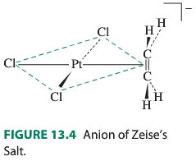
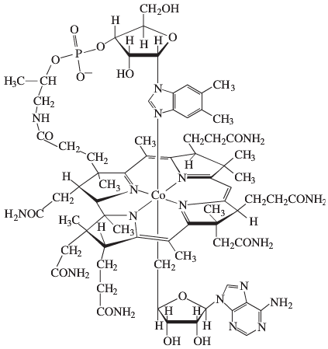
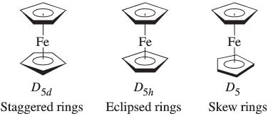
Conformations of Ferrocene
Vitamin B₁₂ Coenzyme

Slide 6
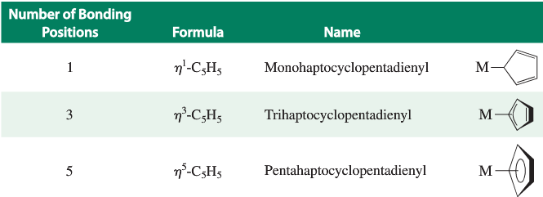
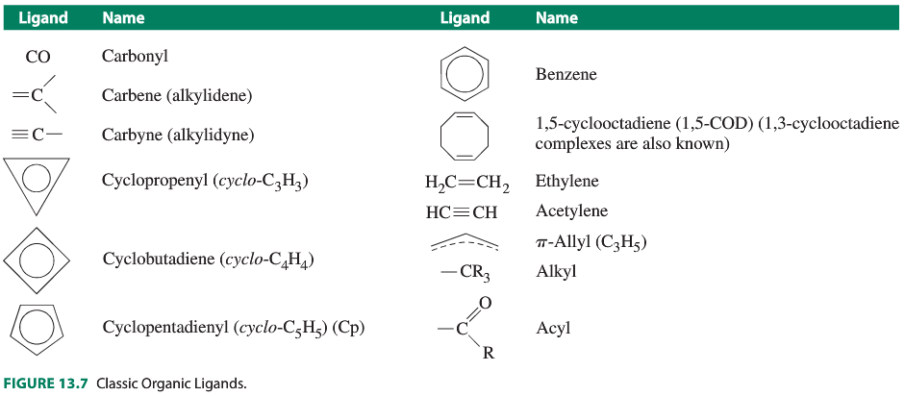
Ligand
Nomenclature

Slide 7
18 Electron Rule: Examples
Cr(CO)₆
(η⁵-C₅H₅)Fe(CO)₂Cl
[Re(CO)₅(PF₃)]⁺
PF₃ is neutral

Slide 8
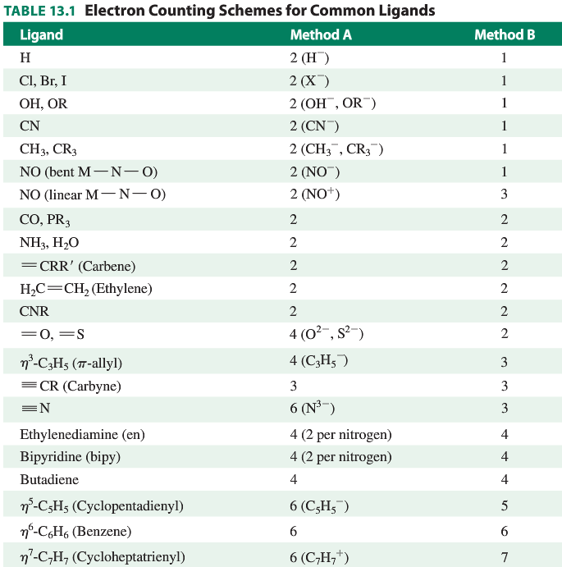
18 Electron Rule

Slide 9
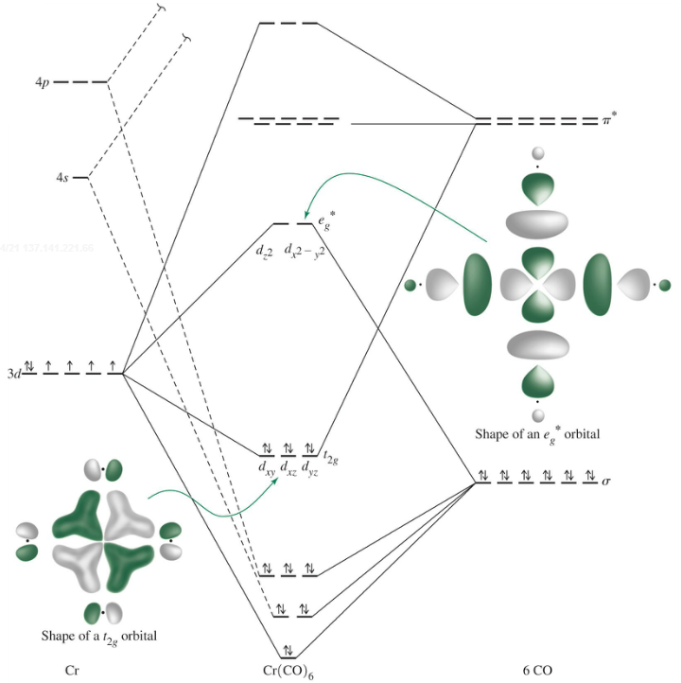
18 Electron Rule: Why? Use an octahedral example
Happens with strong
σ-donor and/or
strong π-backbonding
ligands.
Why not fewer e⁻’s?
Why not more e⁻’s?

Slide 10
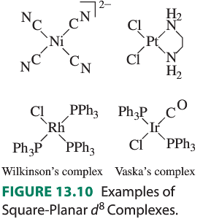
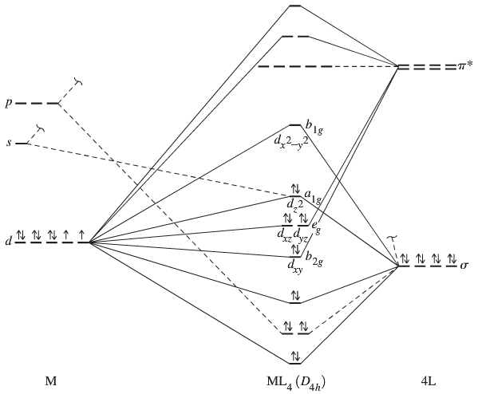
16/18 Electron Rule: Important 16-e⁻ square planar examples; all
high field d⁸

Slide 12
18 Electron Rule: Many, many classical complexes don’t follow it.
[Zn(en)₃]²⁺
Cr(NH₃)₆³⁺

Slide 14
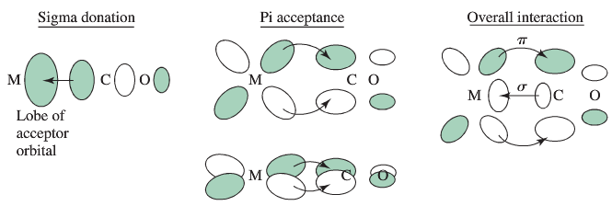
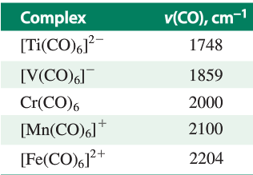
Carbonyl Compounds
Using υ_{CO} as a guide to π-backbonding
Isoelectronic
series, varying
charge

Slide 15
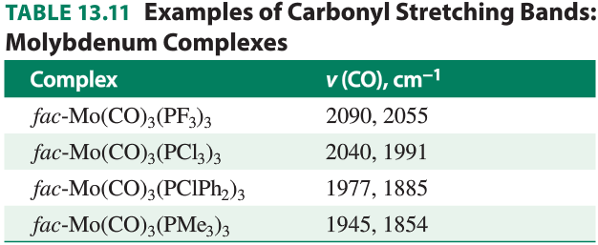
Carbonyl Compounds
Using υ_{CO} as a guide to π-backbonding
Varying ligand electron donation.

Slide 16
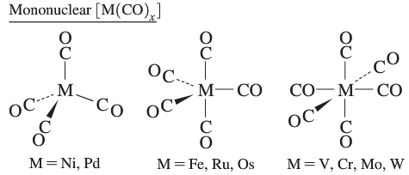
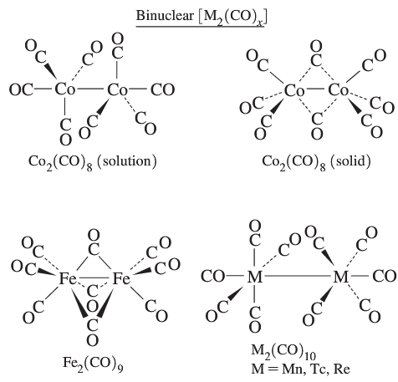
Carbonyl Compounds: Mono and Binuclear

Slide 17
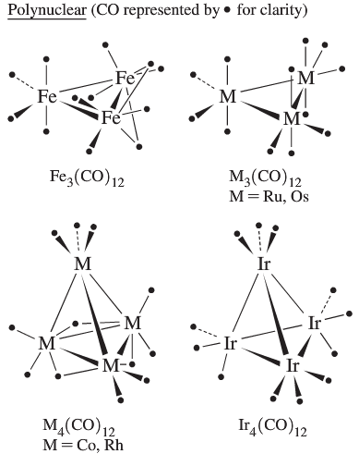
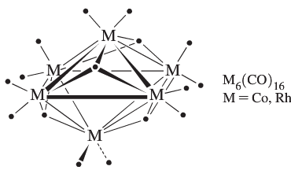
Polynuclear Carbonyl Compounds (“Clusters”)

Slide 18
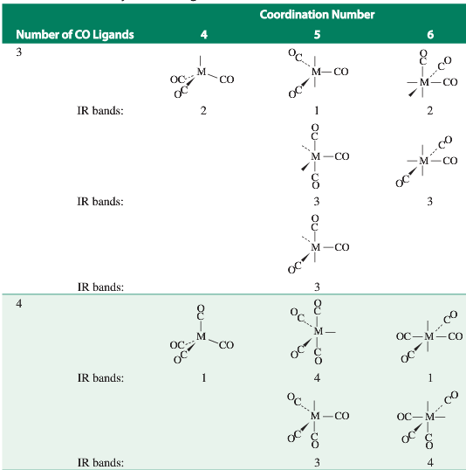
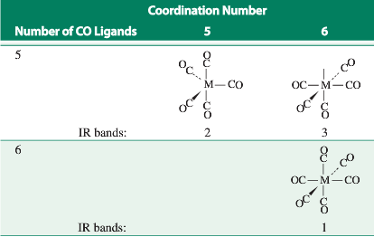
Carbonyl Compounds: IR structure determination

Slide 19
Carbonyl Compounds: Bridging Modes

Slide 20
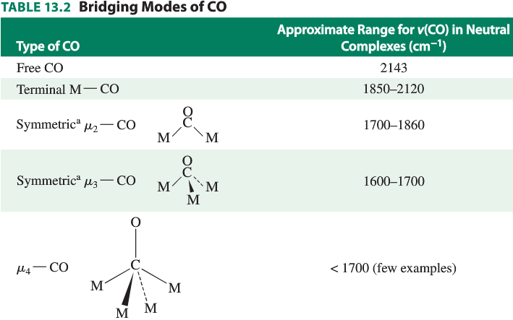
Carbonyl Compounds: Bridging Modes

Slide 21
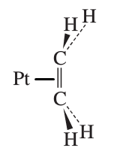
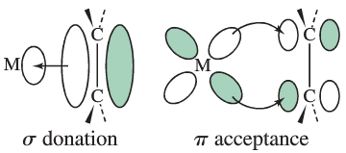
Metal-Alkene Complexes
Metal-Allyl Complexes

Slide 22
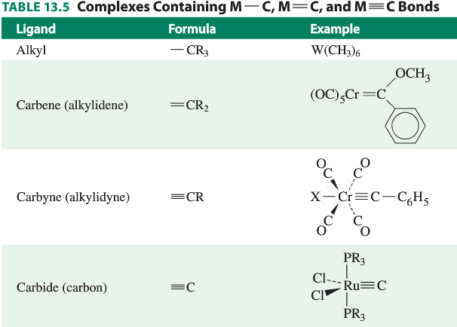
Metal-Alkyl, Carbene, Carbyne Complexes: sigma bonded M-C

