Slide 1
Chapter 14
Organometallic Chemistry
Reactions and Catalysis

Slide 2
Types of Reactions
Ligand loss or gain
Dissociation/Substitution
Oxidative addition
Reductive elimination
Nucleophilic displacement
Ligand modification
Insertion
Carbonyl insertion (methyl migration)
Hydride elimination
Abstraction

Slide 3
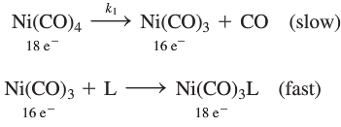
Types of Reactions:
Dissociation, Addition and Substitution

Slide 4
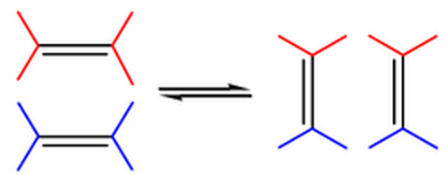
Aside: olefin = alkene
metathesis = exchange of bonds
2005 Nobel Prize

Slide 5
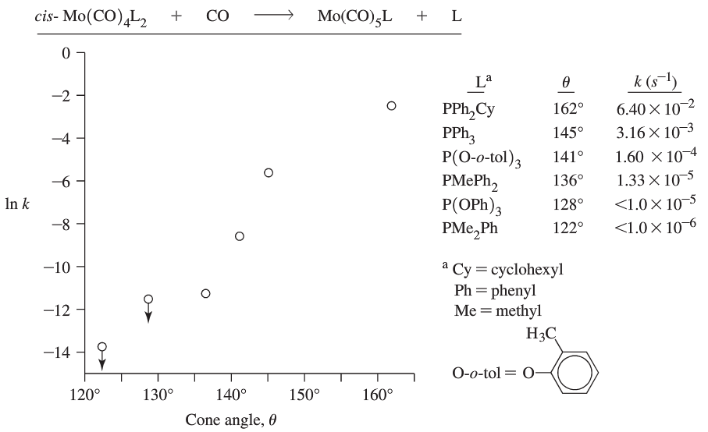
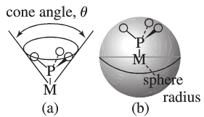
Dissociation of Phosphine Ligands: Steric Effects

Slide 6
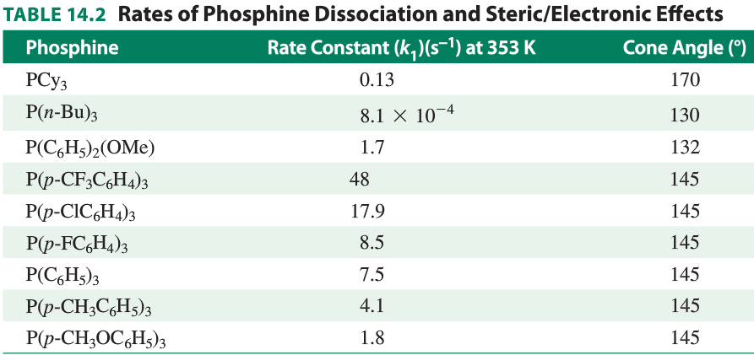
Dissociation of Phosphine Ligands: Steric vs. Electronic Effects

Slide 7
Types of Reactions: Oxidative Addition/Reductive Elimination

Slide 8
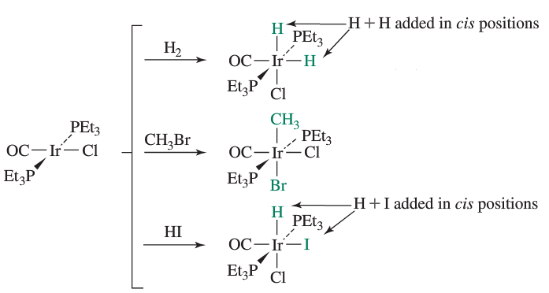
Oxidative Addition
Coordination #’s and Oxidation States?

Slide 9
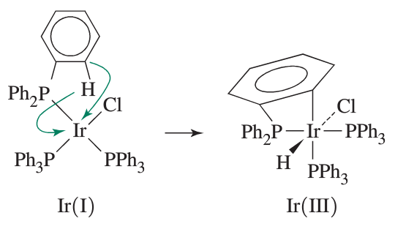
Special Case: Cyclometallation (orthometallation)

Slide 10
Reductive Elimination: Key usefulness– forms a new bond
H-H, C-H, C-X (X = halide, amide, alkoxide, othes)
Rates depend on electronic and steric effects.
Electronic effects:
more weakly bonded ligands are eliminated faster.

Slide 11
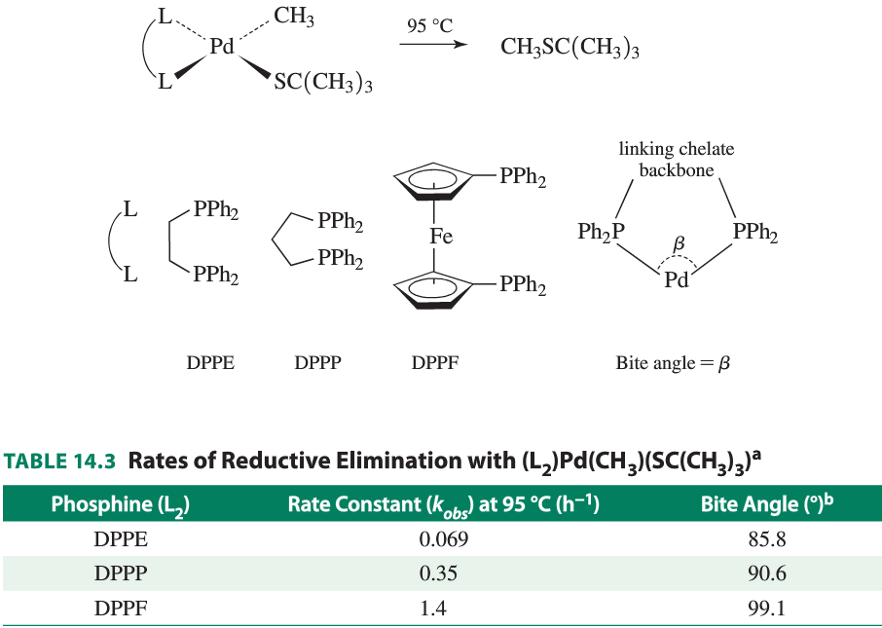
Steric Effects:
Rate of reductive
elimination as a
function of
other ligand’s
“bite angle”

Slide 12
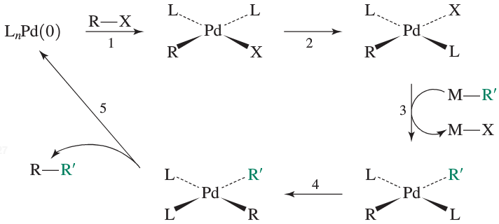
Pd-catalyzed Cross-Coupling reactions: 2010 Nobel Prize
Overall Organic Reaction?

Slide 13
Pd-catalyzed Cross-coupling reactions
Step 1?
Step 2?
Step 3: transmetallation
substitution adding –R or –Ar
to the Pd(II) center
Step 4?
Step 5?

Slide 14
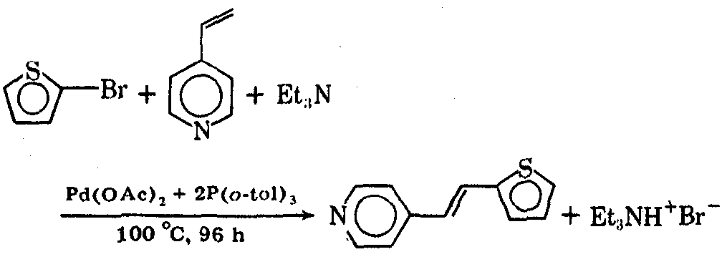
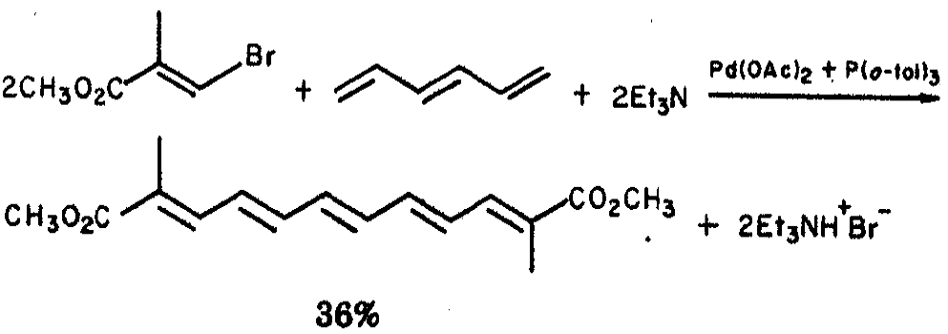
Pd-catalyzed Cross-coupling reactions

Slide 15
Pd-catalyzed Cross-coupling reactions

Slide 16
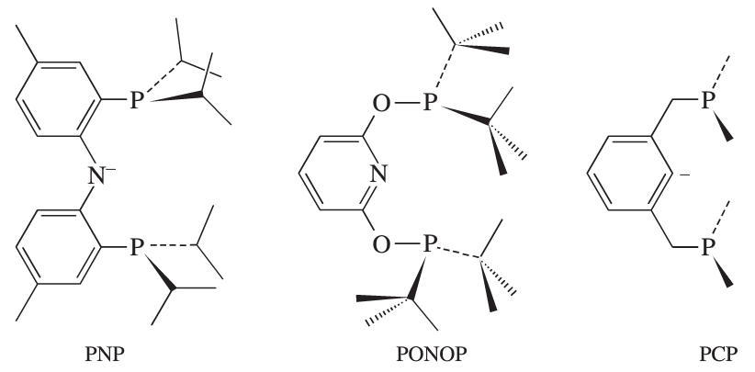
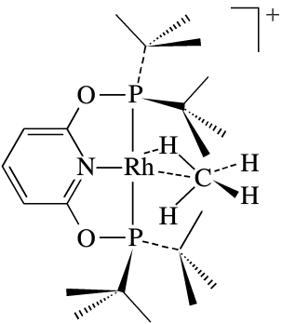
Current Research Area: Pincer Ligands

Slide 17
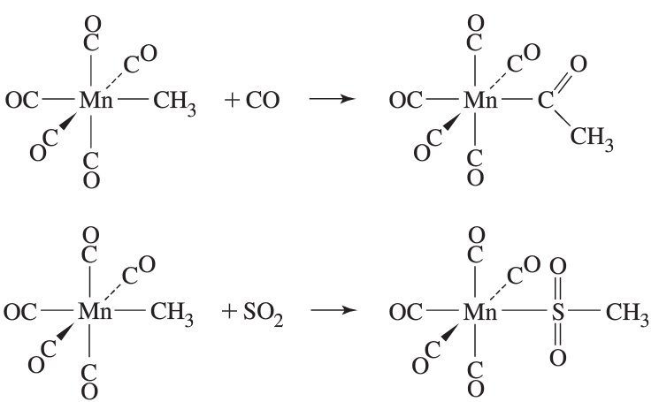
Ligand Modification Reactions: Insertion Reactions
Examples:

Slide 18
Ligand Modification Reactions: Carbonyl Insertion
Possible Mechanisms:
Propose mechanisms and examine experimental results.

Slide 19
Possible Mechanisms:

Slide 20
Possible Mechanisms:

Slide 21
Possible Mechanisms:

Slide 22
Experimental Evidence:

Slide 23
Which mechanism is best supported?
Analyze Mechanism 1. Is this a plausible mechanism?
Compare Mechanisms 2 and 3. Which is better supported by the evidence.

Slide 24
1. Analyze Mechanism 1. Is this a plausible mechanism?

Slide 25
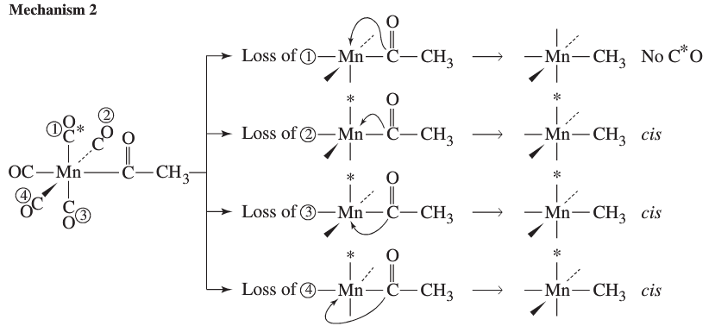
2. Compare Mechanisms 2 and 3: Use reverse reaction results

Slide 26
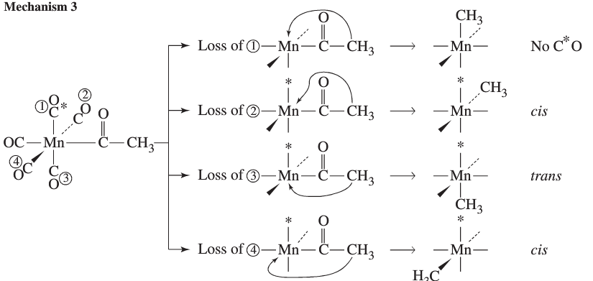
2. Compare Mechanisms 2 and 3: Use reverse reaction results

Slide 27
1,2-olefin Insertion Reactions

Slide 28
Hydride Elimination (β-elimination)
What is the reverse reaction?

Slide 29
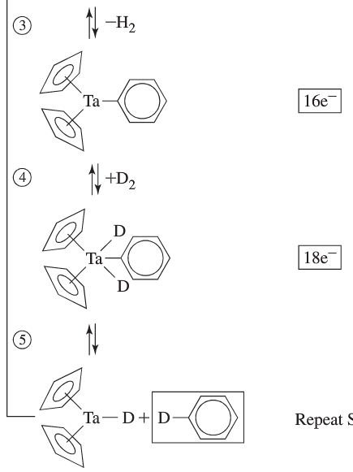
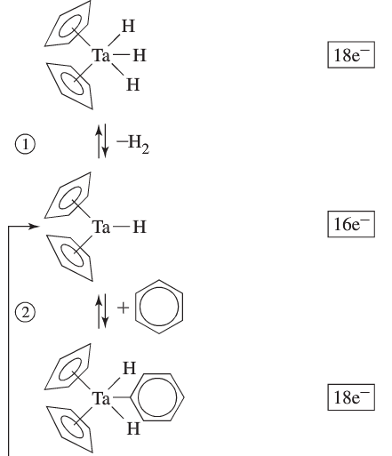
Catalysis: Deuteration

Slide 30
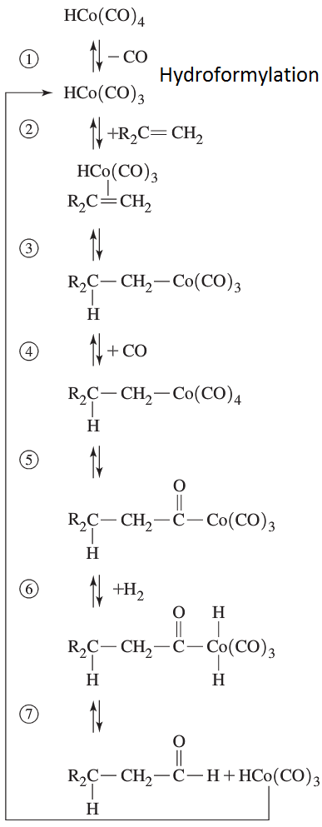
Catalysis: Hydroformylation

Slide 31
Catalysis: Hydroformylation

Slide 32
Turnover Frequency
http://pubs.acs.org/doi/pdf/10.1021/om100552h
Turnover Number:
http://pubs.acs.org/doi/abs/10.1021/om060605p

