Slide 1
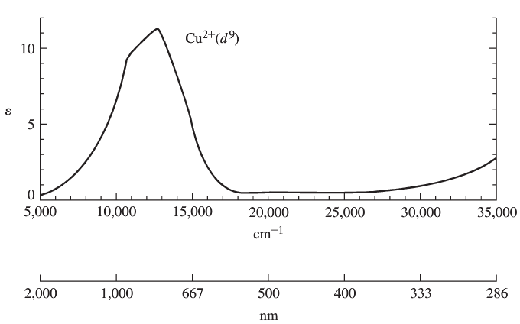
Chapter 11: Electronic Spectra

Slide 2
Why are absorption spectra bands instead of lines?
Ground and excited state energy wells.
Electronic, vibrational, rotational and solvent transitions.

Slide 3
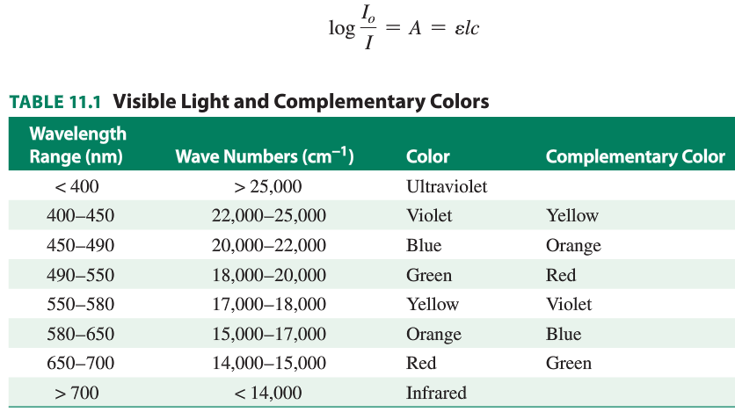
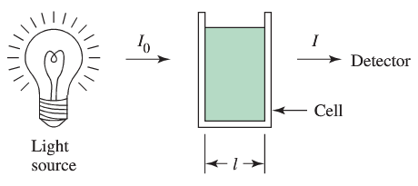

Slide 4
Electronic states of free ions.
Quantum numbers of multielectron atoms. Microstates.
Draw all microstates for a p² configuration. (15 of them)
m_{l} m_{l}
+1 0 -1 +1 0 -1

Slide 5
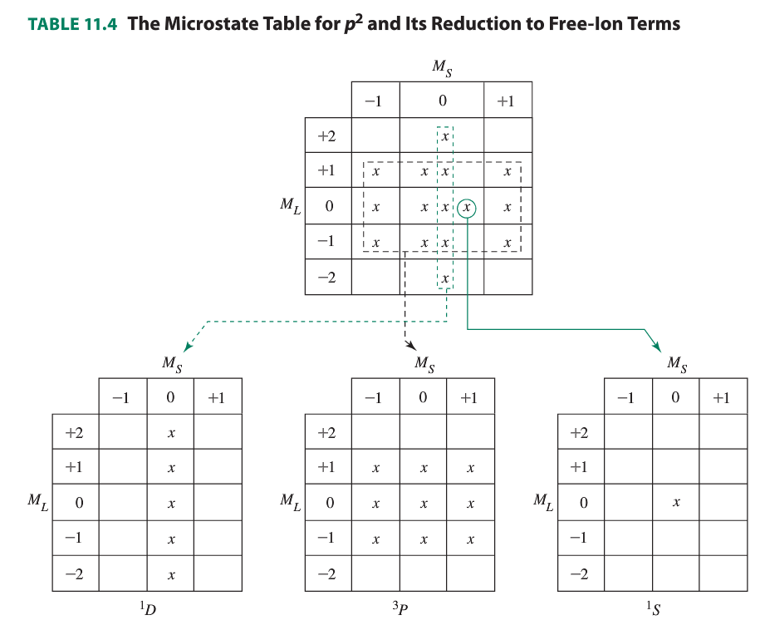

Slide 6
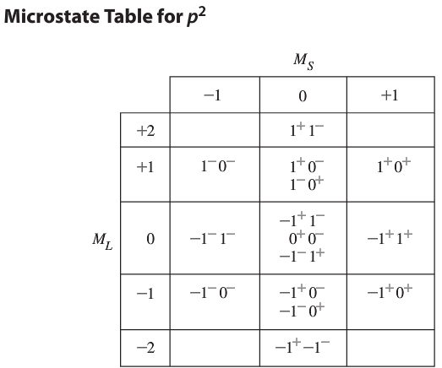
Electronic states of free ions.
Quantum numbers of multielectron atoms. Microstates.

Slide 7
Preview: d-d Transitions for transition metal complexes

Slide 8
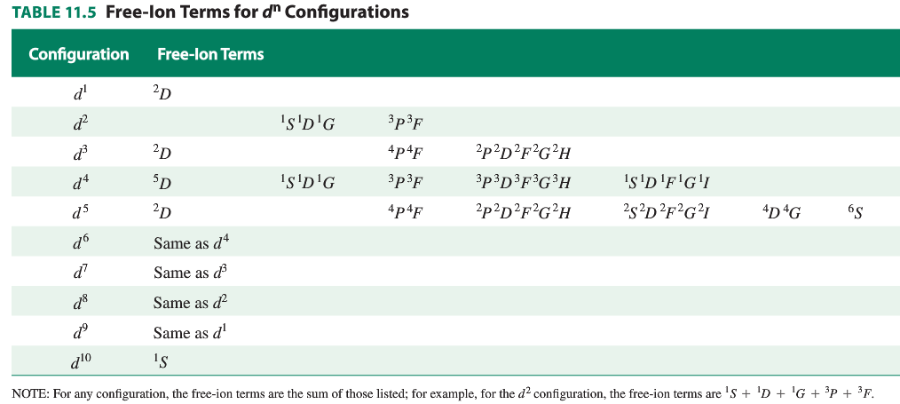

Slide 10
Since octahedral compounds all seem to have only d-d
transitions that must be Laporte forbidden, why are they
colored?

Slide 11
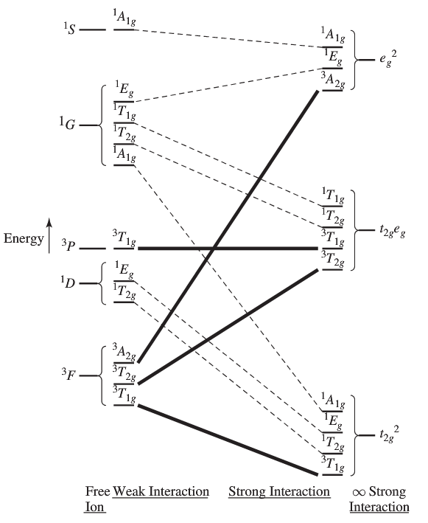
Correlation diagram for
free ions and complexes.
Example: d² ion

Slide 12
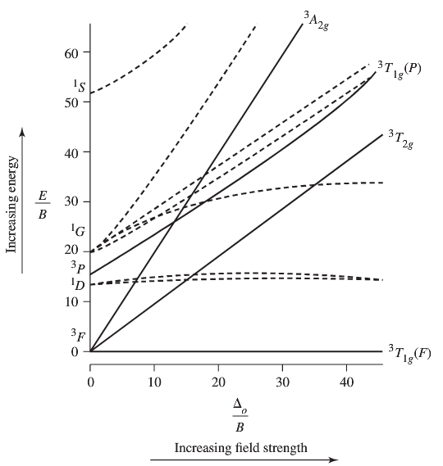
Tanabe-Sugano Diagrams
Example: d²

Slide 13
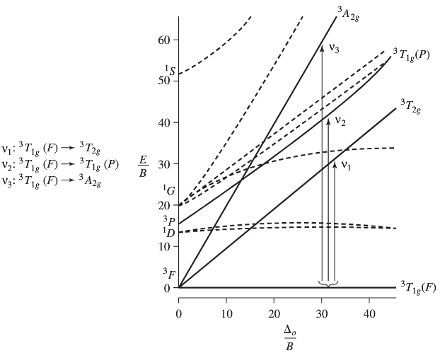
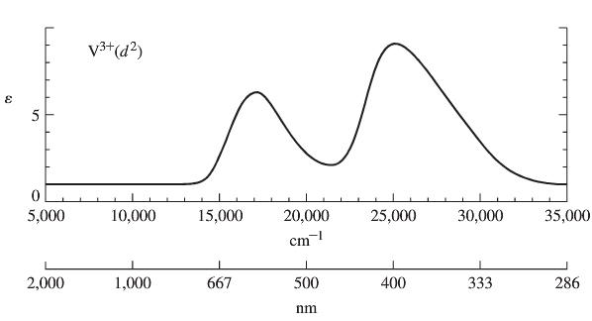
Tanabe-Sugano Diagrams: Example V(H₂O)₆³⁺

Slide 14
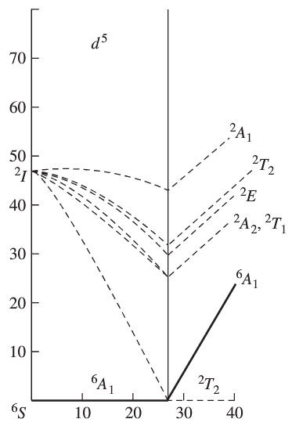
The interesting d⁵ case:

Slide 15
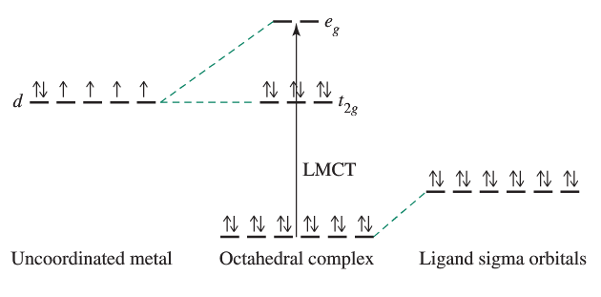
Charge Transfer Transitions: LMCT

Slide 16
Charge Transfer Transitions: MLCT

Slide 17
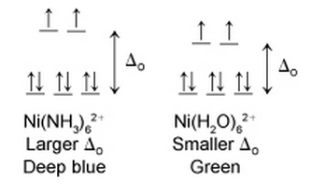
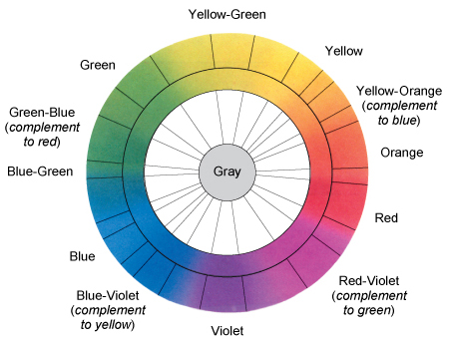
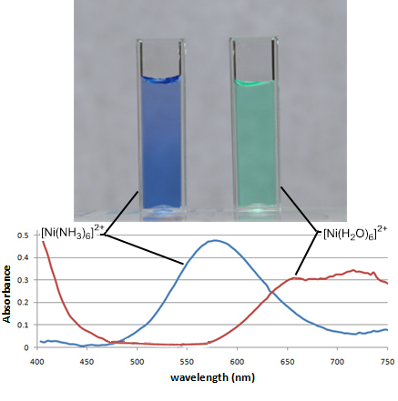
Colors and Spectroscopy of Transition Metal Complexes

Slide 18
Why is:
Mn²⁺(aq) colorless
Cu²⁺(aq) less deeply blue colored than Cu(NH₃)₄²⁺
Zn²⁺(aq) colorless
MnO₄⁻ deeply colored
W(CO)₆ colorless

Slide 19
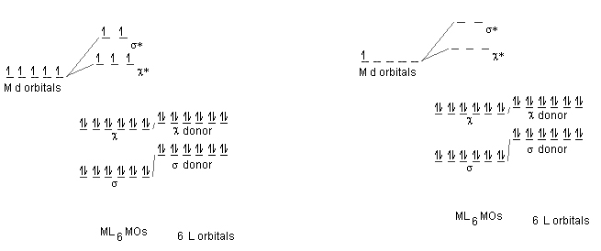
Mn²⁺(aq) MnO₄ ⁻

Slide 20
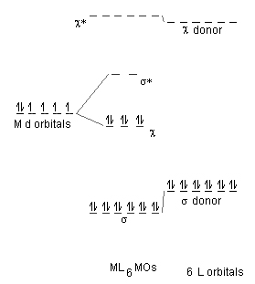
Pi Acceptor Ligands and spectroscopy: CO, CN⁻, pyridine

Slide 21
Photophysics vs. Photochemistry
Ru(bpy)₃²⁺ vs. Ru(py)₂(bpy)₂²⁺

Slide 22
Ru(py)₂(bpy)₂²⁺

