Slide 1
Chapter 13 Organometallic Chemistry Structure and Bonding

Slide 2
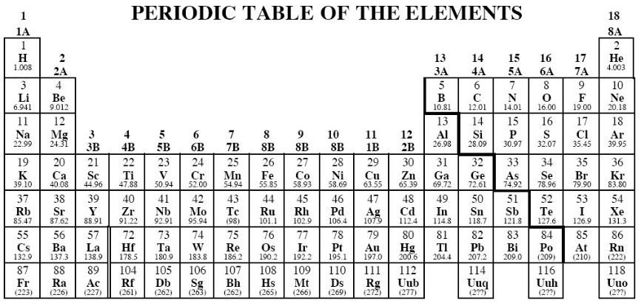

Slide 4
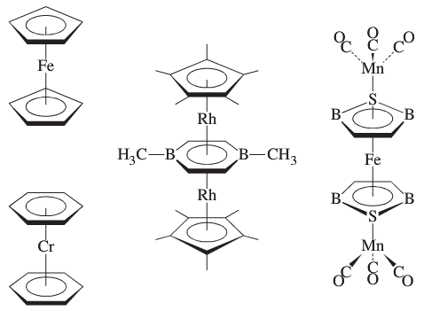
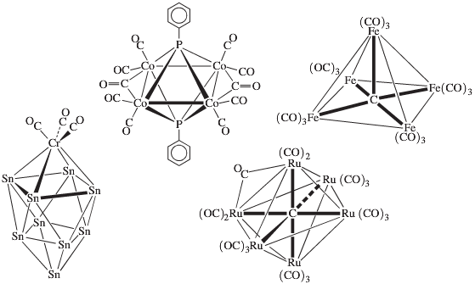
Sandwich Compounds
Cluster Compounds

Slide 5
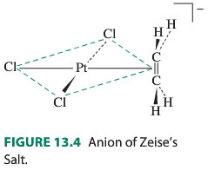
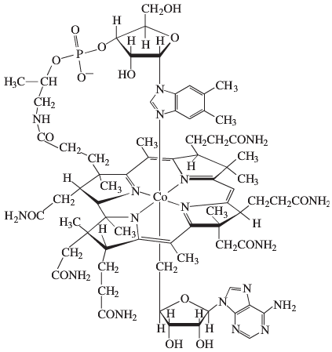
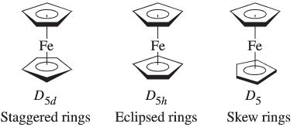
Conformations of Ferrocene
Vitamin B₁₂ Coenzyme

Slide 6
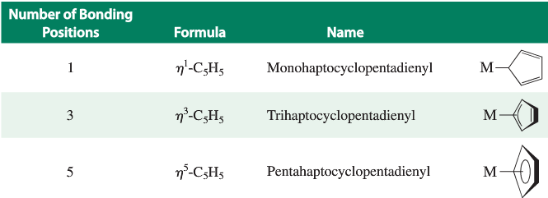
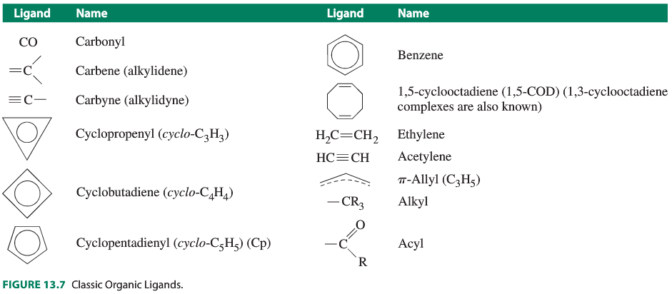
Ligand
Nomenclature

Slide 7
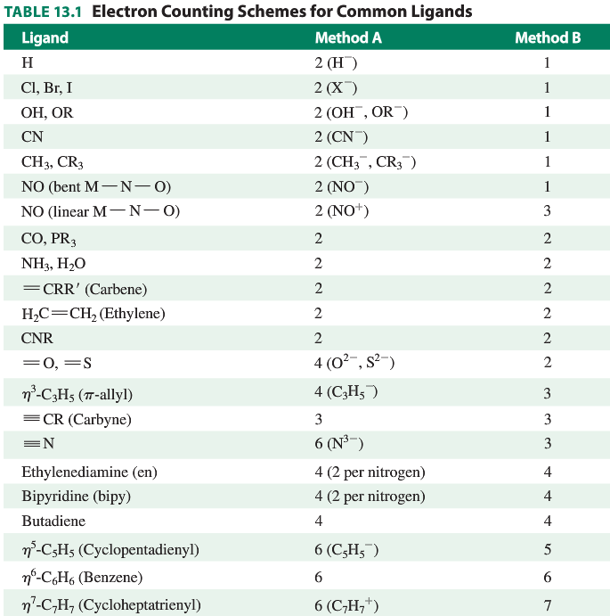
18 Electron Rule

Slide 10
18 Electron Rule: Examples
Cr(CO)₆
(η⁵-C₅H₅)Fe(CO)₂Cl
[Re(CO)₅(PF₃)]⁺
PF₃ is neutral

Slide 12
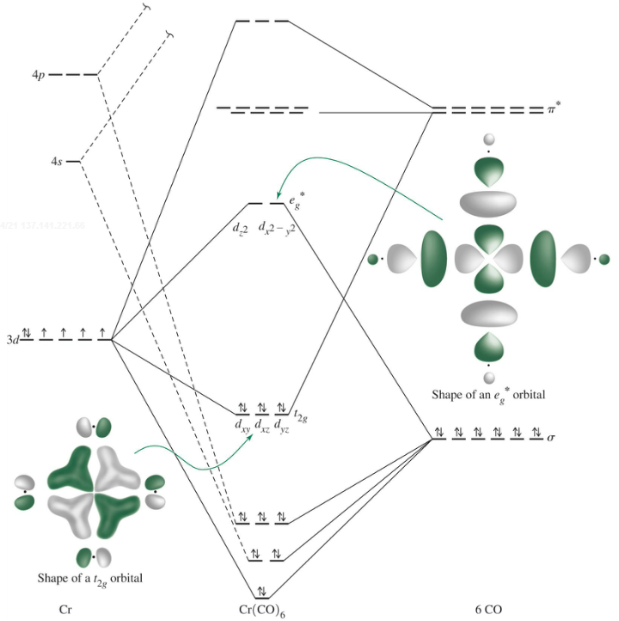
18 Electron Rule: Why? Use an octahedral example
Happens with strong
σ-donor and/or
strong π-backbonding
ligands.
Why not fewer e⁻’s?
Why not more e⁻’s?

Slide 13
18 Electron Rule: Why? Use an octahedral example
Happens with strong
σ-donor and/or
strong π-backbonding
ligands.
Why not fewer e⁻’s?
Why not more e⁻’s?

Slide 14
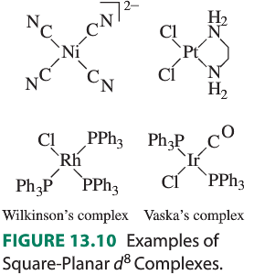
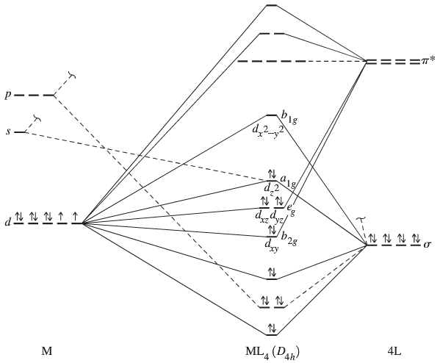
16/18 Electron Rule: Important 16-e⁻ square planar examples; all
high field d⁸

Slide 16
18 Electron Rule: Many, many classical complexes don’t follow it.
[Zn(en)₃]²⁺
Cr(NH₃)₆³⁺

Slide 17
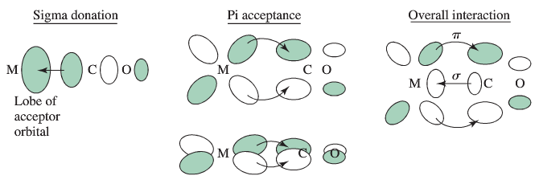
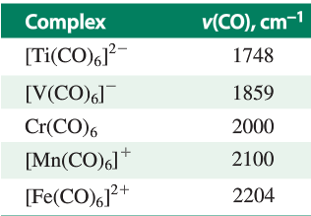
Carbonyl Compounds: IR spectra used to probe bonding
Using υ_{CO} as a guide to π-backbonding
Isoelectronic
series, varying
charge

Slide 18
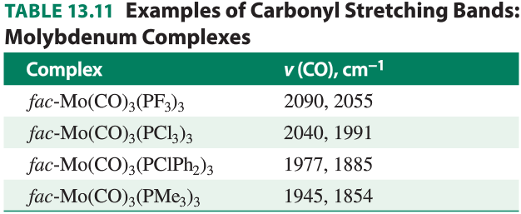
Carbonyl Compounds
Using υ_{CO} as a guide to π-backbonding
Varying ligand electron donation.

Slide 20
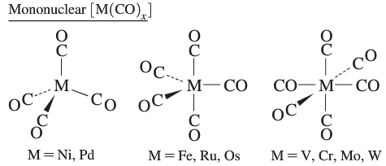
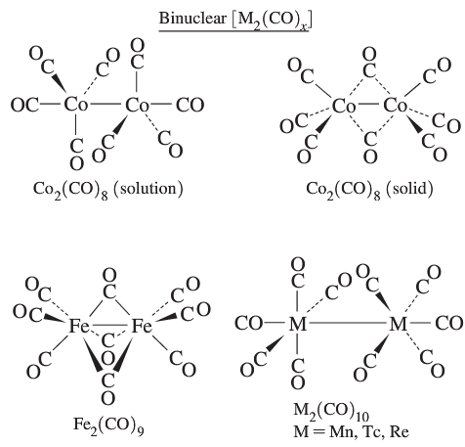
Carbonyl Compounds: Mono and Binuclear

Slide 22
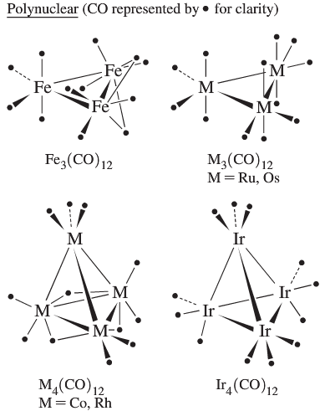
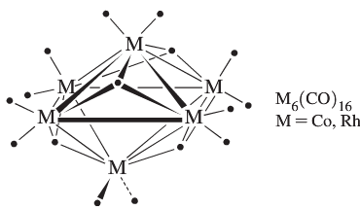
Polynuclear Carbonyl Compounds (“Clusters”)

Slide 23
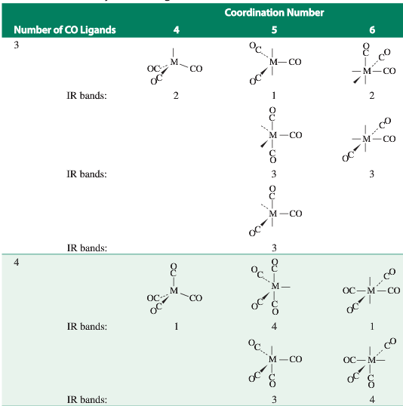
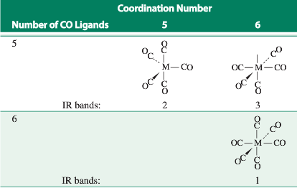
Carbonyl Compounds: IR structure determination

Slide 24
Carbonyl Compounds: Bridging Modes

Slide 25
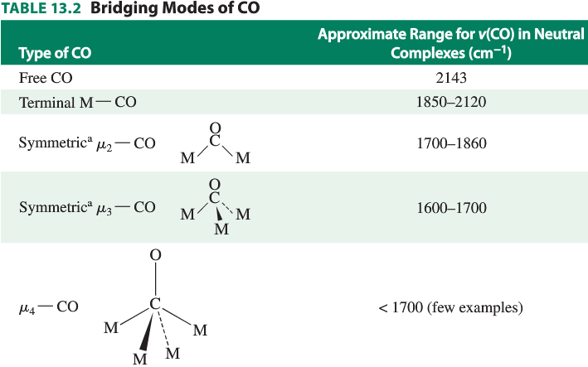
Carbonyl Compounds: Bridging Modes

Slide 26
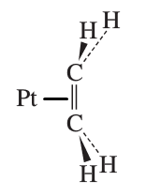
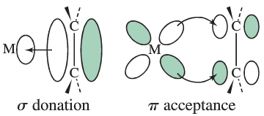
Metal-Alkene Complexes
Metal-Allyl Complexes

Slide 27
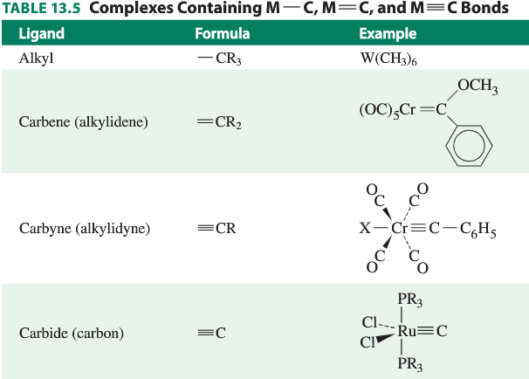
Metal-Alkyl, Carbene, Carbyne Complexes: sigma bonded M-C

