Slide 1
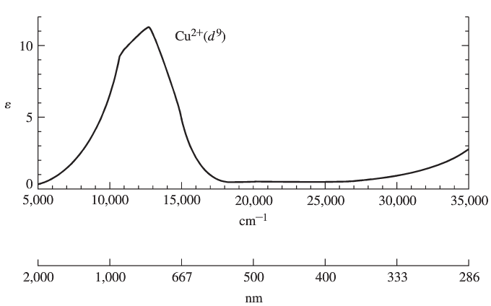
Chapter 11: Electronic Spectra

Slide 2
Why are UV-Vis absorptions bands instead of lines?
Energy wells.

Slide 4
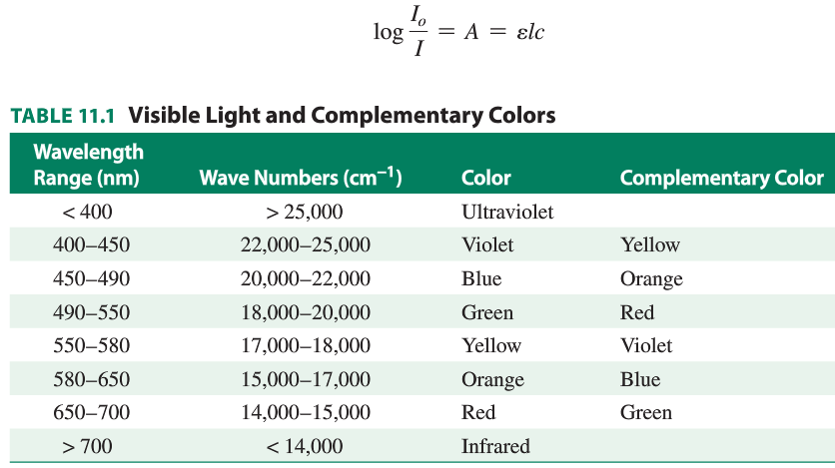
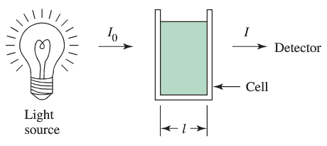

Slide 7
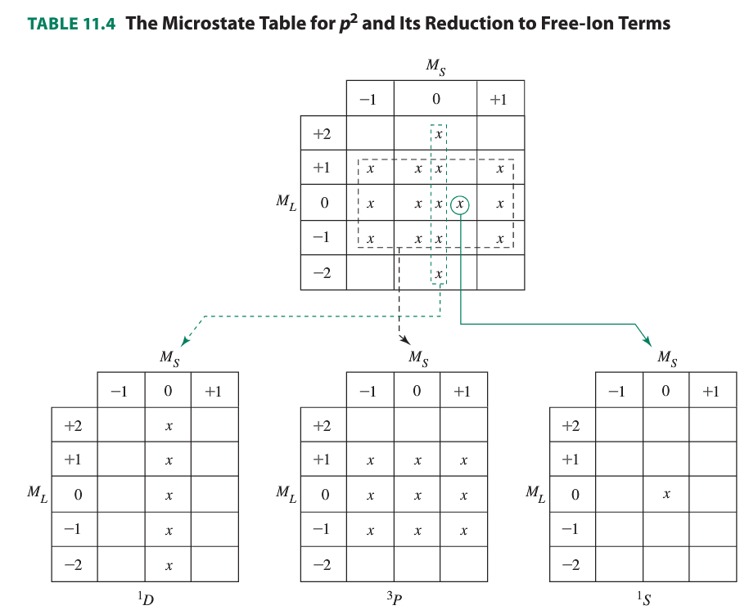

Slide 8

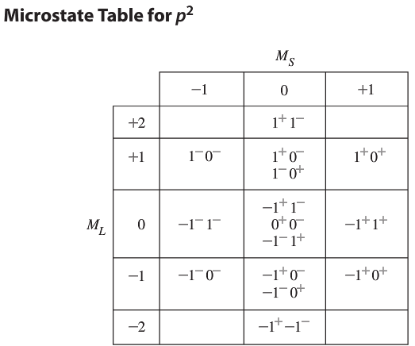
Electronic states of free ions.
Quantum numbers of multielectron atoms. Microstates.

Slide 9
Preview: d-d Transitions for transition metal complexes

Slide 10
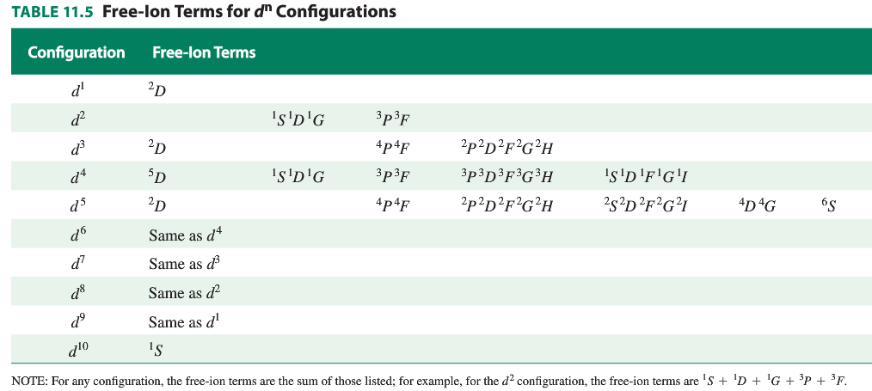

Slide 11
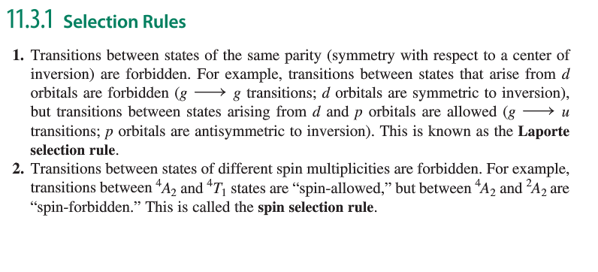

Slide 12
Since octahedral compounds all seem to have only d-d
transitions that must be Laporte forbidden, why are they
colored?

Slide 13
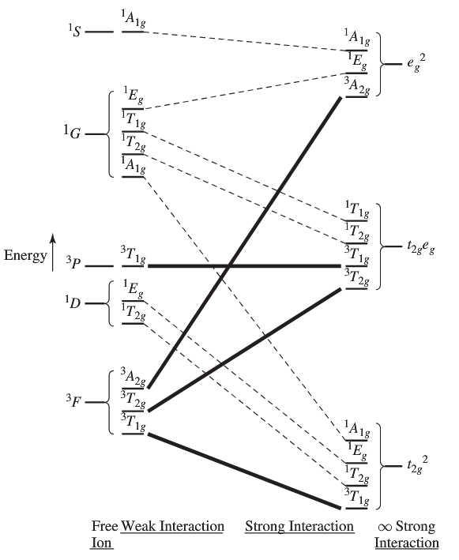
Correlation diagram for
free ions and complexes.
Example: d² ion

Slide 14
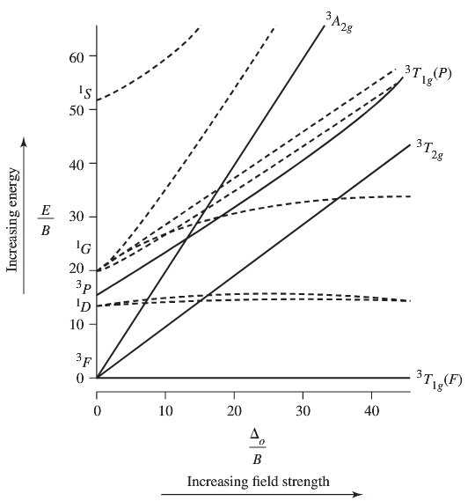
Tanabe-Sugano Diagrams
Example: d²

Slide 15
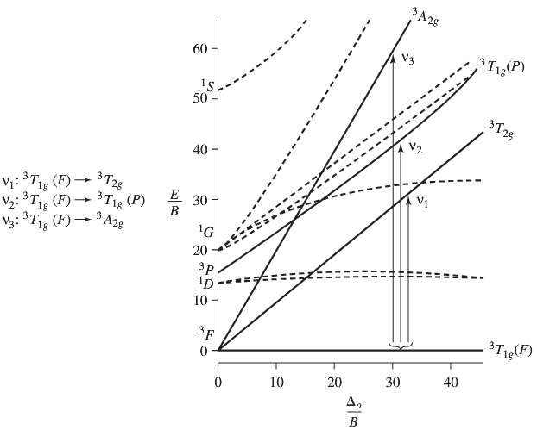
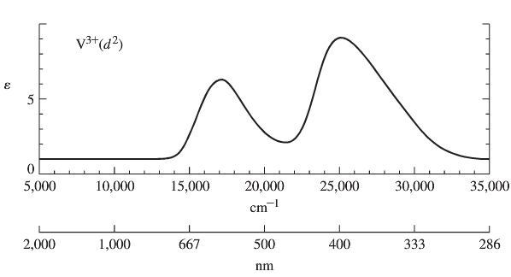
Tanabe-Sugano Diagrams: Example V(H₂O)₆³⁺

Slide 16
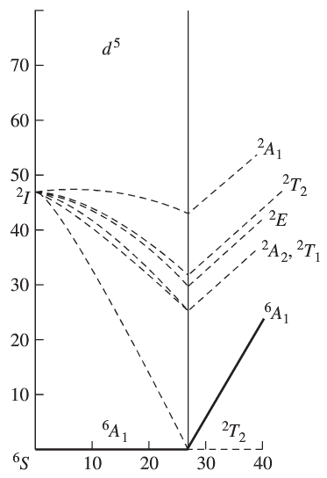
The interesting d⁵ case:

Slide 17
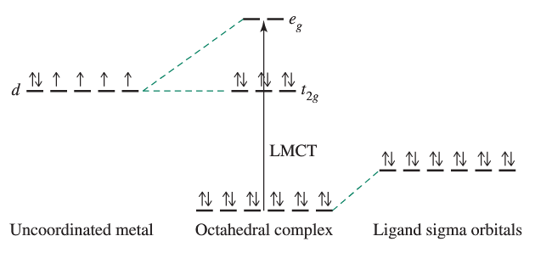
Charge Transfer Transitions: LMCT

Slide 19
Charge Transfer Transitions: MLCT

Slide 20
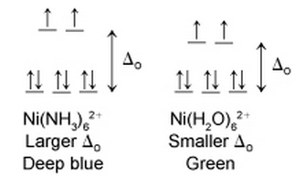
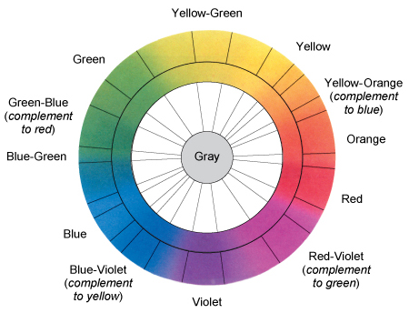
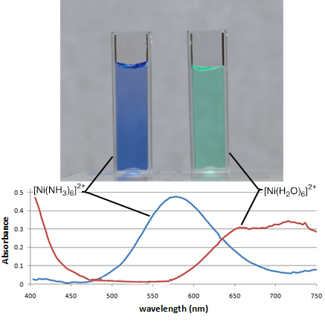
Colors and Spectroscopy of Transition Metal Complexes

Slide 21
Why is:
Mn²⁺(aq) colorless
Cu²⁺(aq) less deeply blue colored than Cu(NH₃)₄²⁺
Zn²⁺(aq) colorless
MnO₄⁻ deeply colored
W(CO)₆ colorless

Slide 22
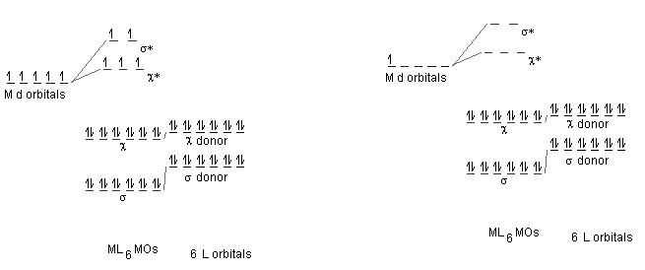
Mn²⁺(aq) MnO₄ ⁻

Slide 23
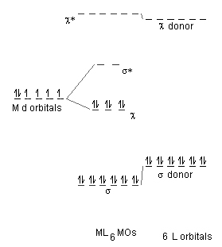
Pi Acceptor Ligands and spectroscopy: CO, CN⁻, pyridine

Slide 24
Ru(bpy)₃²⁺ vs. Ru(py)₂(bpy)₂²⁺

Slide 25
Ru(py)₂(bpy)₂²⁺

