Slide 1
Chapter 4
Symmetry and its Applications
Symmetry = do something to a molecule and have it look the same

Slide 2
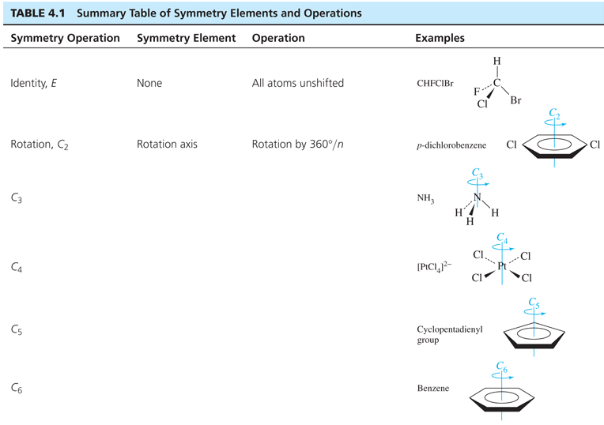

Slide 3
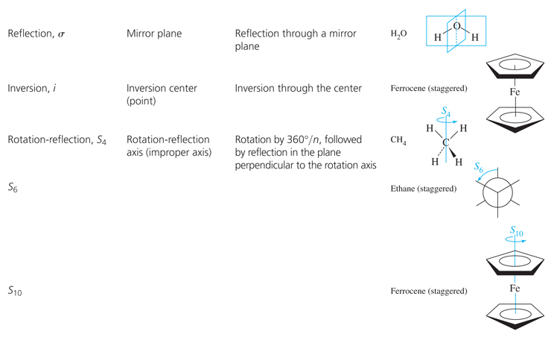

Slide 4
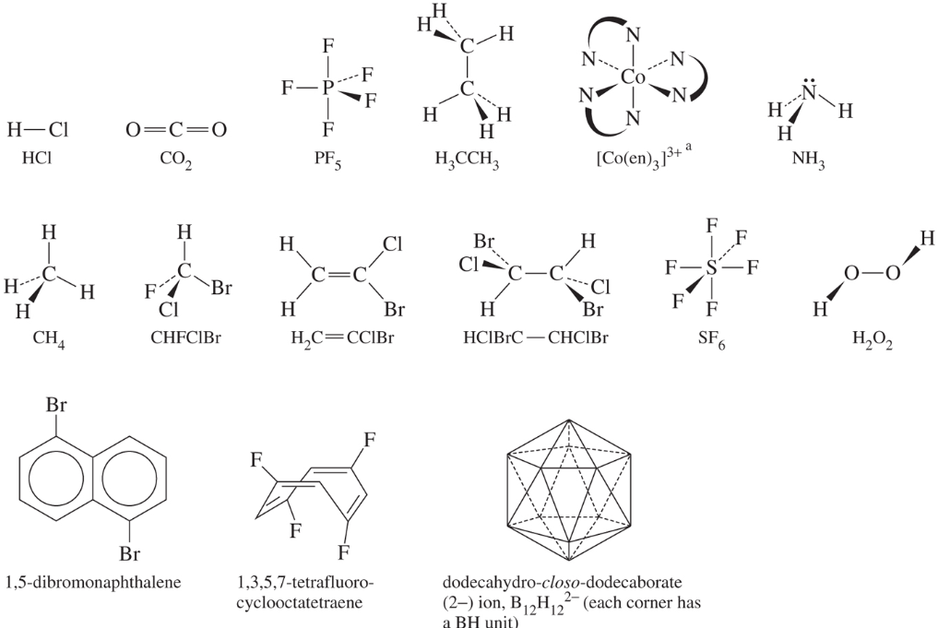

Slide 5
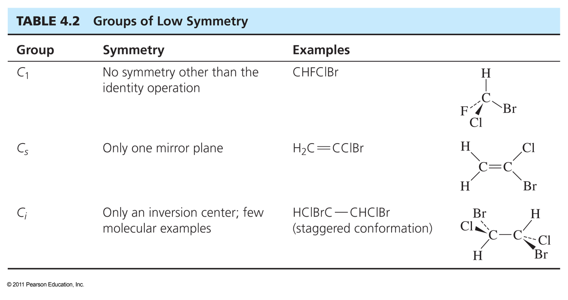

Slide 6
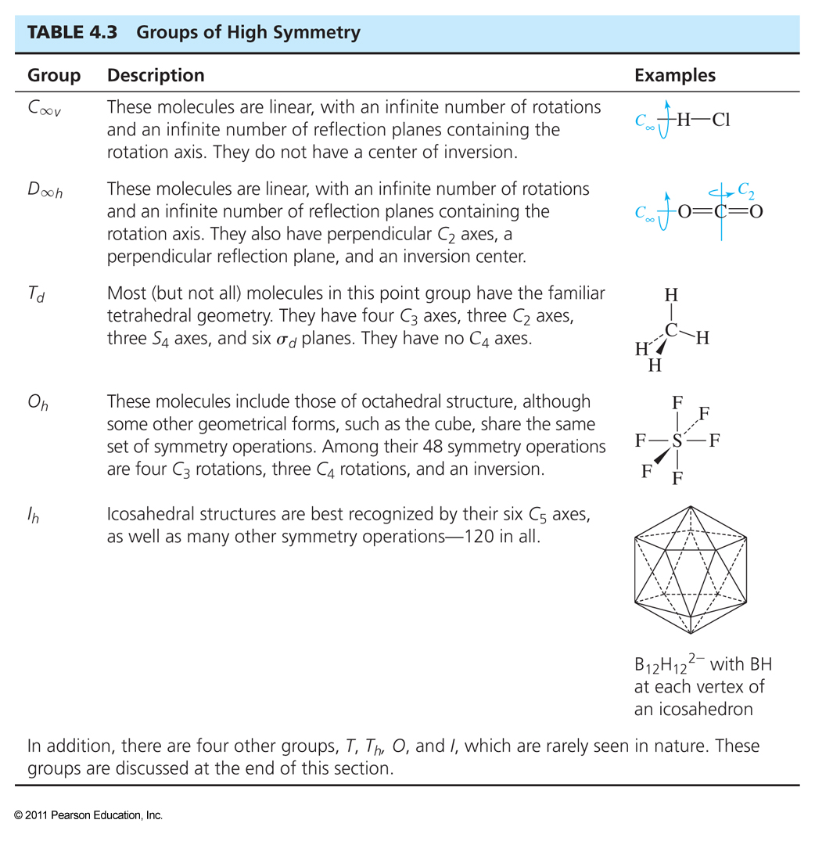

Slide 7
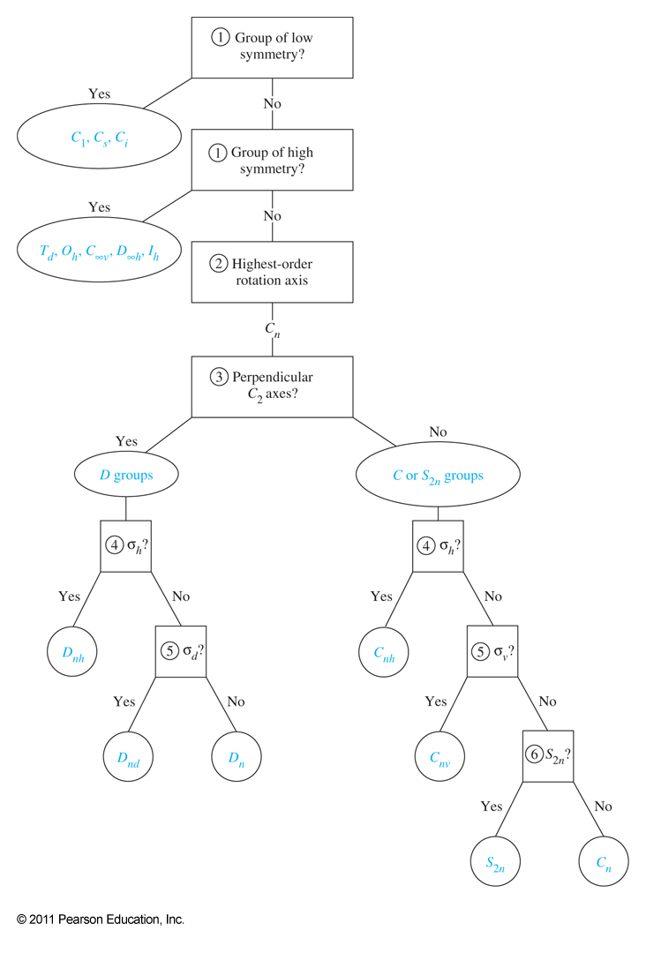

Slide 8
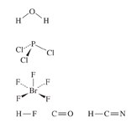

Slide 9
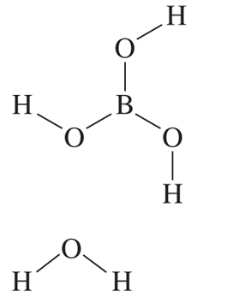

Slide 10
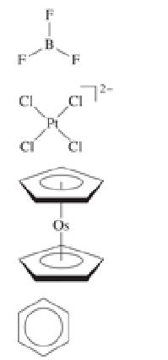

Slide 11
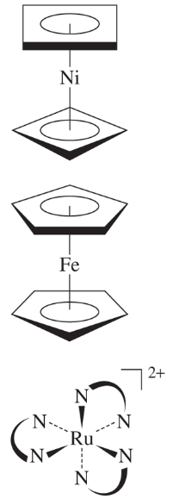

Slide 12
Representations of Groups:
Example: effect of operations on x, y, z axes together

Slide 13
Reducible vs. Irreducible Representations of Groups:
Example: effect of operations on x, y, z axes alone

Slide 14
Character Tables

Slide 15
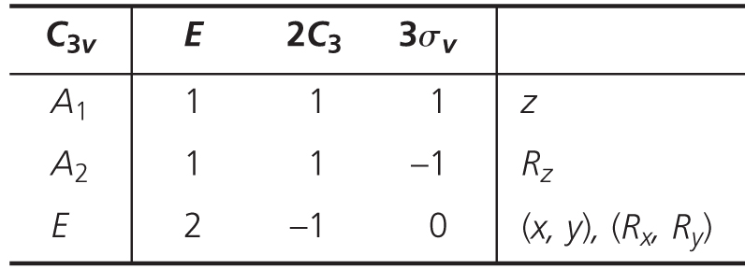
Definitions by Example:
Order = # symmetry operations = 6
Classes = grouping of similar operations = 3
Dimensions = # under E operation
Order of group = Σ(characters under E)²

Slide 16
Symmetry Applications: Vibrations
Examine x, y, z changes for each atom.
An atom that moves gets zeros for each.
Those not moving get 1 or -1 for each.
Add them up to get reducible representation for atomic motions.
Break reducible representation up to get list of irreducible representation.
# irrrep= 1/order Σ(#operations in class)(character of redrep)(character of irrerep)
All motions = degrees of freedom = 3n
Translations = 3 and go by x, y, z functions.
Rotations = 3 and go by Rx. Ry, and Rz functions.
Vibrations are what’s left over.
IR active translate as x, y, z functions.
Raman active translate as xy, xz, yz, z², etc. functions.

Slide 17
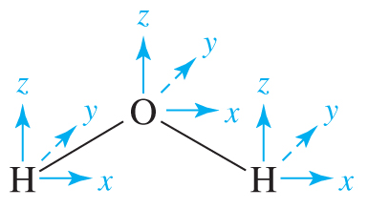
Vibrational Analysis for Water

Slide 18
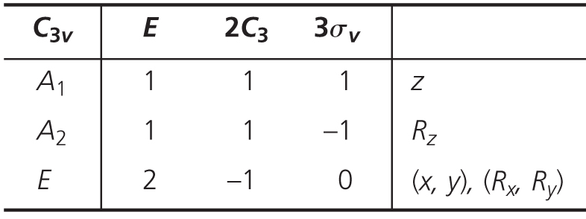
Vibrational Analysis of NH₃

Slide 19
Vibrational Analysis of XeF₄

Slide 20
Vibrational Analysis of XeF₄

Slide 22
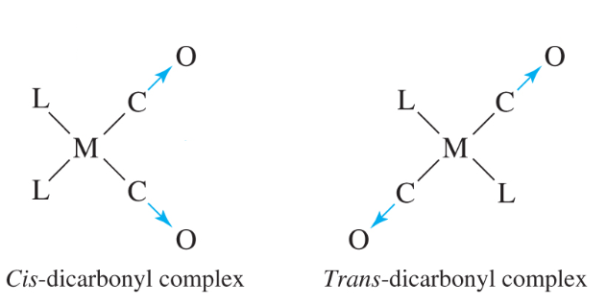
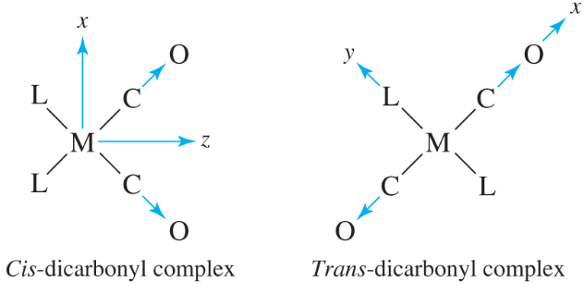
Vibrational Analysis of Selected Vibrational Modes: CO stretches:
Consider only the C-O axis. If it moves, = 0 ; if it stays, =1
Can an IR spectrum distinguish between these two isomers?

Slide 23
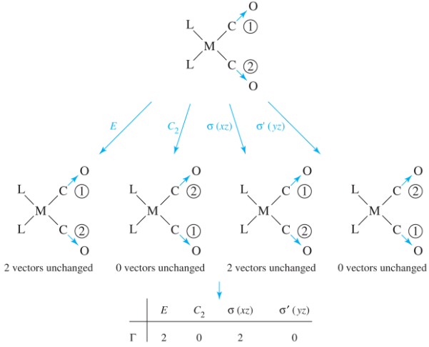
cis-ML₂(CO)₂

Slide 24
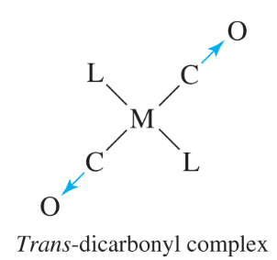
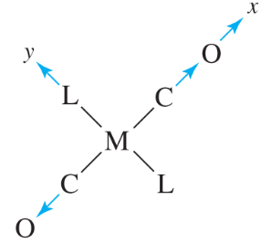
trans-ML₂(CO)₂

Slide 25
trans-ML₂(CO)₂

Slide 27
Chapter 4 Homework
1, 2, 3, 5, 13, 16 a-e, 21, 23 (using items from problems 4 and 5 only),
24, 25, 26, 27, 28

