Slide 1
Section 1.3-1.4 Units and Dimensional Analysis
Bill Vining
SUNY College at Oneonta

Slide 2
In this section…
Common units
Dimensional analysis: conversion factors
Using density

Slide 3
General Idea
A quantity is known and expressed in a unit.
To convert to another unit, assemble a “conversion factor”
by building a fraction where the numerator and denominator
express the same physical reality in different units. Multiply the
original quantity by the conversion so that units cancel to give
the answer in the desired unit.

Slide 4
Eggs!
Express 63 eggs in units of dozens of eggs.

Slide 5
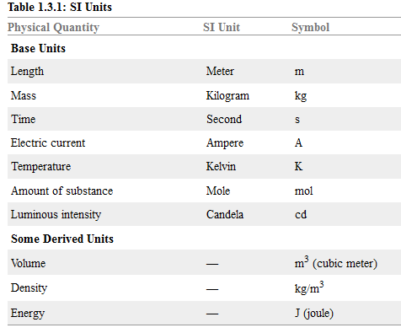
Common Units

Slide 6
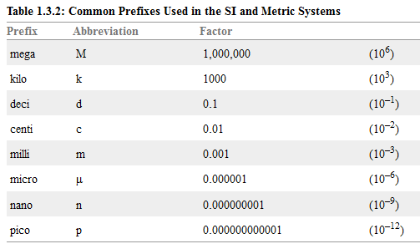
Metric System Prefixes

Slide 7
Converting between units: simple metric
Express 1.75 m in cm.
Express 5.8 ns in s.

Slide 8
Converting between units:
Express 458 s as minutes.

Slide 9
Converting between units: multiple steps
How many seconds are in a day?

Slide 10
Dealing with Multistep Conversion: Problem Maps
The distance to the nearest star is about 4.24 light years. Light
travels 186000 miles per second. What is this distance, in kilometers?
1.00 mile =1.61 km

Slide 11
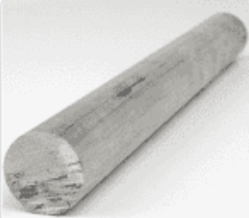
Using Density as a Conversion Factor Between Mass and Volume
Density of aluminum = 2.7 g/cm³
What is the mass of a solid aluminum rod that
is 1.00 m long and gas a diameter or 3.00 cm?

