Slide 1
Section 2.1 The Structure of the Atom

Slide 2
The Structure of the Atom
In this section…
The components of an atom
Atomic symbols
Isotopes and atomic weight

Slide 3
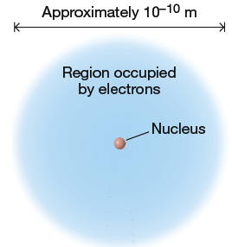
The Structure of the Atom
Components of an Atom:

Slide 4
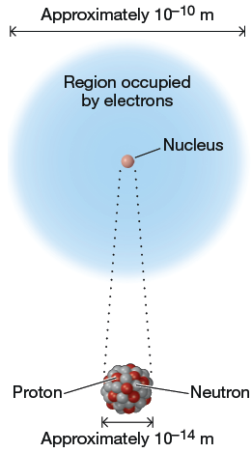
The Structure of the Atom
Components of an Atom:

Slide 5
The Structure of the Atom

Slide 6
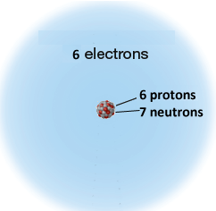
The Structure of the Atom
Atomic number and mass number:

Slide 7
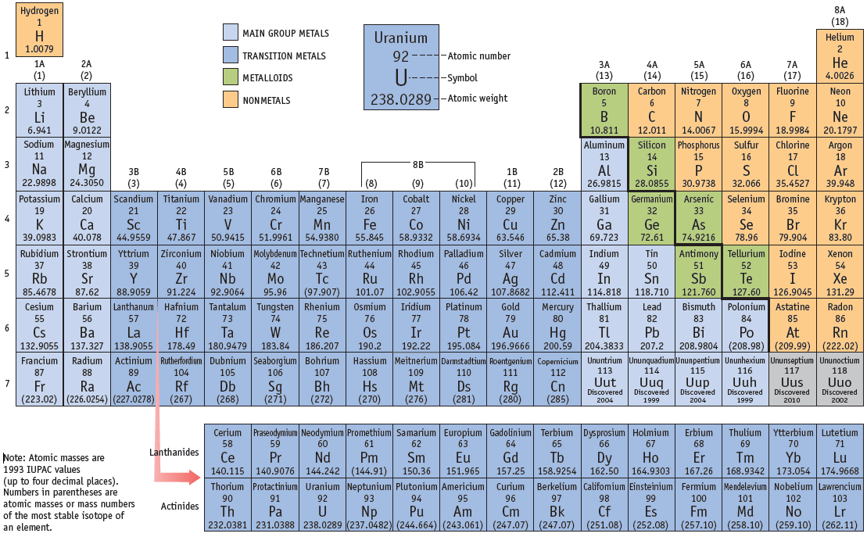
The Structure of the Atom
Atomic symbols:

Slide 8
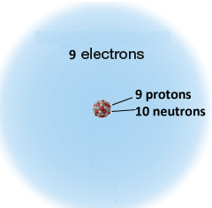
The Structure of the Atom
Atomic symbols:

Slide 9
The Structure of the Atom
Isotopes: atoms with the same number of protons
but different numbers of neutrons

Slide 10
The Structure of the Atom
Isotopes and average atomic weight:
The average atomic weight of an element depends
on the mass of the atoms but also on the relative
abundance of each isotope.

Slide 11
The Structure of the Atom
Average atomic weights are shown on periodic table:

Slide 12
Chiuaua: 4 lbs.
Mastif: 120 lbs.
What is the average weight of a collection of these dogs?

Slide 13
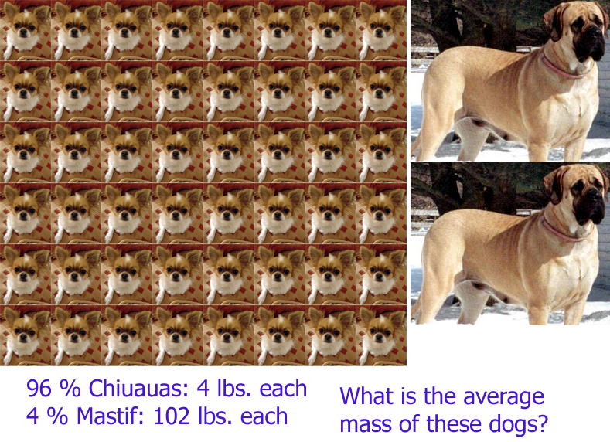

Slide 14
The Structure of the Atom
Isotopes and average atomic weight:
Average dog mass:
96 % Chiuauas @ 4 lbs.
4 % Mastifs @ 120 lbs.

Slide 15
The Structure of the Atom
Elements with a single isotope have
atomic weight = mass of that isotope
Can make rough estimate of relative abundance
from average atomic weight.

Slide 17
Isotope trends among the elements:

Slide 18
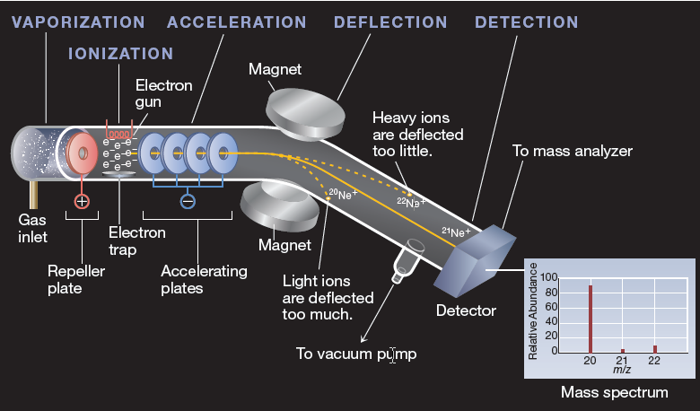
The Structure of the Atom
Isotopes and average atomic weight:
how do we know all this?
Mass spectrometry

Slide 19
Section 2.2 The Periodic Table

Slide 20
The Periodic Table
In this section…
Structure of the periodic table
Classifications of elements
Element structures (atomic arrangements)

Slide 22
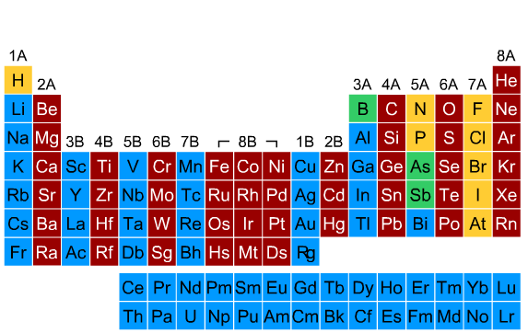
Periodic table structure: groups (columns)

Slide 24
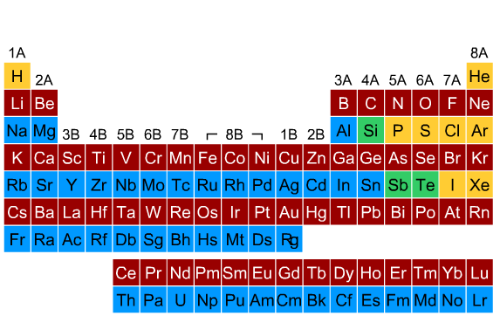
Periodic table structure: periods (rows)

Slide 25
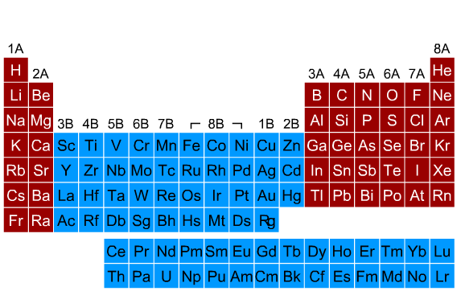
Periodic table structure: main group elements

Slide 26
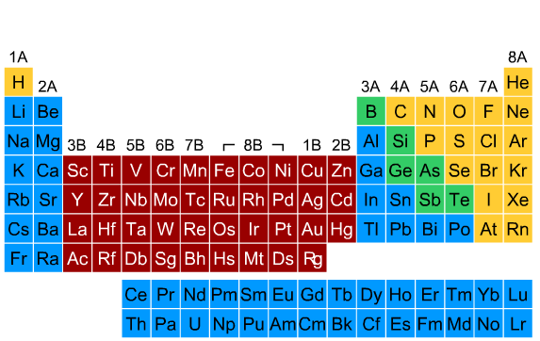
Periodic table structure: transition metals

Slide 27
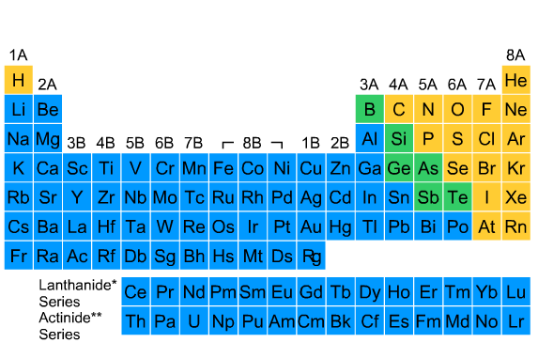
Periodic table structure: lanthanides and actinides

Slide 28
Periodic table structure: lanthanides and actinides

Slide 29
Periodic table structure: lanthanides and actinides

Slide 30
Periodic table structure: named groups

Slide 31
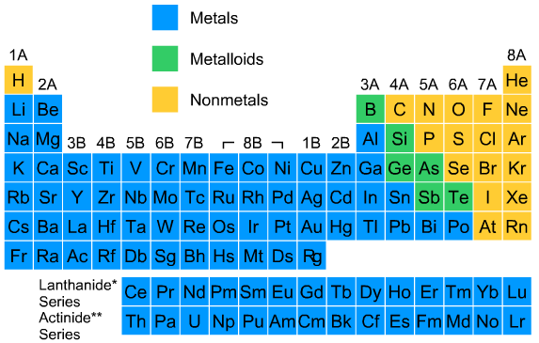
Classification of elements:

Slide 32
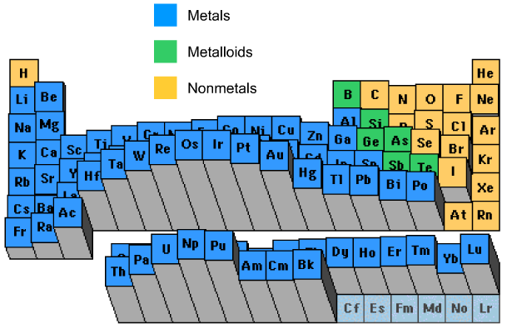
Periodic trends: density

Slide 33
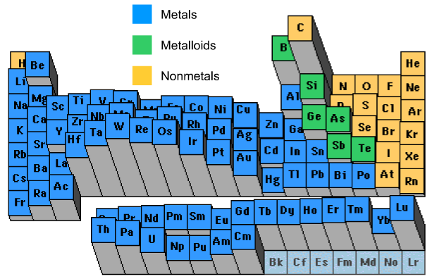
Periodic trends: melting point

Slide 34
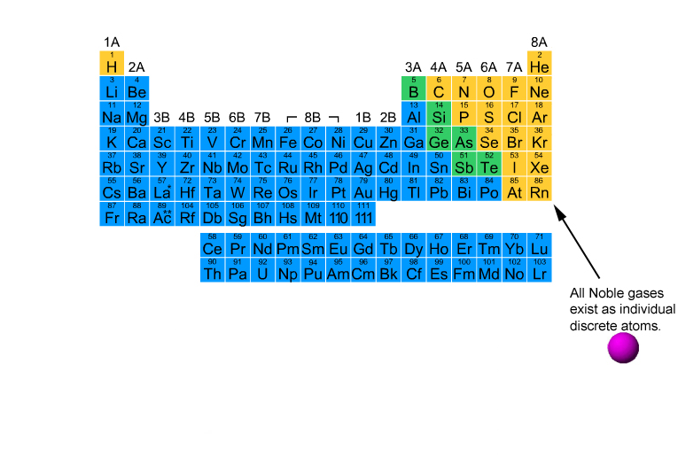
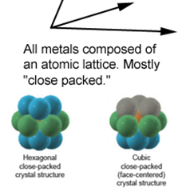
Element structures

Slide 35
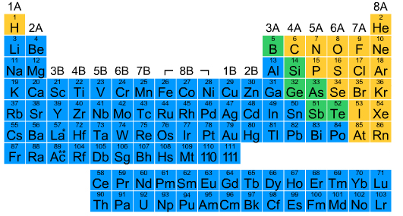
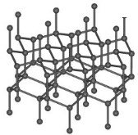
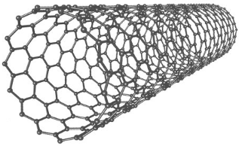
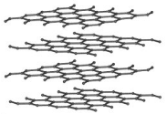
Element structures: extended structures

Slide 36
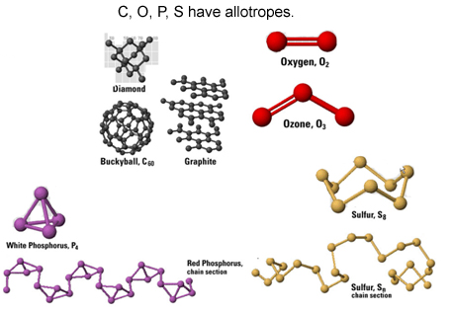
Element structures: allotropes (same element,
different structures)

