Slide 1
Section 2.3 Covalent Compounds

Slide 2
Covalent Compounds
In this section…
The nature of covalent compounds
Ways of representing covalent compounds
Naming covalent compounds

Slide 3
Covalent Compounds
Covalent compounds are composed of atoms of
different elements that are bonded together by
sharing electrons.
Two types: -- molecular compounds
-- network covalent compounds

Slide 4
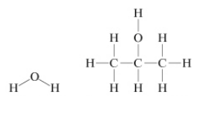
Covalent Compounds
Molecular compounds:
composed of individual molecules containing
the same number of atoms

Slide 5
Covalent Compounds
Molecular compounds:
composed of individual molecules containing
the same number of atoms

Slide 6
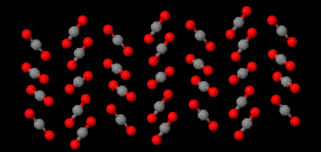
Molecular Compounds
Molecular compounds: carbondioxide

Slide 7
Covalent Compounds
Network covalent compounds:
A large number of atoms of different elements
bonded by shared electrons. Each sample
has molecules with different numbers of atoms.

Slide 8
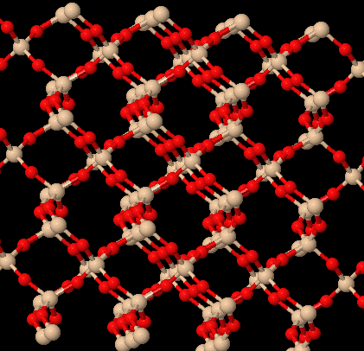
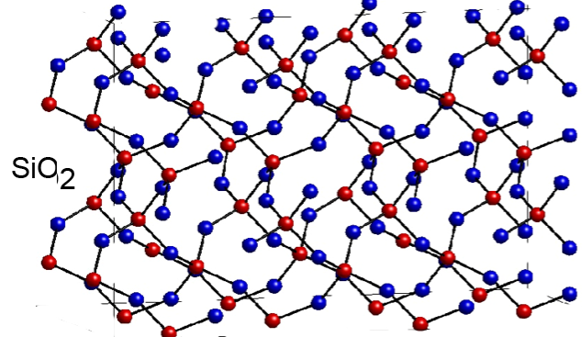
Covalent Compounds
Network covalent compounds: silicondioxide

Slide 9
Covalent Compounds
Representing compounds:
Molecular formula: depicts number of atoms
of each element
Empirical formula: shows simplest integer ratio
of atoms of each element
Structural formula: shows atomic linkages
Models: show 3-dimensional shape of molecule

Slide 10
Covalent Compounds
Molecular formula: depicts number of atoms
of each element

Slide 11
Covalent Compounds
Empirical formula: shows simplest integer ratio
of atoms of each element
molecular formula:
empirical formula:

Slide 12
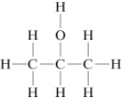
Covalent Compounds
Molecular and Empirical formulas
are often the same.

Slide 13
Covalent Compounds
Structural formula: shows connections
between atoms

Slide 14
Covalent Compounds
Condensed structural formula: mainly for organics.
CH₃CH₂CH₂CH₂OH

Slide 15
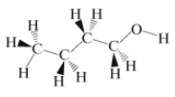
Covalent Compounds
Models: show 3-dimensional shape
wedge-and-dash
ball-and-stick

Slide 16
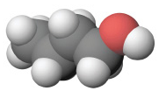
Covalent Compounds
Models: Ball-and-Stick vs. Space Filling

Slide 17
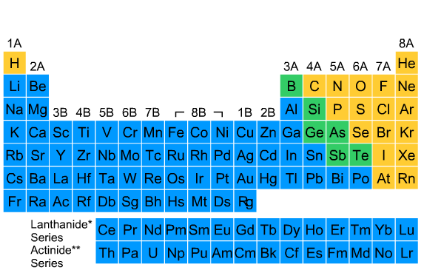
Nomenclature: Naming Binary Nonmetal Compounds
Going from formula to name.
Interactive Table 2.3.1

Slide 18
Interactive Table 2.3.1
1. The first word in the compound name is the name of the first element in the compound
formula. If the compound contains more than one atom of the first element, use a prefix
(Table 2.3.2) to indicate the number of atoms in the formula.
CS₂First word in compound name: carbon
N₂O₄First word in compound name: dinitrogen
2. The second word in the compound name is the name of the second element in the formula
that has been changed to end with -ide. In all cases, use a prefix (Table 2.3.2) to indicate
the number of atoms in the formula.
CS₂Second word in compound name: disulfide
N₂O₄Second word in compound name: tetraoxide
3. The compound is named by combining the first and second words of the compound
name.
CS₂carbon disulfide
N₂O₄dinitrogen tetraoxide

Slide 19
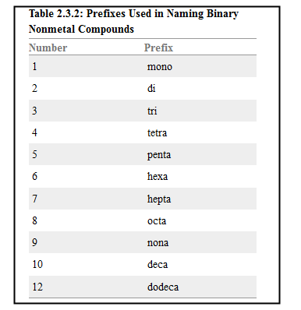

Slide 20
Some Examples:
SO₂
SO₃
ClO
S₂F₁₀
Some Common Compounds:
H₂O N₂H₄
H₂O₂ NO
NH₃

Slide 21
Important Simple Hydrocarbons
Alkanes: Table 2.3.4
Hydrocarbon Name
CH₄ Methane
C₂H₆ Ethane
C₃H₈ Propane
C₄H₁₀ Butane
C₅H₁₂ Pentane
C₆H₁₄ Hexane
C₇H₁₆ Heptane
C₈H₁₈ Octane
C₉H₂₀ Nonane
C₁₀H₂₂ Decane

Slide 22
Table 2.3.5: Names and Formulas of the Halogen Oxoacids
Name Formula Name Formula
HClO₄ Perchloric acid HBrO₄ Perbromic acid
HIO₄ Periodic acid HClO₃ Chloric acid
HBrO₃ Bromic acid HIO₃ Iodic acid
HClO₂ Chlorous acid HBrO₂ Bromous acid
HIO₂ Iodous acid HClO Hypochlorous acid
HBrO Hypobromous acid HIO Hypoiodous acid

Slide 23
Table 2.3.6: Names and Formulas of Some Inorganic Acids
Name Formula
Hydrogen chloride HCl (also hydrochloric acid)
Hydrogen bromide HBr (also hydrobromic acid)
Hydrogen iodide HI (also hydroiodic acid)
Nitric acid HNO₃
Nitrous acid HNO₂
Hydrogen sulfide H₂S
Sulfuric acid H₂SO₄
Sulfurous acid H₂SO₃
Phosphoric acid H₃PO₄

