Slide 1
Section 2.4 Ionic Compounds

Slide 2
Ionic Compounds
In this section…
Monatomic and Polyatomic ions
Ionic compound formulas
Naming ionic compounds
Covalent vs. Ionic compounds

Slide 3
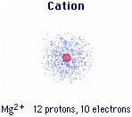
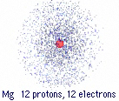
Formation of Ions
Cations: Positive ions form by loss of electrons.

Slide 4
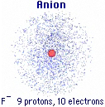
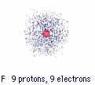
Formation of Ions
Anions: Negative ions form by gain of electrons.

Slide 5
Names of Monatomic Ions
monatomic cations: element name + “ion”
monatomic anions: element name with “ide” suffix + “ion”

Slide 6
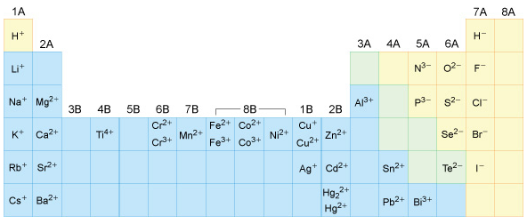
Common Monatomic Ions

Slide 7
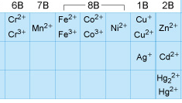
Naming Transition Metal Cations
The name of a transition metal cation is the element name
followed by the cation charge in Roman numerals
within parentheses and the word ion.
Cr²⁺
Co³⁺

Slide 8
Polyatomic Ions Groups of bonded atoms with a charge
Ammonium ion: NH₄⁺
Carbonate ion: CO₃²⁻

Slide 9
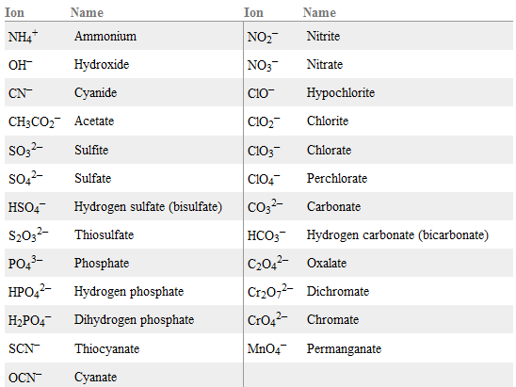
Table 2.4.1: Polyatomic Ions

Slide 10
Formulas of Ionic Compounds
Rule: Total charge on cations = Total charge on anions
So, ions combine in numbers so charges cancel.
Mg²⁺ and Cl⁻
Mg²⁺ and N³⁻
Na⁺ and O²⁻
Mg²⁺ and O²⁻

Slide 11
Formulas of Ionic Compounds
Rule: Total charge on cations = Total charge on anions
When multiple polyatomic ions are present, they are in
parentheses.
Mg²⁺ and PO₄³⁻
Parentheses are not used with a single polyatomic ion:
Mg²⁺ and SO₄²⁻

Slide 12
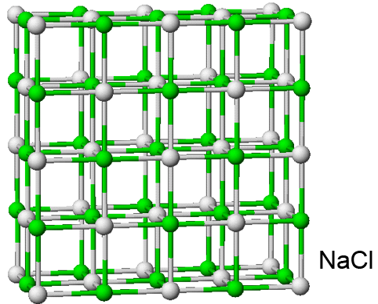
Formulas of Ionic Compounds
Ionic compounds are extended structures:
No molecules, so no “molecular formula.”

Slide 13
Naming Ionic Compounds
Ionic compound name = cation name + anion name
The word “ion” is dropped from the ion names.
The name does NOT reflect the number of ions.
NaCl
Na₂SO₄
MgCl₂
(NH₄)₃PO₄

Slide 14
Naming Ionic Compounds
Transition metals with variable charges?
The name of a transition metal cation is the element name
followed by the cation charge in Roman numerals
within parentheses and the word ion.
CrCl₂
CoPO₄

Slide 15
Identifying Covalent vs. Ionic Compounds
Ionic Compounds:
Metals + nonmetals
Metals + polyatomic anions
Two polyatomic ions
Covalent Compounds:
Two nonmetals,
but no polyatomic ions

