Slide 1
Section 4.3 Net Ionic Equations
Bill Vining
SUNY Oneonta

Slide 2
In this section: a. Precipitation Reactions b. Acid-Base Reactions c. Gas-Forming Reactions

Slide 3
Precipitation Reactions
Two soluble reactants produce an insoluble product.
Swap cations and anions and see if either product is insoluble.
AgNO₃(aq) + NaCl(aq) →

Slide 4
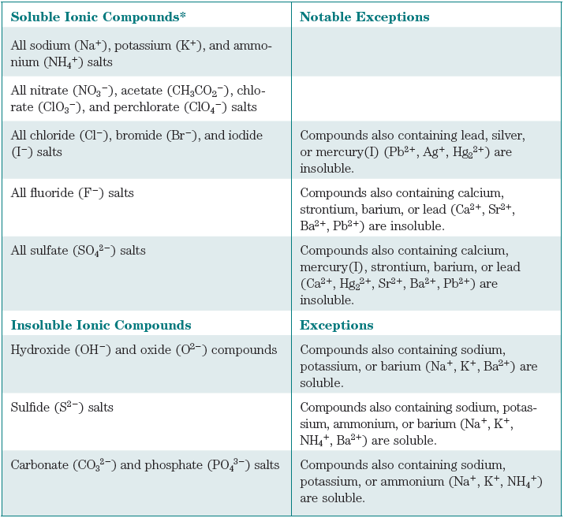

Slide 5
Precipitation Reactions
Two soluble reactants produce an insoluble product.
Swap cations and anions and see if either product is insoluble.
Fe(NO₃)₂(aq) + NaOH(aq) →

Slide 7
Precipitation Reactions
Two soluble reactants produce an insoluble product.
Swap cations and anions and see if either product is insoluble.
Fe(NO₃)₂(aq) + NaCl(aq) →

Slide 9
Net Ionic Equations: How to write
Write full ionic equation and cancel spectator ions.
Rules: strong electrolytes are written as separate ions.
This means soluble salts and strong acids and bases.
All acids are soluble. Weak acids are written in their non-ionized form.

Slide 10
Precipitation Reactions: Net Ionic Equations
Write full ionic equation and cancel spectator ions.
Fe(NO₃)₂(aq) + 2 NaOH(aq) → Fe(OH)₂(s) + 2 NaNO₃(aq)

Slide 11
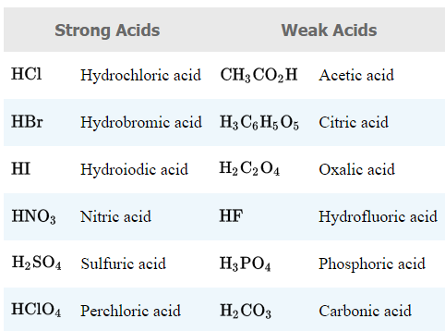
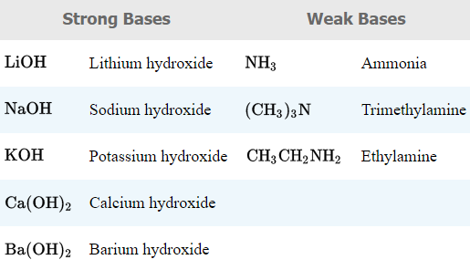
Common Acids and Bases

Slide 12
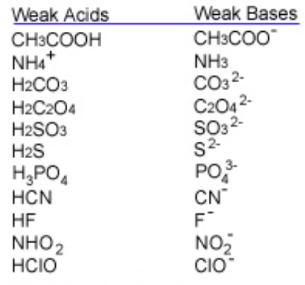
Weak Acid-Base Conjugate Pairs

Slide 13
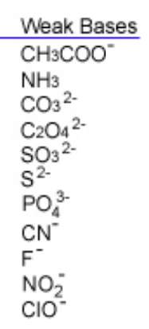
Salts that Contain Basic Anions

Slide 14
Salts that Contain Acidic Cations
NH₄⁺

Slide 15
Acid-Base Reactions
The acid transfers an H⁺ ion to the base.
HF(aq) + NH₃(aq) →
HCN(aq) + NaCH₃CO₂(aq) →

Slide 16
Acid-Base Rxns: Strong Base Produces Water
Products are a salt and H₂O.
HCl(aq) + KOH (aq) →
H₃PO₄ + NaOH →

Slide 17
Strong Acid- Strong Base Reactions
Products are a salt and H₂O.
HCl(aq) + KOH (aq) →

Slide 18
Gas-Forming Reactions
Special cases of acid-base reactions that produce gases.
Carbonates react with acid to form carbon dioxide gas.
Step 1: 2 H⁺(aq) + CO₃²⁻(aq) → H₂CO₃(aq)
Step 2: H₂CO₃(aq) → H₂O(l) + CO₂(g)

Slide 19
Three Gas-Forming Reactions
Special cases of acid-base reactions that produce gases.
Carbonates:
2 H⁺(aq) + CO₃²⁻(aq) → H₂O(l) + CO₂(g)
Sulfites:
2 H⁺(aq) + SO₃²⁻(aq) → H₂O(l) + SO₂(g)
Sulfides:
2 H⁺(aq) + S²⁻(aq) → H₂S(g)

Slide 20
Gas-Forming Reactions
Special cases of acid-base reactions that produce gases.
HCl(aq) + Na₂CO₃(aq) →
HNO₃(aq) + K₂SO₃(aq) →
HCl(aq) + CaS(s) →

Slide 21
Net Ionic Equations: How to write compounds in solution.
1. Strong electrolytes are written as separate ions.
This means soluble salts and strong acids and bases.
Ca(NO₃)₂(aq) is written as Ca²⁺(aq) + 2 NO₃⁻(aq)
HCl is written as H⁺(aq) + Cl⁻(aq)
2. All acids are soluble. Weak acids are written in their non-ionized form:
CH₃CO₂H(aq)
3. Insoluble salts and molecular compounds are written as the full compound:
CaCO₃(s) NO₂(aq)

Slide 22
Net Ionic Equations: General Procedure
Identify reaction and write balanced equation
Do double displacement reaction
Identify any precipitates (if so, precipitation rxn occurs)
Identify acid and base (must be both to have acid-base reaction)
Look for basic anions
Look for gas forming reaction
2. Write full ionic equation
3. Cancel spectator ions to give net ionic equation

Slide 23
K₂CO₃ + SrCl₂ →

Slide 24
NaCH₃CO₂ + HCl →

Slide 25
CrCl₃ + Na₂S →

Slide 26
HCl + CaCO₃ →

Slide 27
Ba(OH)₂ + HClO₄ →

Slide 28
KOH + H₃PO₄ →

Slide 29
Ca₃(PO₄)₂ + HCl →

