Slide 1
Sections 6.1 – 6.3 Electromagnetic Radiation and its Interaction with Atoms
Bill Vining
SUNY College at Oneonta

Slide 2
In this section:
electromagnetic radiation
photons and photon energy
the Bohr model of the H atom

Slide 3
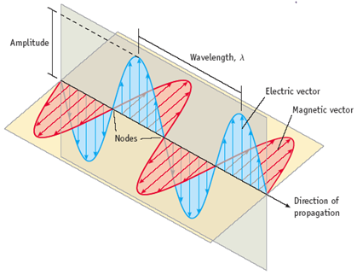

Slide 4
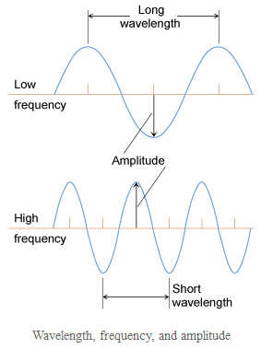

Slide 5
Wavelength and Frequency
c = λν
c = speed of light = 3.00 x 10⁸ m/s

Slide 6
A radio station has a frequency of 103.5 MHz. What is the wavelength of this radiation?

Slide 7
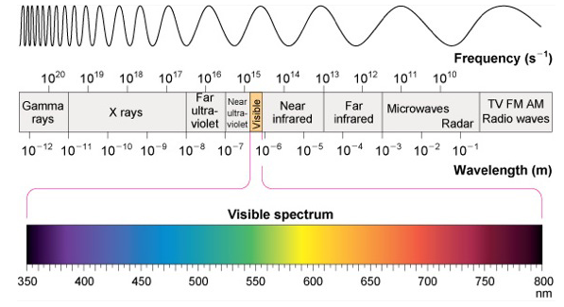
The Electromagnetic Spectrum

Slide 8
How radiation interacts with atoms and molecules
visible and ultraviolet
infrared
microwave
radio waves
x-rays

Slide 9
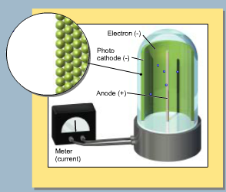
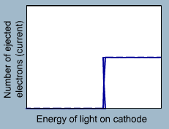
The Photoelectric Effect

Slide 10
Photons and Photon Energy
E_{photon} = hν
h = 6.626 × 10^{–34} J•s
What is the energy of a photon of 455 nm visible light?

Slide 11
Where does light come from?
Excited solids emit a continuous spectrum of light
Excited gas-phase atoms emit only specific wavelengths of light (“lines”)

Slide 12
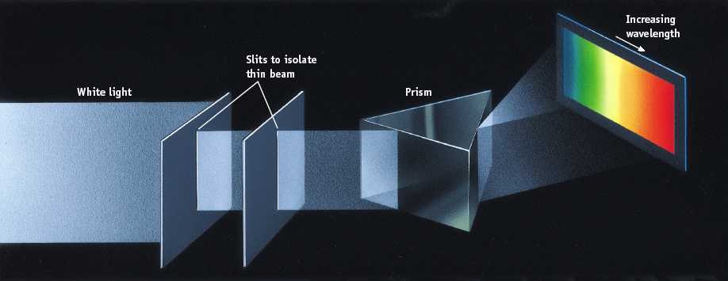
Light emitted by solids

Slide 13
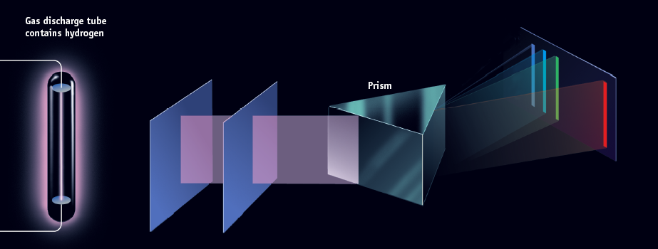
Light emitted by hydrogen gas

Slide 14
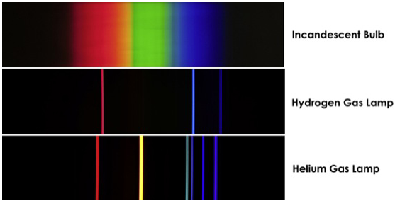
Spectra

Slide 15
What do line spectra tell us?

Slide 16
Hydrogen Electronic Transitions

Slide 17
Hydrogen Energy Levels
Why negative?
What is “zero”?

Slide 18
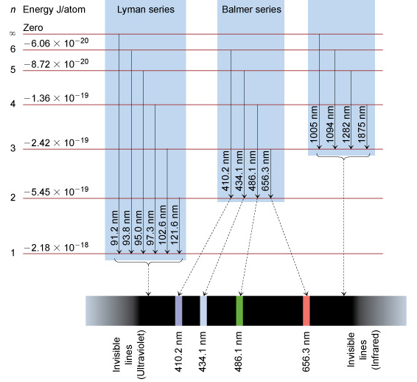
Hydrogen
Energy
Levels

Slide 19
Hydrogen Transition Energies

Slide 20
What is the wavelength of light used to promote an
electron from the n = 3 level to the n = 4 level?

Slide 21
a) The emission line with the longest wavelength. b) The absorption line with the shortest wavelength. c) The emission line with the lowest energy. d) The absorption line with the lowest energy. e) The emission line with the lowest frequency. f) The line corresponding to the ionization energy of hydrogen.

