Slide 1
Sections 9.1 – 9.3 Valence Bond Theory and Hybrid Orbitals
Bill Vining
SUNY Oneonta

Slide 2
Valence Bond Theory
In this section…
Bond formation
Hybrid orbitals
Pi bonding
Isomers and Conformations

Slide 3
Why do bonds form?
Valence bond theory

Slide 4
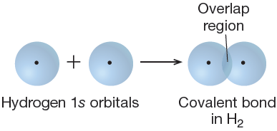
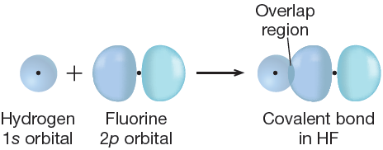
Sigma Bonding: Overlap region lies directly between the nuclei of bonding atoms

Slide 5
Hybrid Orbitals
Consider methane, which has tetrahedral geometry
Valence orbitals for central C atom:

Slide 6
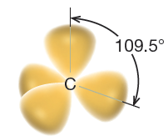
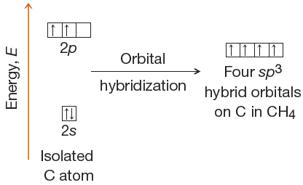
Hybrid Orbitals
2s, 2p_{x}, 2p_{y}, 2p_{z} orbitals
combine to form four sp³ hybrid orbitals

Slide 7
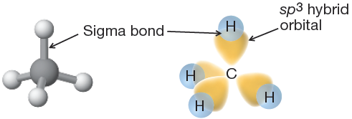
Bonding in Methane

Slide 8
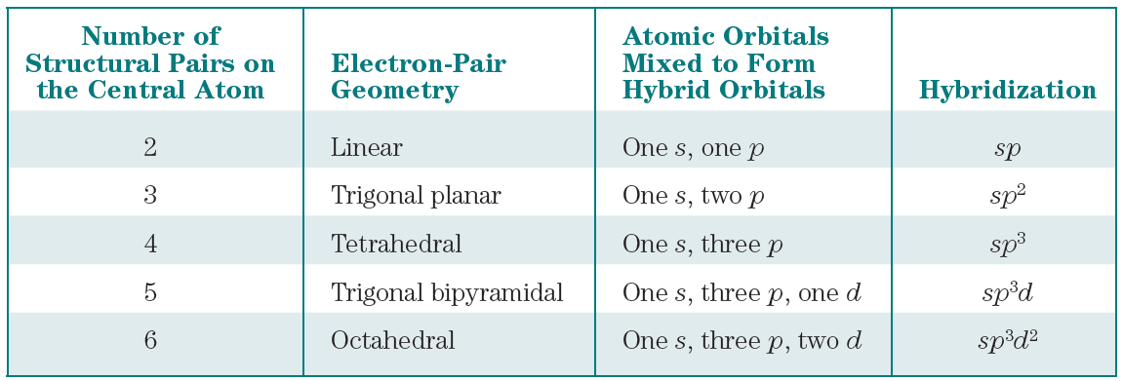
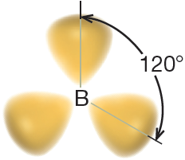
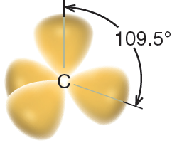
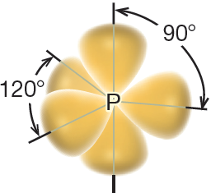
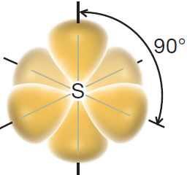
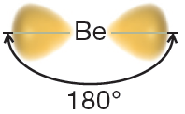
Types of Hybrid Orbitals
sp sp² sp³ sp³d sp³d²

Slide 9
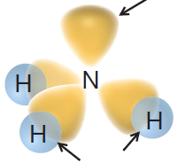
Bonding in Ammonia: NH₃

Slide 10
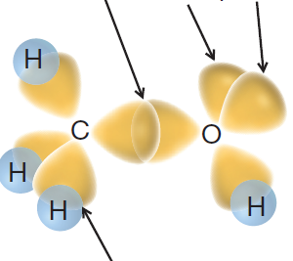
Bonding in Methanol: CH₃OH

Slide 11
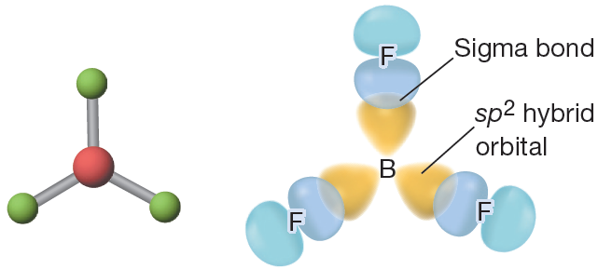
Bonding in BF₃

Slide 12
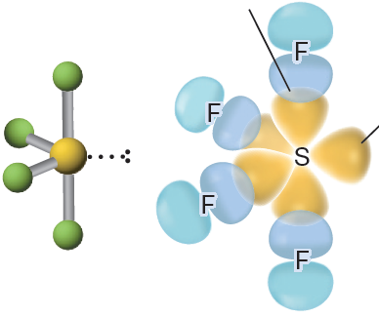
Bonding in SF₄

Slide 13
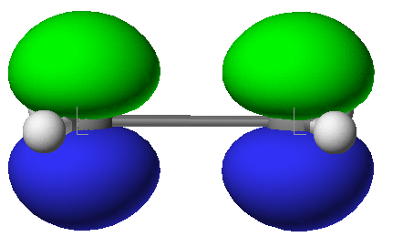
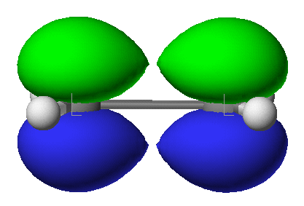
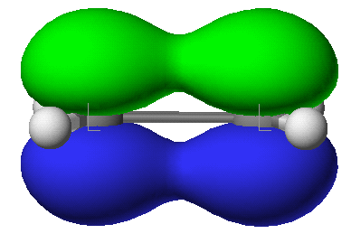
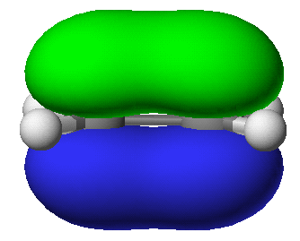
Formation of pi Bonds
Pi bonds form by overlap of parallel p orbitals (overlapping side-to-side)

Slide 14
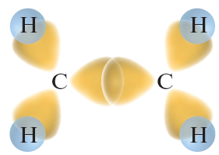
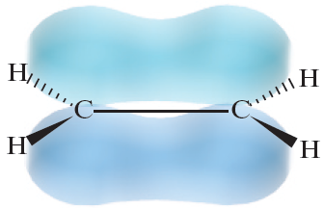
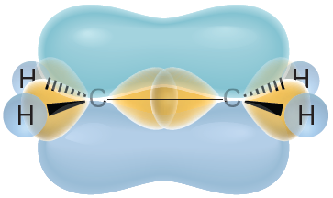
Bonding in ethene: C₂H₄
sigma bonding:
pi bonding:
combined bonding:

Slide 15
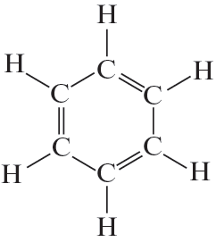
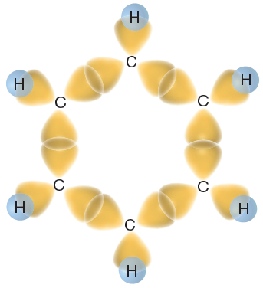
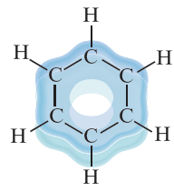
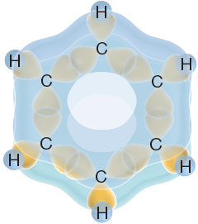
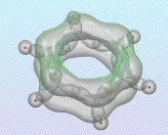
Bonding in benzene: C₆H₆
sigma bonding:
pi bonding:
combined
bonding:

Slide 16
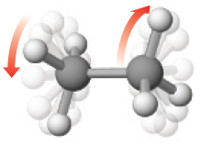
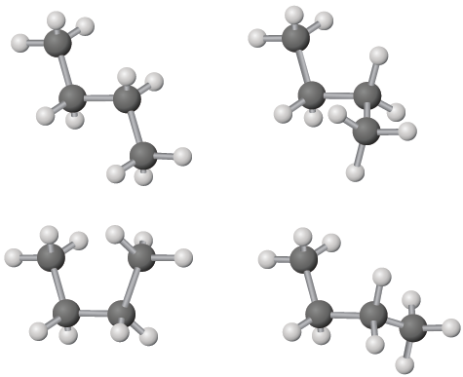
Isomers vs. Conformations
Bond Rotations: rotations about single bonds are easy
Bond Rotations about single bonds result in conformations

Slide 17
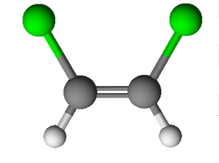
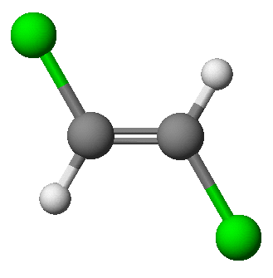
Isomers vs. Conformations
Bond Rotations: rotations about pi bonds are difficult
Bond Rotations about pi bonds result in isomers

Slide 18
cis-trans isomerization in alkenes
cis
trans

Slide 19
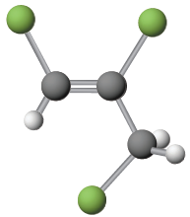
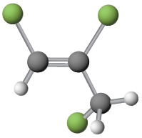
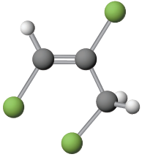
Isomers vs. Conformations
vs.
vs.

