Slide 1
Sections 10.1 and 10.2 Properties of Gases Historical Gas Laws

Slide 2
Properties of Gases and Historical Gas Laws
In these sections…
Gas Properties and their Unites
Pressure
Historical Gas Laws
Boyle’s Law (Pressure and Volume)
Charles’s Las (Temperature and Volume)
Avogadro’s Law (Amount and Volume)

Slide 3
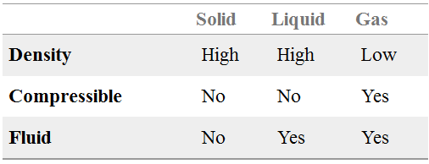
Properties of Gases
What makes gases special?
Gases vs. Solids and Liquids

Slide 4
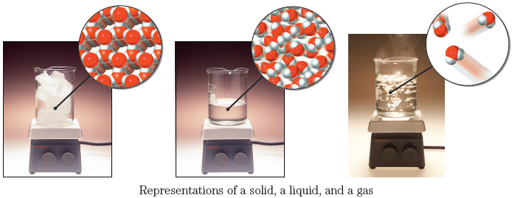
Simulation

Slide 5
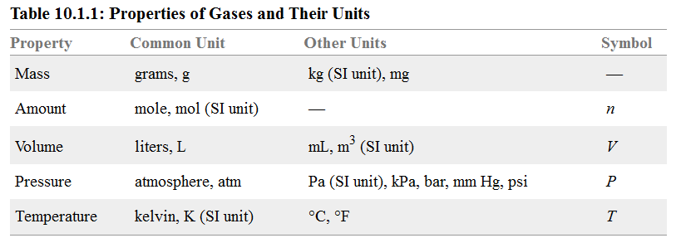
Properties of Gases: Units

Slide 6
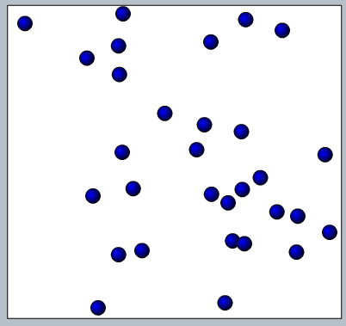
Properties of Gases: Pressure

Slide 7
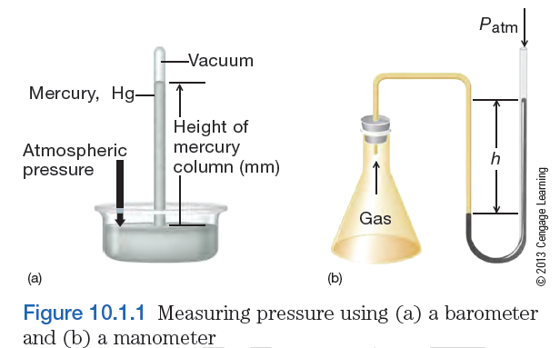
Properties of Gases: Measuring Pressure

Slide 8
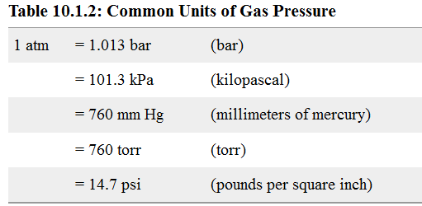
Properties of Gases: Pressure Units

Slide 9
Properties of Gases:
Converting Between Pressure Units
A gas sample has a pressure of 50.4 kPa. What is this pressure in atm?

Slide 10
Historical Gas Laws

Slide 11
Historical Gas Laws: Boyle’s Law
When temperature and
amount are constant.
Simulation

Slide 12
Historical Gas Laws: Boyle’s Law
A sample of gas has a volume of 458 mL at a pressure of 0.970 atm. The gas is
compressed and now has a pressure of 3.20 atm. Predict if the new volume is
greater or less than the initial volume, and calculate the new volume. Assume
temperature is constant and no gas escaped from the container.

Slide 13
Historical Gas Laws: Charles’s Law
When pressure and
amount are constant.
Simulation

Slide 14
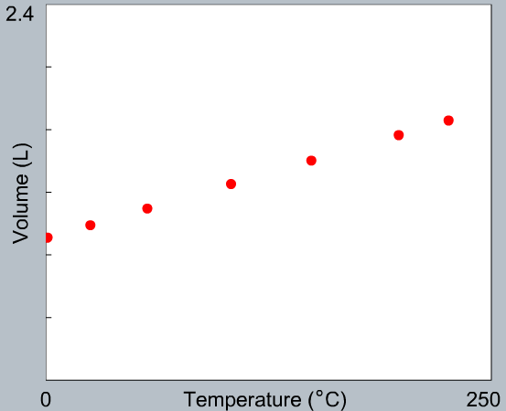
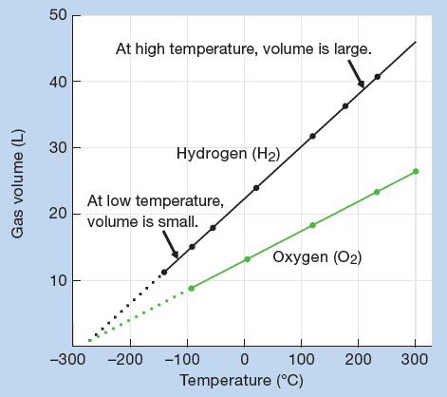
Historical Gas Laws: Charles’s Law
Why isn’t V = 0
when T = 0 ºC?

Slide 15
Historical Gas Laws: Charles’s Law
A sample of gas has a volume of 2.48 L at a temperature of 58.0 °C. The gas sample is cooled to a temperature of –5.00 °C (assume pressure and amount of gas are held constant). Predict whether the new volume is greater or less than the original volume, and calculate the new volume.

Slide 16
Historical Gas Laws: Avogadro’s Law
When pressure and
temperature are constant.
Simulation

Slide 17
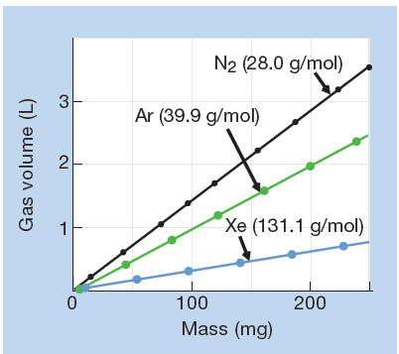
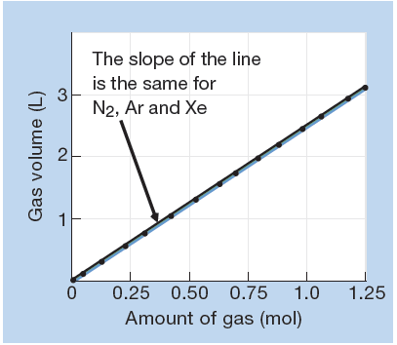
Historical Gas Laws: Avogadro’s Law
KEY: Gas volume depends only on amount present, not what gas is present.

Slide 18
Historical Gas Laws: Avogadro’s Law
A sample of gas contains 2.4 mol of SO₂ and 1.2 mol O₂ and occupies a
volume of 17.9 L. The following reaction takes place:
2 SO₂(g) + O₂(g) → 2 SO₃(g)
Calculate the volume of the sample after the reaction takes place
(assume temperature and pressure are constant).
2 SO₂(g) + O₂(g) → 2 SO₃(g)

