Slide 1
Sections 10.3 and 10.4 The Combined and Ideal Gas Laws Partial Pressures Gas Laws and Stoichiometry

Slide 2
The Combined and Ideal Gas Laws
In these sections…
Combined Gas Law: Relating changes in P, V, n, or T
Ideal Gas Law: Relating P, V, n, and T for a gas sample
Using the Ideal Gas Law: Gas Density and Molar Mass
Gas Mixtures: Partial Pressures
Gas Laws and Stoichiometry

Slide 3
Historical Gas Laws
Combined Gas Law
before change after change

Slide 4
Combined Gas Law:
Predicting Changes in Gas Properties
before change after change
Key: Determine which properties are constant and cancel them from both sides.

Slide 5
Combined Gas Law
A 2.68-L sample of gas has a pressure of 1.22 atm and a temperature
of 29 °C. The sample is compressed to a volume of 1.41 L and cooled
to –17 °C. Calculate the new pressure of the gas, assuming that no
gas escaped during the experiment.

Slide 6
The Ideal Gas Law
Key: There are four variable: P, V, T, and n. If you know three
of them, you can calculate the last one.

Slide 7
The Ideal Gas Law
A sample of O₂ gas has a volume of 255 mL, has a pressure of
742 mm Hg, and is at a temperature of 19.6 °C. Calculate the
amount of O₂ in the gas sample.
Steps:
1. Rearrange ideal gas law for desired property.
2. Convert all properties to units matching R.
3. Calculate.

Slide 8
Using the Ideal Gas Law: Determining Molar Mass of a Gas
KEY: If you know the V, T, P, and mass of a gas sample, you can determine molar mass by
calculating amount present (moles, n).
A 4.07-g sample of an unknown gas has a volume of 876 mL and a pressure of 737 mm Hg
at 30.4 °C. Calculate the molar mass of this compound.

Slide 9
Using the Ideal Gas Law: Gas Density
Calculate the density of oxygen gas at 788 mm Hg and 22.5 °C.
Steps:
Assume 1 L volume.
Calculate moles present.
Convert moles to grams using molar mass.
Calculate density in g/L.

Slide 10
STP: Standard Temperature and Pressure
Standard conditions: Temperature = 0 ºC = 273.15 K
Pressure = 1.00 atm
Standard Molar Volume:

Slide 11
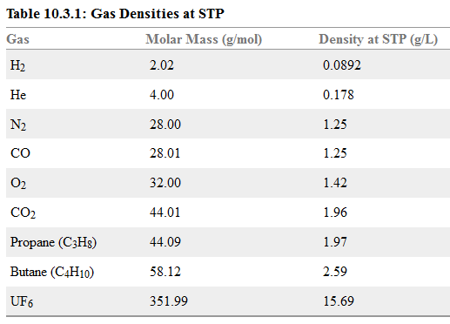
STP Gas Densities
KEY: Gas density at STP α molar mass of gas.

Slide 12
Gas Mixtures: Partial Pressures
KEY: In a mixture of different gases, the pressure of each can
be considered independently. The total pressure of the mixture
is the sum of the partial pressures.

Slide 13
Gas Mixtures: Partial Pressures
A gas mixture is made up of O₂ (0.136 g), CO₂ (0.230 g), and Xe (1.35 g).
The mixture has a volume of 1.82 L at 22.0 °C. Calculate the partial
pressure of each gas in the mixture and the total pressure of the gas
mixture.
0.136 g O₂ = 0.00425 mol O₂
0.230 g CO₂ = 0.00523 mol CO₂
1.35 g Xe = 0.0103 mol Xe
P_{total} = P_{O2} + P_{CO2} + P_{Xe} = 0.0566 atm + 0.0695 atm + 0.137 atm = 0.263 atm

Slide 14
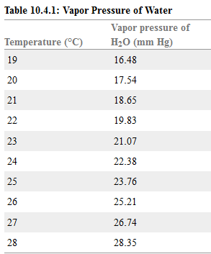
Using Partial Pressure: Collecting Gases over Water
H₂ gas is produced in a reaction and collected by water displacement. The gas sample has a temperature of 22.0 °C, a volume of 27.58 mL, and a pressure of 738 mm Hg. Calculate the amount of hydrogen gas produced in the reaction. P_{H2O}(22.0 ºC = 19.83 mm Hg)
P_{total} = P_{H2} + P_{H2O}
P_{H2} = P_{total} – 19.83 mm Hg
P_{H2} = 738 mm Hg – 19.83 mm Hg
P_{H2} = 718 mm Hg

Slide 15
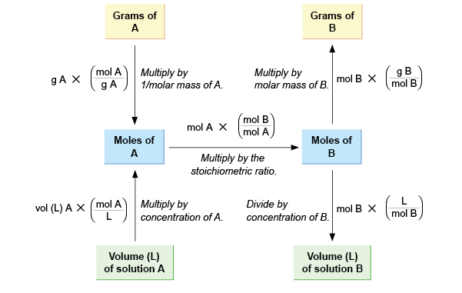
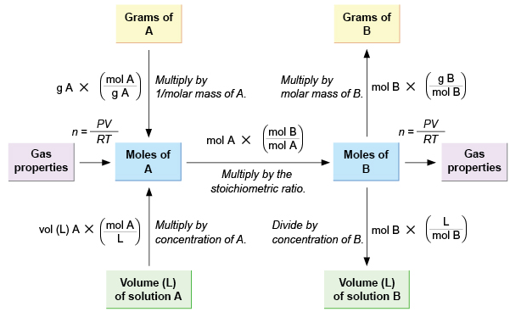
Gas Laws and Stoichiometry
Up to this point: mass for pure substances; volume for solutions.
Now add gas properties for gas samples.

Slide 16
Gas Laws and Stoichiometry
Magnesium reacts with hydrochloric acid:
Mg(s) + 2 HCl(aq) → MgCl₂(aq) + H₂(g)
If a sample of Mg reacts and leads to generation of 244 mL H₂ gas at 16 ºC and a
pressure of 0.955 atm, what mass of Mg was present?

