Slide 1
Sections 8.1 – 8.2
Bonding in Covalent Molecules

Slide 2
Bonding in Covalent Molecules
In these sections…
Why do covalent bonds form?
Valence Electrons
Drawing Lewis Structures
Exceptions to the Octet Rule
Resonance Structures

Slide 3
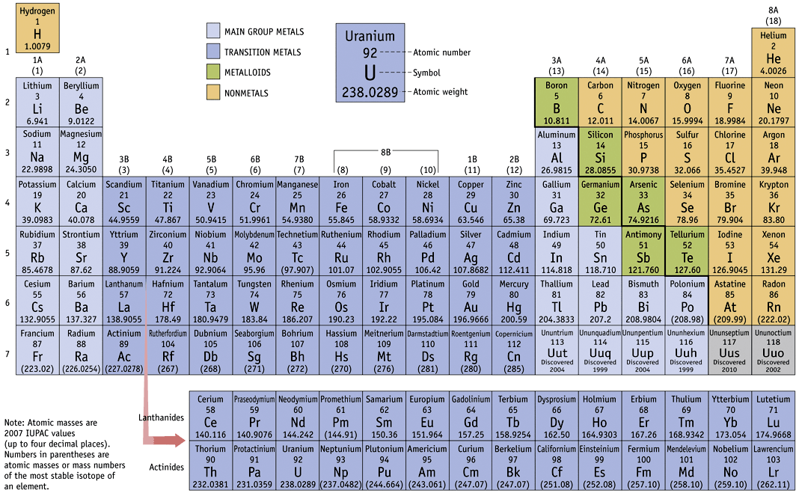
But first: This only works for…

Slide 4
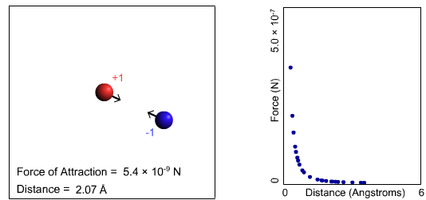
Coulomb’s Law:
Electrostatic Attractions and Repulsions

Slide 5
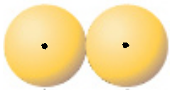

Why Do Bonds Form Between Neutral Atoms?
H H

Slide 6
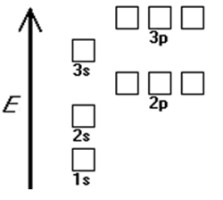
Valence Orbitals and Electrons
C
F

Slide 7


Lewis Symbols for Atoms
C
F

Slide 8
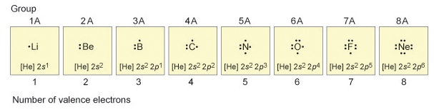
Lewis Symbols for Atoms

Slide 9
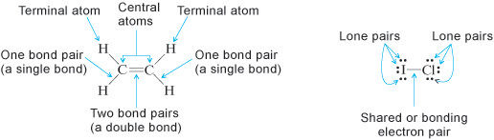
Lewis Symbols for Molecules

Slide 10
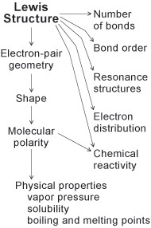
Why Bother?

Slide 11
How to Draw Lewis Structures: PF₃
Step 1: Count valence electrons.
Count the total number of valence electrons in the molecule or ion. Anions have extra electrons, so add 1 electron for each negative charge. Cations have a deficiency of electrons, so subtract 1 electron for each positive charge.
Step 2: Arrange atoms.
The central atom is usually the one with the lowest affinity for electrons (the one farthest from fluorine on the periodic table). Exception: H is never a central atom. Certain elements are found more frequently as central atoms (C, N, S, P) or terminal atoms (halogens, O) but there are, of course, exceptions. Electronegativity (Section 8.4b) can also be used to choose the central atom in a Lewis structure.

Slide 12
How to Draw Lewis Structures: PF₃
Step 3: Add single bonds.
Add one bond (using a line) between each terminal atom and the central atom. Each bond represents 2 electrons.
Step 4: Add remaining electrons.
Assign any remaining electrons to the terminal atoms, in pairs, until the octet rule is satisfied for each terminal atom (except hydrogen). If additional electrons remain, add them to the central atom.
Step 5: Check octet rule.
Use the octet rule to determine whether multiple bonds are necessary between atoms. If there is an electron deficiency for an element, change a nonbonding electron pair (lone pair) on an adjacent atom into a bonding pair. Continue only until the octet rule is satisfied for all elements (other than the known exceptions described in Section 8.2c).
Only C, N, O , P, and S form multiple bonds.

Slide 13
How to Draw Lewis Structures: CO₃²⁻
Step 1: Count valence electrons.
Count the total number of valence electrons in the molecule or ion. Anions have extra electrons, so add 1 electron for each negative charge. Cations have a deficiency of electrons, so subtract 1 electron for each positive charge.
Step 2: Arrange atoms.
The central atom is usually the one with the lowest affinity for electrons (the one farthest from fluorine on the periodic table). Exception: H is never a central atom. Certain elements are found more frequently as central atoms (C, N, S, P) or terminal atoms (halogens, O) but there are, of course, exceptions. Electronegativity (Section 8.4b) can also be used to choose the central atom in a Lewis structure.

Slide 14
How to Draw Lewis Structures: CO₃²⁻
Step 3: Add single bonds.
Add one bond (using a line) between each terminal atom and the central atom. Each bond represents 2 electrons.
Step 4: Add remaining electrons.
Assign any remaining electrons to the terminal atoms, in pairs, until the octet rule is satisfied for each terminal atom (except hydrogen). If additional electrons remain, add them to the central atom.
Step 5: Check octet rule.
Use the octet rule to determine whether multiple bonds are necessary between atoms. If there is an electron deficiency for an element, change a nonbonding electron pair (lone pair) on an adjacent atom into a bonding pair. Continue only until the octet rule is satisfied for all elements (other than the known exceptions described in Section 8.2c).
Only C, N, O , P, and S form multiple bonds.

Slide 15
Exceptions to the Octet Rule: Expanded Valence IF₃
Step 1: Count valence electrons.
Step 2: Arrange atoms.
Step 3: Add single bonds.
Step 4: Add remaining electrons.
Step 5: Check octet rule.
Only C, N, O , P, and S form multiple bonds.

Slide 16
Exceptions to the Octet Rule: Expanded Valence
When does this most often happen?

Slide 17
Exceptions to the Octet Rule: Electron Deficient BF₃
Step 1: Count valence electrons.
Step 2: Arrange atoms.
Step 3: Add single bonds.
Step 4: Add remaining electrons.
Step 5: Check octet rule.
Only C, N, O , P, and S form multiple bonds.

Slide 18
Exceptions to the Octet Rule: Electron Deficient Compounds
When does this most often happen?

Slide 19
Resonance Structures

Slide 20
Equivalent Resonance Structures
Nonequivalent Resonance Structures

Slide 21
And remember: This only works for…

