Slide 1
Section 8.3 Bond Properties

Slide 2
Bond Properties
In this section…
Bond order
Bond length
Bond energy
Bond energy and ΔH

Slide 3
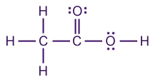
Bond Order = # bonds between two atoms

Slide 4
Bond Length = distance between nuclei of bonded atoms

Slide 5
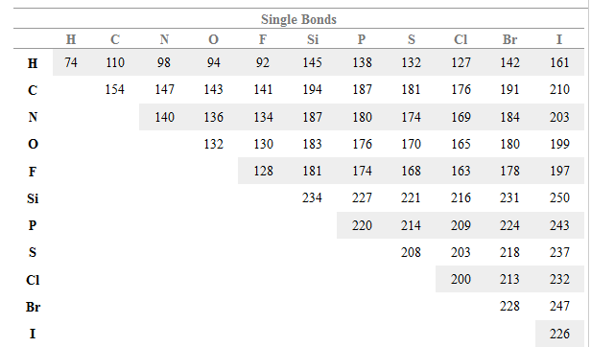
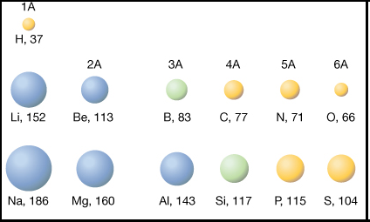
Bond Length Trends: Larger atoms make longer bonds

Slide 6
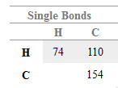
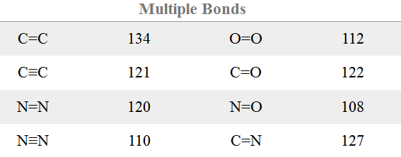
Bond Length Trends: Multiple bonds are shorter than single bonds

Slide 7
Bond Energy: Energy required to break one mole of bonds
O-H bond energy = 463 kJ/mol
Bond energies range from about 150 kJ/mol to about 950 kJ/mol
Single bonds are from 150 – 500 kJ/mol

Slide 8
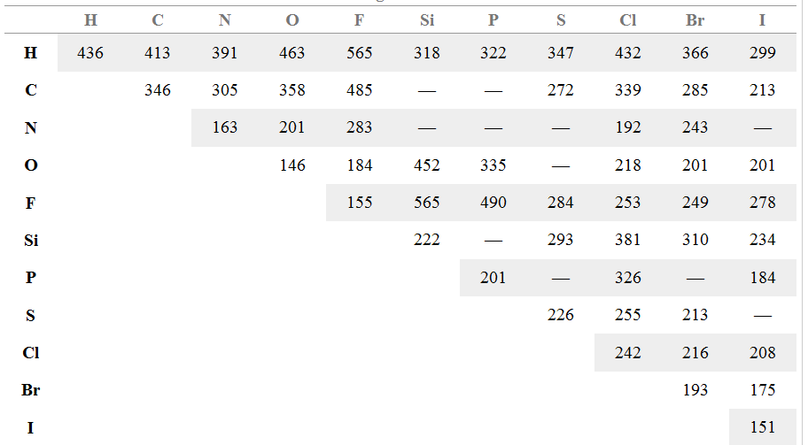
Bond Energy Trends: Larger atoms make weaker bonds

Slide 9
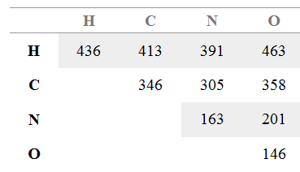
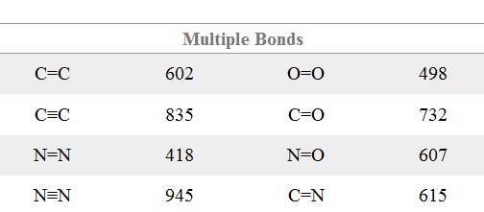
Bond Energy Trends: Multiple bonds are stronger than single bonds

Slide 10
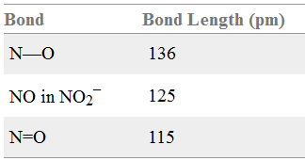
Resonance Effects on Bond Properties
Bond length and energy follow same trends:

Slide 11
Using Bond Energy to Calculate Enthalpy Change
Breaking bonds requires energy: endothermic
Forming bonds releases energy: exothermic
NOTE: This only works for gas-phase reactions.

Slide 12
Using Bond Energy to Calculate Enthalpy Change
Bond Energies, kJ/mol
H-H 436
N-H 391
N≡N 945

Slide 13
Section 8.4 Charge Distribution in Molecules

Slide 14
Bond Properties
In this section…
Electronegativity and Bond polarity
Formal charge
Resonance structures
Partial charge

Slide 15
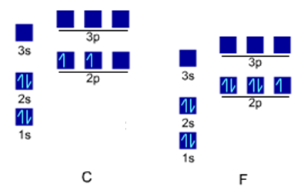
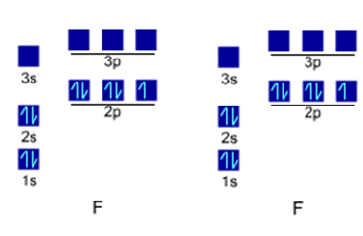
Bond Polarity

Slide 16
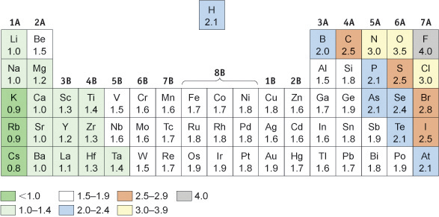
Electronegativity

Slide 17
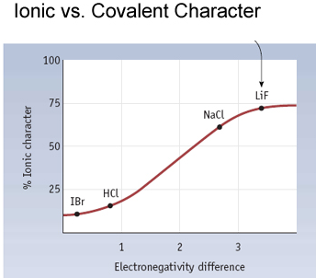
Continuum from Covalent to Ionic Bonding: Bond Character
The larger the electronegativity
difference, the more polar the
bond.
More polar = more ionic character.
Less polar = more covalent character.

Slide 18
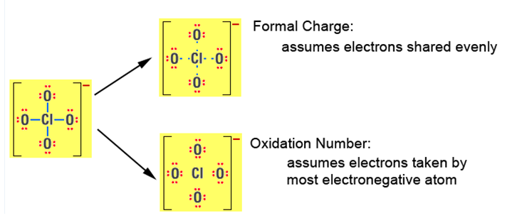
Electron Distribution in Molecules

Slide 19
Formal Charge: Assume all bonding electrons shared evenly between bonded atoms
Formal Charge = Group # - # lone pair electrons – ½ # bonding electrons
Formal Charge = Group # - # assigned electrons

Slide 20
Using Formal Charge to Rank Nonequivalent Resonance Structures
Rule 1: avoid large or split charges
Rule 2: negative charges are more stable on more electronegative atoms

Slide 21
Electron Distribution in Molecules: Partial Charges
Actual atoms in molecules have partial charges.
Oxidation Number -2 +4 -2 -2 +4 -3
Formal Charge 0 0 0 -1 0 0

