Slide 1
Section 8.5 and 8.6
Molecular Geometry and Polarity

Slide 2
Molecular Geometry and Polarity
In these sections…
VSEPR Shapes
Molecular Shapes
Molecular Polarity

Slide 3
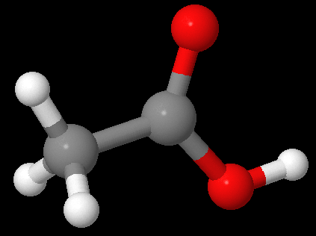
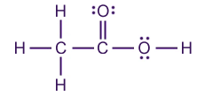
Big Picture: What are the shapes of molecules.
Lewis # Structural Electron-Pair Molecular
Structure Pairs Geometry Geometry
Polarity

Slide 4
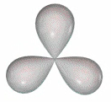
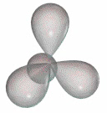
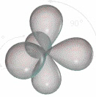
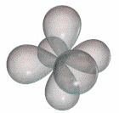

Valence Shell Electron-Pair Repulsion Theory
(VSEPR)
Valence electron pairs repel one another.

Slide 5
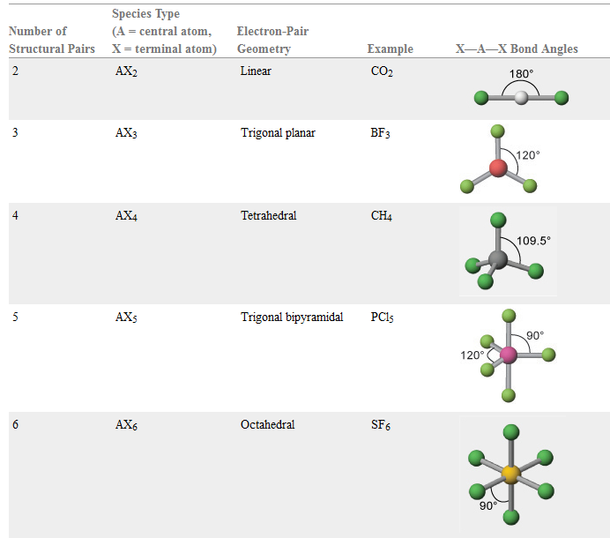
Valence Shell Electron-Pair Repulsion Geometries

Slide 6

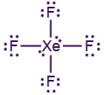

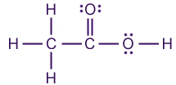


Determining Electron-Pair Geometry
- Find Number of Structural Electron Pairs
# pairs EPG
linear
trigonal planar
tetrahedral
trigonal bipyramidal
octahedral
# Structural Pairs = # bonded + # lone
on Central Atom atoms pairs

Slide 7
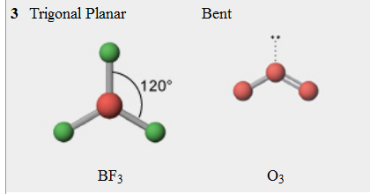
Determining Molecular Geometry
- Electron-Pair Geometry, ignoring Lone Pair Positions
no lone pairs 1 lone pair

Slide 8
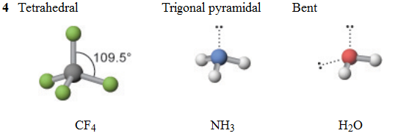
Determining Molecular Geometry
- Electron-Pair Geometry, ignoring Lone Pair Positions
no lone pairs 1 lone pair 2 lone pairs

Slide 9
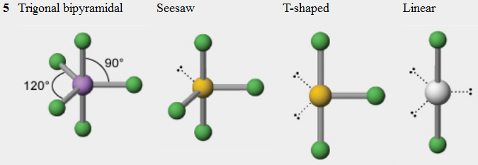
Determining Molecular Geometry
- Electron-Pair Geometry, ignoring Lone Pair Positions
no lone pairs 1 lone pair 2 lone pairs 3 lone pairs

Slide 10
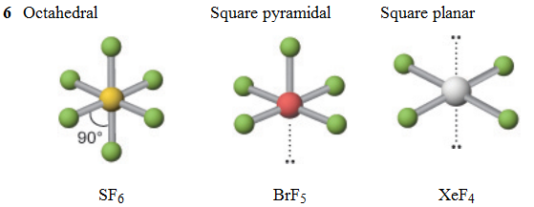
Determining Molecular Geometry
- Electron-Pair Geometry, ignoring Lone Pair Positions
no lone pairs 1 lone pair 2 lone pairs

Slide 11

Drawing Shapes on Paper: Wedge-and-Dash Notation
line = in plane of paper/screen
solid wedge = coming towards you
dashed line = moving away from you

Slide 12

Deviations from Ideal Molecular Geometry
- Lone pairs take up more room
CH₄ NH₃ H₂O

Slide 13
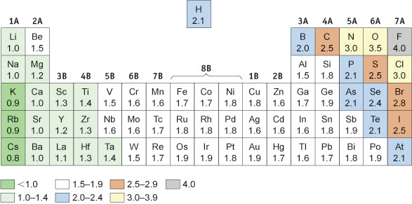
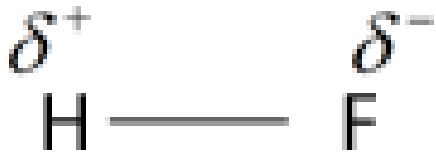
Molecular Polarity
- Net effect of polar bonds in a molecule

Slide 14

Molecular Polarity
- Net effect of polar bonds in a molecule
CO₂

Slide 15
Molecular Polarity
- Net effect of polar bonds in a molecule
NH₃

Slide 16
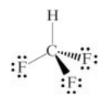
Molecular Polarity
- Net effect of polar bonds in a molecule
CHF₃

Slide 17
Molecular Polarity
- Three general rules
1. Fully symmetrical molecules with no lone pairs are nonpolar.
2. Hydrocarbons are nonpolar.
3. Molecules containing N-H or O-H bonds are almost always polar.

