Slide 1
Advanced Periodic Trends
and
Structures of the Elements

Slide 2
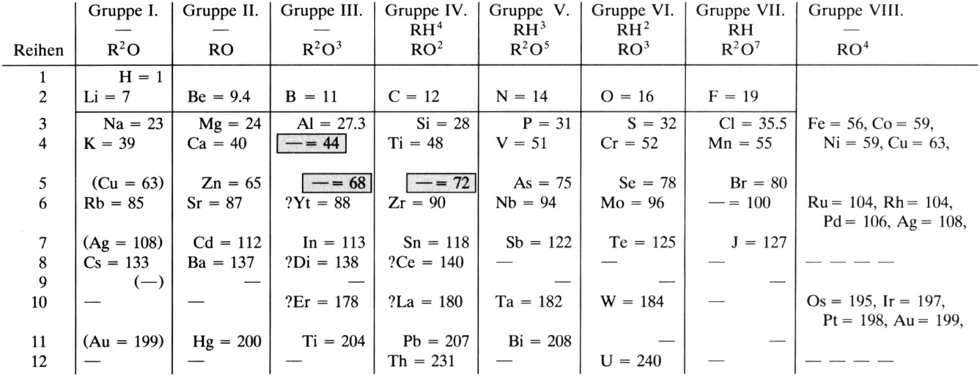

Slide 3
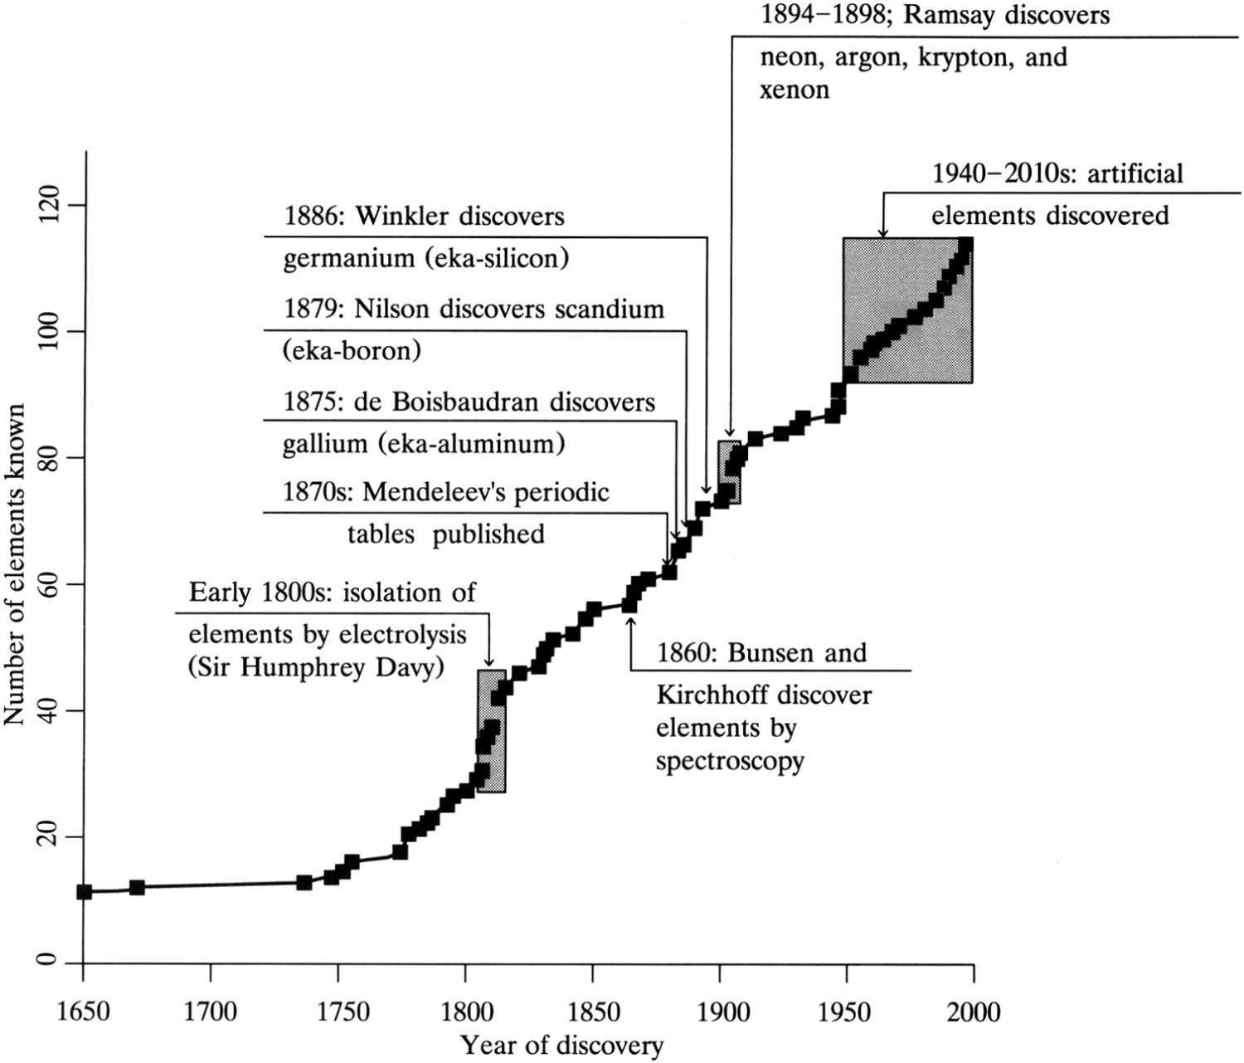

Slide 4
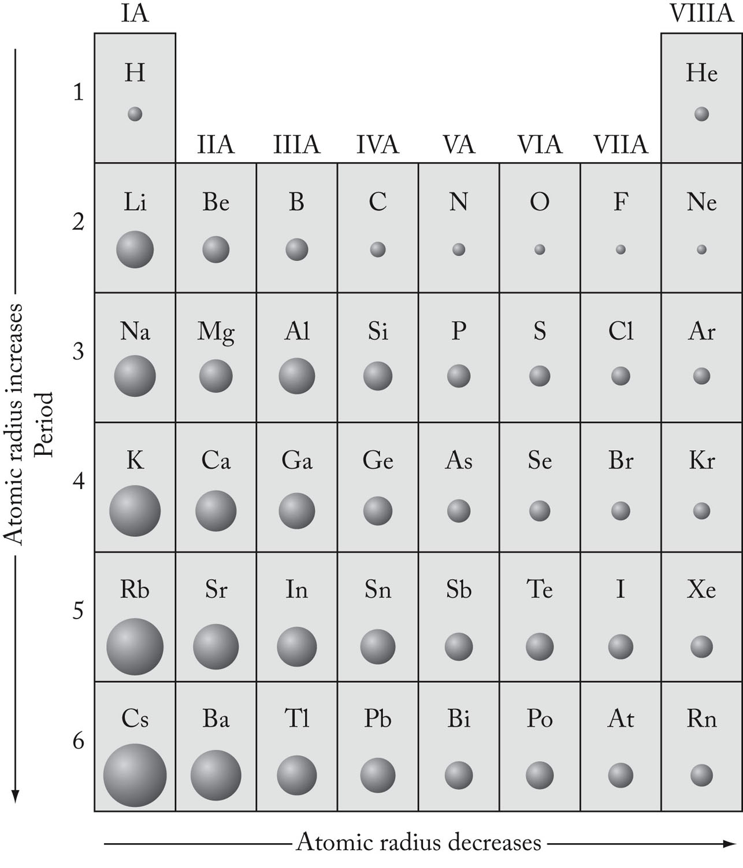

Slide 5
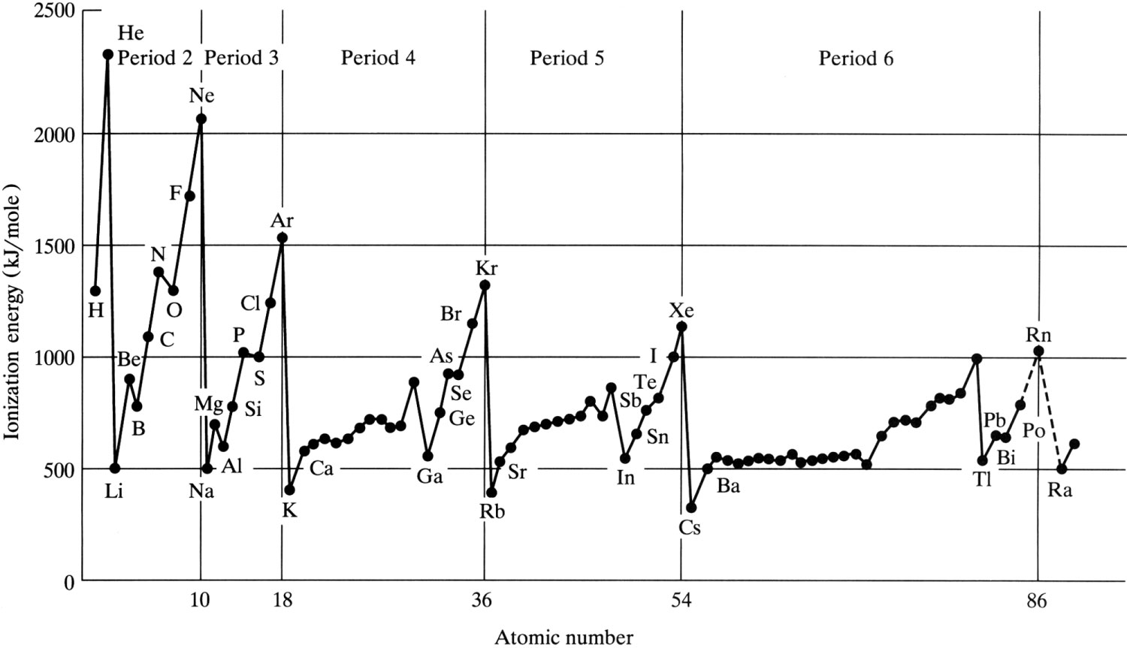

Slide 6
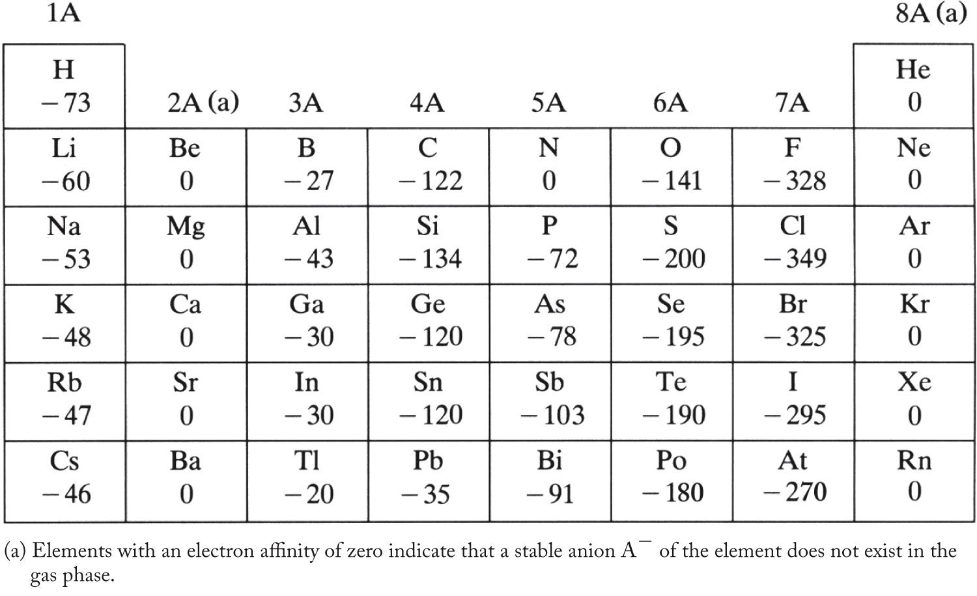

Slide 7
Trends Down a Group:

Slide 8
Trends Across a Period:
Effective Nuclear Charge: Z* = Z – S

Slide 10
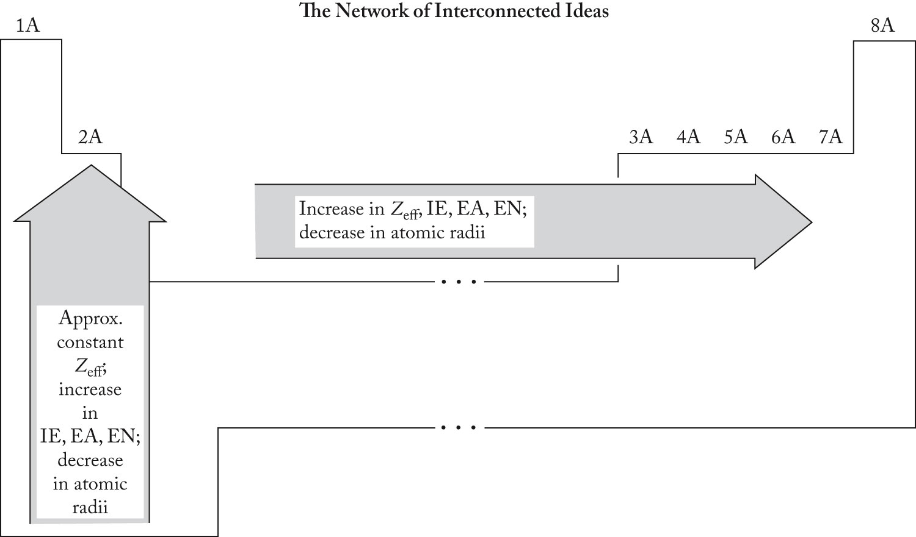

Slide 11
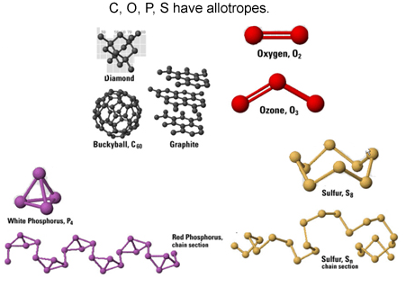
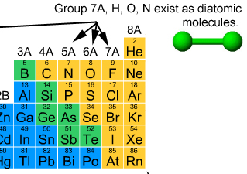
Chemical Structures
of the Elements

Slide 12
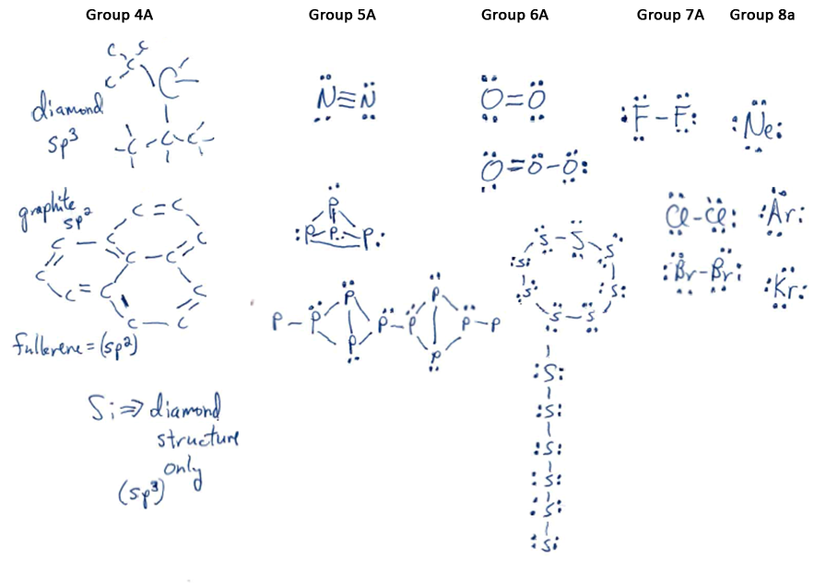

Slide 13
Thermodynamics Review:
ΔG = ΔH - TΔS
Bond Strength
Favored by strong bonds.
Freedom of Movement
Favored by more particles.
Example: Cl-Cl vs. Cl Cl
Cl-Cl bond strength = 242 kJ/mol
Sº (Cl) = 165 J/K⋅mol
Sº (Cl₂) = 223 J/K⋅mol

Slide 14
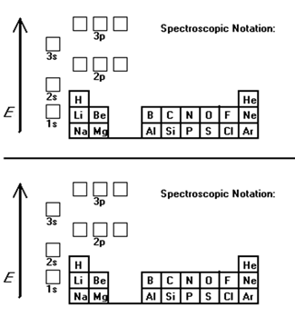
Bonding Concerns and Trends:
a. Number of bonds
b. Type of bonds: sigma vs. pi

Slide 15
Number of Bonds Possible: F, O

Slide 16
Type of bonds: sigma vs. pi
C vs. Si
O vs. S

Slide 18
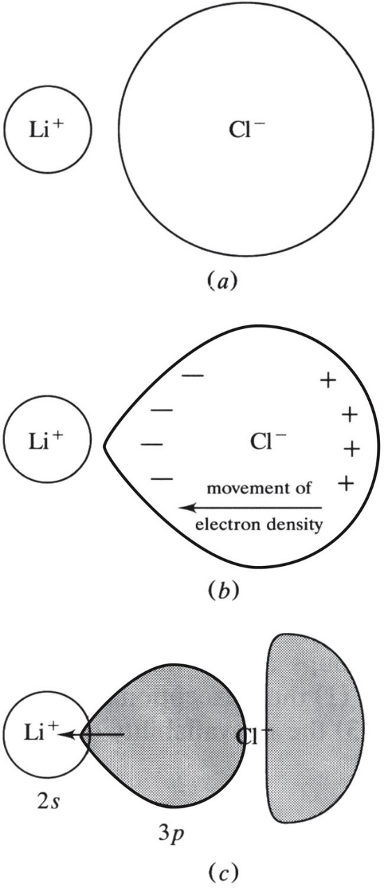
Covalent Character of 2nd Period Elements
Larger charge density = more covalent character
Charge density = Z/r
Examples: Be, B, sometimes Li, F

Slide 19
Unavailability of d-orbitals in 2nd period elements
NF₃ OF₂ F₂

Slide 20
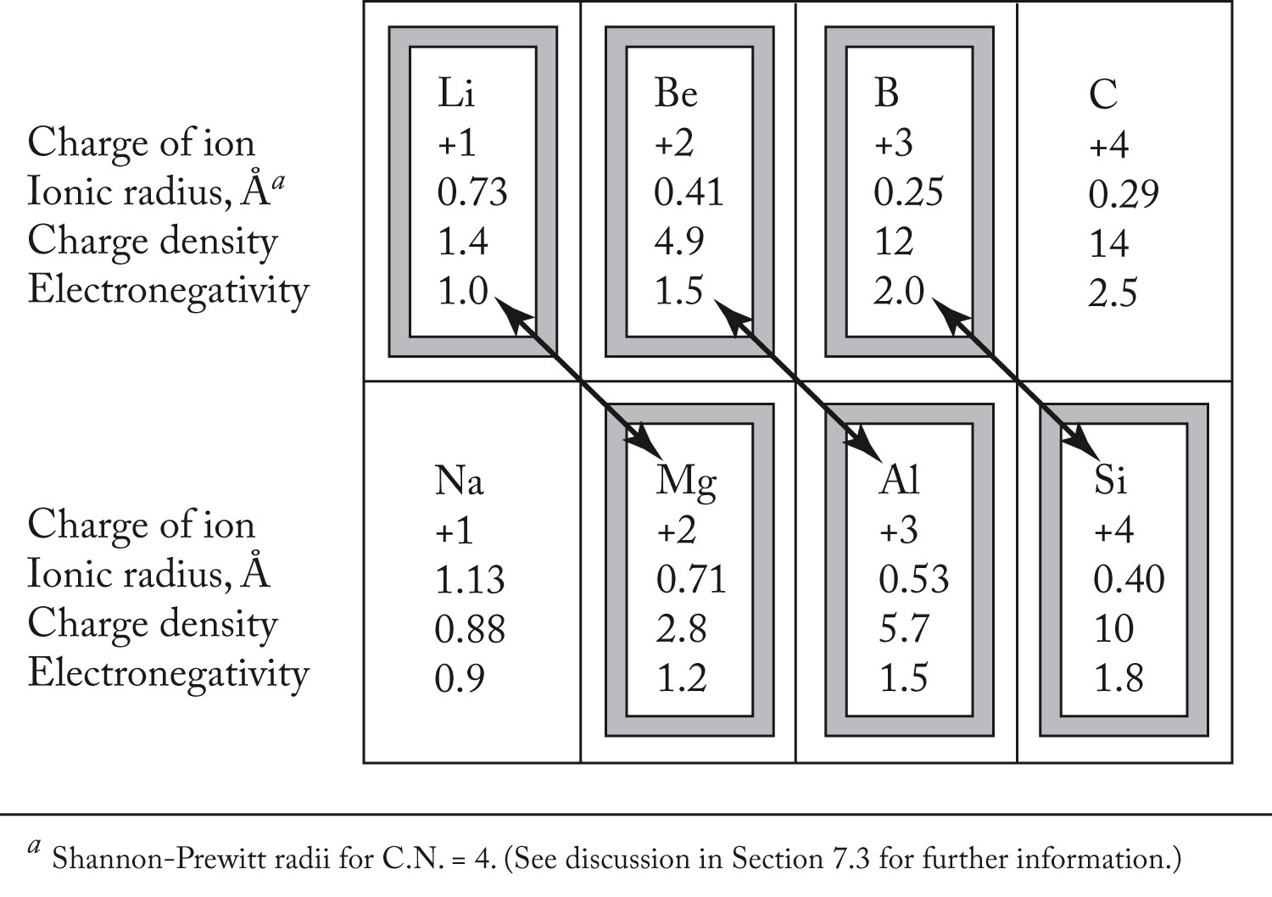
The Diagonal Effect

Slide 21
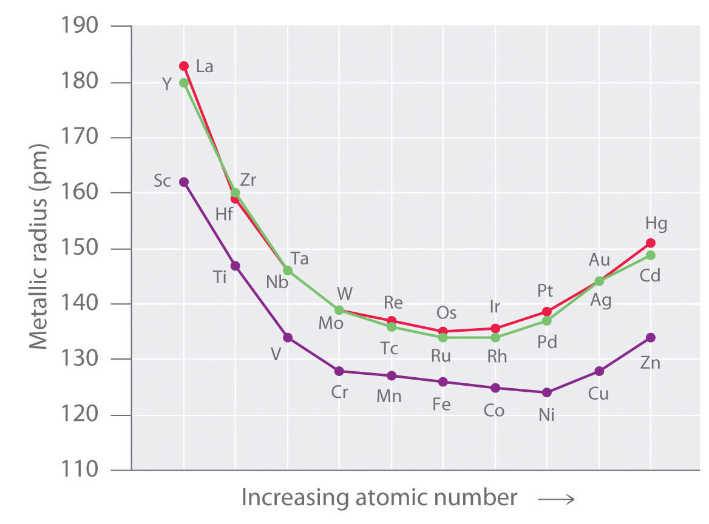
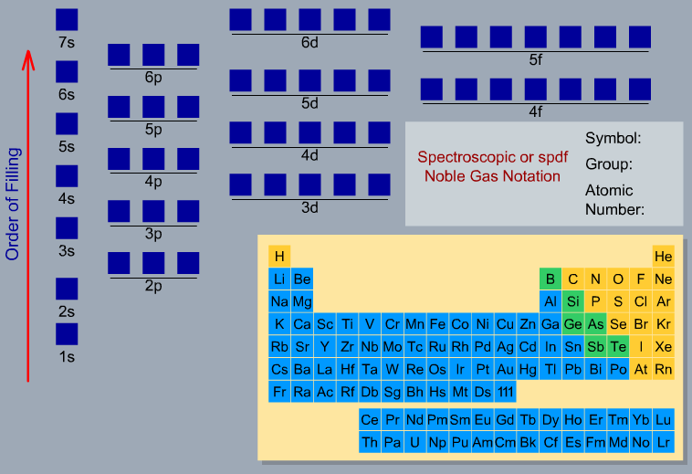
The Lanthanide Contraction

Slide 22
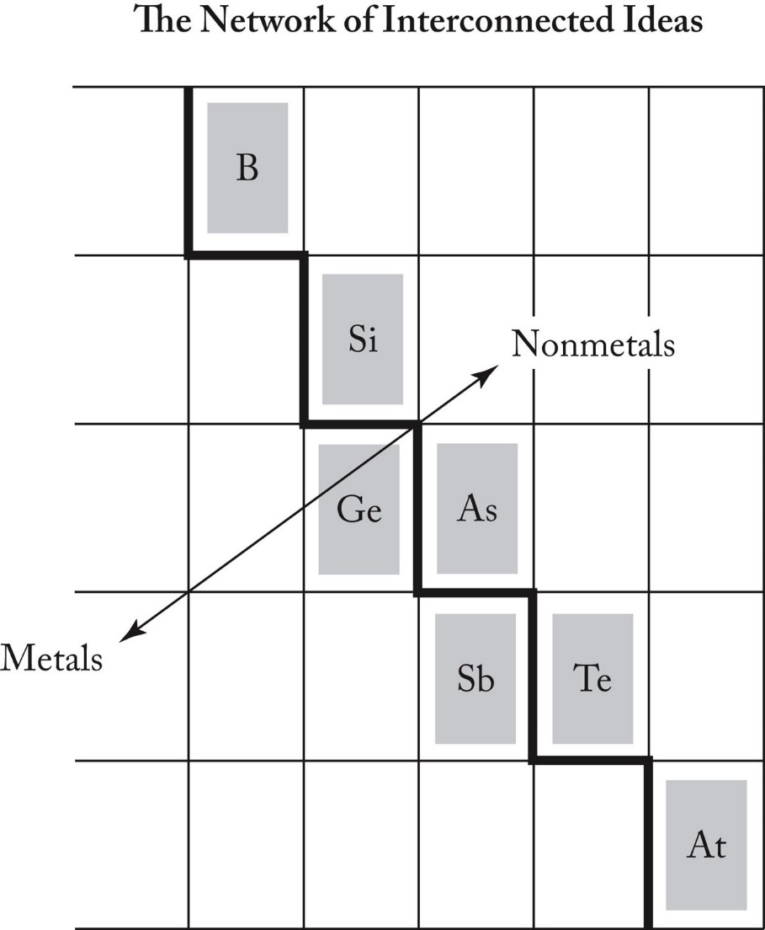
The Metal-Nonmetal Line
Nonmetals gain electrons
and form interactions
with few atoms
Metals lose electrons
and form interactions
with many atoms

Slide 23
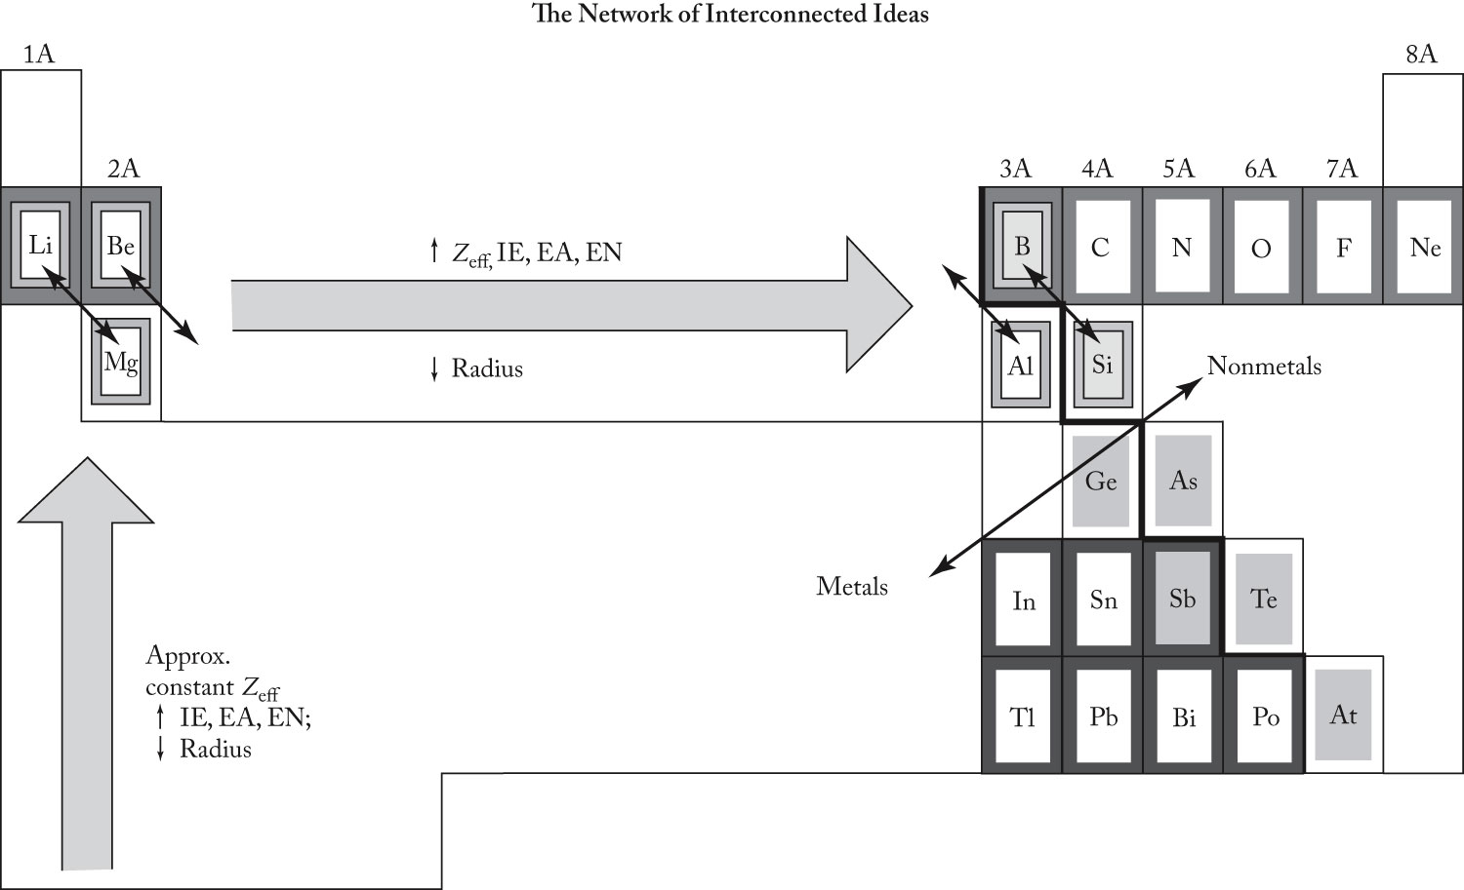
Summary

Slide 24
Chapter 10: Hydrogen

Slide 25
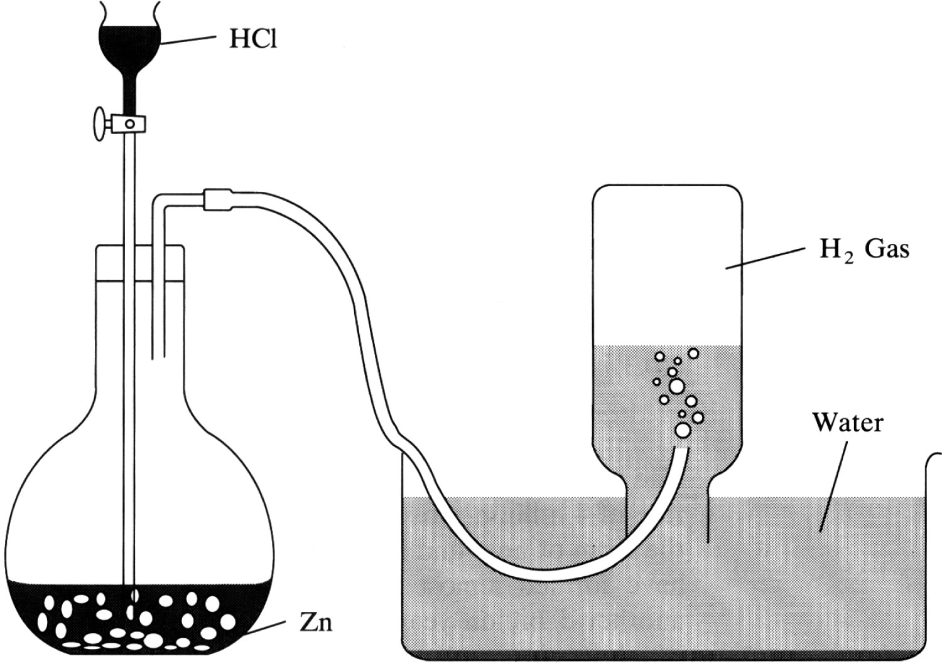
Synthesizing Hydrogen

Slide 26
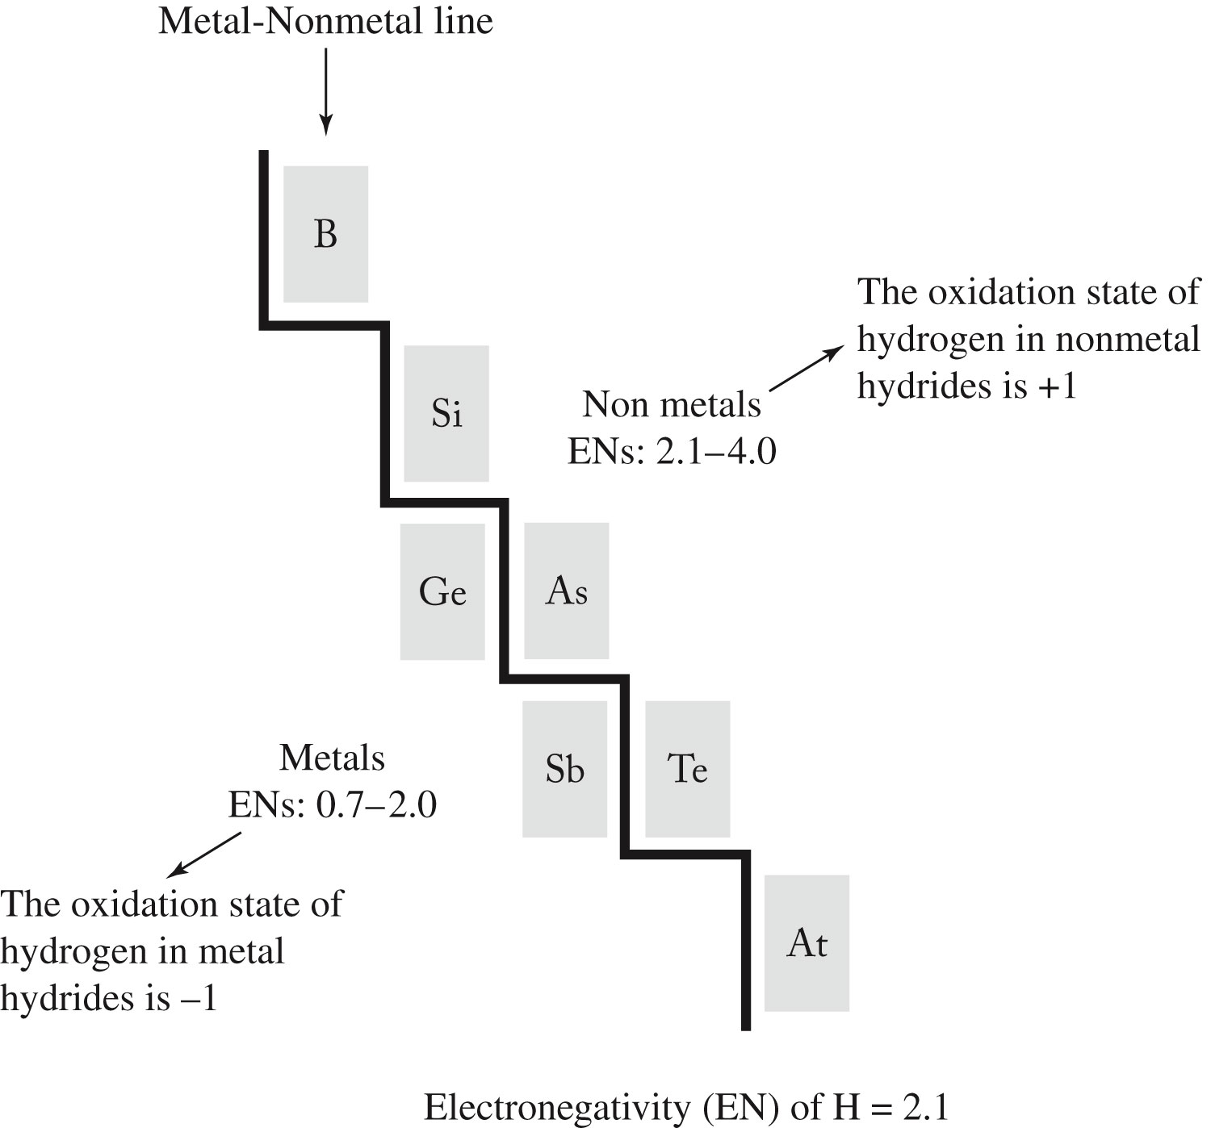

Slide 27
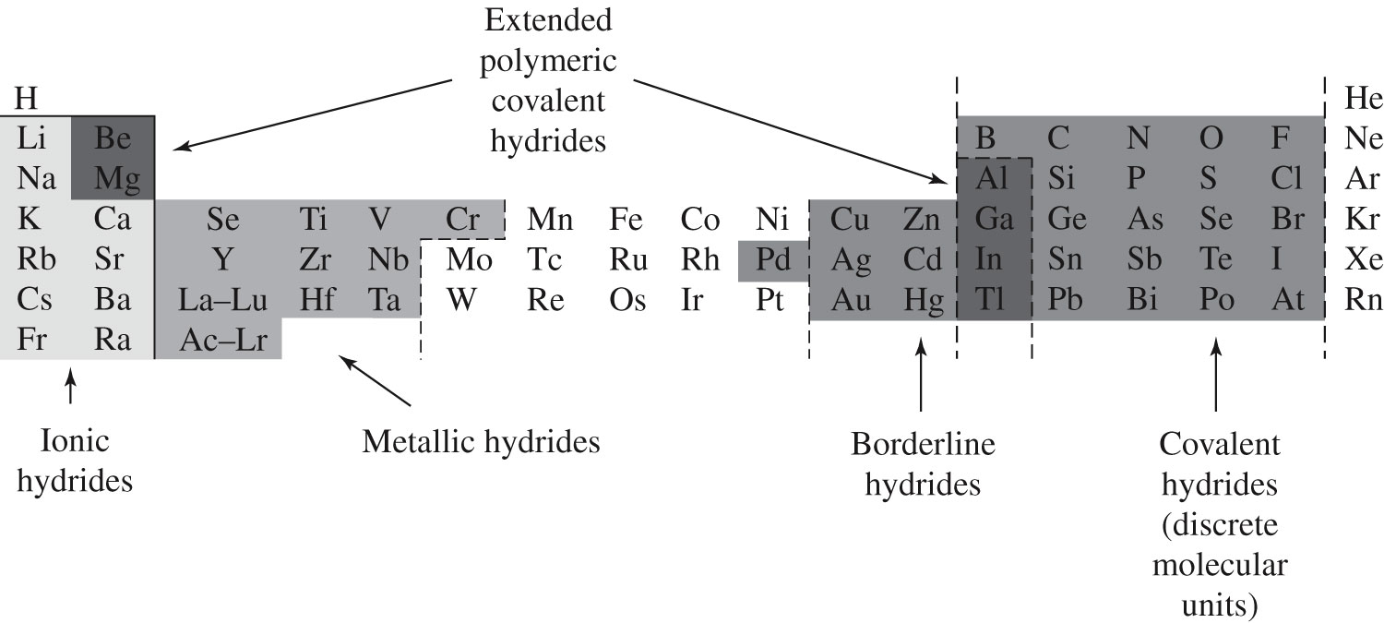
Hydrides

Slide 28
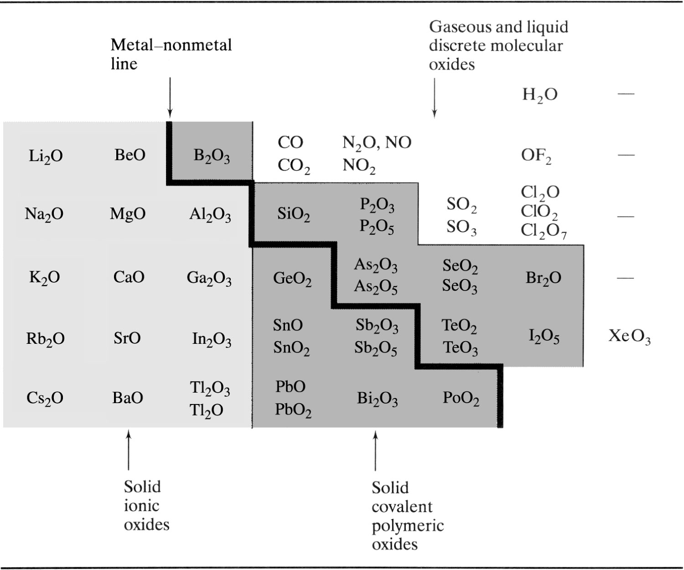
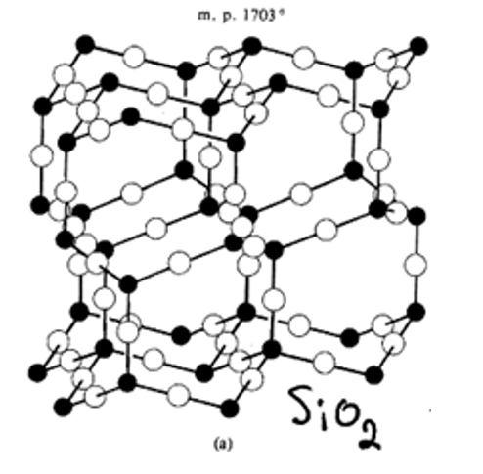
Structure and Bonding of Oxides

Slide 29
Chapter 11: Oxygen, Aqueous Solutions,
Acid-Base Character of Oxides

