Slide 1
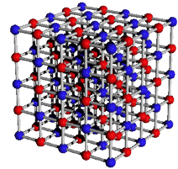
Ionic Compounds
What holds them together?

Slide 3
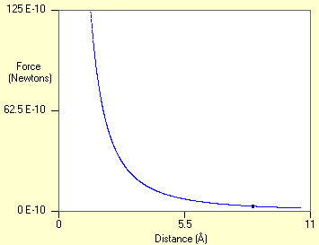
Ion Pair Energy
Attractions:

Slide 4
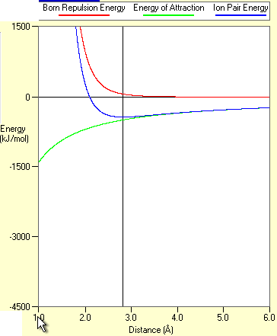
Ion Pair Energy
The big picture:

Slide 5
Ion Pair Energy: Trends for charges and ion size

Slide 6
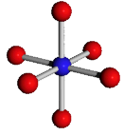
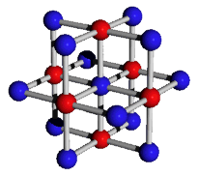
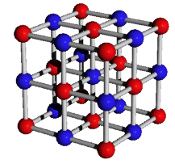
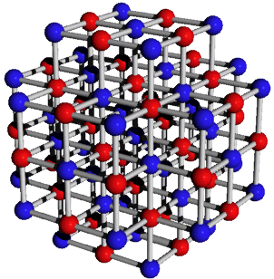
Madelung Constant:

Slide 7
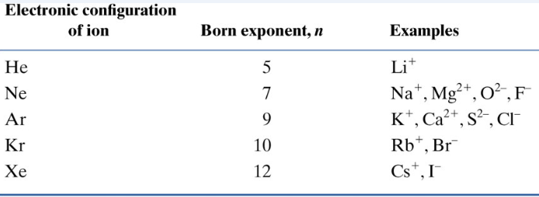
Ion-Pair Energy
Energy released when gas phase ions
combine to form the pair of ions.
U = lattice energy
N = Avogadro’s Number
z = charges
e = charge on electron = 1.602 x 10⁻¹⁹ C
ε_{o} = 8.854 x 10⁻¹² C²/m⋅J
r_{o} = sum of radii
n = average Born exponent
NaCl: r_{o} = 283 pm = 2.83 x 10⁻¹⁰ m; A = 1.748

Slide 8
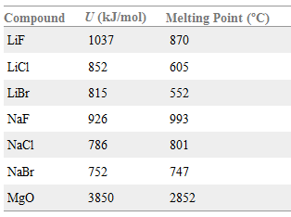

Slide 9
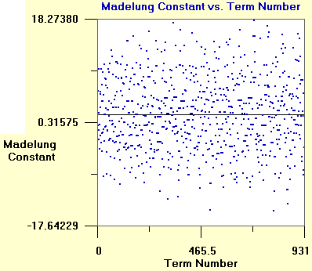
Madelung Constant:

Slide 10
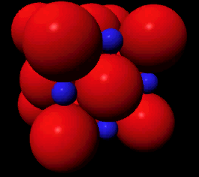
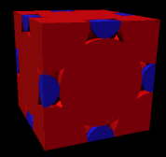
Madelung Constant:

Slide 11
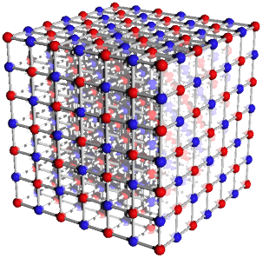
Madelung Constant: Concentric cube approach

Slide 12
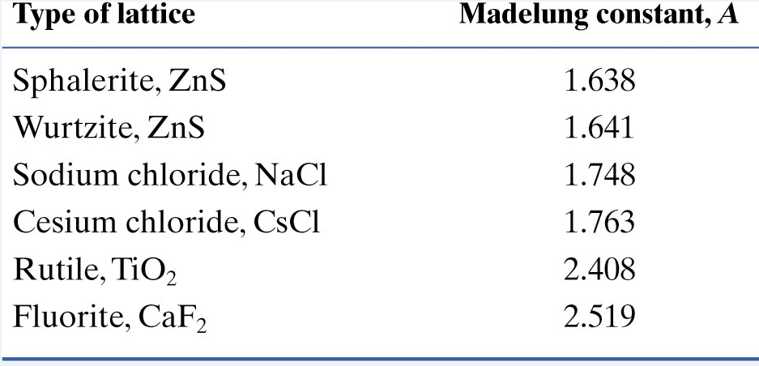

Slide 13
Lattice Energy
Energy released when gas phase ions
combine to form the ionic solid.
U = lattice energy
N = Avogadro’s Number
A = Madelung constant
z = charges
e = charge on electron = 1.602 x 10⁻¹⁹ C
ε_{o} = 8.854 x 10⁻¹² C²/m⋅J
r_{o} = sum of radii
n = average Born exponent
NaCl: r_{o} = 283 pm = 2.83 x 10⁻¹⁰ m; A = 1.748

Slide 15
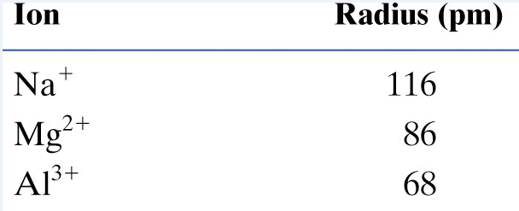
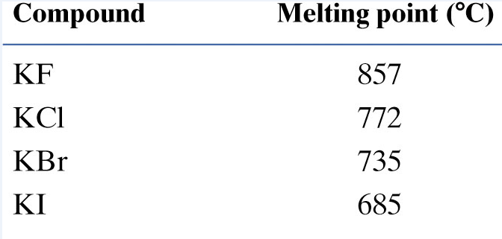
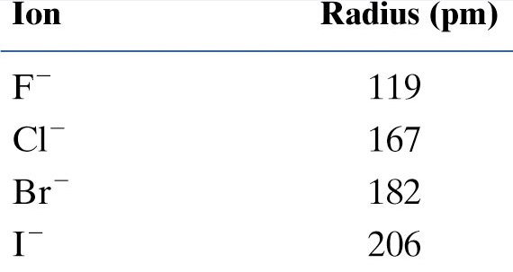
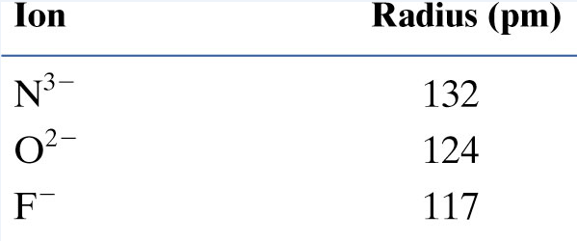
Properties

Slide 16
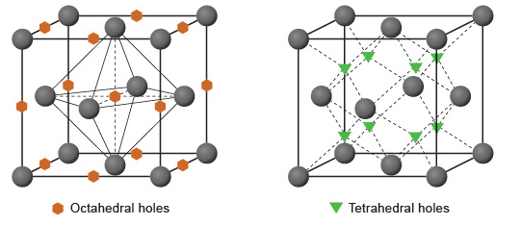
Lattice Holes and Structure Selection

Slide 17
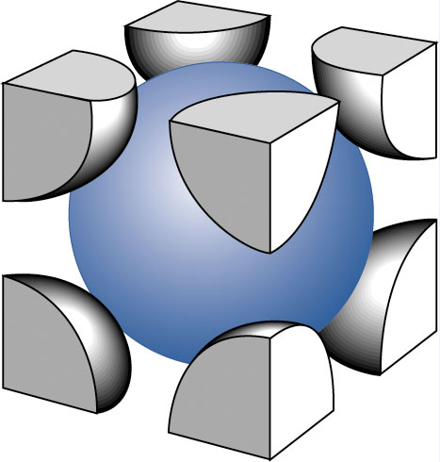
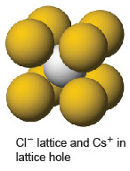
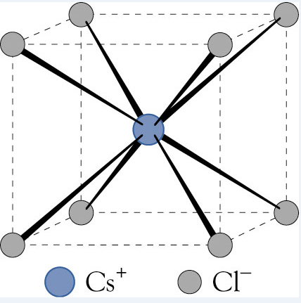
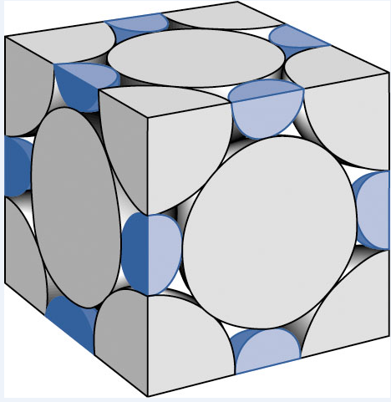
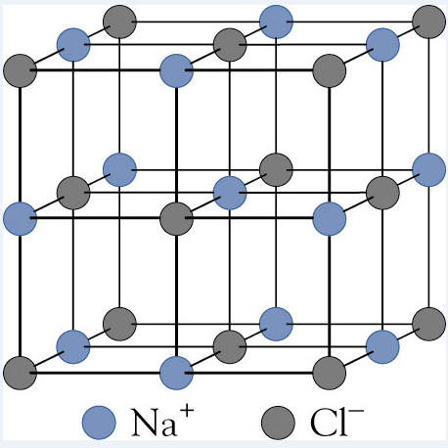
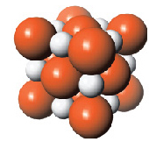

Slide 18
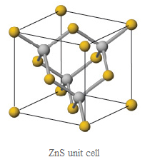
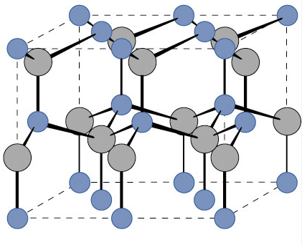
ZnS

Slide 19
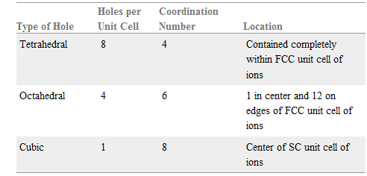

Slide 20
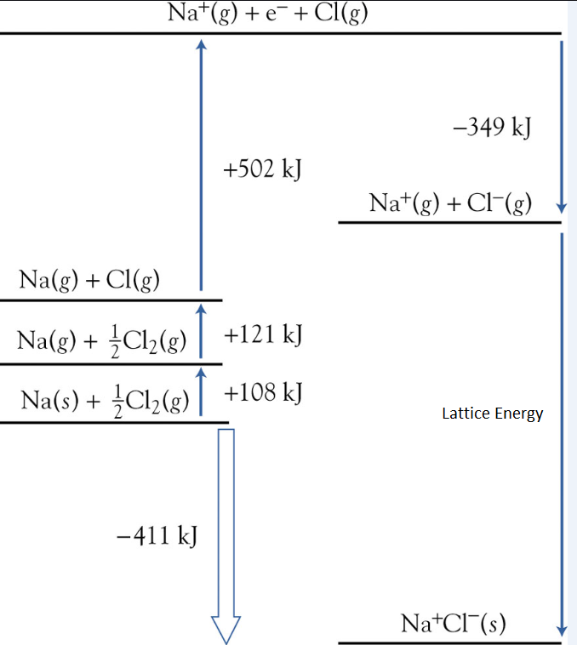
Measuring Lattice Energies: Born-Haber Cycles
ΔH_{f} (NaCl) = -411 kJ/mol
ΔH_{atomization}(Na) = 108 kJ/mol
Cl-Cl bond energy = 242 kJ/mol
IE(Na) = 502 kJ/mol
EA(Cl) = -349 kJ/mol

Slide 21
Question: Is the driving force for formation of NaCl
the electron transfer from Na to Cl?
That is, is it because Cl wants Na’s valence electron
more than Na wants it?

Slide 22
Why does MgF₂ form instead of MgF or MgF₃?

Slide 23
