Slide 1
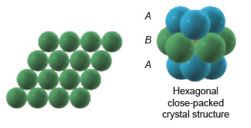
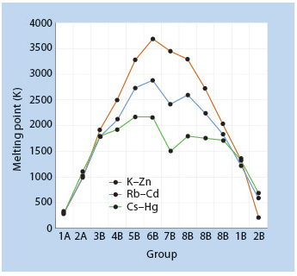
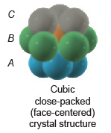
Band Theory: Metallic Bonding
Photoelectron Spectroscopy

Slide 2
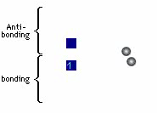
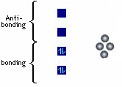
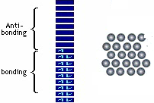
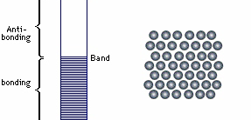
Band Theory: Metallic Bonding
Photoelectron Spectroscopy

Slide 3
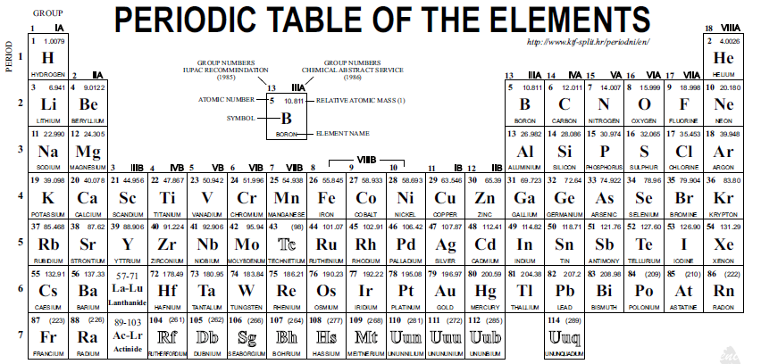

Slide 4
Band Structure for Periods 4-6, Group 1A – 2B
http://employees.oneonta.edu/viningwj/sims/metallic_bonding_band_theory_s.html

Slide 8
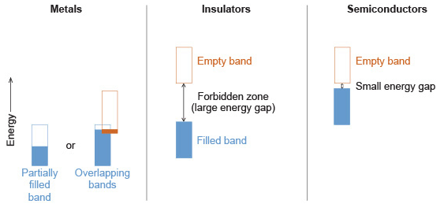
Conduction in Solids

Slide 9
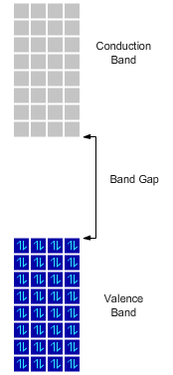
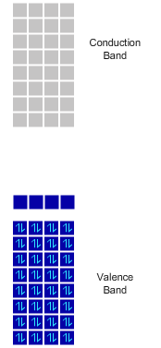
Silicon Semiconductors

Slide 13
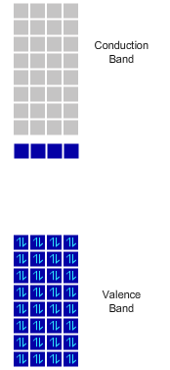
Silicon Semiconductors

Slide 14
Chip Fabrication
Make really, really pure Si
Add impurities in a controlled way (doping)
SiO₂(s) + 4 HCl → SiCl₄ (l) + H₂O(l)
SiCl₄ purified by distillation.
SiCl₄ + 2 Zn → Si + ZnCl₂
Si now 99.9% pure.
Zone refining used to purify to 99.99999% pure.

Slide 15
Circuit Components
Diodes
Transistors

Slide 16
Doping
Apply coating
Illuminate through mask
Dissolve illuminated areas
Add gas phase dopant
Repeat

Slide 17
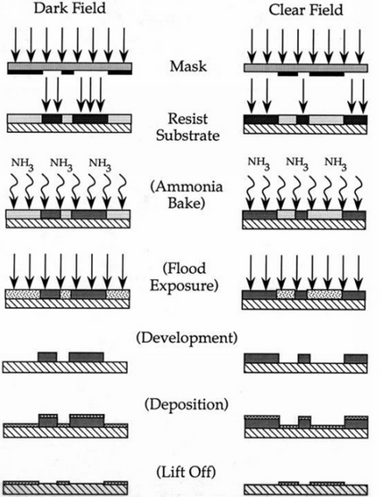
Photolithography
http://www.cnf.cornell.edu/cnf_process_photo_resists.html

