Slide 1
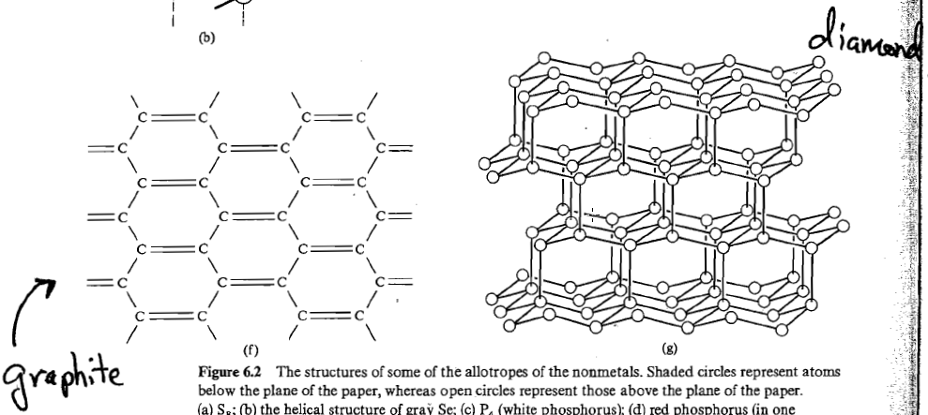
Relative Stability of Diamond vs. Graphite

Slide 3
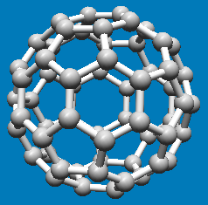
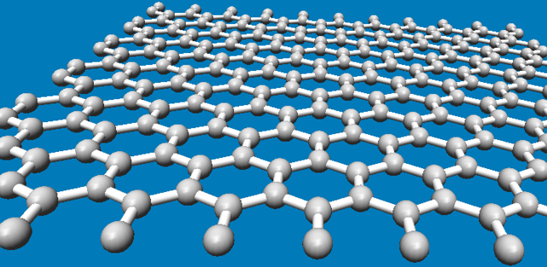
Relative Stability of Fullerene vs. Graphite

Slide 4
Fullerenes and other nano-carbon structures Nanotube Modeler

Slide 5
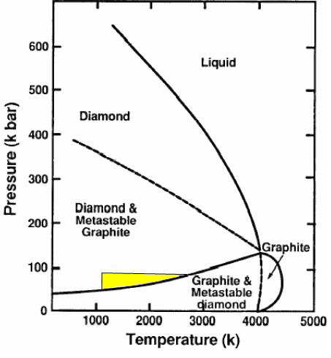
Industrial Production of Diamonds

Slide 6
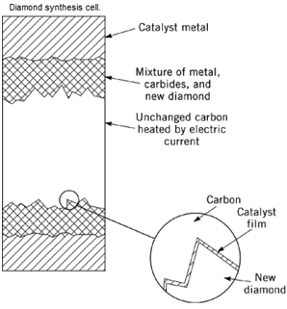

Slide 7
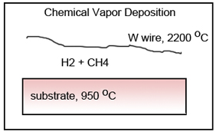
H₂(g) → 2 H(g)
H(g) + CH₄(g) → CH₃(g) + H₂(g)
CH₃ + C(diamond-H, surface) → Diamond-CH₃ + H
CVD: Why is diamond formed, and not graphite?

