Slide 1
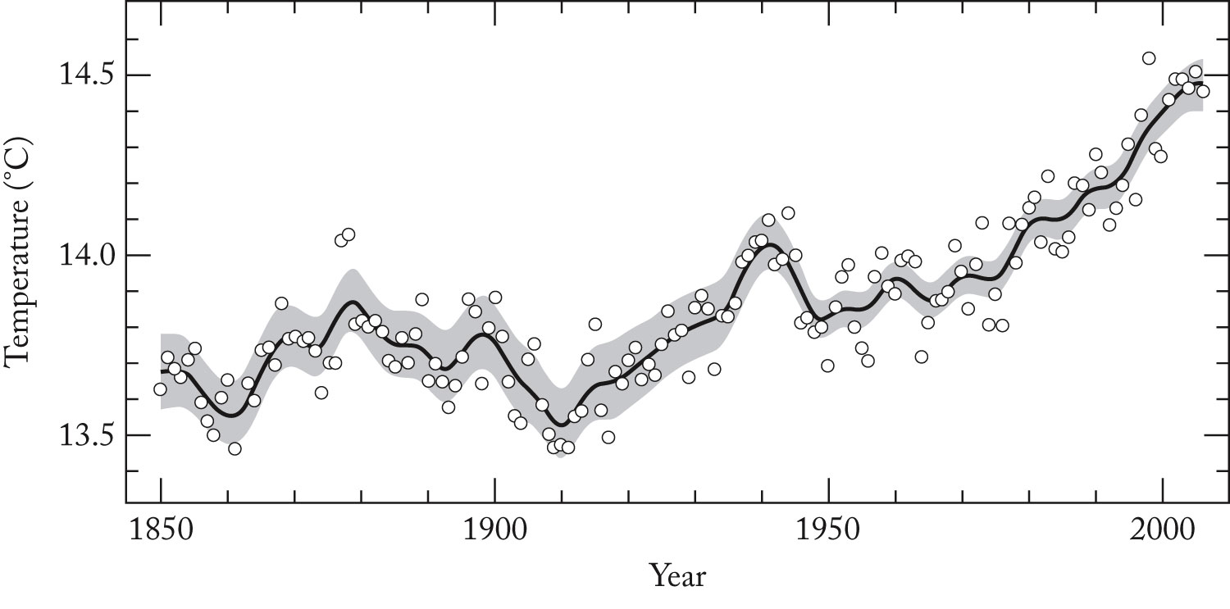
Global Warming

Slide 3
Composition of Atmosphere:
Gas | Mole Percent
N₂ | 78.08
O₂ | 20.95
Ar | 0.934
CO₂ | 0.03
O₃ | 1.0 x 10⁻⁷

Slide 4
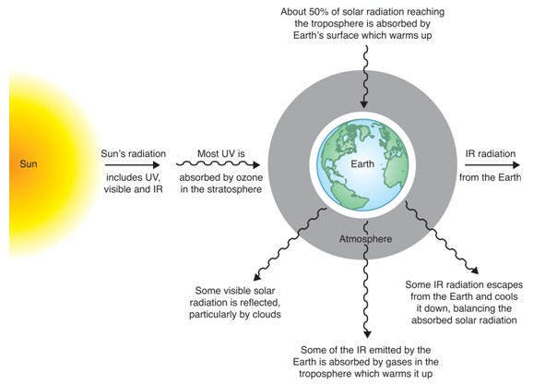

Slide 5
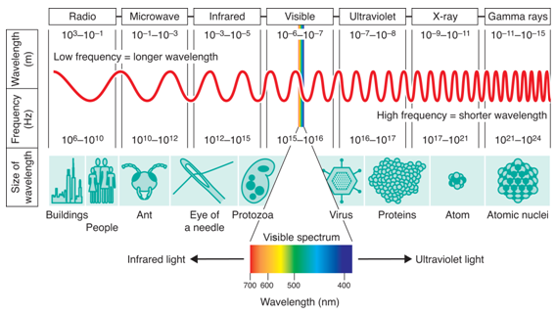

Slide 6
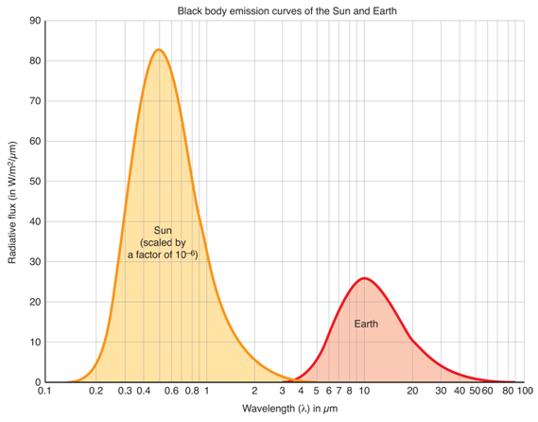

Slide 7
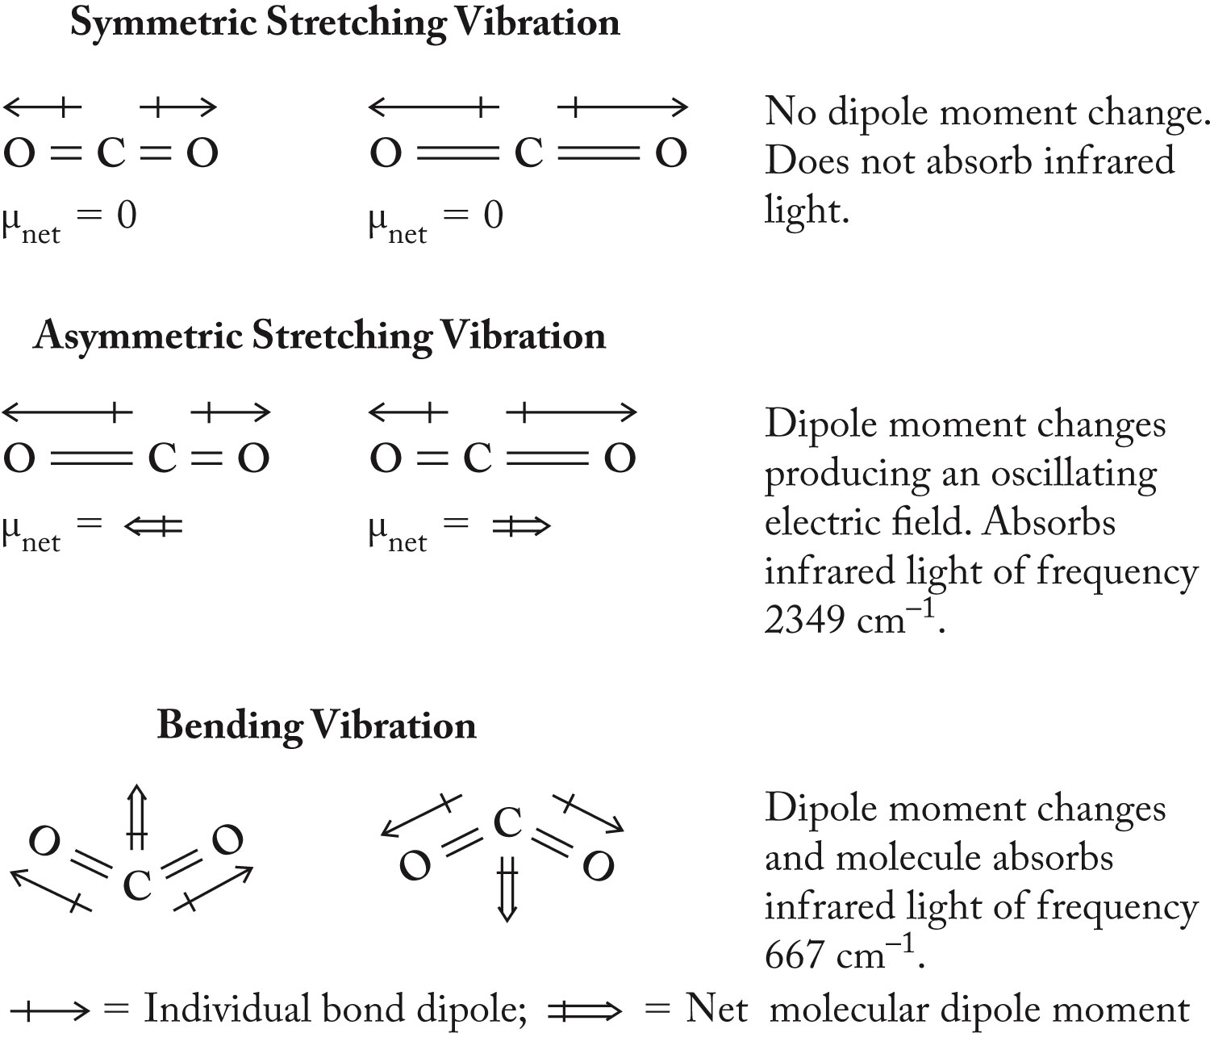

Slide 8
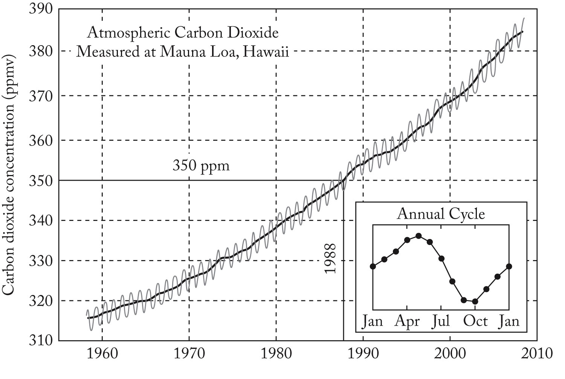
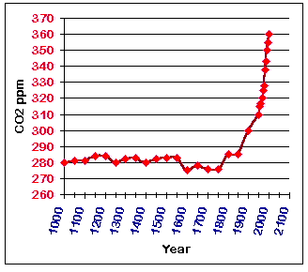
Why CO₂ is
important:
CO₂ Levels

Slide 9
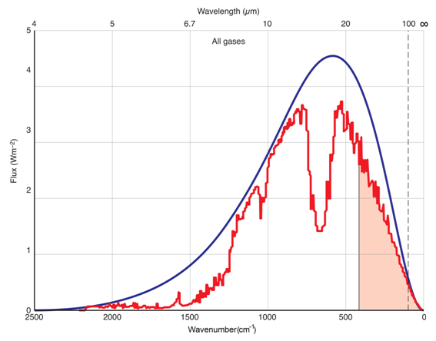

Slide 10
Global Energy Balance:
= 5.67 x 10⁻⁸ W/m²K⁴
= Albedo (shinyness)
Earth = 0.28
Mars = 0.17
Jupiter = 0.73
Venus = 0.71
Es = solar energy input
Earth = 1380 W/m²
Mars = 600
Venus = 2600
E_{out} = σT⁴
If E_{in} = E_{out}, then

Slide 11
= 5.67 x 10⁻⁸ W/m²K⁴
= Albedo
Earth = 0.28
Mars = 0.17
Jupiter = 0.73
Venus = 0.71
E_{s} = solar energy input
Earth = 1380 W/m²
Mars = 600
Venus = 2600
Try for Earth: Calculate average temperature of Earth
Of Venus?

Slide 12
Greenhouse Effect:
Some energy radiated back to space is
captured and re-radiated back to Earth.
f = IR transmission factor = fraction energy escaping
So: E_{out} = fσT⁴

Slide 13
= 5.67 x 10⁻⁸ W/m²K⁴
= Albedo
Earth = 0.28
Mars = 0.17
Jupiter = 0.73
Venus = 0.71
E_{s} = solar energy input
Earth = 1380 W/m²
Mars = 600
Venus = 2600
Calculate IR transmission factor for Earth: T_{actual} = 291 K
Calculate IR transmission factor for Venus: T_{actual} = 750 K

Slide 15
Climate Modeling
Determine all the relationships.
Predict amounts and rates.
Feedback loops: positive and negative.
Simulate into the future by iterative method.
How do you test your model?

Slide 16
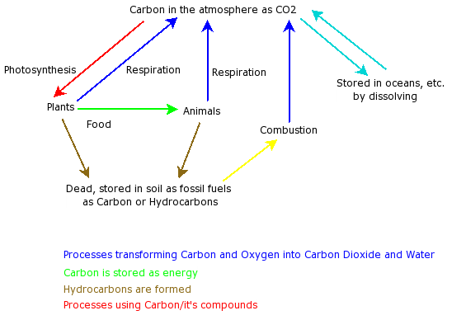
Element Cycles

Slide 17
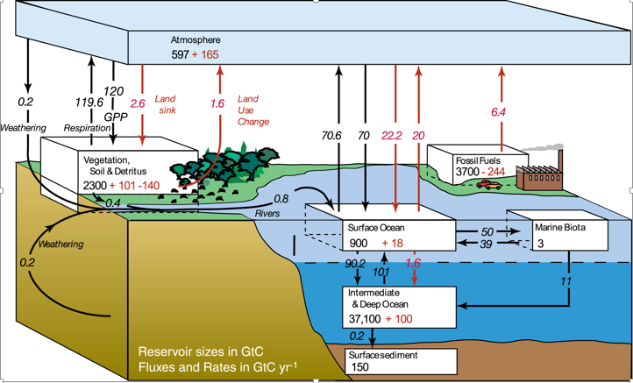
Element Cycles: reservoirs and fluxes

Slide 18
Come Up with Relationships to include in model

Slide 19
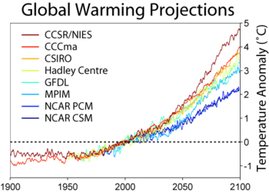

Slide 20
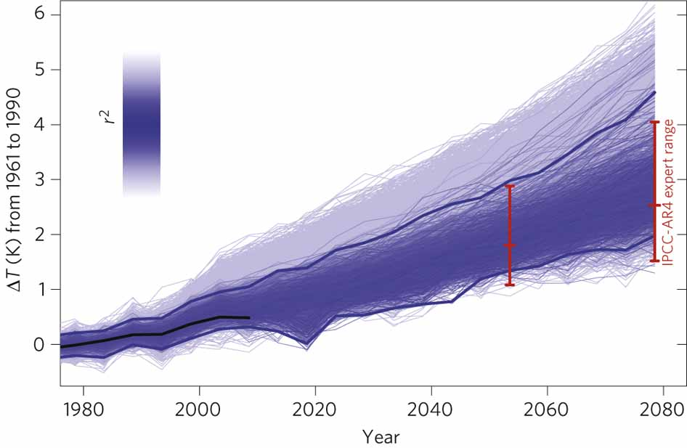

Slide 21
Modeling in Excel

Slide 22
= 5.67 x 10⁻⁸ W/m²K⁴
= Albedo
Earth = 0.28
Mars = 0.17
Jupiter = 0.73
Venus = 0.71
E_{s} = solar energy input
Earth = 1380 W/m²
Mars = 600
Venus = 2600
Try for Earth: Calculate average temperature of Earth
Of Venus?

Slide 23
Greenhouse Effect:
Some energy radiated back to space is
captured and re-radiated back to Earth.
f = IR transmission factor = fraction energy escaping
So: E_{out} = fσT⁴

Slide 24
= 5.67 x 10⁻⁸ W/m²K⁴
= Albedo
Earth = 0.28
Mars = 0.17
Jupiter = 0.73
Venus = 0.71
E_{s} = solar energy input
Earth = 1380 W/m²
Mars = 600
Venus = 2600
Calculate IR transmission factor for Earth: T_{actual} = 291 K
Calculate IR transmission factor for Venus: T_{actual} = 750 K

Slide 26
Climate Modeling
Determine all the relationships.
Predict amounts and rates.
Feedback loops: positive and negative.
Simulate into the future by iterative method.
How do you test your model?

Slide 27
Element Cycles

Slide 28
Element Cycles: reservoirs and fluxes

Slide 33
Ozone in upper atmosphere
Who cares?
Formation:

Slide 34
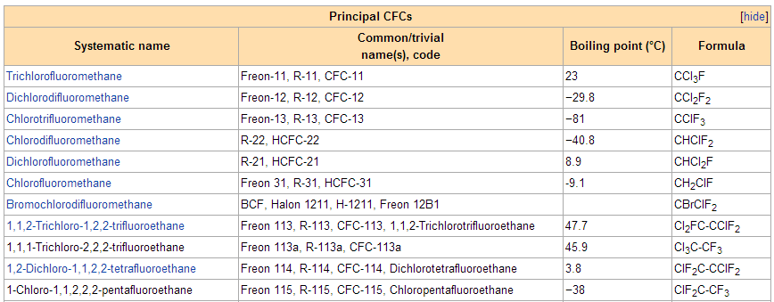
CFCs: chlorofluorcarbons
What are they?

Slide 35
Naming CFCs
A numbering system is used for fluorinated alkanes, prefixed with Freon-, R-, CFC-, and HCFC-. The rightmost value indicates the number of fluorine atoms, the next value to the left is the number of hydrogen atoms plus 1, and the next value to the left is the number of carbon atoms less one (zeroes are not stated). Remaining atoms are chlorine. Thus, Freon-12 indicates a methane derivative (only two numbers) containing two fluorine atoms (the second 2) and no hydrogen (1-1=0). It is therefore CCl₂F₂.
Another, easier equation that can be applied to get the correct molecular formula of the CFC/R/Freon class compounds is this to take the numbering and add 90 to it. The resulting value will give the number of carbons as the first numeral, the second numeral gives the number of hydrogen atoms, and the third numeral gives the number of fluorine atoms. The rest of the unaccounted carbon bonds are occupied by chlorine atoms. The value of this equation is always a three figure number. An easy example is that of CFC-12, which gives: 90+12=102 -> 1 carbon, 0 hydrogens, 2 fluorine atoms, and hence 2 chlorine atoms resulting in CCl₂F₂. The main advantage of this method of deducing the molecular composition in comparison with the method described in the paragraph above, is that it gives the number of carbon atoms of the molecule.

Slide 36
Naming CFCs

Slide 37
CFCs: chlorofluorcarbons
Are CFCs very reactive?
Why were they used?

Slide 38
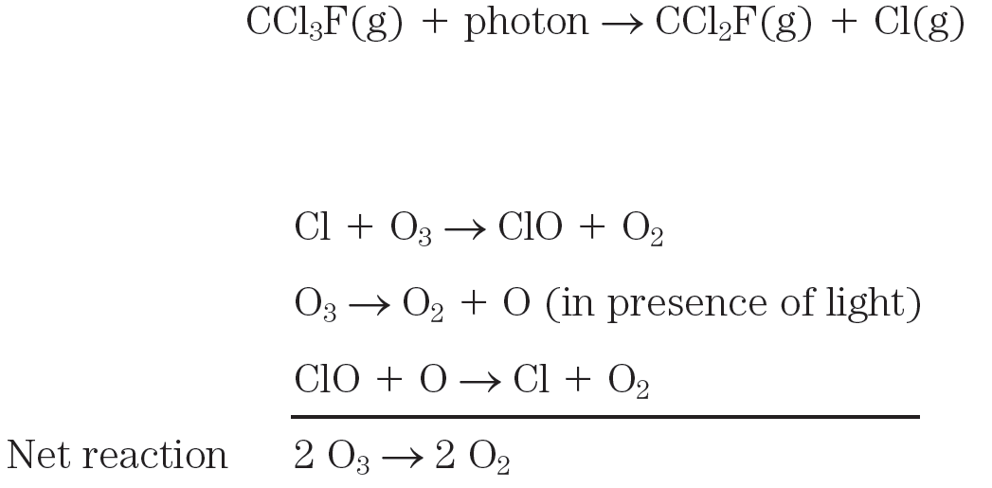
CFCs: Why are they bad for ozone?

Slide 39
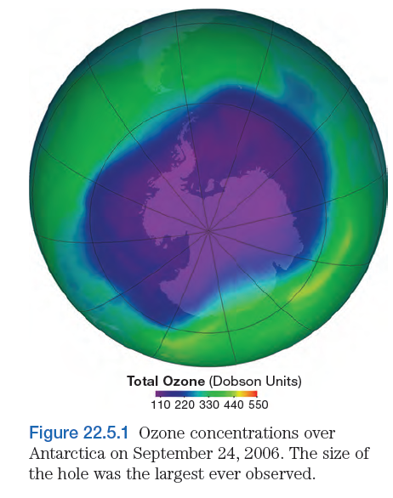
Why is the ozone hole over the South Pole?
Why in October?

