Slide 1
Oxidation-Reduction Chemistry
Redox

Slide 2
Definitions
Oxidation:
Reduction:
Oxidizing Agent:
Reducing Agent:

Slide 3
Examples:
2 Ag⁺(aq) + Cu(s) → 2 Ag(s) + Cu²⁺(aq)
MnO₄⁻(aq) + 5 Fe²⁺(aq) + 8 H⁺(aq) → Mn²⁺(aq) + 5 Fe³⁺(aq) + 4 H₂O(l)

Slide 4
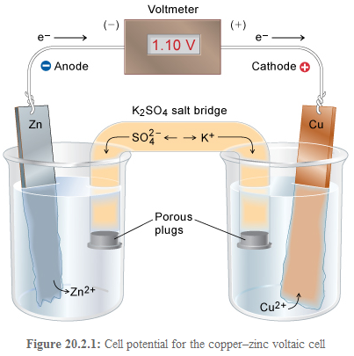
Electrochemical Cells: Batteries
Anode:
Cathode:

Slide 5
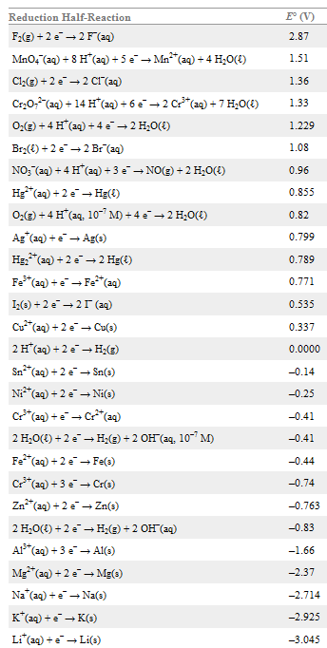
Reduction potential: measure of how much the reactant wants to gain electrons to form product.
Rank oxidizing and reducing agents.

Slide 6
Reduction Potentials and Cell Potentials
Eº_{cell} = Eº_{anode} – Eº_{cathode} more positive = more favored
What is the standard cell potential for a cell using: Al → Al³⁺ and Hg²⁺ → Hg

Slide 7
ΔGº = -nFEº F = 96485 J/mol
When is a cell reaction favored?
What is ΔGº for a cell using Cu²⁺ → Cu and Zn → Zn²⁺

Slide 8
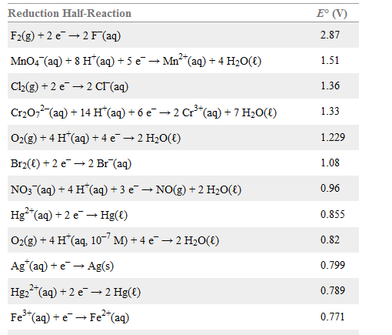
Predicting favored reactions from the table
Eº = Eº _{cathode} - Eº _{anode}
Eº = Eº _{forward half reaction} - Eº _{reversed} _{half reaction}

Slide 9
If Eº relates to ΔGº, it must relate to K.
ΔGº = -RT lnK
ΔGº = -nFEº
At 298 K, RT/F = 0.0257 V, so:

Slide 11
Cell potentials under nonstandard conditions
Nernst Equation: When concentrations differ
Recall Q
Predict E vs. [products] or [reactants]

Slide 15
Concentration Cells
What is the potential of a cell that contains a Cu wire and [Cu²⁺] = 1.5 M in the
cathode compartment and a Cu wire and [Cu²⁺] = 0.00058 M in the anode compartment?
Cu²⁺ + Cu → Cu + Cu²⁺

Slide 16
Concentration Cells
Real use of concentration cells: measure E to determine concentration.
[H⁺] in cathode half-cell = 1.00 M
[H⁺] in anode half-cell = 4.6 x 10⁻⁴ M
E = ?

Slide 18
Electrolysis: Coulometry–Counting electrons
Use electrical energy to effect chemical change:
Use an applied voltage to make a cell run “backwards.”
One of only three methods to get products from
thermodynamically unfavorable reactions.

Slide 19
Electrolysis: Coulometry– Counting electrons
1 C = 1 Amp x 1 sec
96485 C = 1 mol e⁻
How many grams of Cu can be deposited from a Cu²⁺ solution by applying a
current of 1.68 A for 22 minutes?

Slide 20
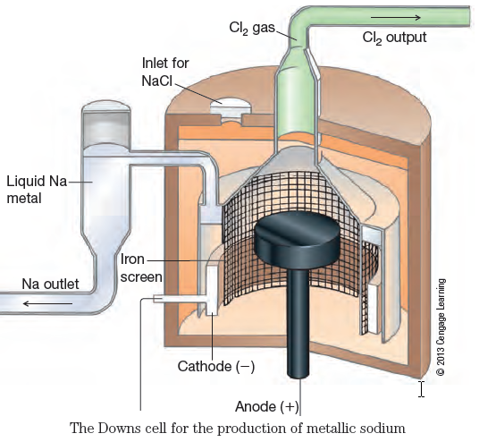
Electrolysis of Molten Salts
NaCl melts at about 801 ºC.
Use a mixture of CaCl₂ and NaCl
is used. Melts at 580 ºC.

Slide 21
Electrolysis of Molten Salts
A current of 7.06 A is passed through an electrolysis cell containing molten CaCl₂ for 12.9 minutes.
a. Predict the products of the electrolysis and the reactions occurring at the cathode and anode.

Slide 22
Electrolysis of Molten Salts
A current of 7.06 A is passed through an electrolysis cell containing molten CaCl₂ for 12.9 minutes.
b. Calculate the quantity or volume of products collected at the anode and cathode (assume gases are collected at 298 K and 1.00 atm).

Slide 23
Batteries

Slide 24
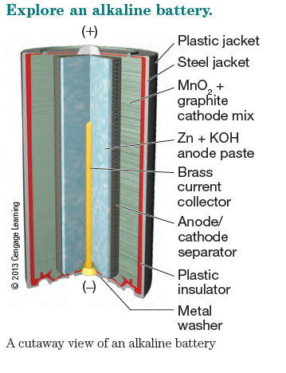
Alkaline Battery
Cathode: 2 MnO₂(s) + H₂O(ℓ) + 2 e− → Mn2O3(s) + 2 OH−(aq)
Anode: Zn(s) + 2 OH−(aq) → ZnO(s) + H₂O(ℓ) + 2 e−
Net reaction: 2 MnO₂(s) + Zn(s) → Mn₂O₃(s) + ZnO(s) E_{cell} = 1.5 V

Slide 25
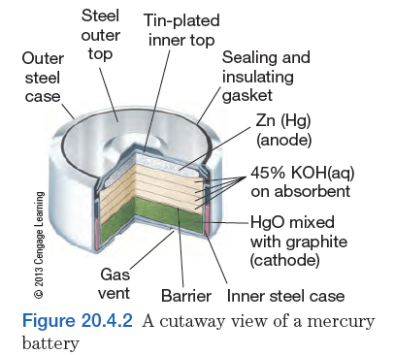
Watch Battery
Cathode: HgO(s) + H₂O(ℓ) + 2e− → Hg(ℓ) + 2 OH−(aq)
Anode: Zn(s) + 2 OH−(aq) → ZnO(s) + H₂O(ℓ) + 2 e−
Net reaction: HgO(s) + Zn(s) → ZnO(s) + Hg(ℓ) E_{cell} = 1.3 V

Slide 26
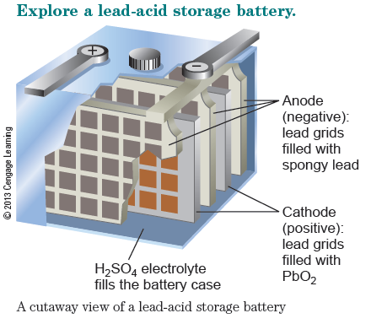
Lead Acid Battery
Cathode: PbO₂(s) + 2 H₂SO₄(aq) + 2 e− → PbSO₄(s) + 2 H₂O(ℓ)
Anode: Pb(s) + SO₄²⁻(aq) → PbSO₄(s) + 2 e−
Net reaction: PbO2(s) + Pb(s) + H₂SO₄(aq) → 2 PbSO₄(s) + 2 H₂O(ℓ)
Recharging: 2 PbSO₄(s) + 2 H₂O(ℓ) → PbO₂(s) + Pb(s) + H₂SO₄(aq)

Slide 27
Rechargeable Batteries
Nickel Metal Hydride Batteries
Cathode: NiO(OH)(s) + H₂O(ℓ) + e− → 2 Ni(OH)₂(s) + OH−(aq)
Anode: MH(s) + OH−(aq) → M(s) + H₂O(ℓ) + e−
Net reaction: MH(s) + NiO(OH)(s) → M(s) + Ni(OH)₂(s)
Lithium Ion Batteries
Cathode: CoO₂(s) + Li⁺ + 1 e− → LiCoO₂(s)
Anode: Li-graphite → C(graphite) + Li⁺ + e−
Net reaction: Li(s) + CoO₂(s) → LiCoO₂(s)

Slide 28
Rechargeable Batteries
What is required for a battery to be rechargeable?

Slide 30
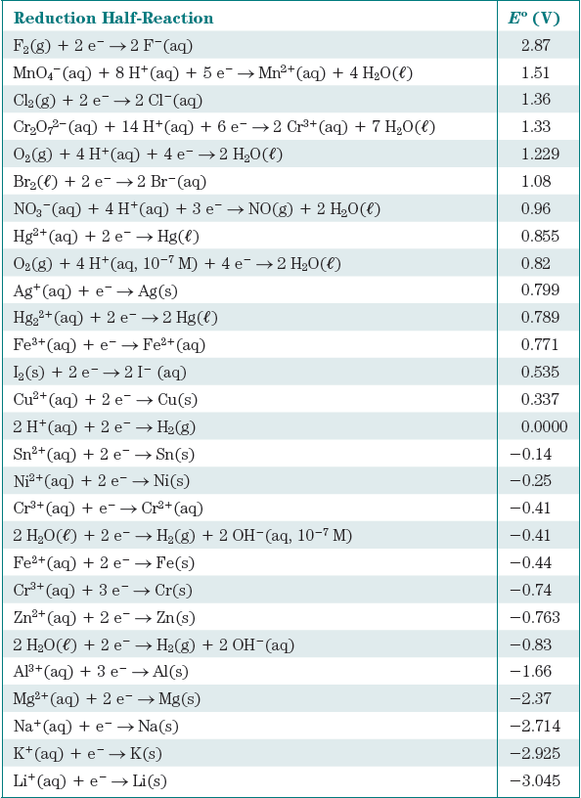

Slide 31
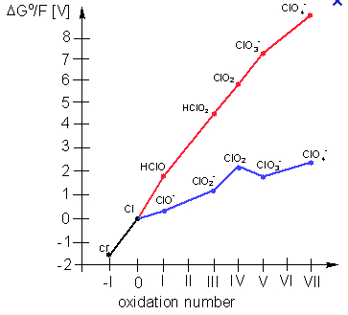
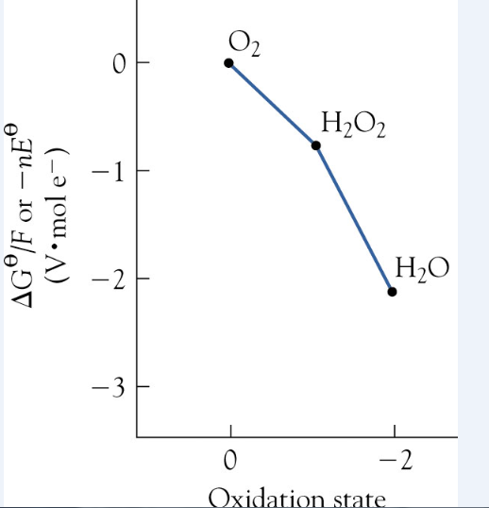
Frost Diagrams

Slide 32
Frost Diagrams
https://www.google.com/search?tbm=isch&sa=1&ei=pQkLWuS-G4_mjwSqmrSYAw&q=frost+diagrams&oq=frost+diagrams&gs_l=psy-ab.12...0.0.0.88417.0.0.0.0.0.0.0.0..0.0....0...1..64.psy-ab..0.0.0....0.XkbBm7LjXjo
https://en.wikipedia.org/wiki/Frost_diagram

Slide 33
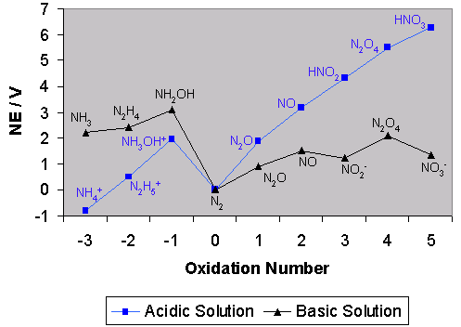
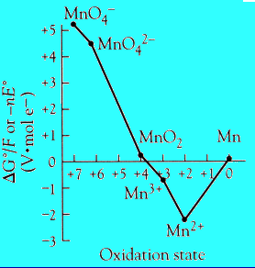

Slide 34
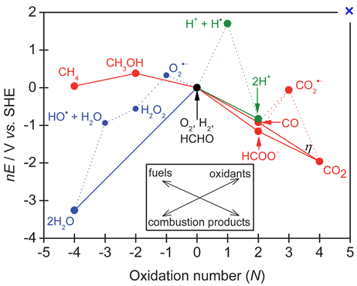

Slide 35
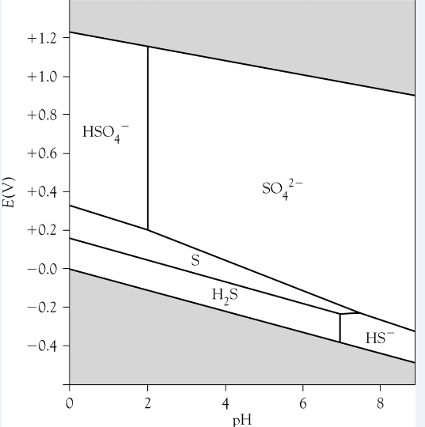
Pourbaix Diagrams

Slide 36
Pourbaix Diagrams
https://en.wikipedia.org/wiki/Pourbaix_diagram
https://www.google.com/search?q=pourbaix+diagrams&source=lnms&tbm=isch&sa=X&ved=0ahUKEwjxgsehr77XAhUK_IMKHfIODggQ_AUICigB&biw=1332&bih=829

Slide 37
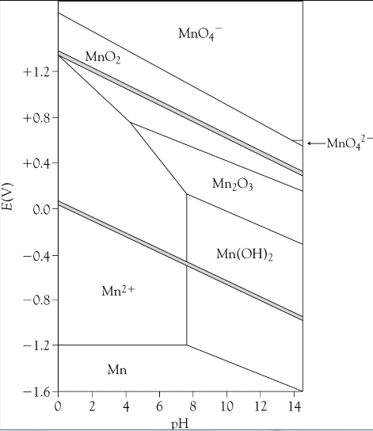

Slide 38
