Slide 1
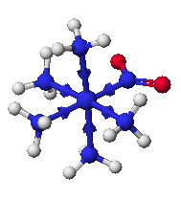
Chapter 9 Coordination Chemistry I
Structures and Isomers

Slide 3
Coordination compounds
Central metal, neutral or cation
Ligand: neutral molecule or anion
Ions for charge balance (if necessary)
Coordination number = number of ligand attachments (commonly 4, 6, 5)
Geometric and optical isomers possible
K_{f} values: usually very large, >10¹⁰

Slide 4
Naming Coordination Compounds
Cation + anion
Ligands + metal in coordination compound
Charge indicated by Roman numerals in parentheses
If complex ion carries a negative charge, add -ate to the name of the metal
Ligands are named in alphabetical order
Prefixes indicate the number of ligands

Slide 5
Naming Ligands
Neutral - aqua, ammine, carbonyl
Anion - chloro, nitro, sulfato
Cations are not common
Chelating - multidentate ethylenediamine EDTA acac
Prefix if ligand is “complex” (neutral or name contains a prefix) 2 (bis), 3 (tris), 4 (tetrakis)

Slide 6
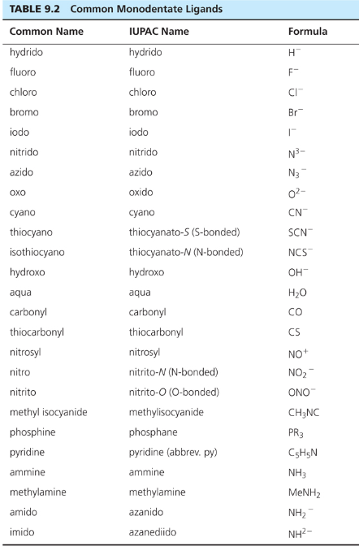

Slide 7
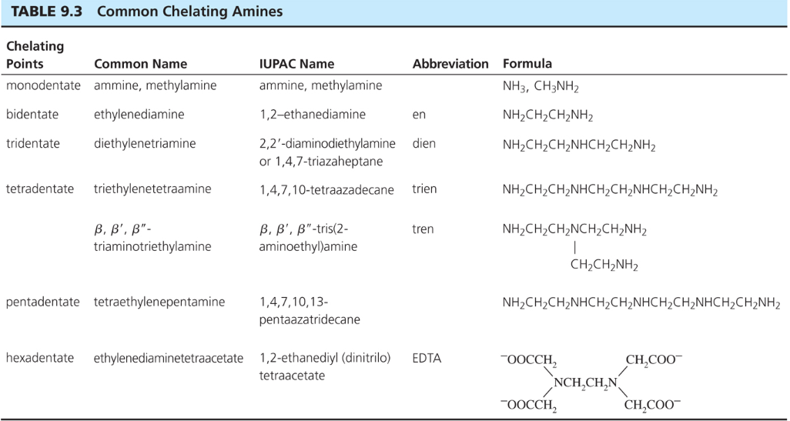

Slide 8
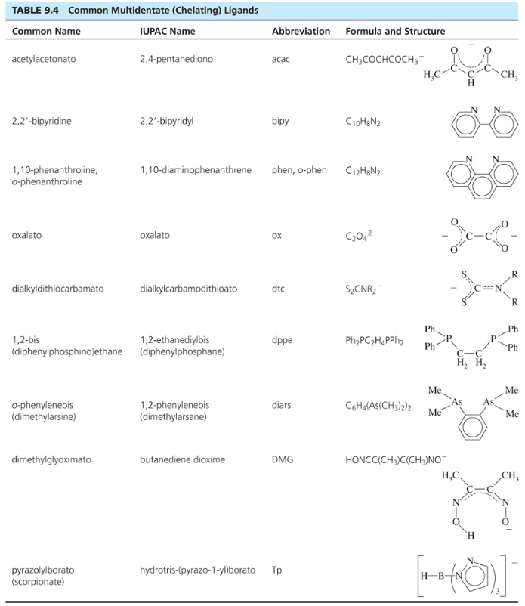

Slide 9
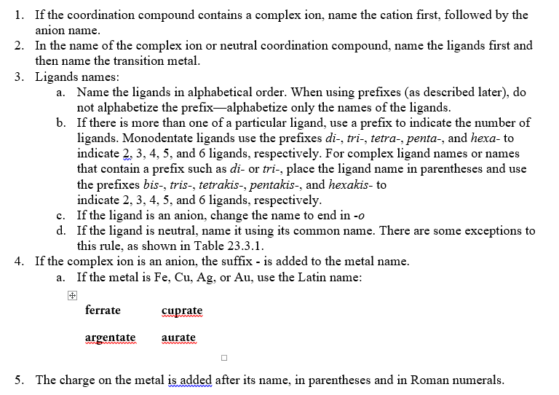

Slide 10
Li₂[CoF₆]
VCl₃(NMe₃)₂
(NH₄)₃[Fe(CN)₅CO]
K₃[Ni(CN)₅]
[Ru(bpy)₃]Cl₂

Slide 11
Some examples...
Pt(NH₃)₄²⁺
[Co(NH₃)₄(H₂O)₂]Cl₂
Ligands shown in Tables in Chapter 9
Bridging ligands - μ
Naming rules in Chapter 9
Exercises 9-1 and 9-2

Slide 12
Common Structures
CN 1, 2, 3 - follow VSEPR Bulky ligands, filled d-orbitals Ag(I), Cu(I), Au(I)
CN 4 - Tetrahedral or Square Planar d¹⁰ - tetrahedral; d⁸ - square planar
CN 5 - trigonal bipyramid or square pyramid Similar energy
CN 6 - octahedral + distorted octahedron
CN 7, 8, ... more unusual, but known

Slide 13
Coordination Compound Isomers
Stereoisomers geometric and optical isomers
Structural hydrate, solvent, ionization, linkage isomers

Slide 14
Geometric Isomers
CN 4 and 6 most common
cis, trans
fac, mer
Isomer designations for compounds containing chelating ligands can get complicated (see textbook), we will not use

Slide 15
Geometric + Optical Isomers
Octahedral geometry (consider monodentate ligands only): trans-pair method
Mabcdef: Identify all trans pairs, then identify optically active isomers (ab)(cd)(ef), (ab)(ce)(df), (ab)(cf)(de), ......
Try Ma₂b₂cd
Diastereomer + mirror image = pair of enantiomers
Bidentate ligands? Use capital letters or “manual” method to identify geometric isomers
M(AA)(BB)c₂
How many isomers? How many chiral isomers?

Slide 17
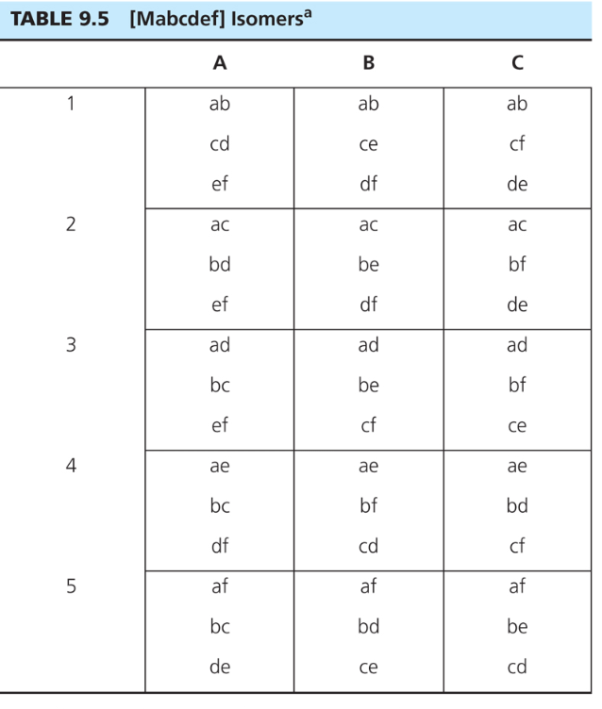

Slide 18
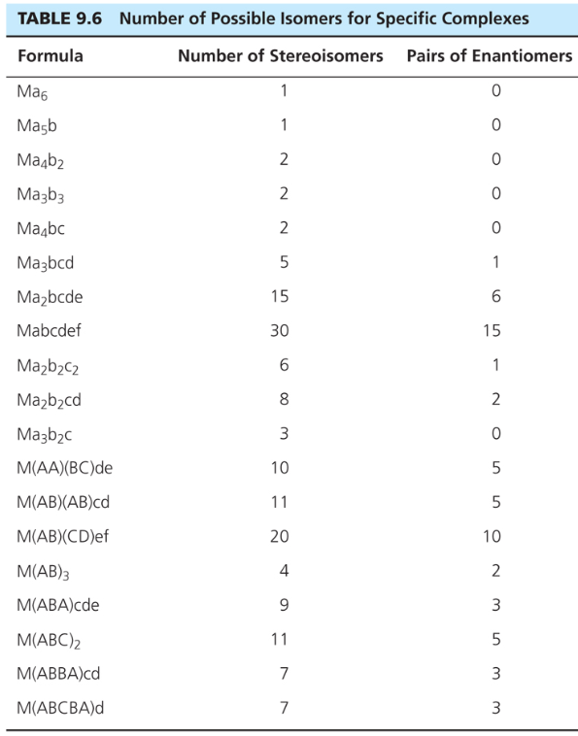

Slide 19
Structural isomers
What is inside the coordination sphere?
CrCl₃.6H₂O has three hydrate isomers: non, mono, and di-hydrate
Coordination isomers differ in what is inside the coordination sphere of each metal [Pt(NH3)4][PtCl4] vs. [PtCl(NH3)3][Pt(NH3)Cl3]
Ionization isomers give different number of ions in solution or different ions in solution [Co(NH₃)₄(NO₂)Cl]Cl [Co(NH₃)₄Cl₂]NO₂

Slide 21
Linkage
Atom bonding to metal changes
NO₂⁻
M-NO₂ - nitro M-ONO - nitrito
Can be converted by gentle heating
SCN⁻ bonds through S or N
DMSO - S or O

Slide 22
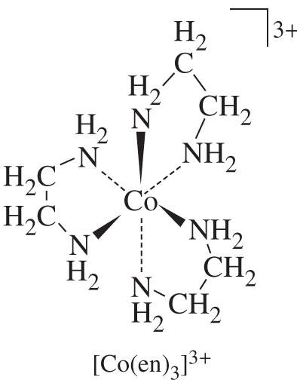
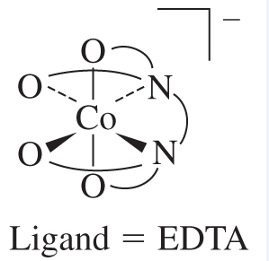

Slide 23
Chapter 10: Bonding

Slide 25
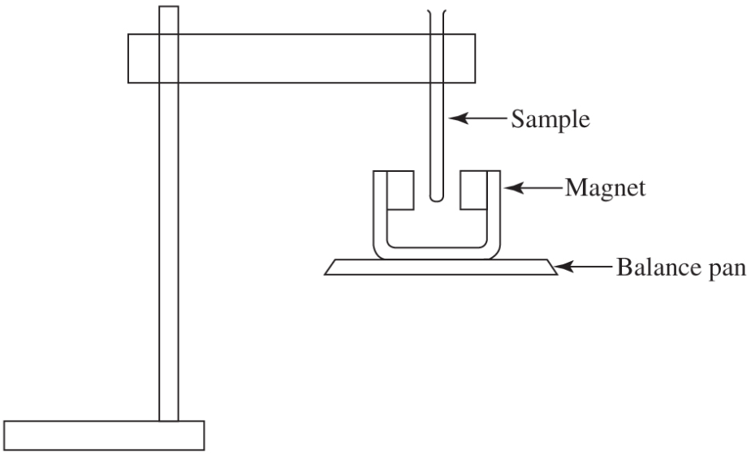
Experimental Evidence: Magnetic Susceptibility

Slide 26
Magnetic Susceptibility
g = constant
S = spin quantum number (multiplicity) = 2(total spin) + 1
L = sum of the highest possible m_{l} values following Hund’s rule

Slide 27
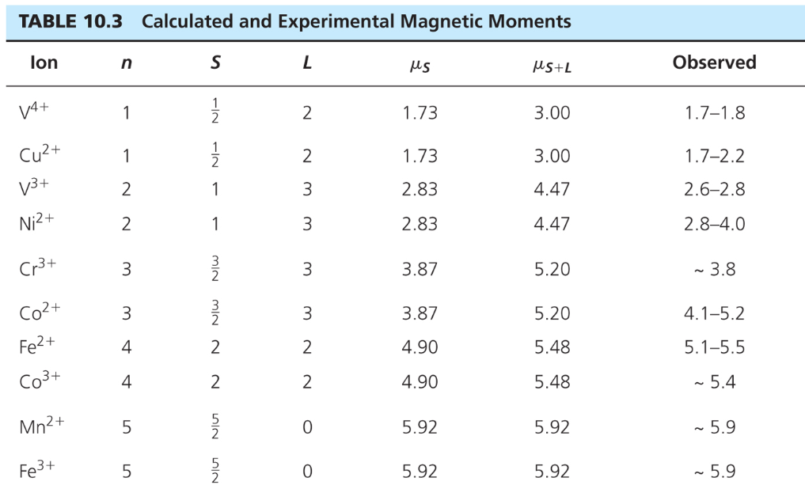
Magnetic Susceptibility

Slide 28
Do some examples:

Slide 29
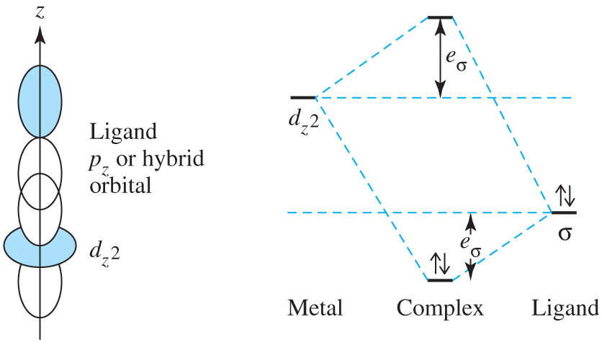
Bonding:
Sigma interactions

Slide 30
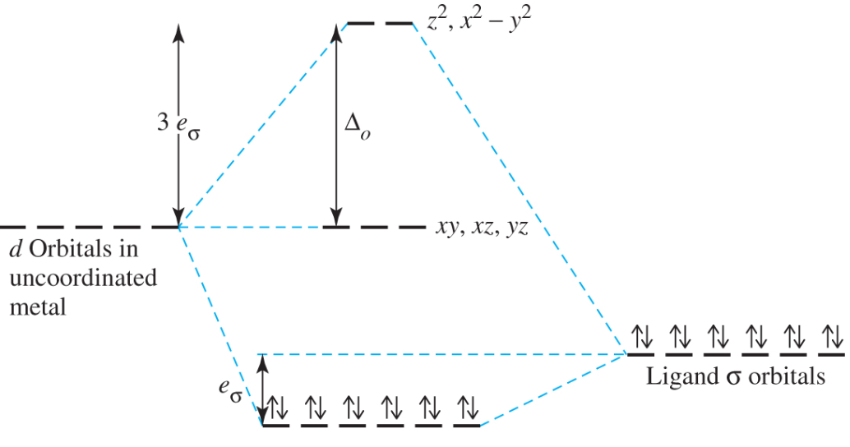
Bonding:
Sigma interactions

Slide 32
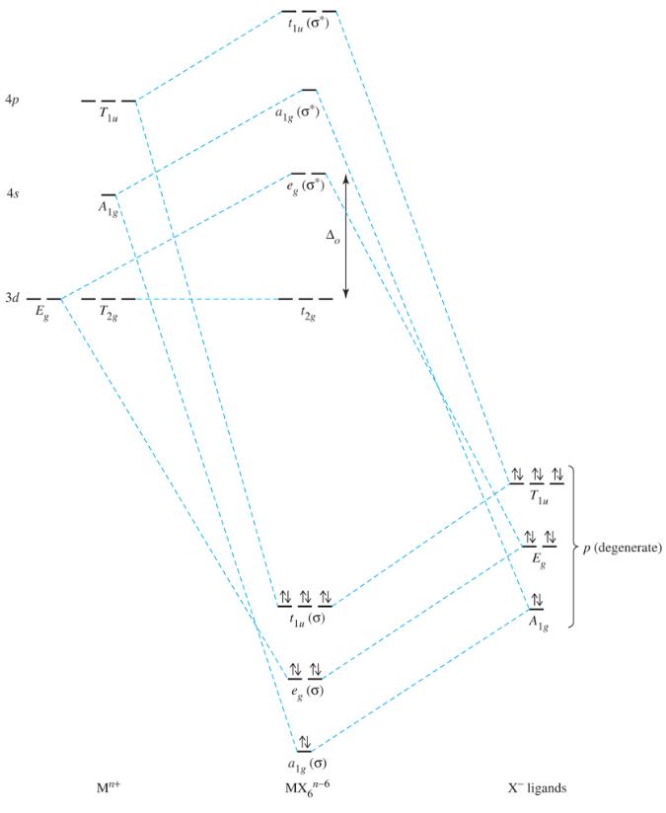
Bonding:
Sigma interactions

Slide 33
High Spin/Low Spin States

Slide 34
High Spin/Low Spin States

Slide 35
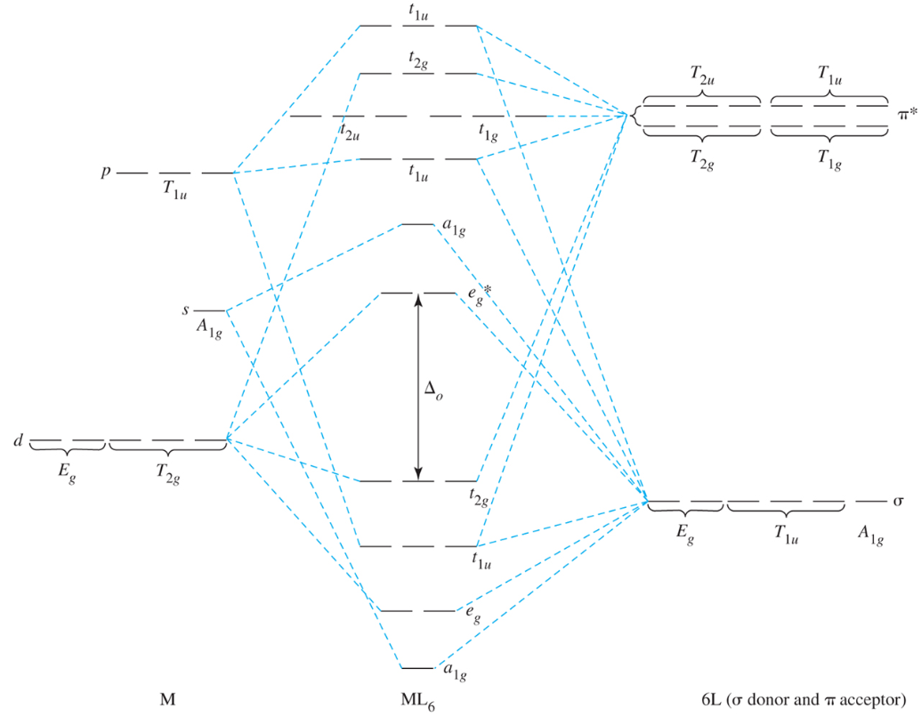

Slide 36
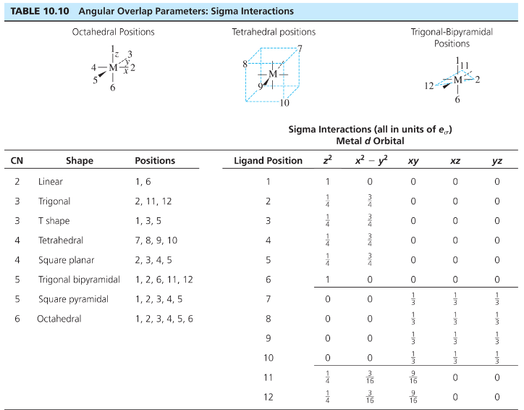

Slide 37
Ligand Field Splitting Trends Spectrochemical Series CO,CN⁻ > phen,bpy > NO₂⁻ > en > NH₃ > NCS⁻ > H₂O > F⁻ > RCO₂⁻ > OH⁻ > Cl⁻ > Br⁻ > I⁻
Strong field
Low spin
Large Δº
Weak field
High spin
Small Δº
Slow Reactions (inert) Intermediate Fast Reactions (Labile)

Slide 38
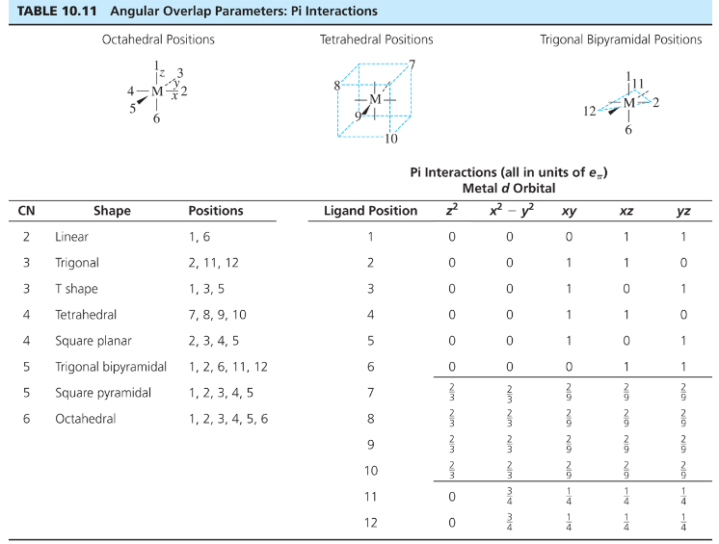

Slide 39
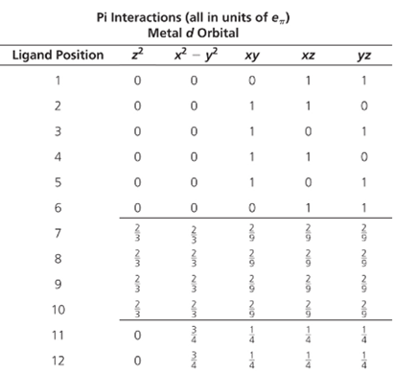

Slide 42
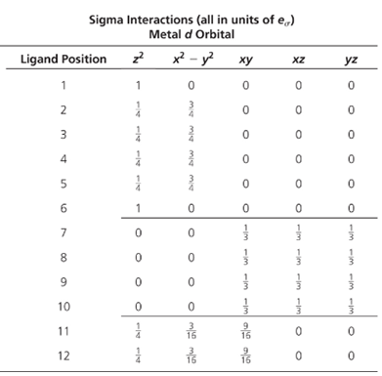

Slide 43
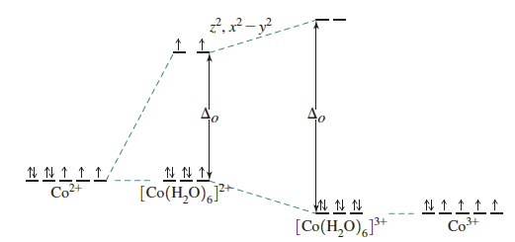
Magnitude of Angular Overlap Interactions: Charge on Metal

Slide 44
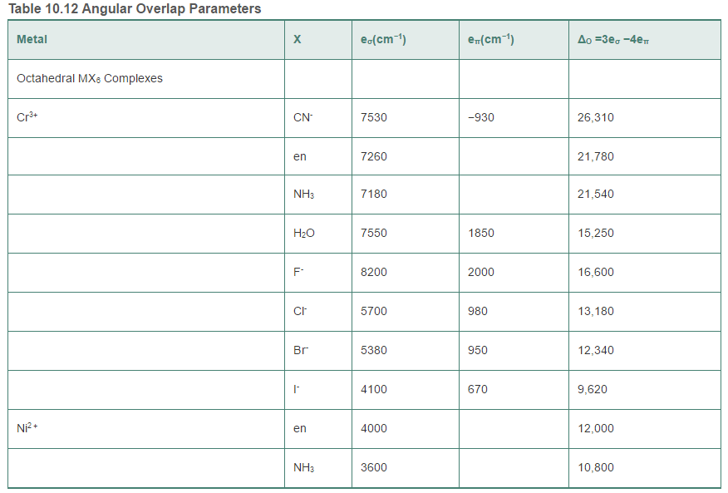
Magnitude of Angular Overlap Interactions

Slide 45
Ligand Field Splitting Trends Spectrochemical Series CO,CN⁻ > phen,bpy > NO₂⁻ > en > NH₃ > NCS⁻ > H₂O > F⁻ > RCO₂⁻ > OH⁻ > Cl⁻ > Br⁻ > I⁻
Strong field
Low spin
Large Δº
Weak field
High spin
Small Δº
Slow Reactions (inert) Intermediate Fast Reactions (Labile)

Slide 46
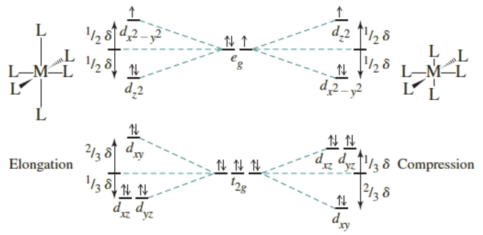
Jahn-Teller Effect

