Slide 1
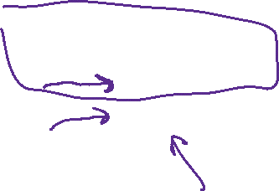

Chapter 12: Coordination Compound Reactions
Goal is to understand reaction mechanisms
Three types of reactions:
  Substitution
  Redox
  Ligand-Based

Slide 2
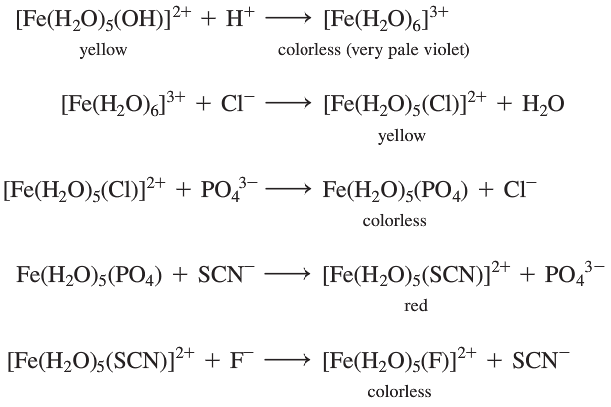



Primarily substitution reactions:

Slide 3
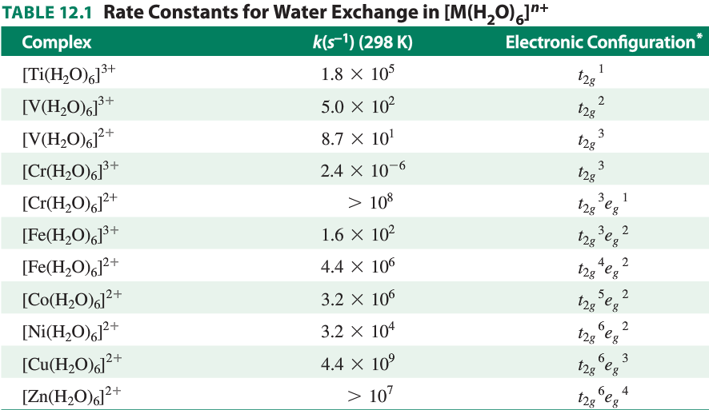

Most substitution reactions are rapid but some are slow

Slide 4
Substitution Reactions
Labile compounds - rapid ligand exchange (reaction half-life of 1 min or less)
Inert compounds - slower reactions
Labile/inert labels do not imply stability/instability
(inert compounds can be thermodynamically unstable) - these are kinetic effects
In general:
  Inert: octahedral d³, low spin d⁴ - d⁶, strong field d⁸ square planar
  Intermediate: weak field d⁸
  Labile: d¹, d², high spin d⁴ - d⁶, d⁷, d⁹, d¹⁰

Slide 5



Substitution Mechanisms
Two extremes:
Dissociative (D, low coordination number intermediate)
Associative (A, high coordination number intermediate)
SN1 or SN2 at the extreme limit
Interchange - incoming ligand participates in the reaction, but no detectable intermediate
  Can have associative (Ia) or dissociative (Id) characteristics
Reactions typically run under conditions of excess incoming ligand
Rate laws, consider primarily octahedral complexes

Slide 6
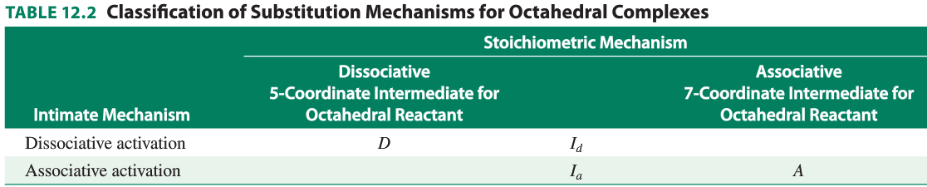
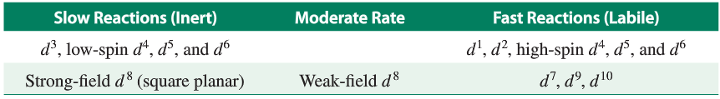

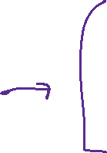
Substitution Mechanisms

Slide 7
Substitution Mechanisms
Pictures:

Slide 8
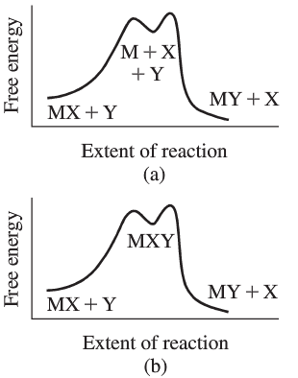
Substitution Mechanisms
dissociative
associative

Slide 9









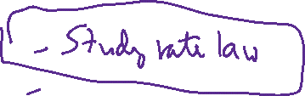







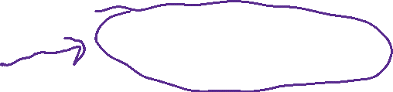
Determining mechanisms
What things would you do to determine the mechanism?

Slide 10



















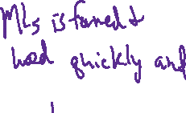




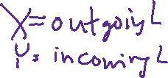



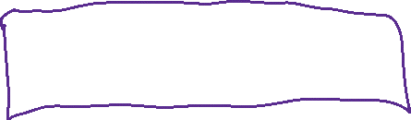
Dissociation (D) Mechanism
ML₅X  ML₅ + X k₁, k₋₁
ML₅ + Y  ML₅Y k₂
₁st step is ligand dissociation. Steady-state hypothesis assumes small [ML5], intermediate is consumed as fast as it is formed

Slide 11
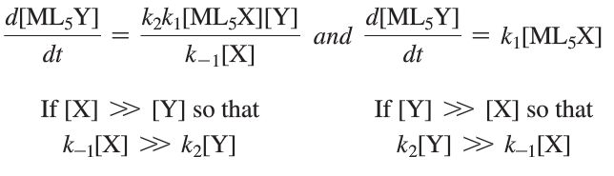

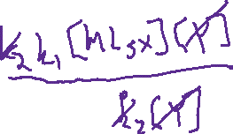

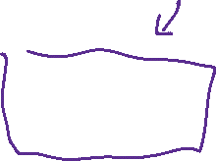
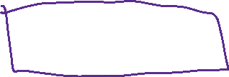


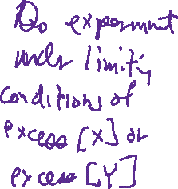
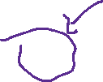




Dissociation (D) Mechanism
ML₅X  ML₅ + X k₁, k₋₁
ML₅ + Y  ML₅Y k₂
How is rate affected by [X] and [Y]?

Slide 12






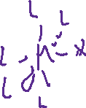

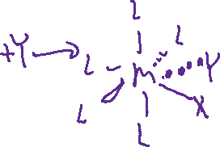

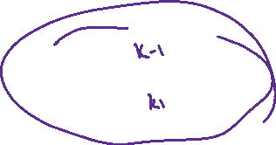
Interchange Mechanism
ML5X + Y  ML5X.Y k1, k–1
ML5X.Y  ML5Y + X k2 RDS
1st reaction is a rapid equilibrium between ligand and complex to form ion pair or loosely bonded complex (not a high coordination number). The second step is slow.
Reactions typically run under conditions where [Y] >> [ML5X]

Slide 13


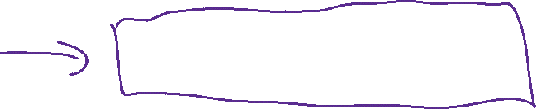
Interchange Mechanism
Between D and A: transition state instead of intermediate
I_{a} vs. I_{d} depending on relative strengths of M-X and M-Y

Slide 14


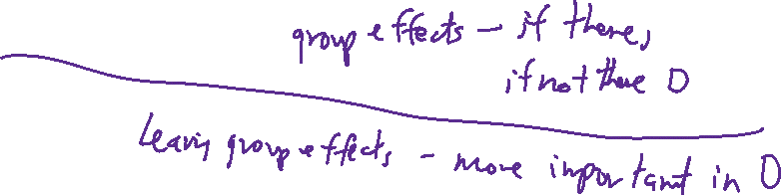














Slide 15

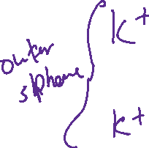
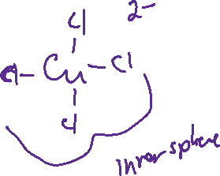

Slide 16
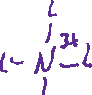

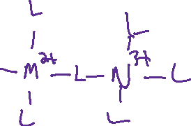

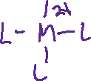
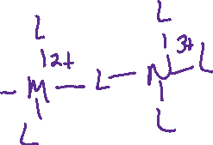






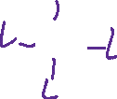
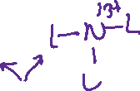

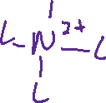





Slide 17
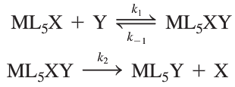



Association (A) Mechanism
1st reaction results in an increased coordination number. 2nd reaction is faster; use steady state apprx:
Rate law is always 2nd order, regardless of [Y]
Very few examples known with detectable intermediate

Slide 18


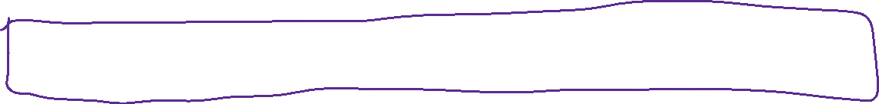


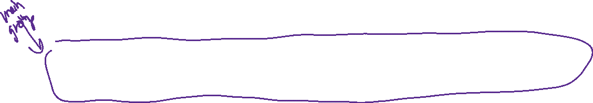
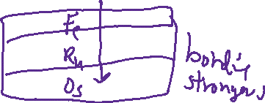




Factors affecting rate
Most octahedral reactions have dissociative character, square pyramid intermediate
Oxidation state of the metal: High oxidation state results in slow ligand exchange
[Na(H2O)6]⁺ > [Mg(H2O)6]²⁺ > [Al(H2O)6]³⁺
Metal Ionic radius: Small ionic radius results in slow ligand exchange (for hard metal ions)
[Sr(H2O)6]²⁺ > [Ca(H2O)6]²⁺ > [Mg(H2O)6]²⁺
For transition metals, Rates decrease down a group
Fe²⁺ > Ru²⁺ > Os²⁺ due to stronger M-L bonding

Slide 19
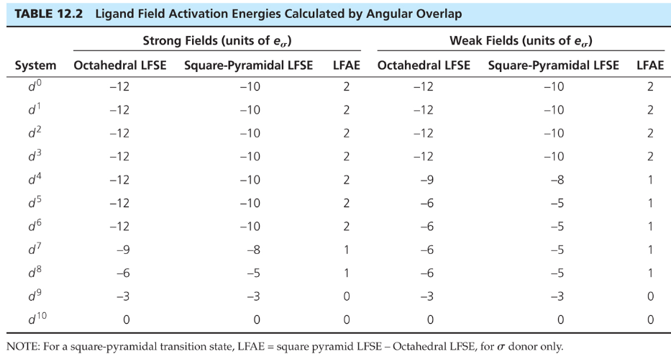





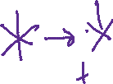
Dissociation Mechanism

Slide 20
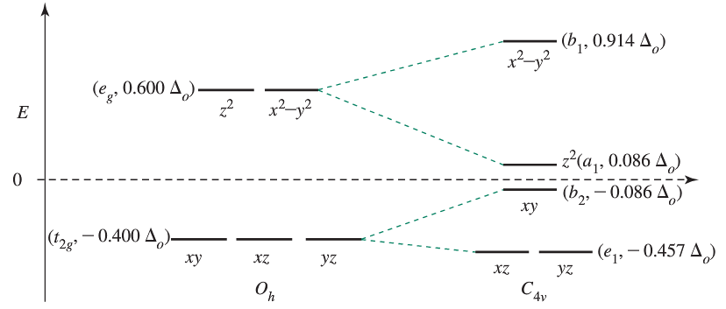






Dissociation Mechanism

Slide 21
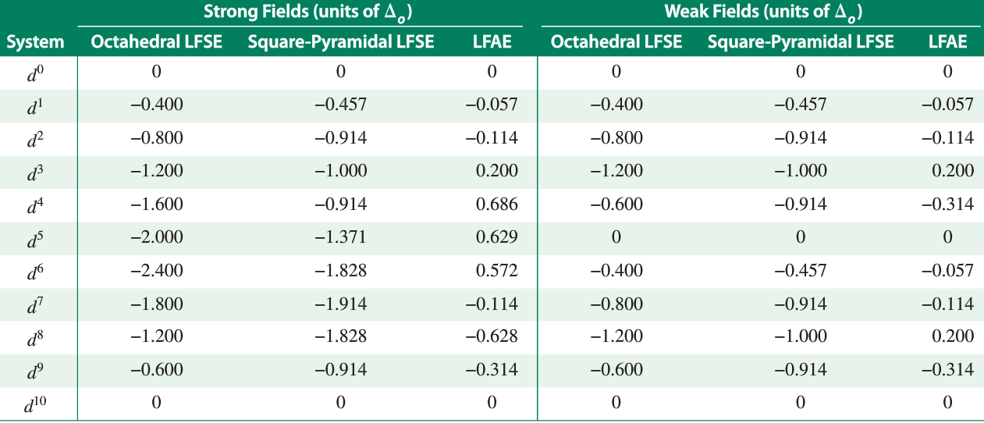








Dissociation Mechanism

Slide 22
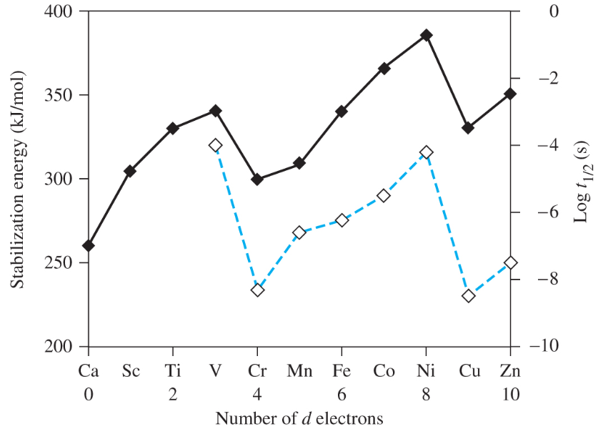


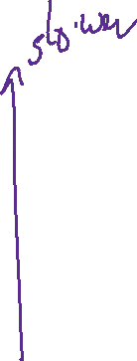
Evidence: Stabilization Energy and rate of H₂O exchange.

Slide 23
Experimental Technique
Psuedo-Order Kinetics

Slide 24
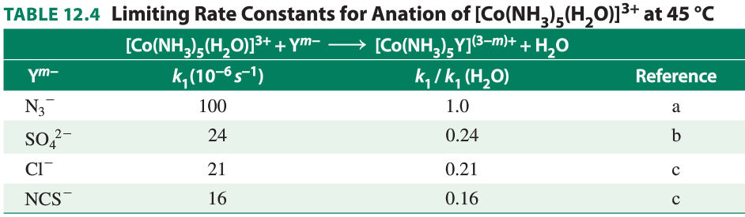


















Entering Group Effects
Small incoming ligand effect = D or I_{d} mechanism

Slide 25
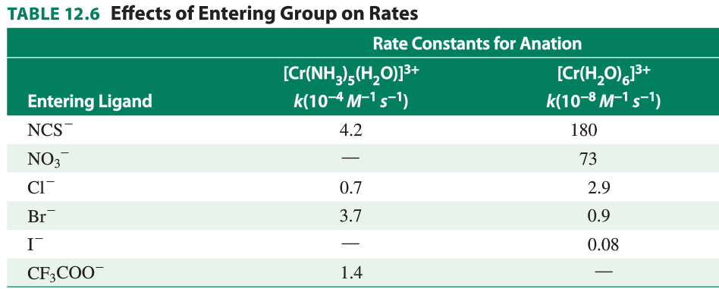






Entering Group Effects
close = D or I_{d} mechanism
not close = I_{a} or A mechanism

Slide 26
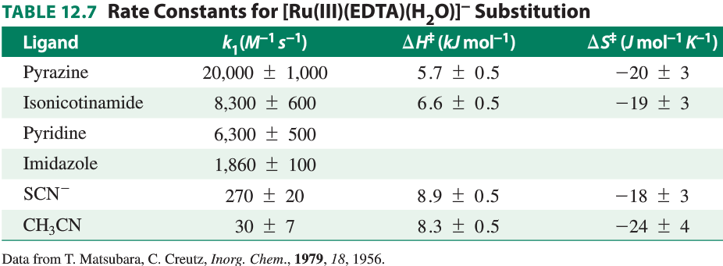
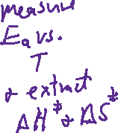
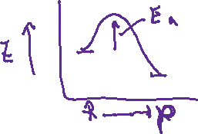




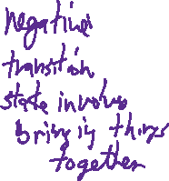

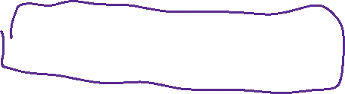


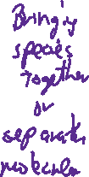




Activation Parameters

Slide 27












Slide 28

















Slide 29














Slide 30


Ru^{II} vs. Ru^{III} substitution
Supports I_{a} for Ru(III) and I_{d} for Ru(II)

Slide 31

Conjugate Base Mechanism
Conjugate base mechanism: complexes with NH3-like or H2O ligands,
lose H⁺, ligand trans to deprotonated ligand is more likely to be
lost.
[Co(NH₃)₅X]²⁺ + OH⁻ ↔ [Co(NH₃)₄(NH₂)X]⁺ + H₂O (equil)
[Co(NH₃)₄(NH₂)X]⁺ → [Co(NH₃)₄(NH₂)]²⁺ + X⁻ (slow)
[Co(NH₃)₄(NH₂)]²⁺ + H₂O → [Co(NH₃)₅H₂O]²⁺ (fast)

Slide 32












Conjugate Base Mechanism
Conjugate base mechanism: complexes with NR3 or H2O ligands,
lose H⁺, ligand trans to deprotonated ligand is more likely to be
lost.

Slide 33












Reaction Modeling using
Excel Programming

Slide 34



Square planar reactions
Associative or Ia mechanisms, square pyramid intermediate
Pt²⁺ is a soft acid. For the substitution reaction
trans-PtL2Cl2 + Y → trans-PtL2ClY + Cl– in CH3OH
ligand will affect reaction rate:
Leaving group (X) also has effect on rate: hard ligands are
lost easily (NO3–, Cl–) soft ligands with π electron density
are not (CN–, NO2–)

Slide 35












Trans effect
In square planar Pt(II) compounds, ligands trans to Cl are more easily replaced than others such as ammonia
Cl has a stronger trans effect than ammonia (but Cl– is a more labile ligand than NH3)
Pt(NH3)4²⁺ + 2 Cl– → PtCl4^{2–} + 2 NH3
Sigma bonding - if Pt-T is strong, Pt-X is weaker (ligands share metal d-orbitals in sigma bonds)
Pi bonding - strong pi-acceptor ligands weaken P-X bond
Predictions not exact

Slide 36














Trans Effect:

Slide 37

Trans Effect: First steps random loss of py or NH₃

Slide 38

Trans Effect:

Slide 39












Electron Transfer Reactions
Inner vs. Outer Sphere Electron Transfer

Slide 40




Outer Sphere Electron Transfer Reactions
Rates Vary Greatly Despite Same Mechanism

Slide 41




















Slide 42











Slide 43






















Nature of Outer Sphere Activation Barrier

Slide 44









Nature of Outer Sphere Activation Barrier
Use of energy wells for reactant and product

Slide 45


















Slide 46










Inner Sphere Electron Transfer
Co(NH₃)₅Cl²⁺ + Cr(H₂O)₆²⁺ → (NH₃)₅Co-Cl-Cr(H₂O)₅⁴⁺ + H₂O
Co(III) Cr(II) Co(III) Cr(II)
(NH₃)₅Co-Cl-Cr(H₂O)₅⁴⁺→ (NH₃)₅Co-Cl-Cr(H₂O)₅⁴⁺
Co(III) Cr(II) Co(II) Cr(III)
H₂O + (NH₃)₅Co-Cl-Cr(H₂O)₅⁴⁺→ (NH₃)₅Co(H₂O)²⁺ + (Cl)Cr(H₂O)₅²⁺

Slide 47



Inner Sphere Electron Transfer
Co(NH₃)₅Cl²⁺ + Cr(H₂O)₆²⁺ → (NH₃)₅Co-Cl-Cr(H₂O)₅⁴⁺ + H₂O
Co(III) Cr(II) Co(III) Cr(II)
(NH₃)₅Co-Cl-Cr(H₂O)₅⁴⁺→ (NH₃)₅Co-Cl-Cr(H₂O)₅⁴⁺
Co(III) Cr(II) Co(II) Cr(III)
H₂O + (NH₃)₅Co-Cl-Cr(H₂O)₅⁴⁺→ (NH₃)₅Co(H₂O)²⁺ + (Cl)Cr(H₂O)₅²⁺
Nature of Activation Energy:
Key Evidence for Inner Sphere Mechanism:

Slide 48

Example
[Co^{II}(CN)₅]³⁻ + Co^{III}(NH₃)₅X²⁺ → Products
Those with bridging ligands give product [Co(CN)₅X]²⁺.

