Slide 1
Exploring the Basics of Windows 8

Slide 2
Objectives
Start and turn off Windows 8
Describe how to use Windows 8 with a touchscreen device
Tour the Start screen and the desktop
Start Windows 8 and desktop applications

Slide 3
Objectives
Switch between applications and close them
Identify and use the controls in windows and dialog boxes
Get help with Windows 8 tasks

Slide 4
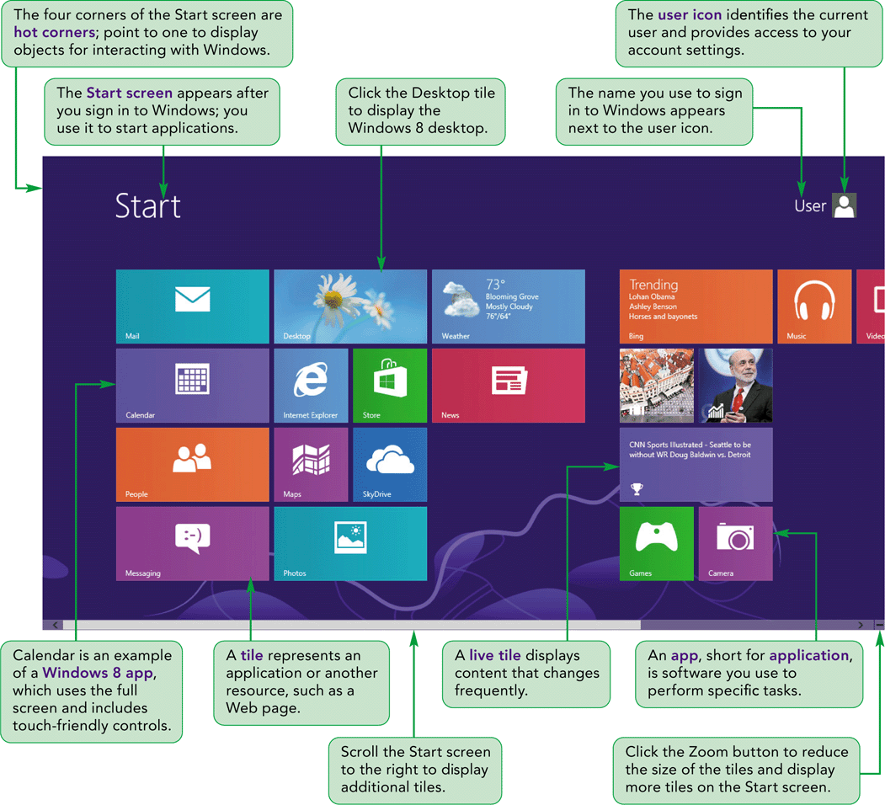
Visual Overview

Slide 5
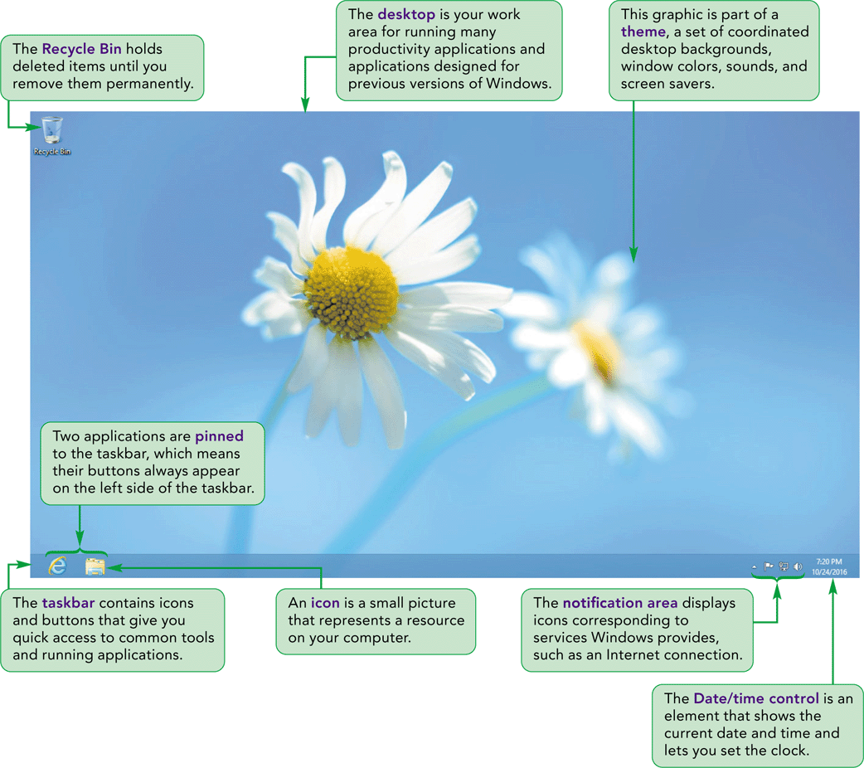
Windows 8 Start Screen & Desktop

Slide 6
Using Windows 8 with Pointing Devices
When you use Windows 8, you interact with objects such as tiles and icons.
You use a pointing device, such as a mouse to move the pointer over locations and objects on the screen, or to point to them.
You use clicking, double-clicking, right-clicking and dragging to interact with specific objects.

Slide 7
Using Windows 8 with Touchscreen Devices
If you are using a computer with a touchscreen, such as a tablet, you use your fingertips to interact with on-screen objects.
The movements you make as you touch the screen with your fingertips are called gestures.
The six basic gestures are tap, press, swipe, slide or drag, pinch, and rotate.

Slide 8
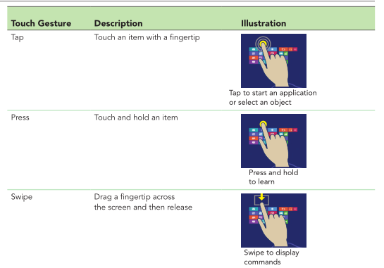
Gestures used with touchscreen devices

Slide 9
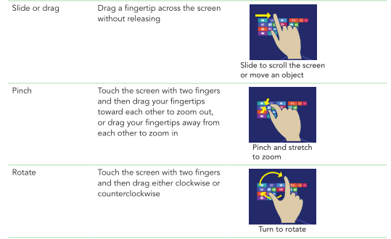
Gestures used with touchscreen devices

Slide 10
Starting Windows 8
Turn on your computer. After a moment, Windows 8 starts and displays the Welcome screen.
If the Welcome screen is displayed for more than a few seconds, click your username, type your password, and the press the Enter key.
The screen that appears after you sign in to Windows 8 is called the Start screen.

Slide 11
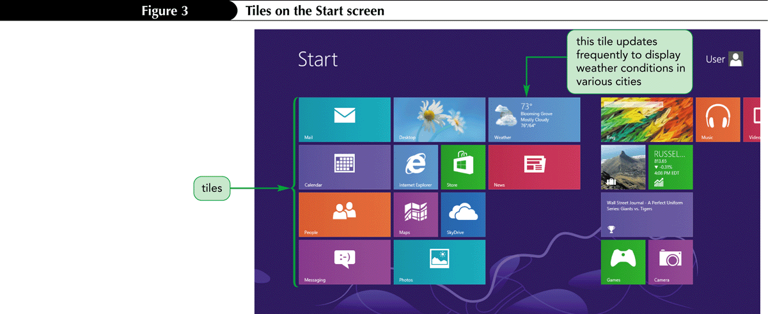
Tiles on the Start Screen

Slide 12
To scroll the Start Screen
Use the mouse to point to the middle of the right edge of the Start screen.
The screen scrolls to display additional tiles not shown on the main Start screen.
You can also scroll the screen by clicking the left scroll arrow button on the horizontal scroll bar at the bottom of the screen.

Slide 13
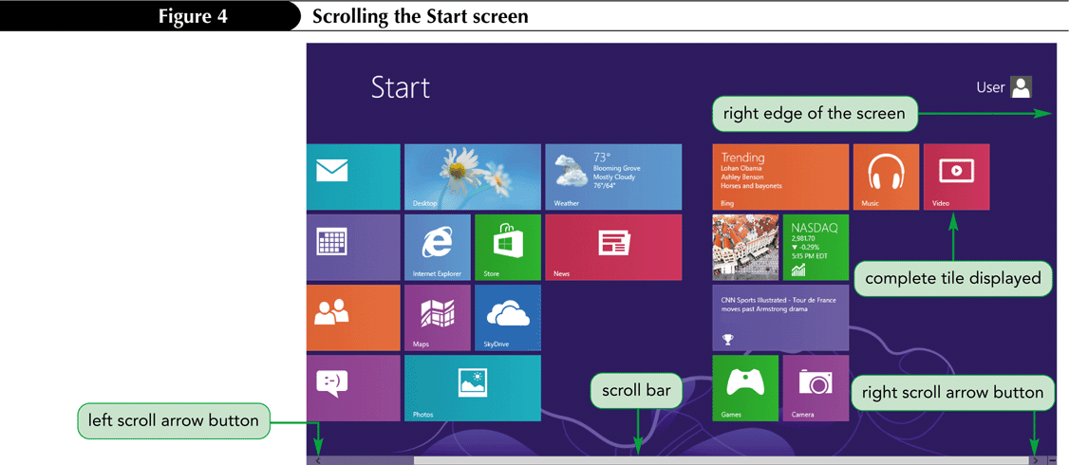
Scrolling the Start screen

Slide 14
To zoom the Start screen
Move the pointer until the Zoom button appears in the lower right corner of the Start screen.
Click the Zoom button to reduce the size of the tiles.

Slide 15
Zooming the Start screen
Click a blank area on the Start screen to return the tiles to their original size.

Slide 16
To open the Settings Menu
Point to the upper-right corner of the screen to display the Charms bar.
Point to the Charms bar to display it with a black background, indicating it is active.

Slide 17
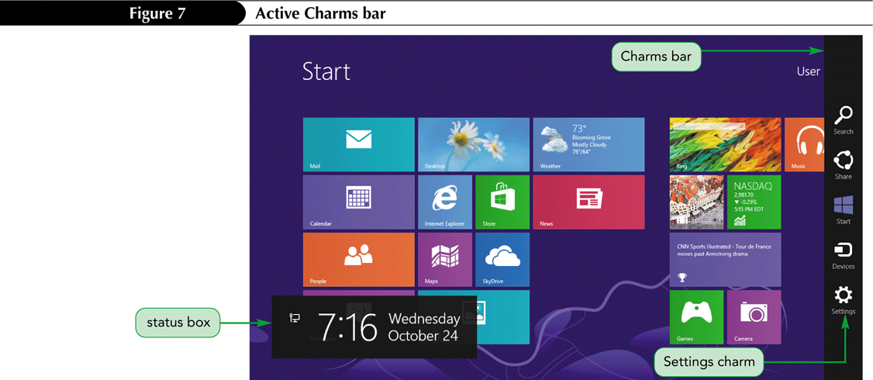
Active Charm Bar
Click the Settings charm on the Charms bar to display the settings menu.

Slide 18
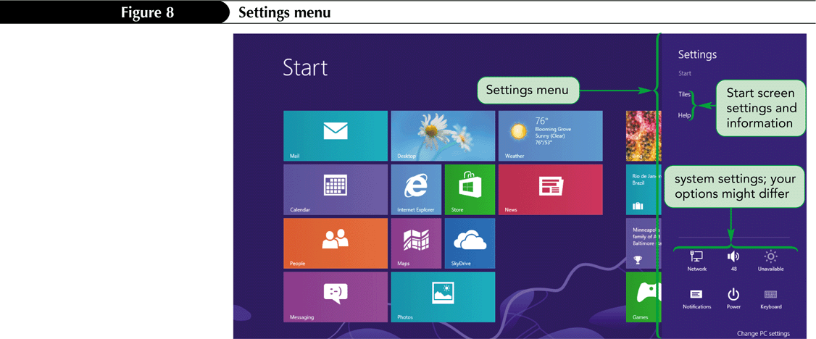
Settings menu
Click a blank area on the Start screen to close the Settings menu.

Slide 19
Starting Applications
Windows 8 runs two types of applications.
Windows 8 applications are designed to use the Windows 8 interface and work with touchscreen devices.
Desktop applications are programs that open and run on the desktop, such as WordPad, used to create basic word-processing documents.

Slide 20
Starting an Application
Click the application’s title on the Start screen.
or
Right-click a blank area on the Start screen, click the All apps button and then click the application.
or
On the Start screen, type the name of the application in the search window and then click the application in the search results.

Slide 21
To start the Weather app from the Start Screen
Click the Weather tile on the Start screen to start the Weather app.
If an Enter location box appears, type the starting letters of a location to display a list of location names, and then select the location.

Slide 22
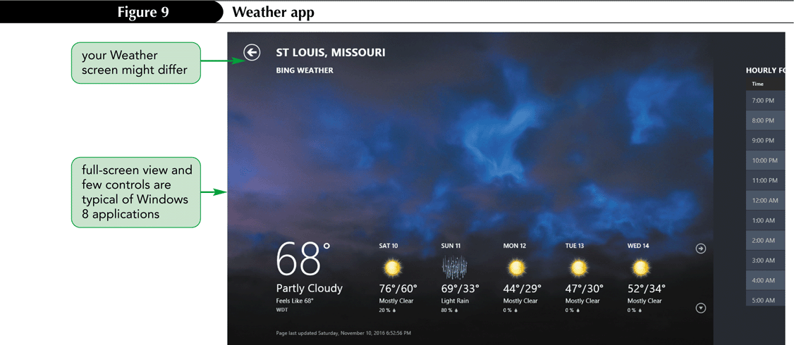
Weather app
Press the Windows key to redisplay the start screen.

Slide 23
Thumbnail of the Weather app
Point to the upper-left corner of the screen to display a thumbnail of the Weather app, a miniature image that indicates that the application is still running.
Click the thumbnail to redisplay the Weather app.

Slide 24
Using the Apps Screen to Start an Application
If an application’s tile does not appear on the Start screen, you can open the application using the Apps screen.
The Apps screen lists all the applications installed on your computer.
Right-click a blank area on the Start screen to display the Apps bar at the bottom of the screen.
Click the All apps button on the right side of the Apps bar to display the Apps screen.

Slide 25
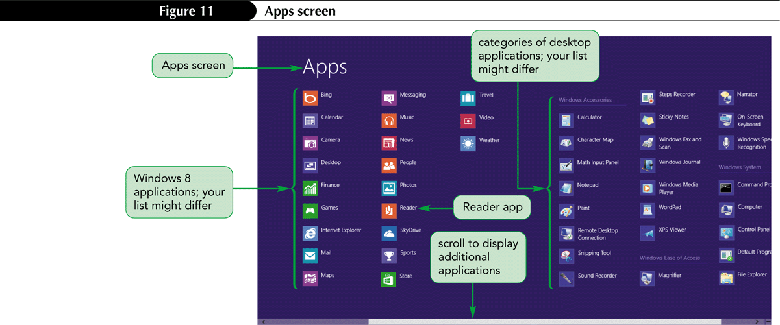
Apps Screen
Click Reader to start the Reader app. A PDF document opens in Reader explaining how to edit PDF files using Microsoft Word.

Slide 26
To snap the Weather app
Point to the upper-left hot corner to display the Weather thumbnail.
Right-click the Weather thumbnail, and click Snap left on the shortcut menu to snap the Weather app to the left side of the screen, while the Reader app is open on the right.

Slide 27
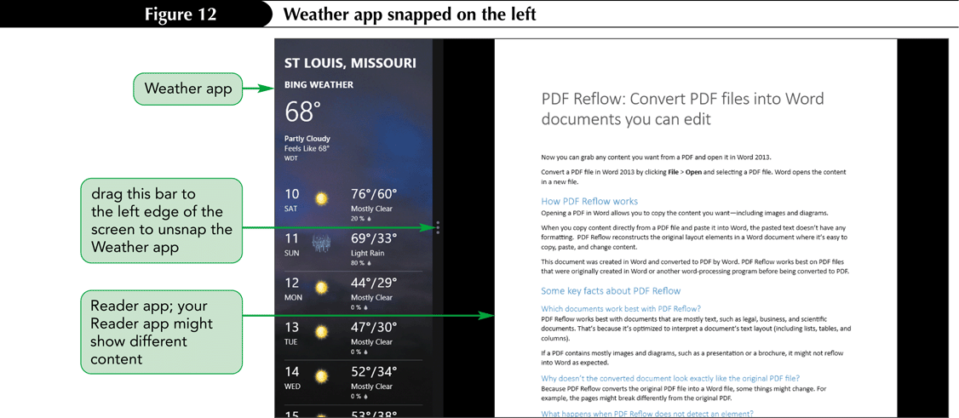
Weather app snapped on the left
Drag the bar between the two applications to the left edge of the screen to unsnap the Weather app. Both apps are still running.

Slide 28
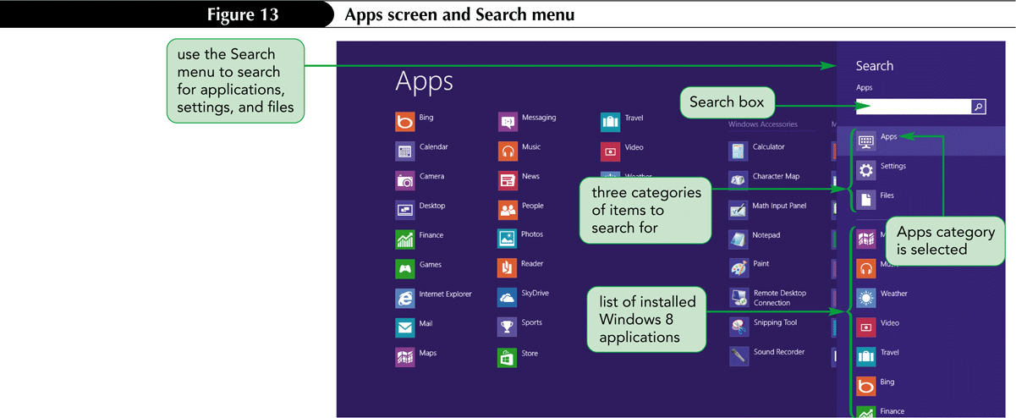
Using the Search Menu to Start an Application
You open the Search menu from the Charms bar.

Slide 29
To start WordPad
On the Start screen, type wordp to display the Search menu with “wordp” inserted in the Search box. The apps screen lists the search results which include the WordPad application.

Slide 30
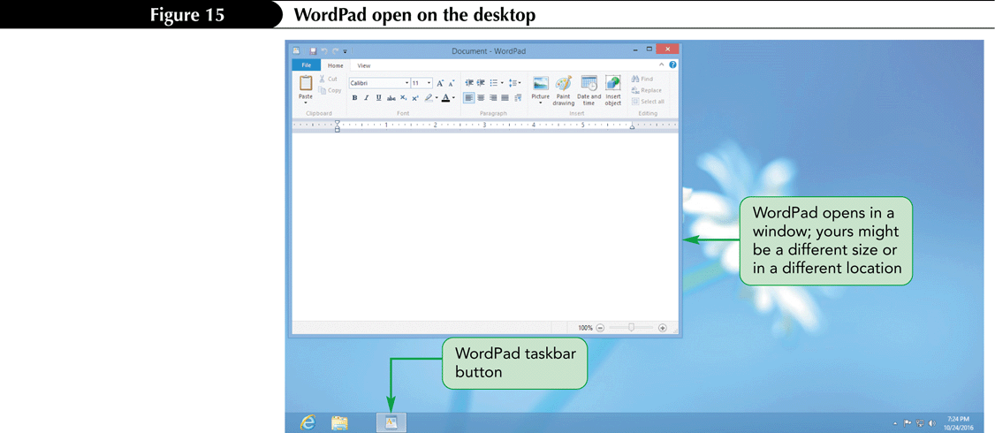
WordPad in the search results
Click WordPad in the search results. WordPad opens on the desktop.

Slide 31
Manipulating Windows
You can manipulate windows to show as much or as little information as your need by using the three buttons that appear on the right side of the title bar.

Slide 32
Using Tools in Desktop Applications
Many desktop applications use a ribbon to consolidate the application’s features and commands.
Ribbons are organized into tabs. Each tab contains commands that perform a variety of tasks.

Slide 33
Using the Ribbon
Bolding text in the WordPad Window

Slide 34
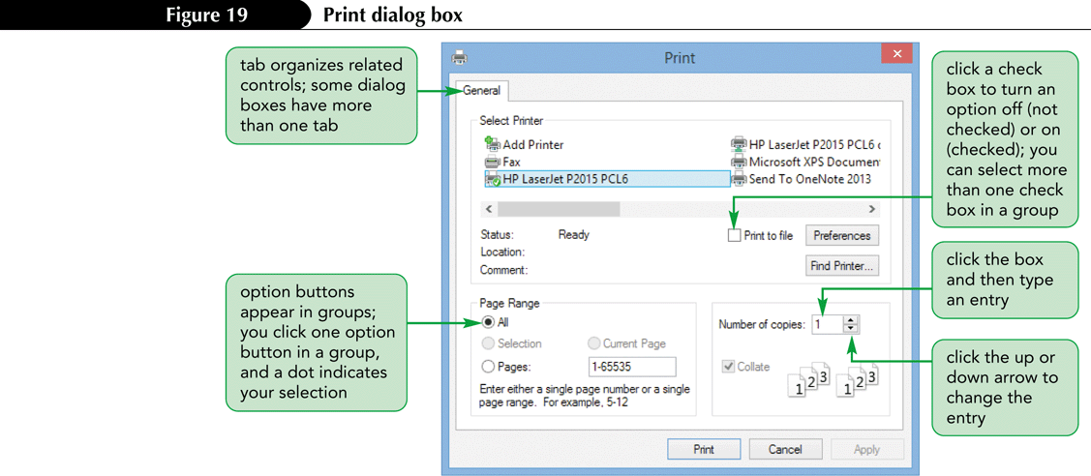
Using Dialog Boxes
A dialog box is a special kind of window in which you enter or choose settings for performing a task.

Slide 35
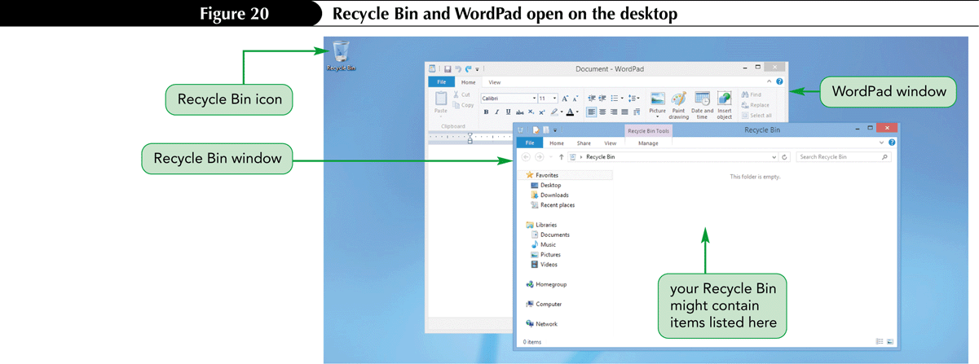
Working with Multiple Applications
Multitasking is a Windows 8 feature that allows you to run multiple applications at the same time.
Recycle Bin and WordPad open on the desktop

Slide 36
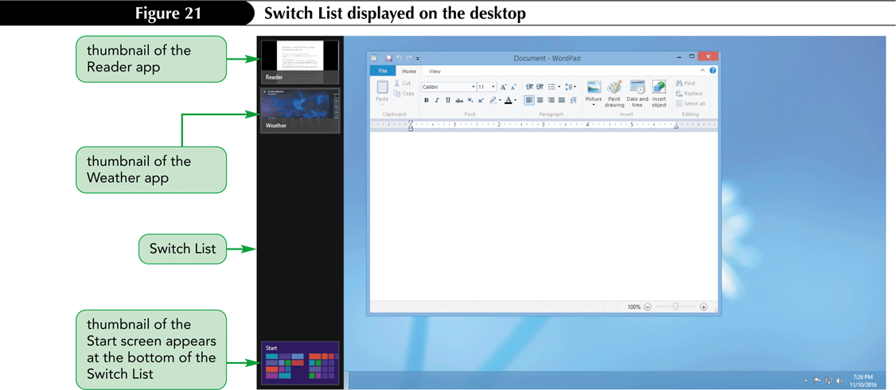
Switching Between Applications
You use the Switch List to display thumbnails of the Windows 8 application running in the background and then select the one you want to work with.

Slide 37
Using Keyboard Shortcuts
A keyboard shortcut is one or more keys you press on the keyboard to perform an action.
The keyboard shortcut for switching to any type of running application is Alt+Tab.

Slide 38
Closing Desktop Applications
One way to close an application is to use the Close button on the window’s title bar.
Another way is to right-click the application window’s taskbar button to display a shortcut menu that includes a command to close the window.

Slide 39
Closing Windows 8 Applications
You close a Windows 8 application using its thumbnail when it appears on its own in the upper-left corner of the screen, or when it appears in the Switch List.
You right-click the thumbnail and then click Close on the shortcut menu to close the application.
You can also us the Alt+F4 keyboard shortcut to close any application.

Slide 40
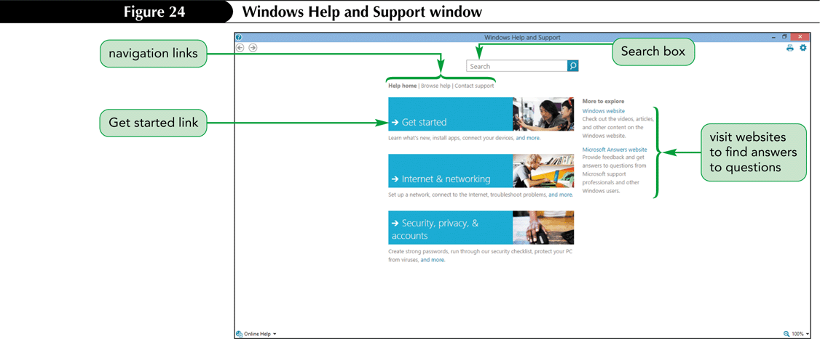
Getting Help
To start Windows 8 Help and Support from the Start screen, type help to display the Apps screen and Search menu with “help” inserted in the Search box, and then Click Help and Support in the search results.

Slide 41
Searching the Help Pages

Slide 42
Turning Off Windows 8
You turn off Windows 8 using the Power button on the Settings menu.
Point to the upper-right hot corner on the desktop to display the Charms bar, and then click the Settings charm to display the Settings menu.
Click the Power button, and then click Shut down. Windows 8 turns off the computer.

