Slide 1
Internet Basics and Information Literacy

Slide 2
Objectives
Learn about the Internet and the World Wide Web
Start the Internet Explorer app and the Internet Explorer desktop application
Develop search techniques for locating information on the web
Use a search engine to conduct a search
Find and evaluate information on the web
Learn about copyright laws
Document web resources

Slide 3
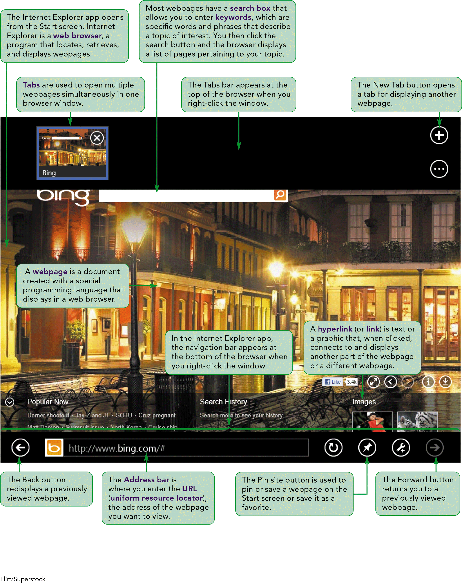
Visual Overview

Slide 4
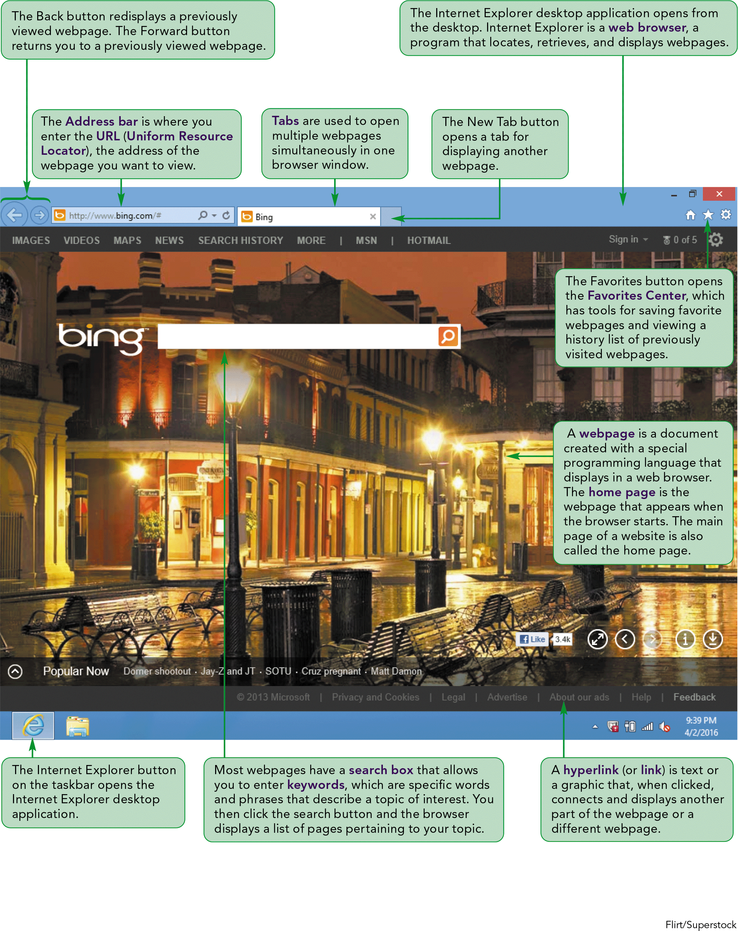
Microsoft Internet Explorer 10

Slide 5
Understanding the Internet and the World Wide Web
The web (World Wide Web) is a collection of electronic documents or files – called webpages – that are available through the Internet.
The Internet is a worldwide collection of computer networks.
Webpages are stored on web servers, which are the computers connected to the Internet.
A website is a collection of related webpages.

Slide 6
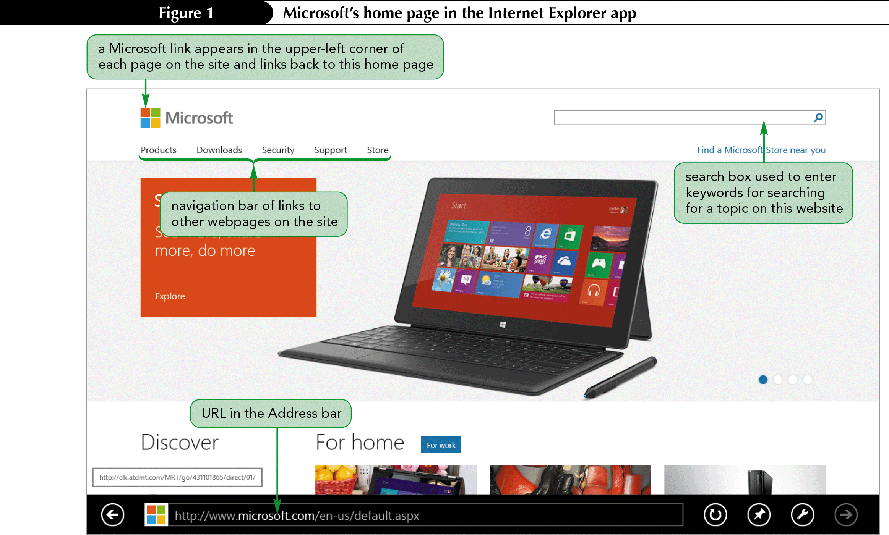
Starting the Internet Explorer App
Click on the Internet Explorer tile to open the home page
To display a specific web page, you can enter its URL in the Address bar.

Slide 7
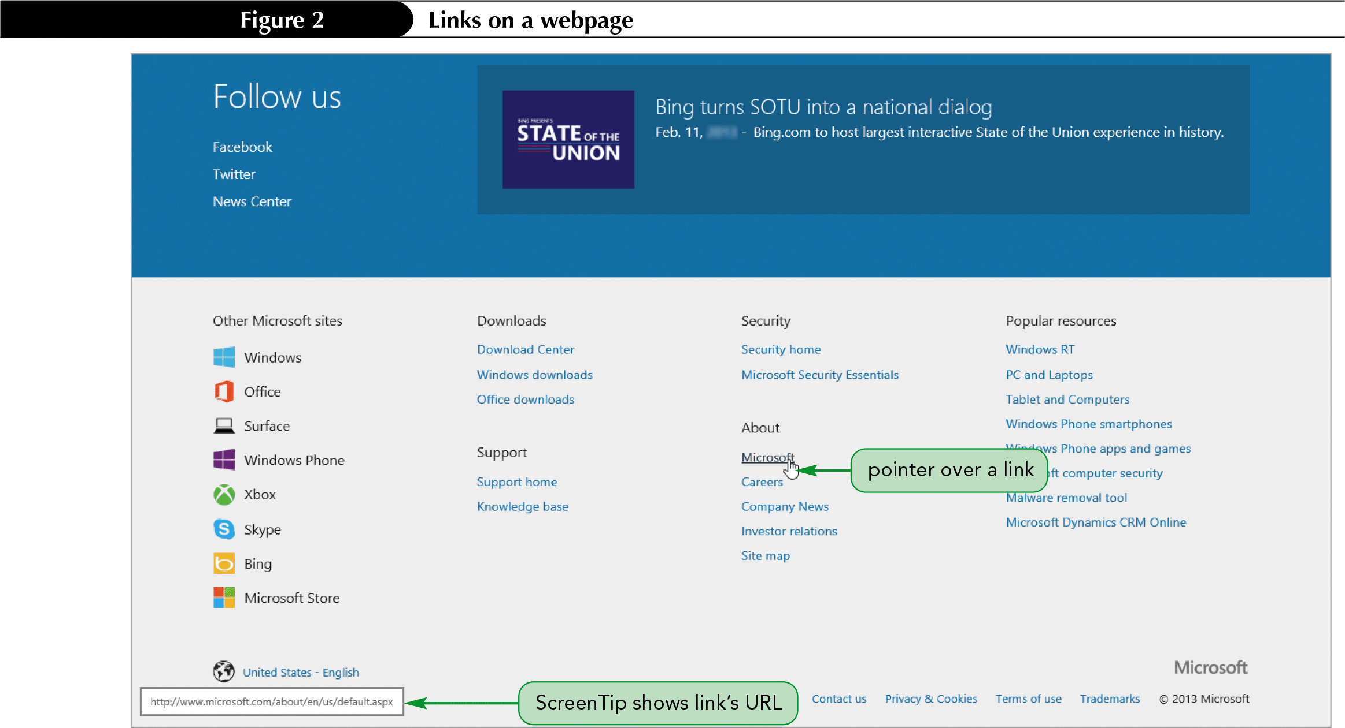
Clicking Links
When you click on a link, a new webpage appears, replacing the previous page

Slide 8
Understanding Search Engines
If you don’t know the URL of a site you want to visit you can use a search engine to locate information.
Search engines use a program called a spider or bot to compile databases that are indexed by keywords
When you enter a keyword in a search engine, it searches the database to find webpages that include those keywords
Results are displayed as a list of links to the webpages

Slide 9
Finding Information on the Web
Formulating a Search Strategy
Identify your topic
List keywords that represent your topic
Refine your keywords list
Develop your search query
A search query is the translation of your original question into a form that a search engine can understand.
Refine your search query

Slide 10
Starting the Internet Explorer Desktop Application
To start the Internet Explorer Desktop application:
Click on the Start screen
Click on the Desktop tile
Click on the Internet Explorer button

Slide 11
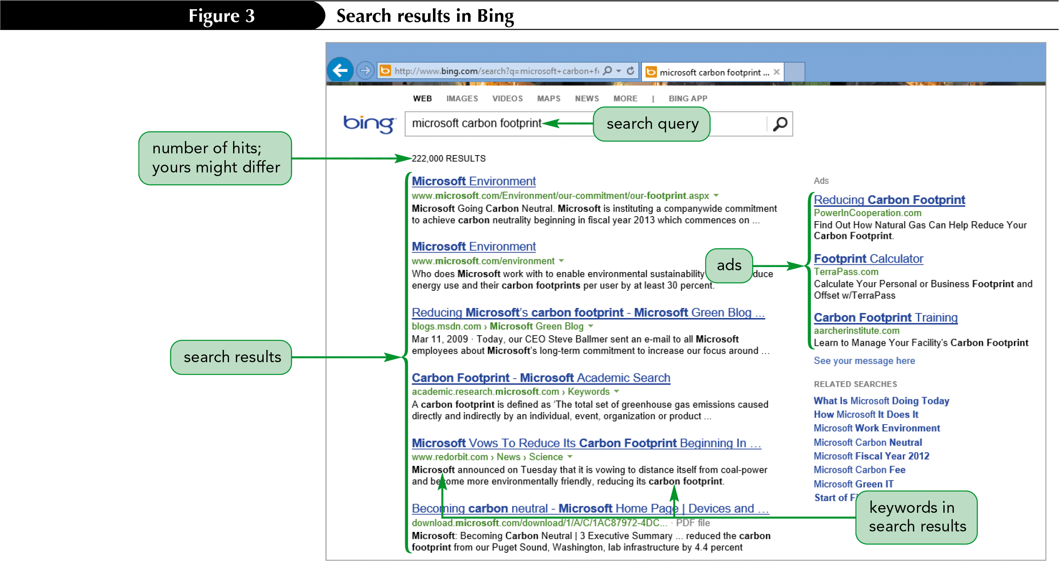
Using the Bing Search Engine from the Address Bar

Slide 12
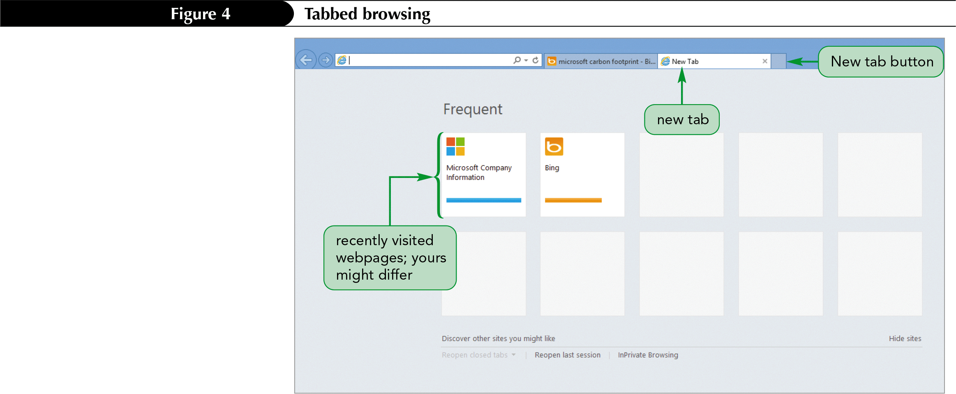
Using Page Tabs
Tabbed browsing displays multiple webpage in the same browser window.

Slide 13
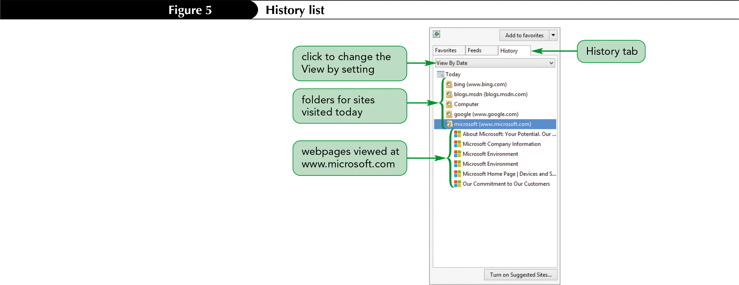
Using the History List
The History list tracks the webpages you visit over a certain time period.

Slide 14
Evaluating the Search Results
Identify the author
Check for objectivity/bias
Verify currency
Assess accuracy
Determine validity
Consider relevancy

Slide 15
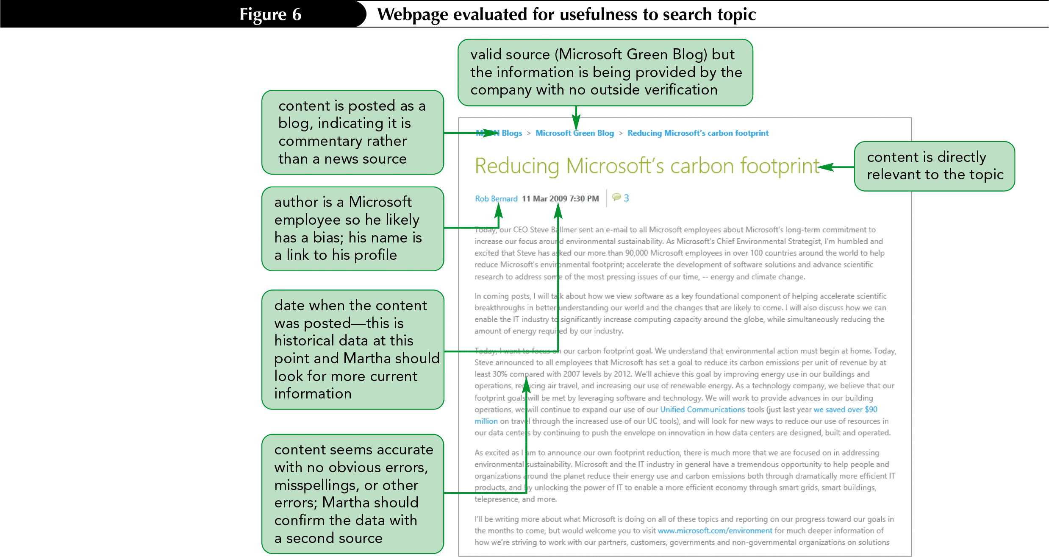
Webpage Evaluated for Usefulness

Slide 16
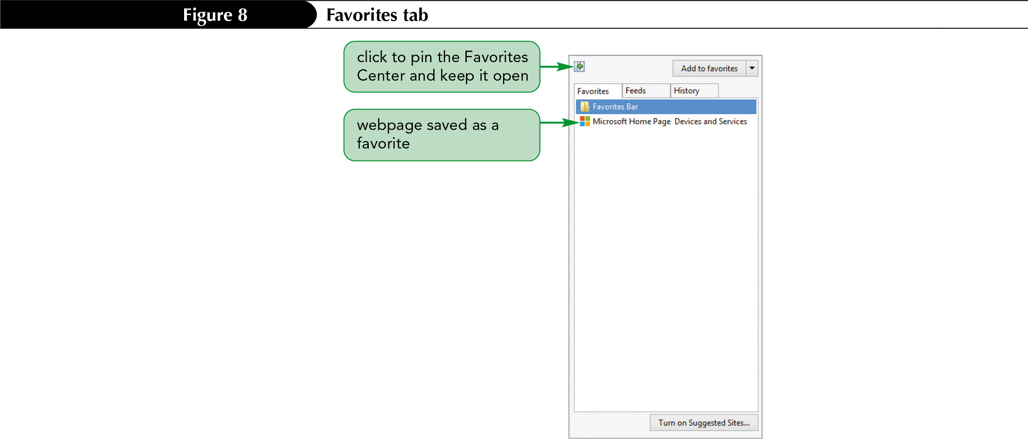
Saving Webpages as Favorites
A Favorites list is a feature you can use to store and organize a list of webpages you want to revisit.

Slide 17
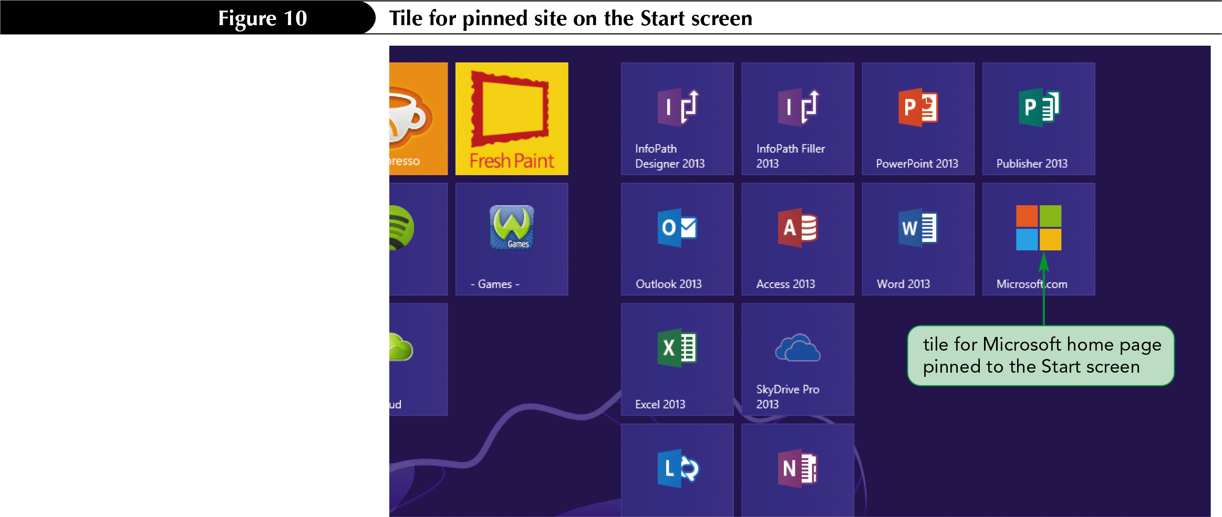
Pinning Webpages
You can pin a page to the taskbar so you open the webpage directly from the desktop without first starting Internet Explorer.

Slide 18
Using the Information you Find
The content found on the web is a form of intellectual property.
Intellectual property includes all creations of the human mind presented in a form that can be shared with others.
A copyright is a protection granted by law to the author or creator of an original work who creates a tangible expression of that work or creation.

Slide 19
Determining Fair Use
U.S. copyright law allows portions of copyrighted works to be used without obtaining permission if that use is a fair use.
Four factors usually determine fair use:
The purpose and character of the new work
The nature of the copyrighted work
The amount and substantiality of the portion used in relation to the copyrighted work as a whole
The effect of the use on the potential market, or value, of the copyrighted work

Slide 20
Identifying Works in the Public Domain
When the term of the copyright has expired, the work moves into the public domain and can be copied without requesting permission.
New print editions or audio recordings of public domain work can be copyrighted and protected under current copyright laws.
Authors or creators can place their own work into the public domain voluntarily at any time.
The source of public domain work must be acknowledged to avoid plagiarism.

Slide 21
Avoiding Plagiarism
Failure to cite the source of material you use is called plagiarism.
Claiming someone else’s work as your own is a serious legal violation.
Be sure to properly reference the sources of works that you use.
You must obtain the copyright holder’s permission to use work in a way that falls outside of fair use.

Slide 22
Documenting Web Resources
Material protected by copyright or in the public domain needs to be properly cited.
For academic research, the two most widely used standards for citation are:
American Psychological Association (APA)
Modern Language Association (MLA)

Slide 23
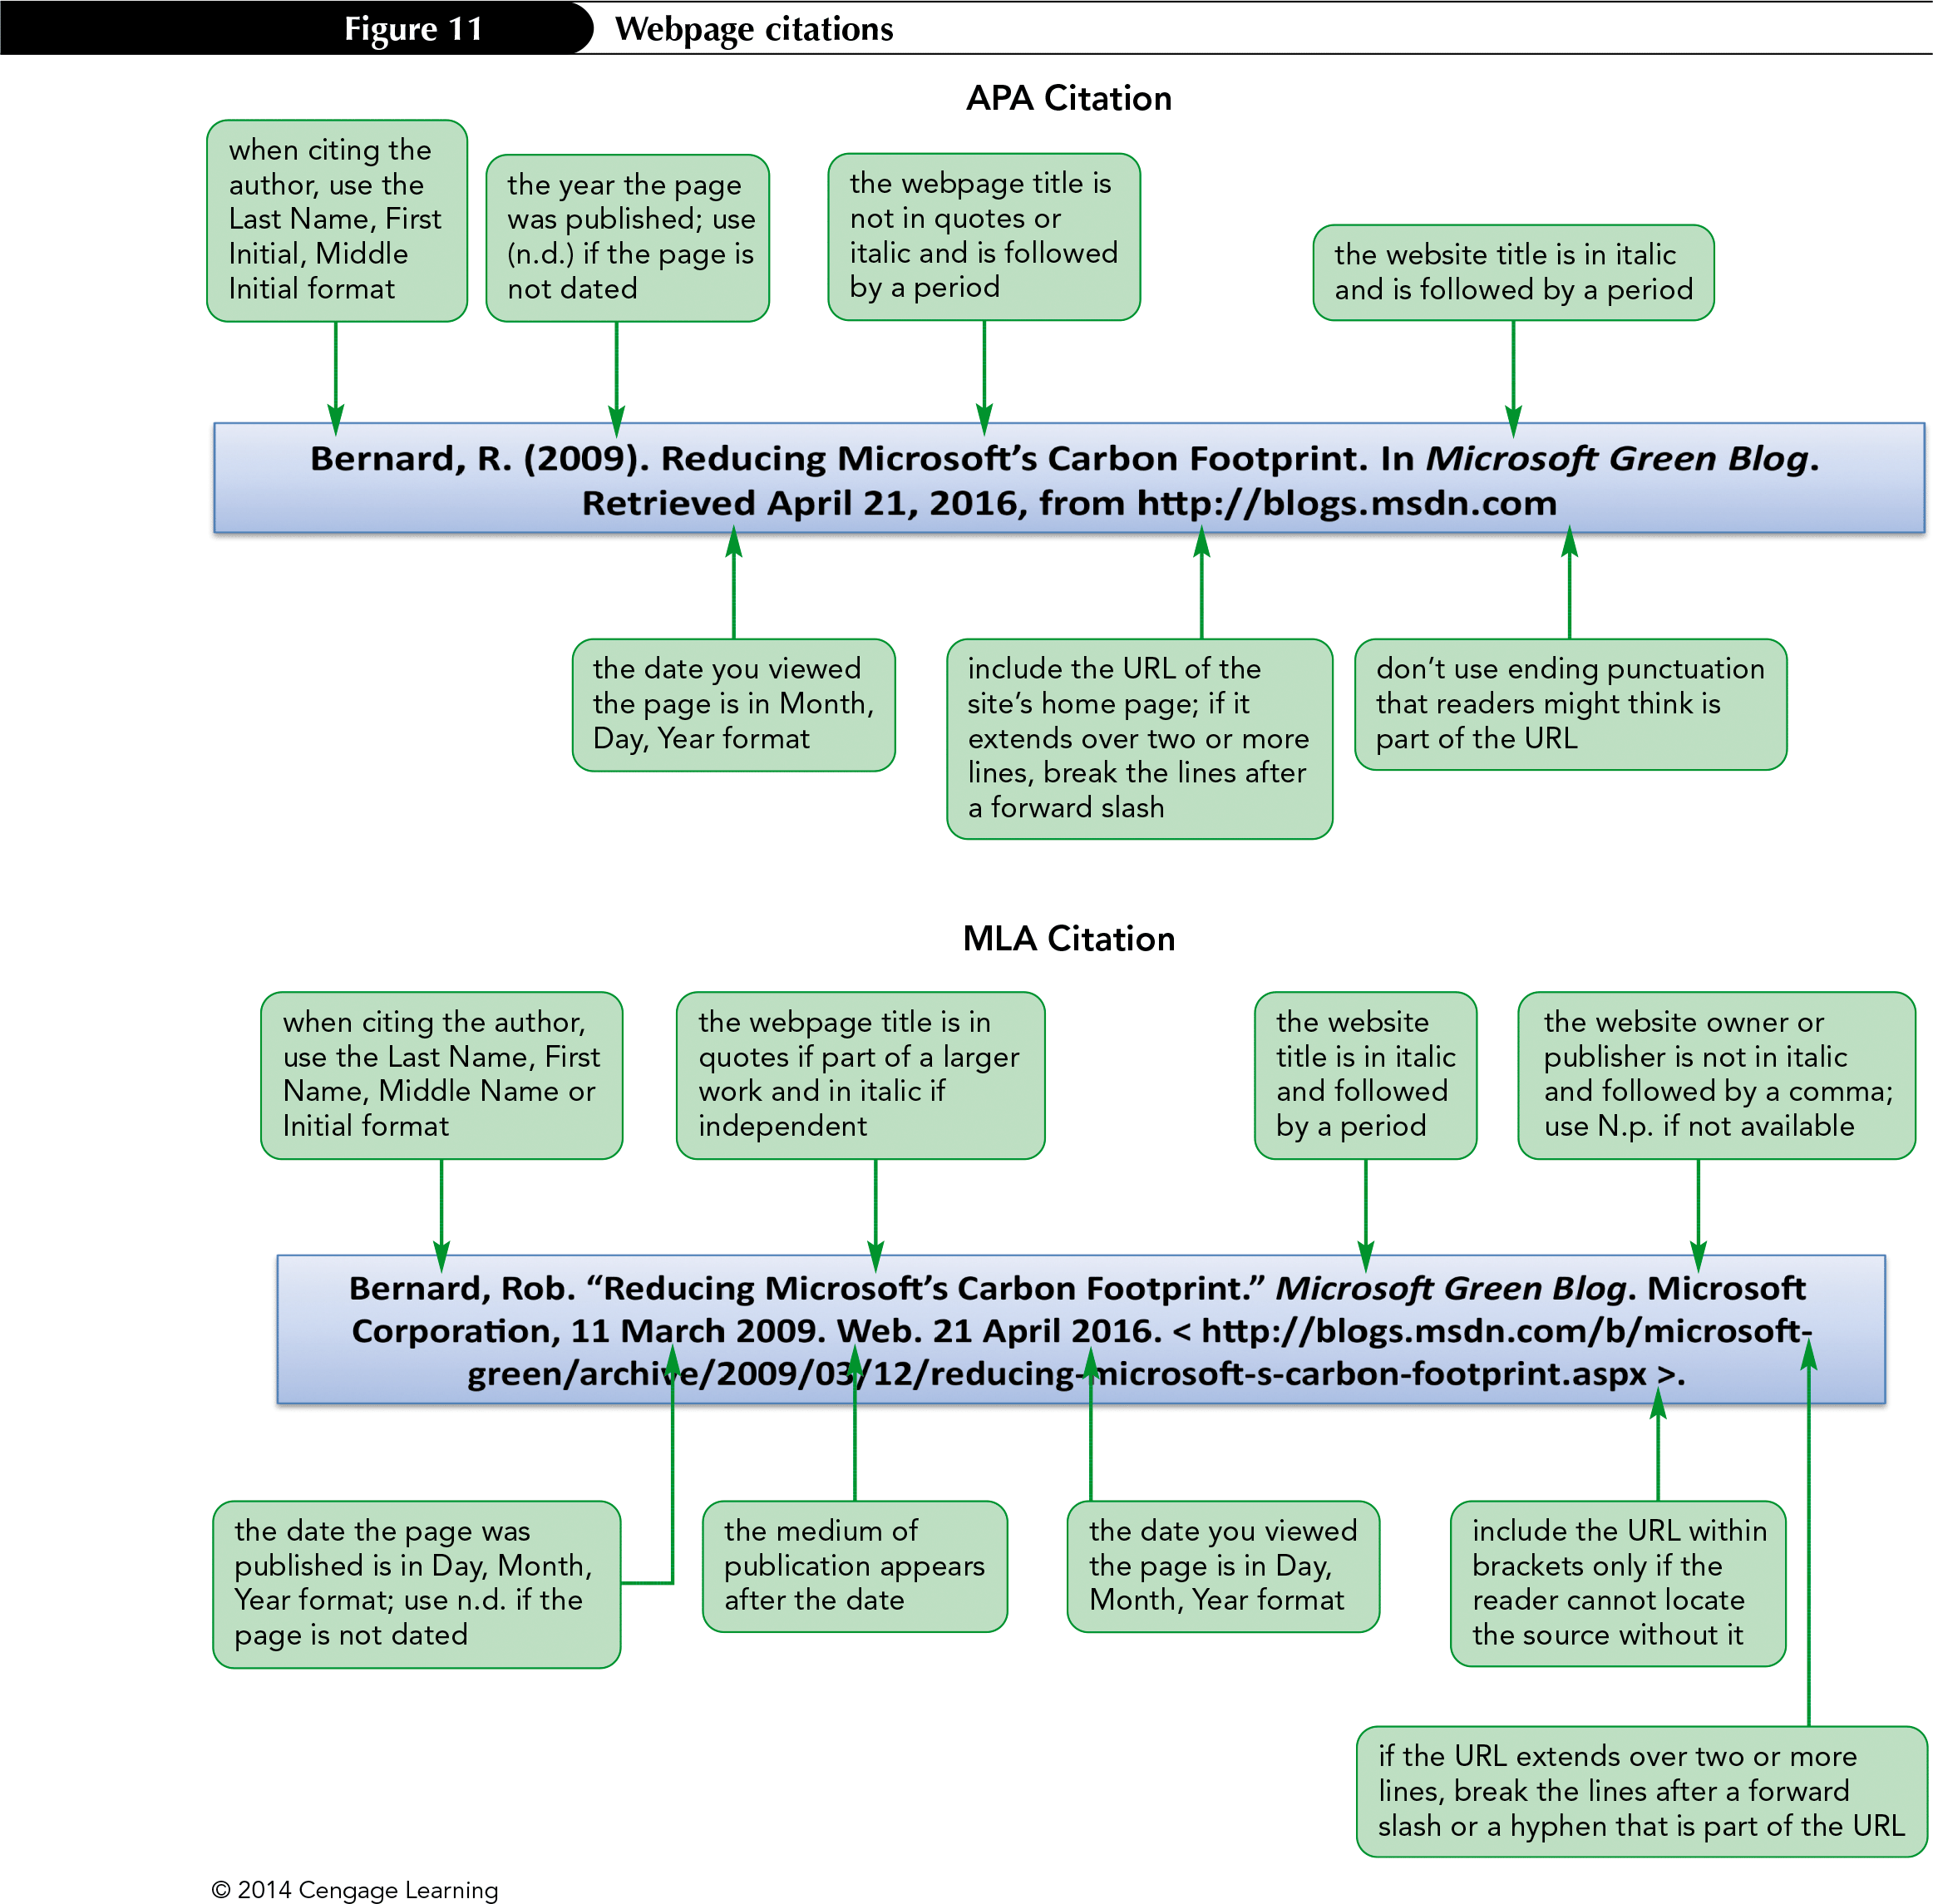
Webpage Citations

Slide 24
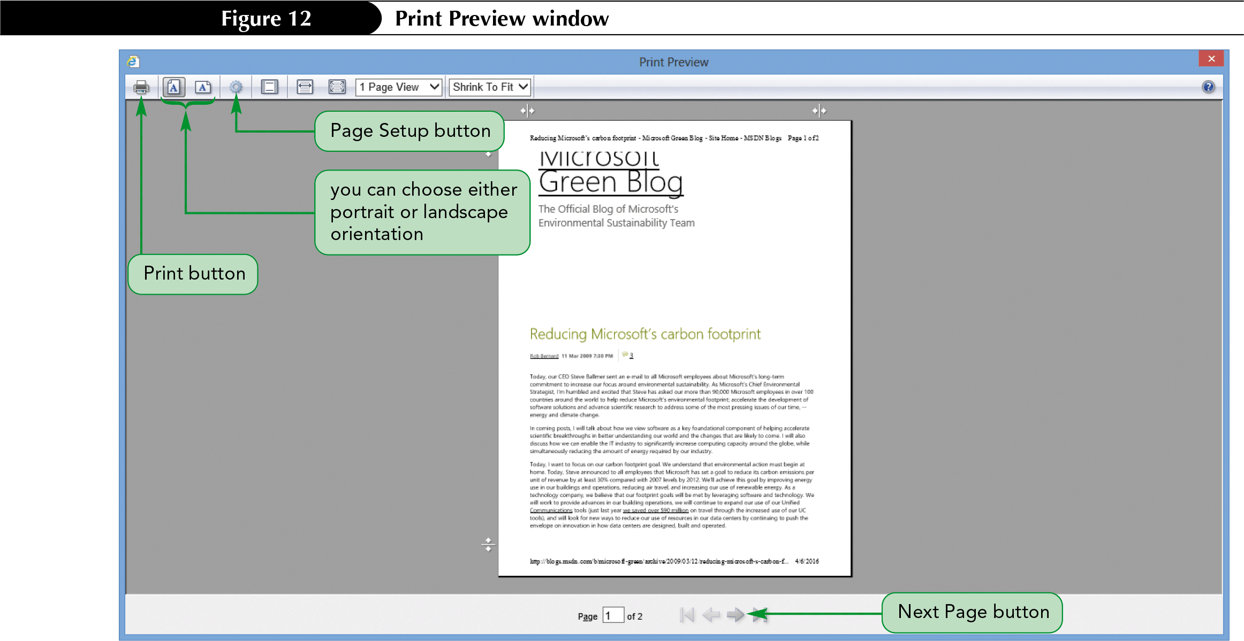
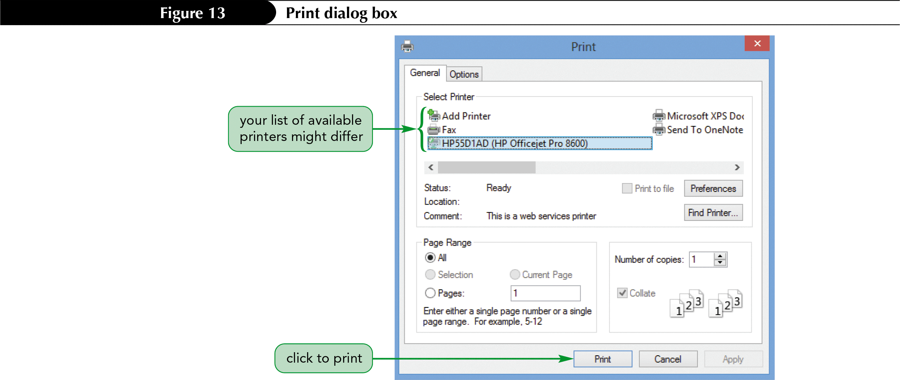
Previewing and Printing a Webpage

Slide 25
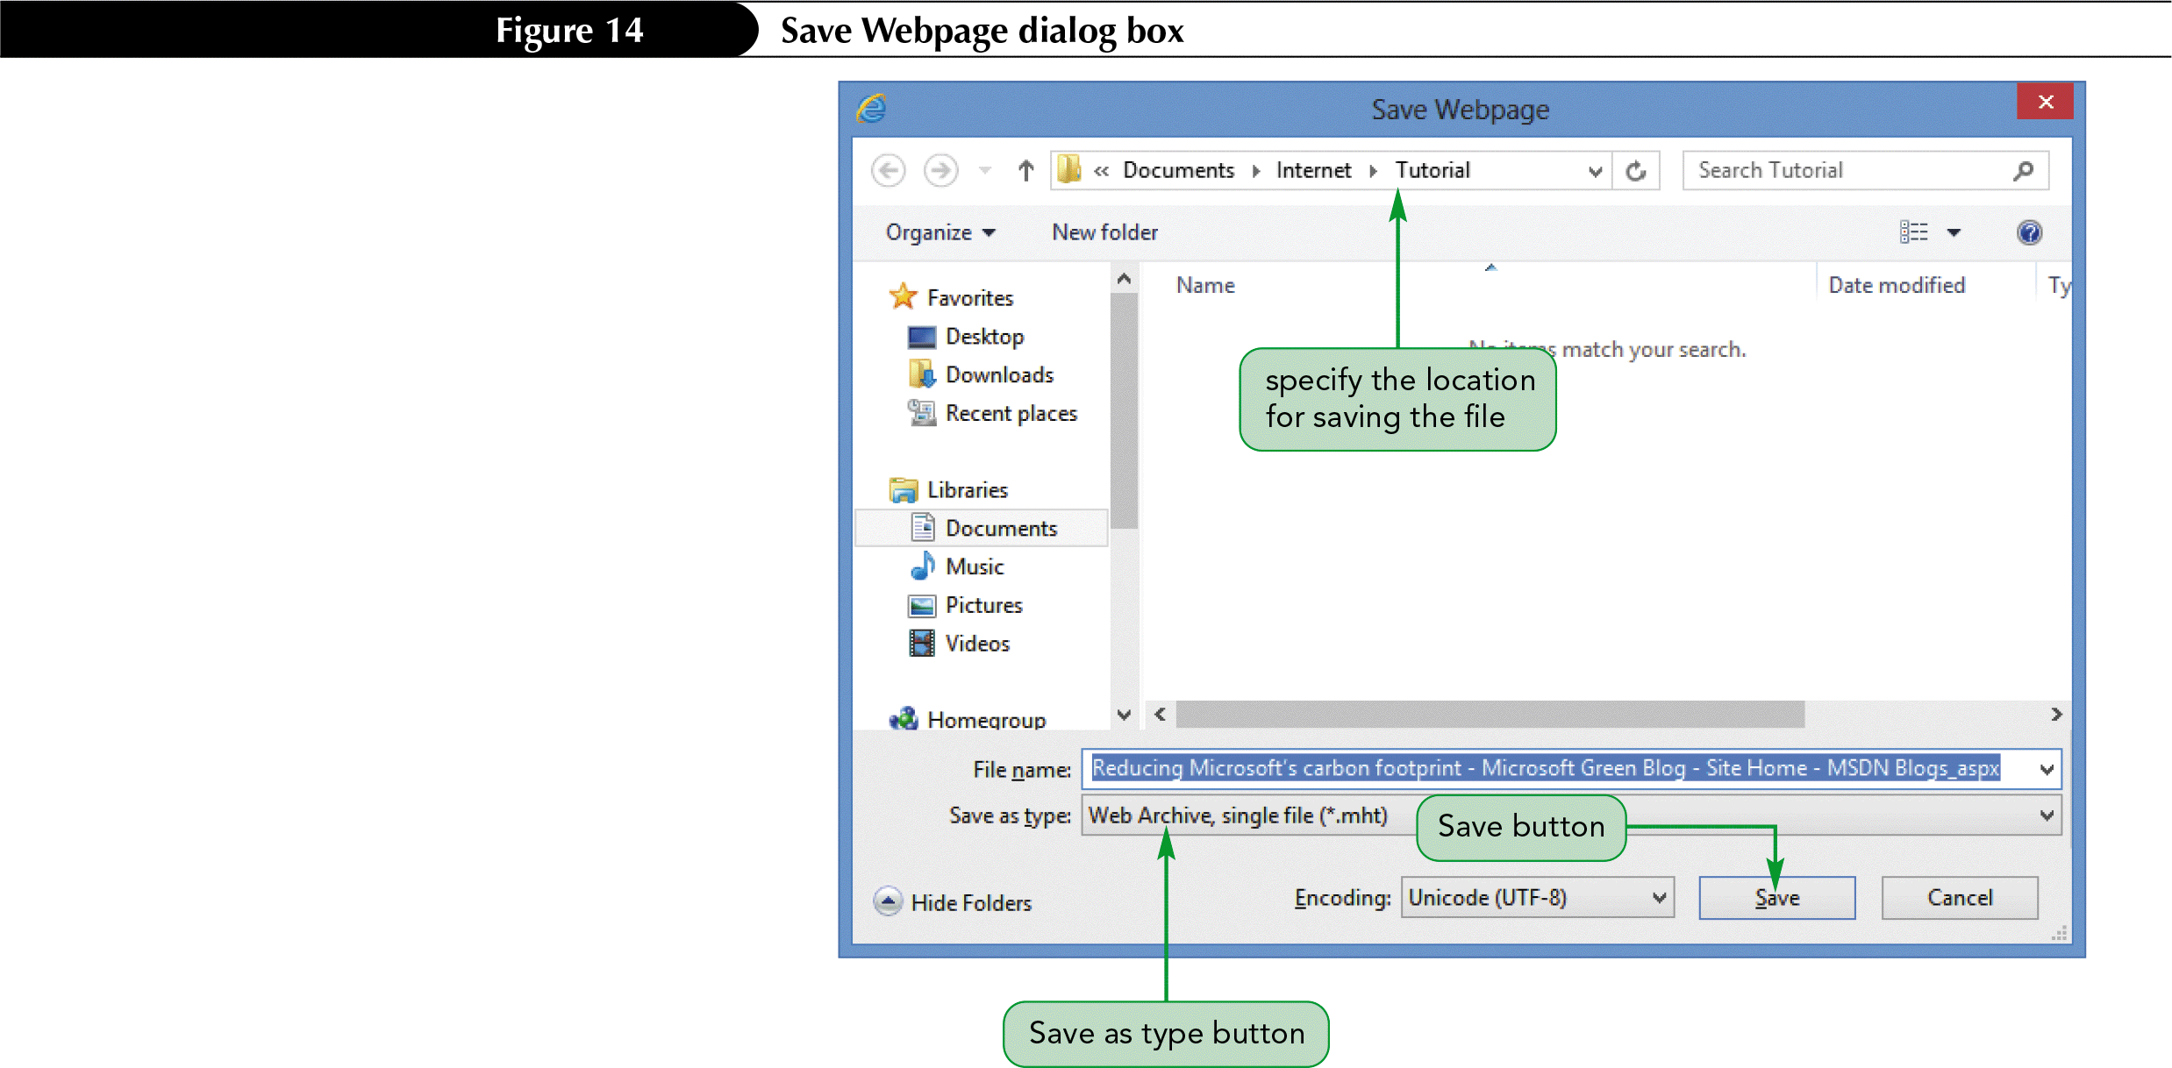
Saving a Webpage

