Slide 1
Essential Computer Concepts

Slide 2
Objectives
Compare the types of computers and the components of a computer system
Learn how data is represented to a computer and how it is transmitted
Learn about processing hardware
Understand memory and storage
Describe peripheral devices and understand how to connect them
Learn about the hardware and software used to establish a network connection

Slide 3
Objectives, cont.
Explain how Internet access, email, and the Word Wide Web affect the use of computers
Describe potential security threats to computers and protection methods
Discuss the types of system software and their functions
Identify popular application software
Learn about cloud computing

Slide 4
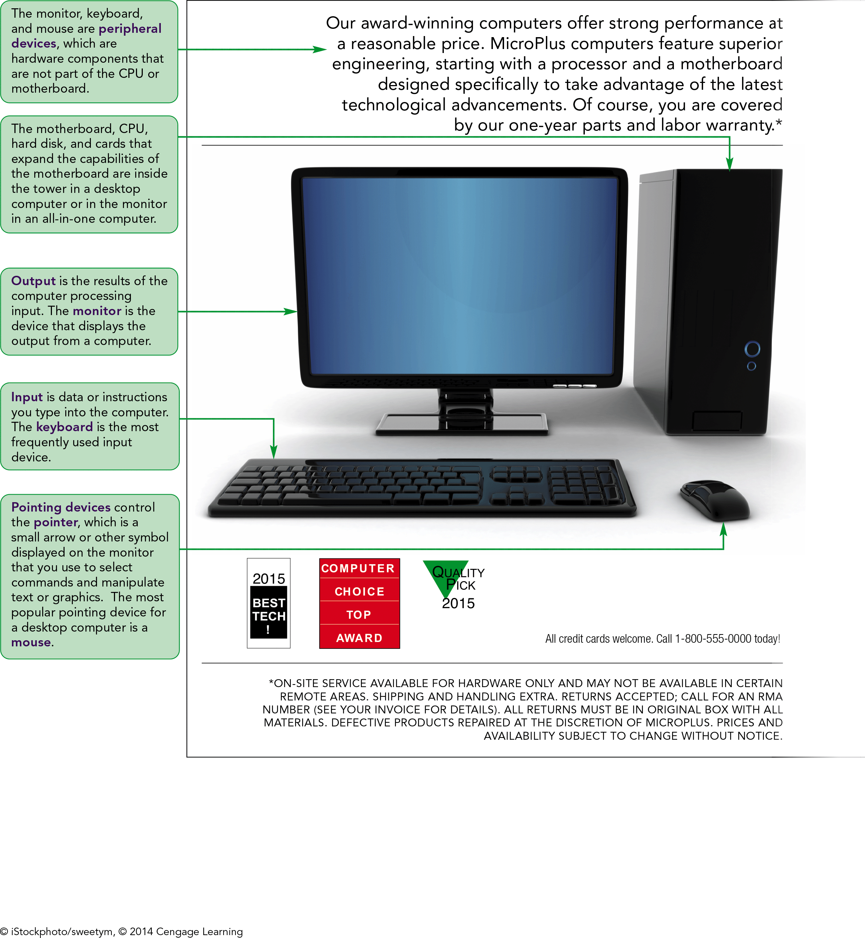
Computer Advertisement

Slide 5
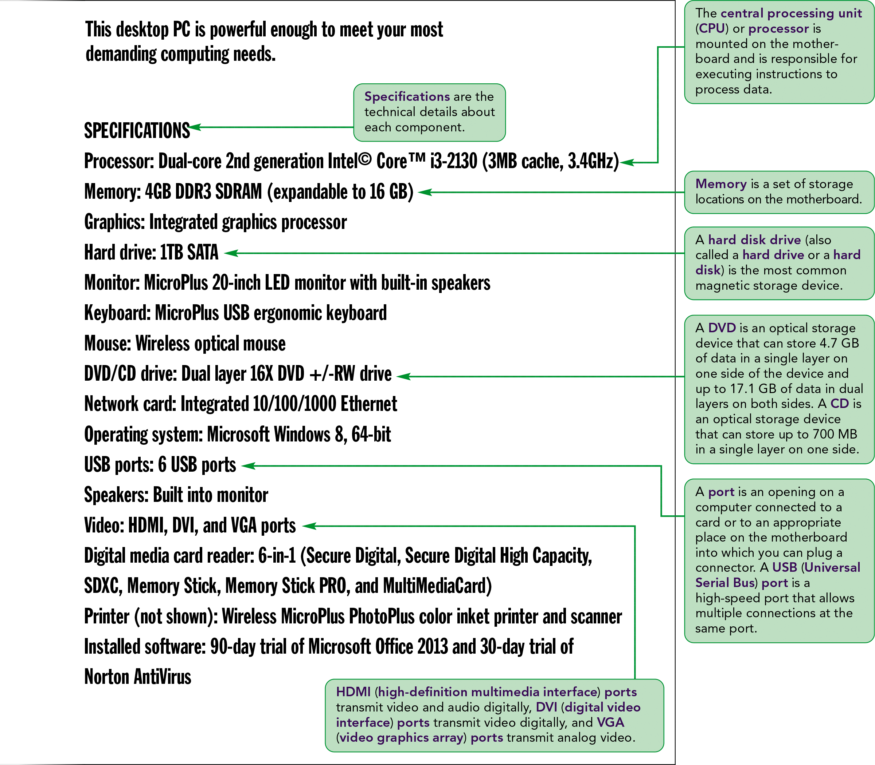
Computer Advertisement cont.

Slide 6
What is a Computer?
A computer is an electronic device that accepts information and instructions from a user, manipulates the information according to the instructions, displays the information in some way, and stores the information for retrieval later

Slide 7
Types of Computers
Desktop computers
Laptops (aka Notebooks)
Netbooks
Tablets
Convertibles
Smartphones
Mainframe computers
Midrange computers (aka Minicomputer)
Supercomputers

Slide 8
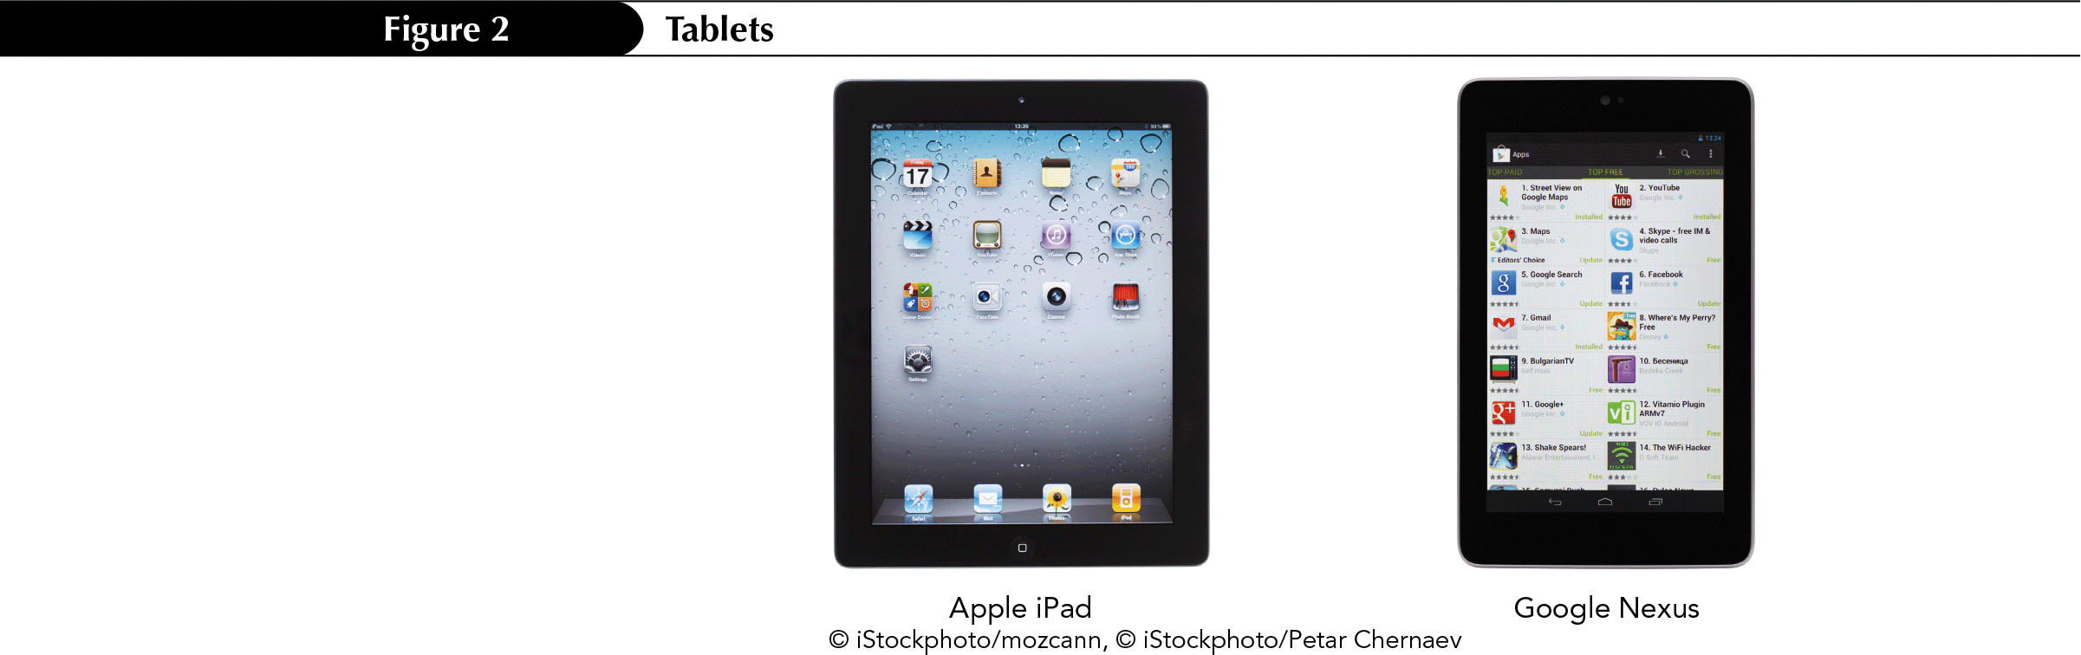
Types of Computers

Slide 9
Computer Systems
Includes computer hardware and software
  Hardware refers to the physical components of a computer
  Software refers to the intangible components of a computer system, particularly the programs, or applications which are lists of instructions the computer needs to perform a specific task
The hardware and software of a computer work together to process data and commands, the instructions to the computer on how to process the data.

Slide 10
Processing Hardware
Processing tasks occur on the motherboard, which contains the processing hardware and is located inside the computer.
  Circuit Board
The CPU consists of transistors and electronic circuits on a silicon chip, mounted on the motherboard.

Slide 11
Processing Hardware cont.
Cards (aka expansion cards) are removable circuit boards inserted into slots on the motherboard to expand the capabilities of the motherboard.
  Sound cards translate the digital audio information from a computer into analog sounds that the human ear can hear and direct the sound to the speakers.
  Graphics cards and Video cards control the visual displays on the monitor

Slide 12
Input Devices
Input devices, such as a keyboard or a mouse are used to input data and issue commands.
  Keyboard
    Ergonomic
  Pointing devices
    Mouse
      Scroll Wheel
    Trackball
    Touchpad
  Touchscreen
  Scanner

Slide 13
Output Devices
Output devices store or show your output.
  Monitors
    Flat panel
    LCD
    LED
  Printers
    Laser
    Inkjet
  Speakers

Slide 14
Connecting Peripheral Devices
Peripheral devices connect to the computer either via a cable or wirelessly.
Cables connect to ports in the computer.
  PS/2 (USB)
  Ethernet

Slide 15
Data Representation
Data refers to the words, numbers, figures, sounds, and graphics that describe people, events, things, and ideas
Binary digits (bits)
A series of eight bits is called a byte
  A Kilobyte (KB or K) is about a thousand bytes
  A Megabyte (MB) is about a million bytes
  A Gigabyte (GB) is about one billion bytes
  A Terabyte (TB) is about one trillion bytes
  A Petabyte (PB) is about 1000 terabytes

Slide 16
Memory
Random access memory (RAM)
  Volatile memory
  DDR SDRAM
Cache memory (RAM cache or CPU cache)
Read-only memory (ROM)
  BIOS
  Boot process
  Nonvolatile memory
Complementary metal oxide semiconductor (CMOS)
  Semipermanent memory

Slide 17
Storage Media
Storage is where the data you create and the instructions you use remain when you are not using them.
A file is a named collection of stored data.
An executable file contains the instructions that tell a computer how to perform a specific task.
A data file is created by a user
Magnetic storage media store data as magnetized particles on a surface.

Slide 18
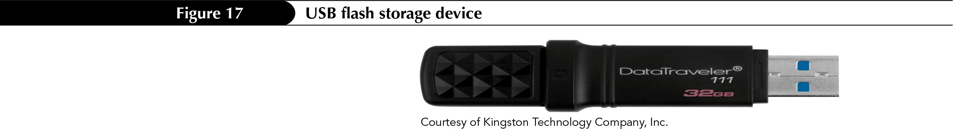
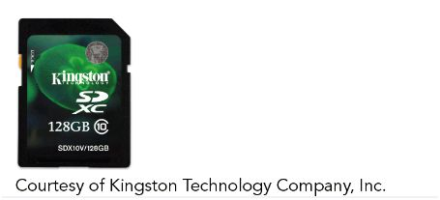
Storage Media
Optical storage devices (CDs and DVDs) store data as a trail of tiny pits or dark spots on the surface.
Flash memory cards are small portable cards to which data can be written and rewritten.

Slide 19
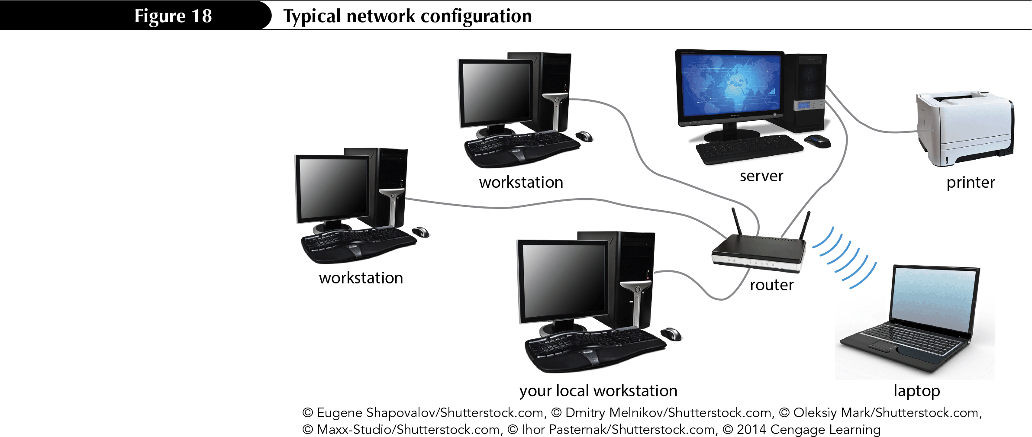
Networks
A network connects one computer to other computers and peripheral devices, enabling you to share data and resources with others.
  Network adapters.
  Network software
Network types:
  Client/server
  Peer-to-peer
  LAN
  WAN
  WLAN
  PAN

Slide 20
Data Communications
The transmission of data from a computer to a peripheral device or from once computer to another is called data communication.
The four essential components of a data communications are:
  Sender (sends message)
  Receiver (receives message)
  Channel (cable, microwave or radio signal, optical fibers)
  Protocol (rules for the orderly transfer of data)

Slide 21
Data Communications cont.
Data can be transmitted via a wired or wireless connection.
Wired connection requires a cable connection between the computer and the peripherals.
Bluetooth, Certified Wireless USB, ultra wideband (USF), Wireless HD (WHD) and Transferjet are standards for short distance wireless connections.
WIMAX (Worldwide Interoperability for Microwave Access) is a standard for long distance wireless connections.
3G, 4G and LTE (long-term evolution) are standards used by cell companies to transmit data.

Slide 22
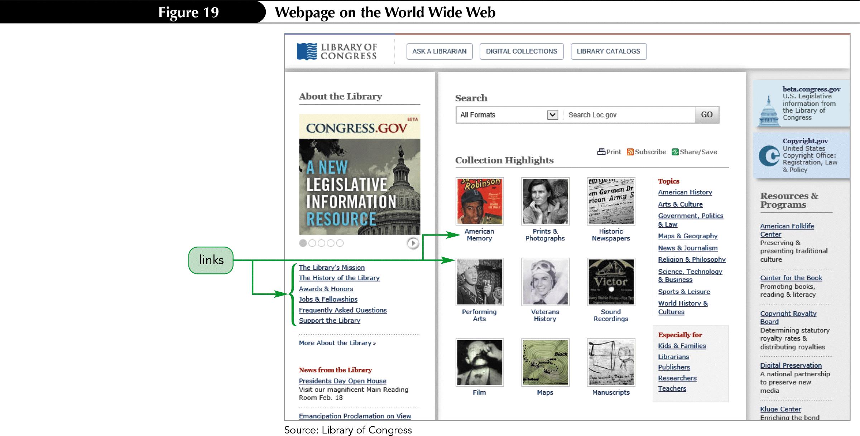
The Internet
The Internet is the largest network in the world
  Email
  World Wide Web
    Web page
    Website
    Hyperlink

Slide 23
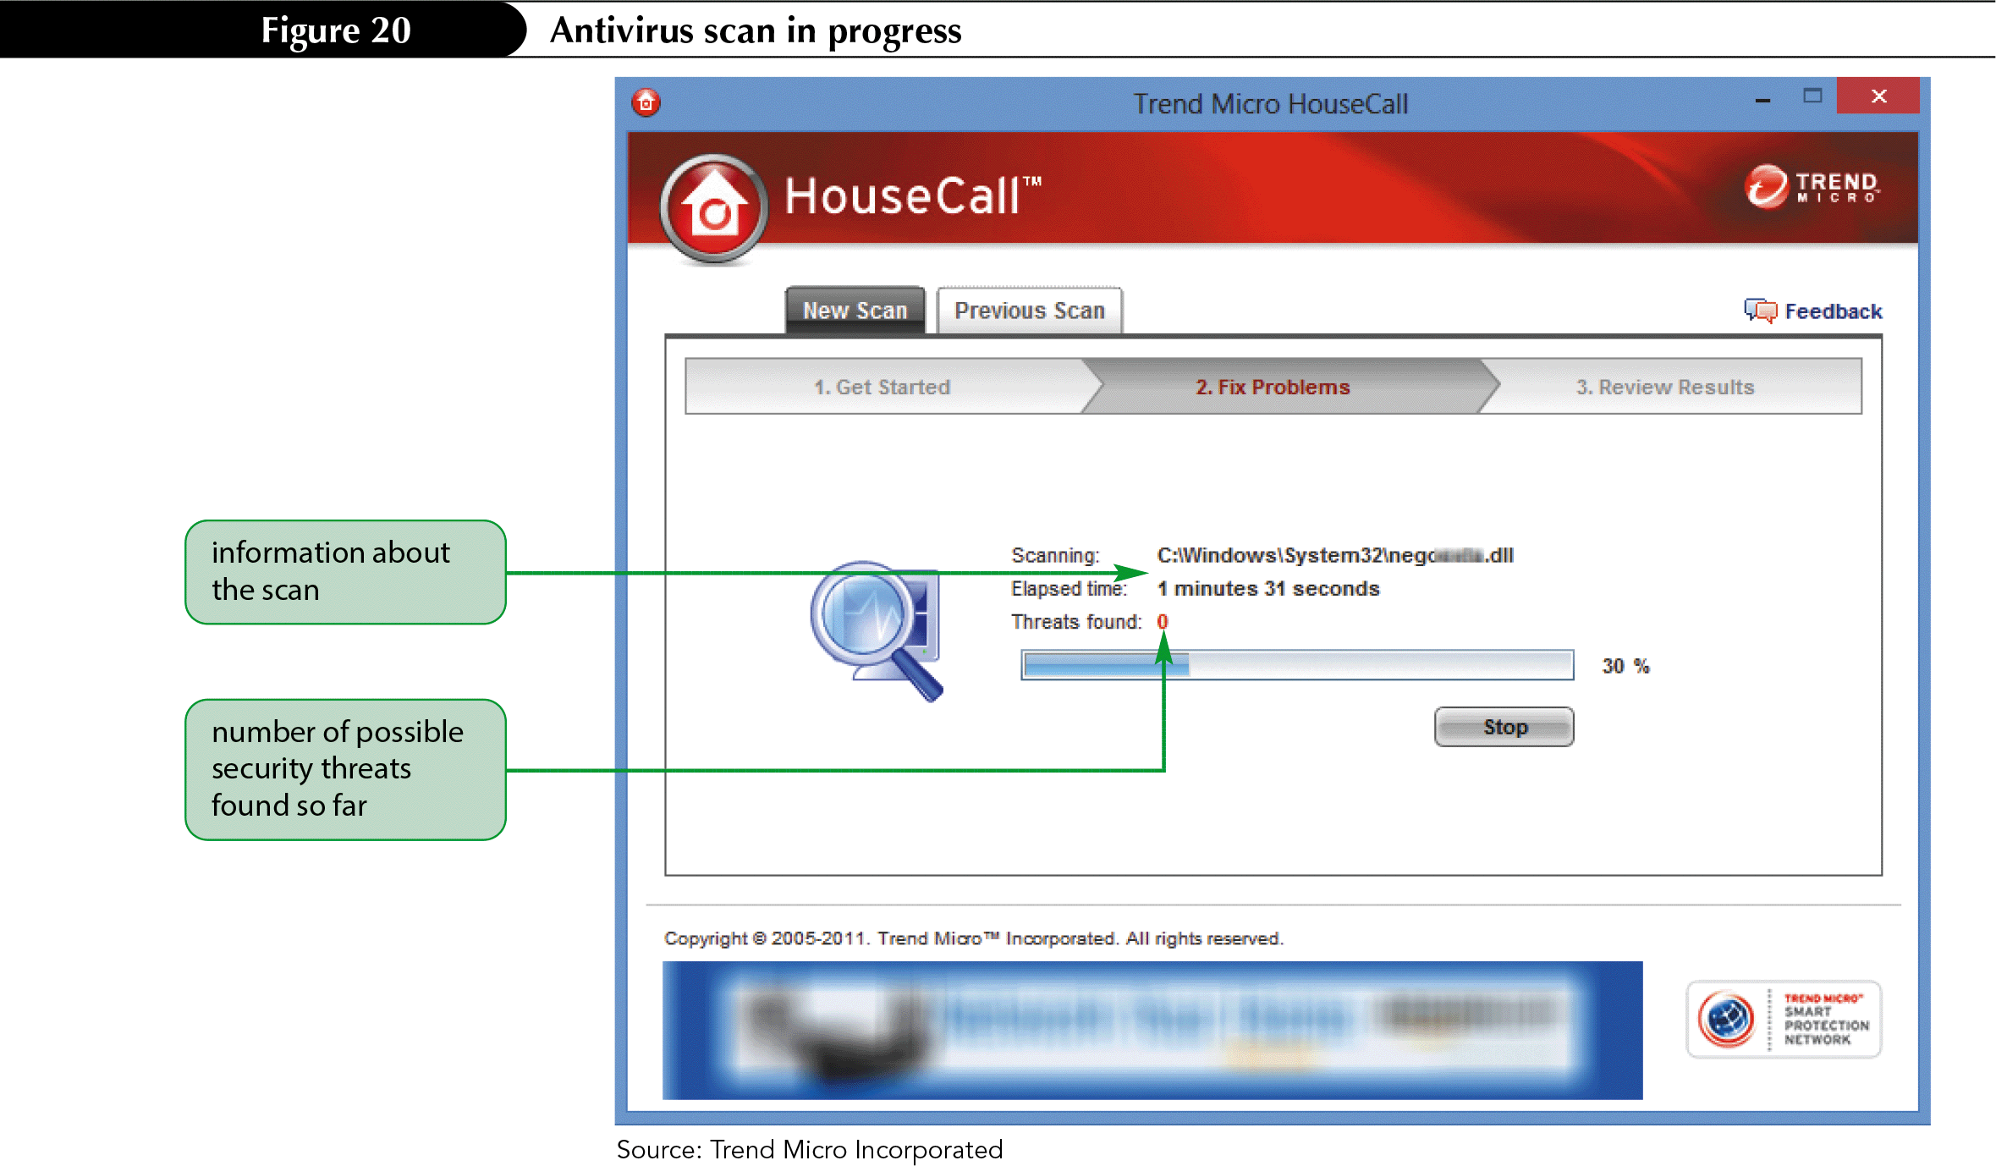
Security Threats
It is essential to protect a computer connected to a network from threats that could steal information or cause malicious damage.
  Malware
  Spyware
  Antivirus software
  Anti-spyware software
  Firewalls
  Adware
  Spoofed sites
  Phishing

Slide 24
System Software
System Software manages the computer’s fundamental operations
  Operating system
    System resources
    Multitasking
    Storage
    Security
  Utilities
  Device Drivers
  Programming Languages
  Operating environments
    graphical user interface (GUI)

Slide 25
Application Software
Application software enables you to perform specific computer tasks, such as document production, spreadsheet calculations, and database management.
  Documentation production software

Slide 26
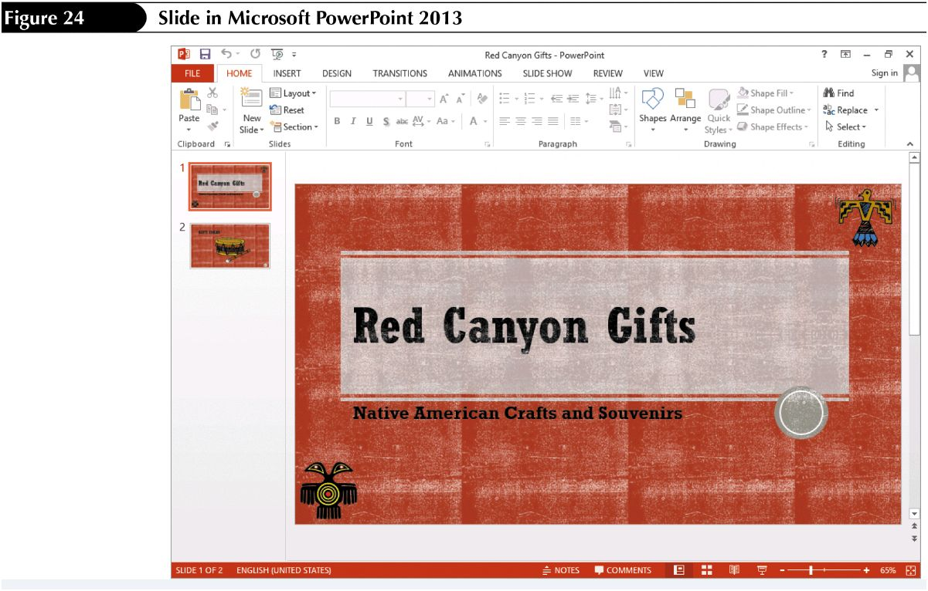
Application Software cont.
Spreadsheet software
  numerical analysis
Presentation Software
  slide presentations

Slide 27
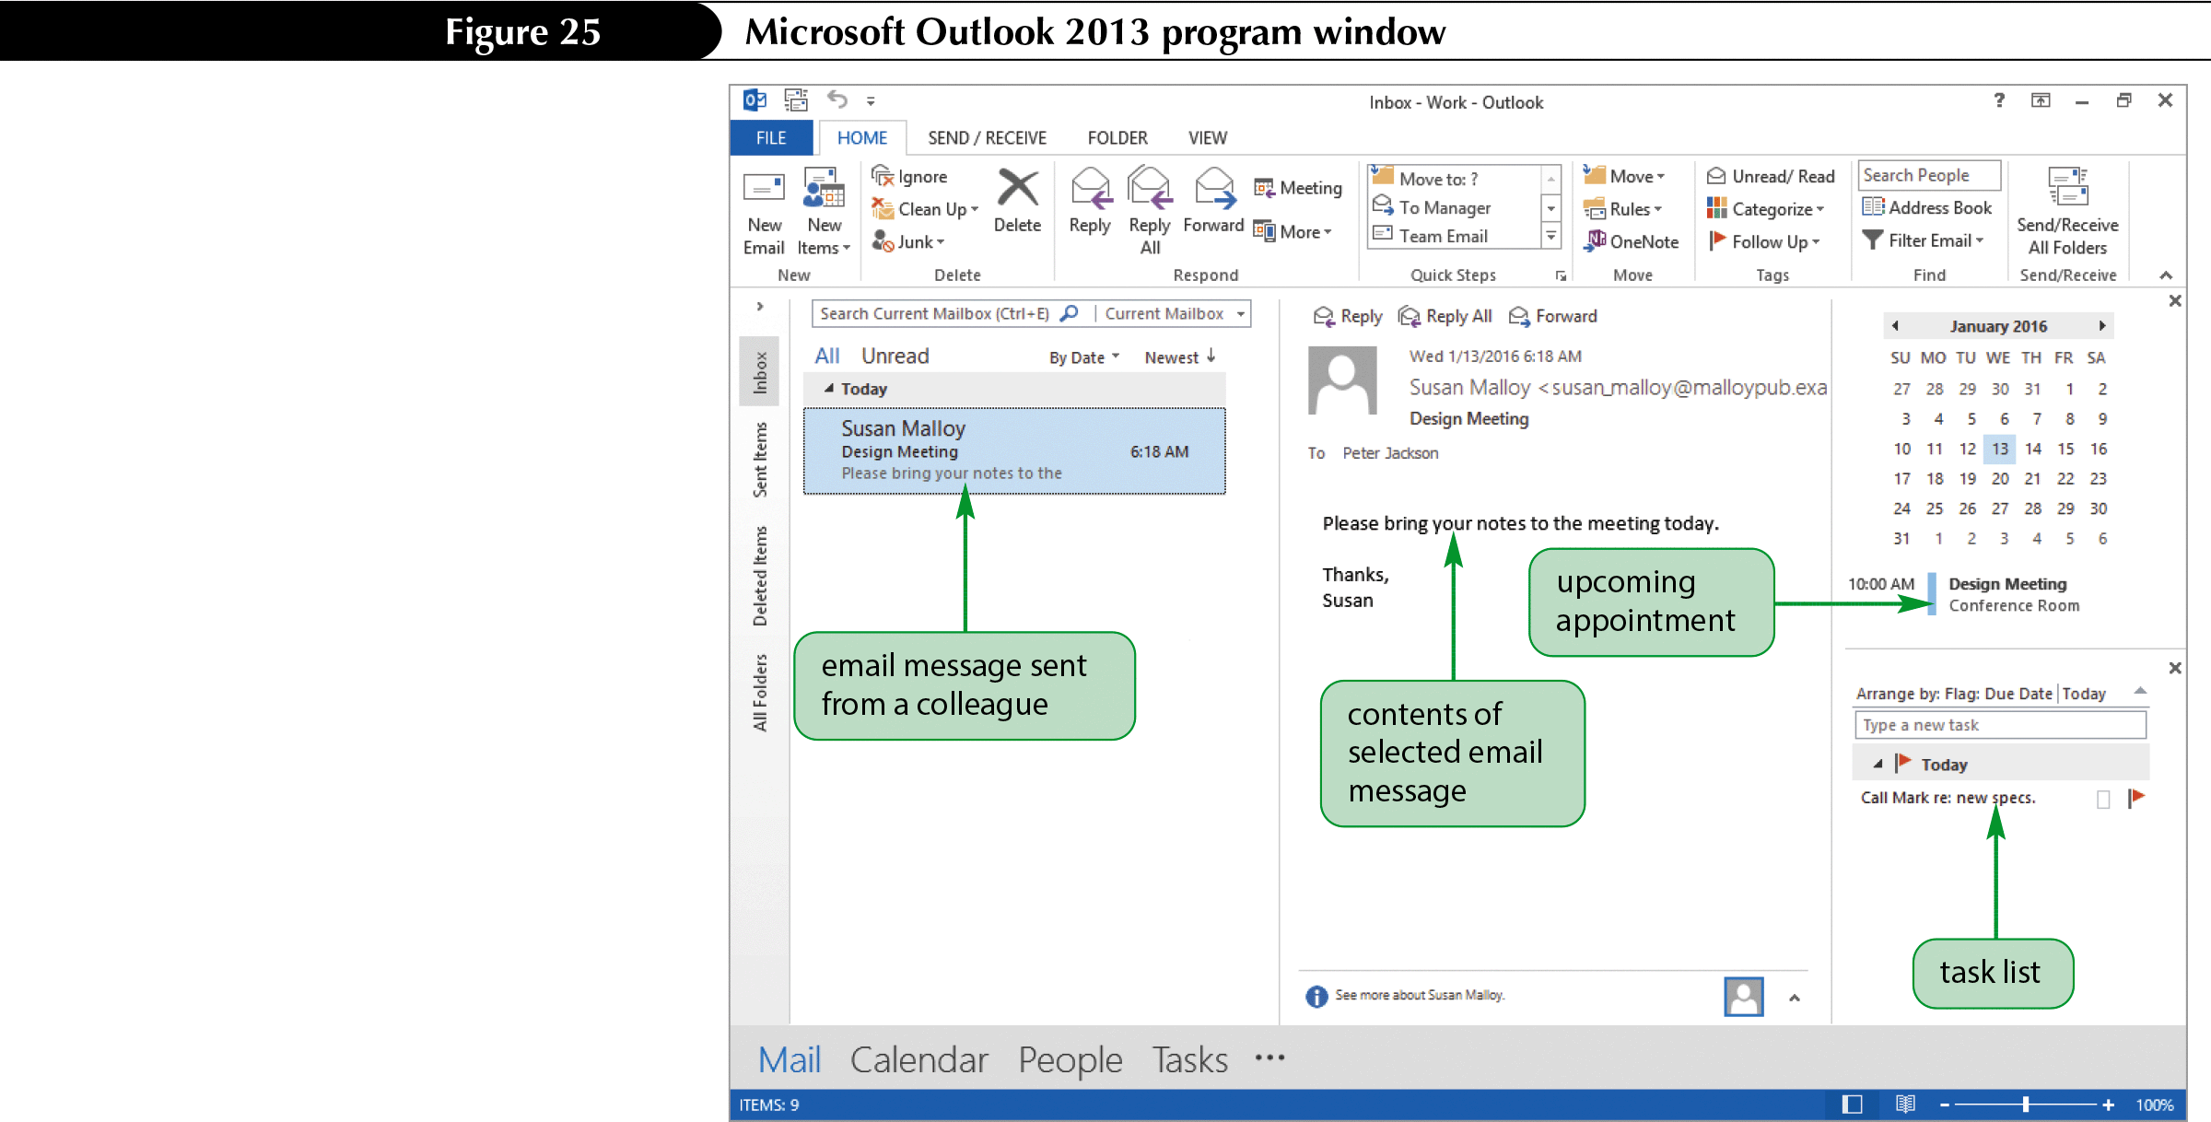
Application Software cont.
Database management software
  collect and manage data.
Information management software
  track schedules, contacts, and to-do lists.

Slide 28
Application Software cont.
There are many other types of application software:
  Photo editing
  Video editing
  Graphics
  Website creation and management
  Multimedia authoring
  Accounting

Slide 29
Computing in the Cloud
Cloud computing means that data, applications and resources are stored on servers accessed over the Internet.
  Microsoft Office WebApps
  Google Docs
  Office 365
  SkyDrive

