Slide 1
Information,
Privacy confidentiality and Cyber Security
Compiled by S. Z.

Slide 2
Outline
how large cyber attacks are and how they cost hundreds of billions of dollars annually.
popular ways cyber attacks occur and the types of attacks.
prevention methods against cyber attacks
Detection
What “virus”, spyware, worms, malware and etc. actually were.
What is cyber security?
    The internet
    Importance of cyber security
    Cyber security spending
Cyber attacks
    Types of attacks
    Difference between virus, malware and spyware
    Ways to prevent attacks

Slide 3
vulnerabilities

Slide 4
viruses

Slide 5
Dancing pigs
In computer security, the "dancing pigs" is a term or problem that describes computer users' attitudes to computer security.
It states that users will continue to pick an amusing graphic even if they receive a warning from security software that it is potentially dangerous. In other words, users choose their primary desire features without considering the security.
"Dancing pigs" is generally used by tech experts and can be found in IT articles.

Slide 6
Trojan horse
A Trojan horse, or Trojan, in computing is a generally non-self-replicating type of malware program containing malicious code that, when executed, carries out actions determined by the nature of the Trojan, typically causing loss or theft of data, and possible system harm.
The term is derived from the story of the wooden horse used to trick defenders of Troy into taking concealed warriors into their city in ancient Anatolia, because computer Trojans often employ a form of social engineering, presenting themselves as routine, useful, or interesting in order to persuade victims to install them on their computers.
A Trojan often acts as a backdoor, contacting a controller which can then have unauthorized access to the affected computer.^{[6]} While Trojans and backdoors are not easily detectable by themselves, computers may appear to run slower due to heavy processor or network usage. Malicious programs are classified as Trojans if they do not attempt to inject themselves into other files (computer virus) or otherwise propagate themselves (worm).^{[7]} A computer may host a Trojan via a malicious program a user is duped into executing (often an e-mail attachment disguised to be unsuspicious, e.g., a routine form to be filled in) or by drive-by download.

Slide 7

Challenges of Cyber Security
convenience/functionalities/usability vs security - Users want useful and/or fun technology
“The user's going to pick dancing pigs over security every time.” — Bruce Schneier

Slide 8
industrial control systems
smart meters,
smart grids,
supervisory control
data acquisition,
process control systems
Industrial Control System Computer Emergency Response
in critical infrastructure resiliency.
its applications to control and automation of industrial control systems.
cyber physical systems

Slide 9
cybersecurity curriculum
security professionals in industry and government.

Slide 10
http://prtl.uhcl.edu/portal/page/portal/SCE/csi

Slide 11
This lecture is not meant to be all encompassing.

Slide 12
Outlines
Terminologies and Definitions
Digital privacy
Information stewardship
Mass surveillance
Potential risks and vulnerabilities
Your role in cyber security and protecting privacy
Best practices in security and privacy
Single computer
Online security
Hacking
systems security
cloud security
mobile security
malware defense
networking security
12

Slide 13
Traceable vs untraceable

Slide 14
Sensitive and private information
sensitive personal information such as telephone numbers, addresses, and credit card information

Slide 15
Information is everywhere, but not easy to get to public

Slide 16
Internet Connections
No free lunch
Convenient but non-secure
Communications over the Internet such as using e-mail, browsing the web, Skyping, sending and receiving information are not secure.
Sensitive personal and business data Information sent by those means may be intercepted.
There is commercial activity going on the Internet and many web sites require the users to fill forms and include. To be able to do that users would like to have a secure, private communication with the other party. Online users may need private and secure communications for other reasons as well. They may simply not want third parties to browse and read their e-mails or alter their content.

Slide 17
Online Banking uses several different methods to protect your information.
All information within Online Banking uses the SSL (Secure Socket Layer) protocol for transferring data.
In practice, your browser will send a message via SSL to the bank’s server. The bank responds by sending a certificate, which contains the bank’s public key. Your browser authenticates the certificate (agrees that the server is in fact Bank of America), then generates a random session key which is used to encrypt data traveling between your browser and the bank’s server. This session key is encrypted using the bank’s public key and sent back to the server. The bank decrypts this message using its private key, and then uses the session key for the remainder of the communication.
Secure Socket Layer (SSL) protects data in three key ways:
Authentication ensures that you are communicating with the correct server. This prevents another computer from impersonating Bank of America.
Encryption scrambles transferred data.
Data integrity verifies that the information sent by you to Bank of America wasn’t altered during the transfer. The system detects if data was added or deleted after you sent the message. If any tampering has occurred, the connection is dropped.

Slide 18
Information on social network!!!

Slide 19
What is an SSL (Secure Sockets Layer) Certificate?
An SSL Certificate adds essential security to online transactions
SSL stands for Secure Sockets Layer. It is encryption that provides a secure connection between internet browsers and websites, for the information being transferred between your browser and the server.
allowing you to transmit private data online securely.
Sites secured with SSL display a padlock in the browsers URL and possibly a green address bar if secured by an EV Certificate.
So what is SSL used for? The SSL protocol is used by millions of e-Business providers to protect their customers, ensuring their online transactions remain confidential. A web page should use encryption expected to submit confidential data, including credit card details, passwords or any personal information. All web browsers have the ability to interact with secured sites so long as the site's certificate is from a recognized certificate authority, such as Comodo.
At a high level, SSL uses public key cryptography to secure transmissions over the Internet.

Slide 20
What is Cryptography?
In simple terms, cryptography is the science concerned with the study of secret communication.
If you look at the origin of the root words of cryptography (crypto and graphy), you will see that "crypto" stands for "hidden, secret", and "graphy" denotes "a process or form of drawing, writing, representing, recording, describing, etc., or an art or science concerned with such a process."
The science or study of the techniques of secret writing, esp. code and cipher systems, methods, and the like.Compare cryptanalysis (def. 2).
The procedures, processes, methods, etc., of making and using secret writing, as codes or ciphers.

Slide 21
What is Encryption?
If you breakdown the the base word--"encrypt"--into its root, you will see "en" and "crypt". The "en" part means "to make", and the "crypt" part (a variation of "crypto") means hidden or secret. Since "encrypt" is a verb, the base term then means "to make hidden or secret".
"encryption" basically is some process or algorithm (known as a cipher) to make information hidden or secret.

Slide 22
In the days of written communication, most common ciphers involved some form or substitution or transposition of alphabetical letters. Substitution means to substitute one character for another while transposition is some form of repositioning characters within the message (which literally scrambles the information).

Slide 23
In the digital age, ciphers changed and are generally based on two types of algorithms--one using the same key to encrypt and decrypt, and one using different keys to encrypt and decrypt (also known as symmetric and asymmetric key algorithms, respectively). The one that uses symmetric keys falls under private-key cryptography, while asymmetric key algorithms falls under public-key cryptography. DES (Data Encryption Standard) and AES (Advanced Encryption Standard) are two well known ciphers based on symmetric key algorithms, while RSA (Rivest, Shamir and Adleman) is a well known cipher based on asymmetric key algorithms.

Slide 24
Information Stewardship
You are a steward of information (personal or professional information.) you use on your devices.
Vulnerabilities at home and at work jeopardize not only yourself, but everyone you connect with
24

Slide 25
The use of cryptographic software to evade prosecution and harassment while sending and receiving information over computer networks is associated with crypto-anarchism, a movement invested in protecting the individual against government mass surveillance.

Slide 26
Digital privacy is a trending social concern^{[1]} subsequent to the 2013 mass surveillance disclosures which cast a shadow over the privacy of cloud storage and social media. While it is concerned with the privacy of digital information in general, it many contexts it specifically references information concerning personal identity shared over public networks.
Until the Edward Snowden disclosures concerning the extent of the NSA's PRISM program, the public debate on digital privacy mainly centered on privacy concerns with social networking services, as viewed from within these services.
With the secrecy of the American Foreign Intelligence Surveillance Act more widely disclosed,^{[2]} digital privacy is increasingly recognized as an issue in the context of mass surveillance.

Slide 27
Welcome to the Cyber Security and Privacy Awareness course. The purpose of this course is to increase your awareness of the threats and risks that are part of using any information system and the sensitive information and data contained in information systems. By information system, we mean paper materials, computers, mobile devices, networks, databases, and electronic information storage. The computing world is the world of cyber.
The Department of Education is responsible for a great deal of sensitive information, especially information that is private information about our customers, our people, and our other stakeholders. When you use Department computers and information systems or access Privacy Act information, such as personally identifiable information (PII) or other types of sensitive information such as personnel information, contracts/financial information, you assume a responsibility to help us all safeguard that information and to keep our information systems working correctly.

Slide 28
Cyber Security Defined
Cyber Security’s goal: Protect our information and information systems
Cyber Security is: “Protection of information systems against unauthorized access to or modification of information, whether in storage, processing or transit, and against the denial of service to authorized users, including those measures necessary to detect, document, and counter such threats.”
28

Slide 29
This course identifies potential risks and vulnerabilities associated with information systems, information, and data. Additionally this course provides a review for you about your role in protecting these systems and the information they contain. You will learn to identify best practices with regard to privacy, how to follow guidelines protecting sensitive information at both work and at home. Of particular importance, you will learn how to protect your PII and that of others from theft.

Slide 30
Remember that the purpose of this course is not just to meet a training requirement. The content of this course is provided to help ensure that the Department’s information and information systems are protected.

Slide 31
We know that even after you have invested your time in completing this training, you may begin to forget what you have learned. Unless you make an effort to commit to a disciplined practice of cyber security and continue to refresh yourself on what you should or should not be doing, you may inadvertently create a point of vulnerability in our security defenses.

Slide 32
Commit to a disciplined practice of information security and continue to refresh yourself so you don’t become a point of vulnerability in our security defenses.

Slide 33
Regardless of your existing experience and knowledge, completing this type of required annual awareness course helps the Department meet our responsibilities to be a champion of cyber security and privacy protection. Only by being the best we can be together can we fulfill the important mission given to us by the American people. A chain is only as strong as its weakest link.

Slide 34
As you know, the Department of Education is the steward of personal information for millions of Americans and, thus, needs to ensure that only individuals with the right authorization can access the information required, and nothing more. You are part of this stewardship responsibility.

Slide 35
Additionally, if you, your family, or friends use a personal computer connected to the Internet, or have set up a home network, that personal computer, and any connections it has, is vulnerable to infiltration and attack. The information provided in this training course can help you be more secure at home, as well as here at the Department of Education.

Slide 36
Privacy Defined
Information privacy, or data privacy: the relationship between collection and dissemination of data, technology, the public expectation of privacy, and the legal and political issues surrounding them.
Information privacy is the right to control what information about a person is released.
36

Slide 37
Information privacy, or data privacy: the relationship between collection and dissemination of data, technology, the public expectation of privacy, and the legal and political issues surrounding them.
Information privacy is the right to control what information about a person is released.

Slide 38
Introduction to Cyber Security
Our lives depend on online services. Gain essential cyber security knowledge and skills, to help protect your digital life.
We shop online.
We work online.
We play online.
We learn online
We live online.
We are online.

Slide 39
As our lives increasingly depend on digital services, the need to protect our information from being maliciously disrupted or misused is really important.
understand online security and start to protect your digital life, whether at home or work.
how to recognise the threats that could harm you online and the steps you can take to reduce the chances that they will happen to you.
o frame your online safety in the context of the wider world,
introducing you to different types of malware,
including viruses and trojans, as well as concepts such as network security, cryptography, identity theft and risk management.

Slide 41
The CIA and N
Confidentiality: Safeguards information from being accessed by individuals without the proper clearance, access level, and need to know.
Integrity: Results from the protection of unauthorized modification or destruction of information.
Availability: Information services are accessible when they are needed. Authentication means a security measure that establishes the validity of a transmission, message, or originator, or a means of verifying an individual's authorization to receive specific categories of information.
Non-repudiation: Assurance the sender of data is provided with proof of delivery and the recipient is provided with proof of the sender's identity, so neither can later deny having processed the data.
41

Slide 42
As an authorized user, you are also responsible for contributing to the security of all Government-owned computer systems.
You must abide by these principles of cyber security in your daily work routine to protect information and information systems. A secure information system maintains the principles of confidentiality, integrity, availability, authentication, and non-repudiation.
Confidentiality:
Safeguards information from being accessed by individuals without the proper clearance, access level, and need to know.
Integrity:
Results from the protection of unauthorized modification or destruction of information.
Availability:
Information services are accessible when they are needed. Authentication means a security measure that establishes the validity of a transmission, message, or originator, or a means of verifying an individual's authorization to receive specific categories of information.
Non-repudiation:
Assurance the sender of data is provided with proof of delivery and the recipient is provided with proof of the sender's identity, so neither can later deny having processed the data.

Slide 43
We are constantly at war with both outsiders and, yes, insiders, who want to compromise our information systems. Your mission is to help in the defense of our systems and our sensitive information.
You need to recognize and protect Confidentiality. Confidentiality, i.e., protecting our organizations, our employee’s and our customer’s sensitive information including privacy information. We do not want to expose anyone or any organization to harm through inappropriate use of sensitive information.
You need to make sure that the only changes to the data and information is purposeful and known. We also need to have confidence in the Integrity of our data and information and our information systems. If data and information has been improperly altered, then we will not be able to accomplish our mission or serve our customers properly.
You need to safeguard your PC and our information systems to ensure Availability of our information systems, the data and information they contain, and the software we use to do our wok. If we cannot use our computers, software we do work with, our communications networks, and/or our information we are temporarily out of business.
You need to be sure that when you receive electronic communications, and when you send electronic communications, that there can be no doubt about what was sent, when it was sent, and by whom it was sent. Our cyber security protection must include Non-repudiation, i.e., that communications are suspect and/or cannot be authenticated.
In general, any information about an individual that directly or indirectly identifies that person may require some level of protection.
The following examples will help you easily identify Sensitive information:
Information that cannot be posted on a wall or on a public or internal web site, for example:
Credit card numbers
Social Security Numbers
Employee’s home telephone numbers
Information such as that found on medical prescriptions and checks

Slide 44
Sensitive Data
Information is considered sensitive if the loss of Confidentiality, Integrity, or Availability could be expected to have a serious, severe, or catastrophic adverse effect on organizational operations, organizational assets, or individuals.
Types of sensitive information include:
  Personnel
  Financial
  Payroll
  Medical
  Privacy Act information.
44

Slide 45

Tips to Help Protect PII
Minimize PII
Secure PII
Safeguard the Transfer of PII
Dispose of PII Properly
45

Slide 46
Minimize PII
Collect only PII that you are authorized to collect, and at the minimum level necessary to accomplish a required purpose
Limit number of copies containing PII to the minimum needed
Secure PII
When not in use, store PII in an access-controlled environment
Use fictional personal data for presentations or training
Review documents for PII prior to posting on ED web pages
Safeguard PII in any format around your work area
Maintain a ‘clean desk’ policy—do not leave paperwork containing PII on your desk; if you have sensitive paper-based PII, be sure to lock it up
Only disclose PII to authorized viewers
Safeguard the transfer of PII
Do not email PII to personal e-mail accounts. Use the Firepass/Citrix VPN for remote/telework
Alert FAX recipients of incoming transmission
Use services that provide tracking and confirmation of delivery when mailing or shipping PII offsite
Dispose of PII Properly
Use the secure shredding bins to dispose of documents containing PII
Ensure that CDs containing PII are purged (deleting alone is not enough)
Work the IT Help Desk to ensure that drives containing PII are wiped before they are disposed of
Delete/dispose of PII at the end of its retention period or transfer it to the custody of the National Archives, as specified by its applicable records retention schedule

Slide 47
Prevent Spillage
When storing sensitive information, including PII, prevent spillage by following these security tips:
  Encrypt data before storing
  Store data only on a network that has been certified and accredited to store this type of information
  Remember, some systems are strictly non-sensitive—never transmit, store, or process sensitive data on a non-sensitive system
  Label paperwork containing PII appropriately and ensure it is not left lying around
  Use the secure bins provided to dispose of paperwork containing PII
47

Slide 48
Spillage or breach includes the improper handling of sensitive information on a non-sensitive system, including the improper:
Storage
Transmission
Processing of information

Slide 49
If You Suspect a PII Breach
Notify your immediate supervisor and ISSO at once.
Or, you can also enter the PII breach yourself using the Department’s online breach/incident reporting system, called OVMS (Operational Vulnerability Management System, available at https://ovms.ed.gov).
Federal agencies must report a breach within 1 hour of discovery (actual or potential breach) so time is of the essence.
49

Slide 50
Threats and Vulnerabilities
What are we protecting our and our stakeholders information from?
  Threats--any circumstances or events that can potentially harm an information system by destroying it, disclosing the information stored on the system, adversely modifying data, or making the system unavailable
  Vulnerabilities--weakness in an information system or its components that could be exploited.
  Vulnerabilities exist when there is a flaw or weakness in hardware or software that could be exploited by hackers. Vulnerabilities are frequently the result of a flaw in the coding of software. To correct the vulnerability, vendors issue a fix in the form of a patch to the software. To address these vulnerabilities on your home computer system, update your operating system and other software as patches become available
50

Slide 51
Securing the Department
Don’t store PII on unencrypted storage devices
Remove your Personal Identity Verification (PIV), or smart card, when leaving your desktop PC
Never transmit secure information over an unsecured fax machine
Check for security badges and make sure guests needing escorts have them
Don’t write down passwords
Use only authorized thumb drives
Properly label removable media such as CDs or DVDs
Be careful how you dispose of anything that might contain sensitive information
51

Slide 52
Department Password Policy
The Department has guidelines pertaining to password use.
  Passwords must be:
  Obscured during login and during transmission.
  Changed after the initial login.
  Forced by the system to be changed every 90 days.
  Strong - shall include three of the four characteristics:
    Numerals
    Alphabetic characters
    Upper and lower case letters
    Special characters
    Passwords shall be at least eight (8) characters in length.
52

Slide 53
Secure Passwords
Do
Use a combination of: lower and upper case letters, numbers, and, special characters
Change it every 90 days
Create a complex, strong password, and protect its secrecy
Don’t
Use personal information
Dictionary words (including foreign languages)
Write it down
Share it with anyone
53

Slide 54
More detailed information can be found in Information Technology Password Guidance, Version 1.0, April 20, 2011. Point out that the Department is moving towards implementing mandatory PIV cards. However, since the card is still linked to your password, choosing a strong password and is still critical.
Using these guidelines at home keeps your home computer secure as well.
Password Do’s:
Do use a combination of:
  Lower and upper case letters,
  Numbers, and,
  Special characters, such as the number sign or percent sign.
Do change your password every 90 days.
Do create a complex, strong password, and protect its secrecy. This is critical for protecting Federal information and information systems, as well as for protecting your own personal information.
Password Don’ts:
Do not use personal information, such as:
  Birthdays, or
  Names of:
    Family members,
    Friends,
    Pets,
    Favorite sports teams, or
    Favorite bands.
Do not use common phrases or words found in the dictionary, including foreign languages. Hackers even have a Klingon dictionary!
Do not write down your password. Commit it to memory.
Do not share your password with anyone, ever!

Slide 55
Protect Your Facility
Protect your facility by following these general security tips:
  Always use your own badge to enter a secure area
  Never grant access for someone else using your badge
  Challenge people who do not display badges or passes.
  Report any suspicious activity that you see to your ISSO or building security using the Information Security Incident Response and Reporting Procedures.
55

Slide 56
Protect your facility by following these general security tips:
  Always use your own badge to enter a secure area
  Never grant access for someone else using your badge
  Challenge people who do not display badges or passes.
  Report any suspicious activity that you see to your ISSO or building security using the Information Security Incident Response and Reporting Procedures.

Slide 57
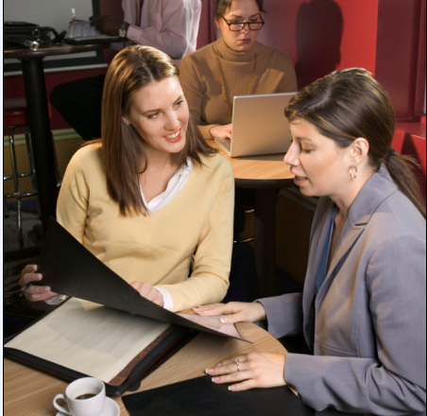
Situational Awareness
To practice good situational awareness, take the following precautions, including but not limited to:
  Avoid discussing topics related to Government business outside Government premises, whether you are talking face to face or on the phone
  Remove your security badge after leaving your work station
  Don’t talk about work outside the office
  Avoid activities that may compromise situational awareness
  Be discreet when retrieving messages from smart phones or other media
57

Slide 58
To practice good situational awareness, take the following precautions, including but not limited to:
  Avoid discussing topics related to Government business outside Government premises, whether you are talking face to face or on the phone
  Remove your security badge after leaving your work station
  Don’t talk about work outside the office
  Avoid activities that may compromise situational awareness
  Be discreet when retrieving messages from smart phones or other media
Even when you are not at the office, you are still a Department employee. Regardless of where you are, you must always be aware of your surroundings. We call this maintaining situational awareness.
When out and about:
Think about who is within earshot.
Ask yourself questions like, could a nearby recording device, such as a smart phone or camera, capture what I am saying?
Am I revealing sensitive, proprietary, or personally identifiable information?
Maintaining situational awareness takes effort, especially when you are off duty, such as during lunch or coffee breaks, shopping, vacations, traveling, talking on the phone, and so on.

Slide 59
Even with the best passwords and encryption, we are still left with the issue of social engineering. Social engineering is a collection of techniques intended to trick people into divulging private information. The social engineer attempts to use the information to gain unauthorized access to computer systems, or to commit fraud.
Social engineers use a variety of communication devices to contact their victims, including:
Telephone surveys,
E-mail messages,
Websites,
Text messaging,
Automated phone calls, and
In-person interviews
The intention of social engineering is to steal your identity (identity theft), run up bills or commit crimes in your name, or access your organization's computer systems. Phishing is a serious, high-tech scam.
Social engineering can also happen to us at work—bad actors trying to break into Department systems.

Slide 60


Social Engineering
Hello, I'm calling from Technology for America – we're a non-profit organization, working to help ensure that the U.S. stays at the forefront of computer technology.
Today we're conducting a telephone survey about the usage of computer systems. Can I ask you a few questions about your computer system?
Social engineering is a collection of techniques intended to trick people into divulging private information. Includes calls emails, web sites, text messages, interviews, etc.
60

Slide 61
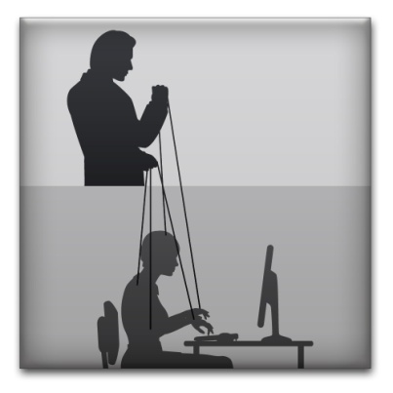
Social Engineering
Do
Document the situation—verify the caller identity, obtain as much information as possible, if Caller ID is available, write down the caller's telephone number, take detailed notes of the conversation
Contact your ISSO
Don’t
Participate in surveys
Share personal information
Give out computer systems or network information
61

Slide 62
You may hear these scams referred to as phishing, spear phishing, vishing, or, when directed at senior executives, whaling.
Regardless of the method of contact or type of request, what all of these scams have in common is that they are an attempt to get you to divulge personal information.
Avoid falling victim to these scams. Protect yourself, your fellow employees, and Federal systems, by following these security tips:
If the request for information is through a survey, tell the person that you do not participate in surveys.
Do not give out personal information about yourself or other Federal employees, including:
  Names,
  Positions,
  Telephone numbers, or
  Passwords.
Do not give out computer systems or network information.
Do not follow any instructions from unverified personnel.
When contacted, document the interaction:
  Attempt to verify the identity of any individuals who approach you.
  Try to obtain as much information about the person as possible.
  If Caller ID is available, write down the caller's telephone number.
  Take detailed notes of the conversation.
Contact your ISSO or help desk with any questions or for additional guidance.

Slide 63
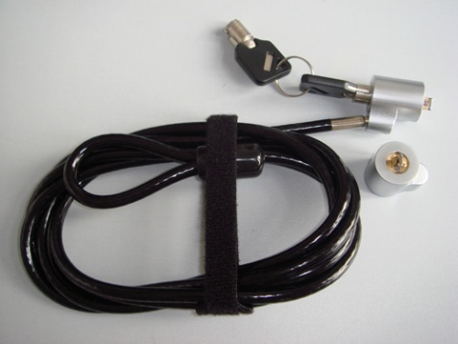

Mobile Computing
Always maintain physical control of mobile devices!
Properly label with classification and contact information
Disable wireless functionality when it is not in use
63

Slide 64
You must be extra vigilant when storing data on mobile computing devices, such as, PDAs, cell phones, laptops, and personal electronic devices, or PEDs. Because of their small size and portability, these devices are especially vulnerable to security risks. Like we just saw in the example, leaving a laptop or other such device unattended in a meeting room is not good practice and is not permitted.
Additionally, all mobile computing devices connecting to Department systems must be in compliance with federal policy. It is never acceptable to use a personal smart phone, such as an Android, to access email.ed.gov—this may only be done via a Department issued phone. Similarly, only iPads, iPhones, and Blackberries that are approved through the Department may be used to access the Department network or store Department data. The reason that this policy is implemented is to ensure that these devices have the appropriate software loaded on them to adequately protect the Department data.

Slide 65
Remember, if your system begins to act unusual, maybe running more slowly or even actually exhibits an increase in performance, you need to consider that you might have a Trojan horse or other kind of virus on your system. This should be reported immediately.

Slide 66

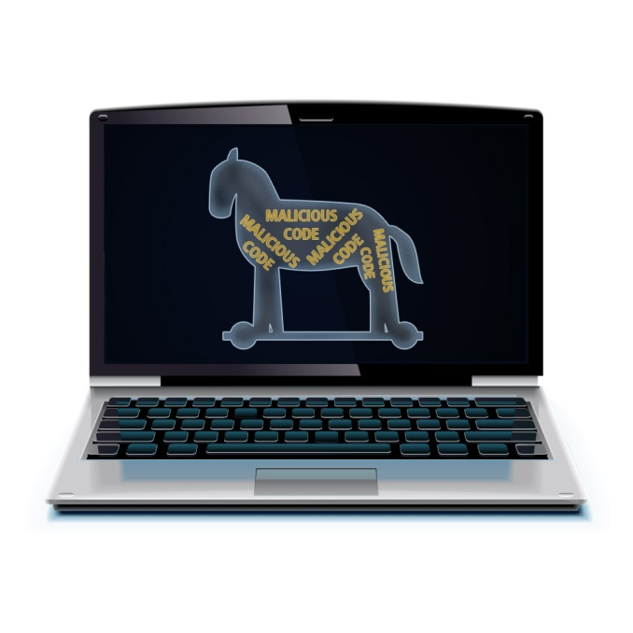
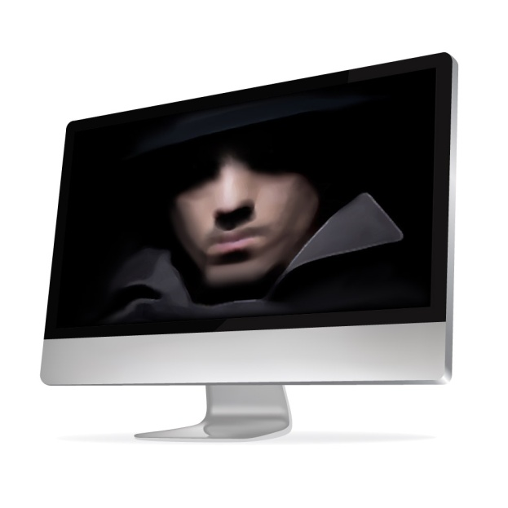
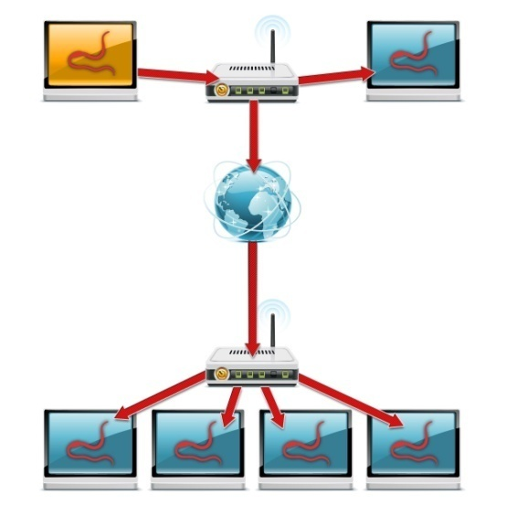
Report Suspicious Computer Problems
If your system acts unusual!
Report immediately
Trojan Horse
Spyware
Worm
66

Slide 67
Use of Social Media
Be aware of what you post online!
Monitor privacy settings
Refrain from discussing any work-related matters on such sites.
67

Slide 68
Be aware of what you post online, even information you might consider inconsequential such as spouse’s name, employer, or birthday could be used by an unscrupulous individual to steal your identity or to gather information for other purposes. Also ensure you monitor privacy settings carefully as these can changes from time-to-time depending on the site. Most require that you actively opt-out of sharing information so those settings must be manually changed. Also, refrain from discussing any work-related matters on such sites.
Did you know that when you take a photo on your smart phone, location information is automatically tracked? Post this photo to a social network and you could be telling the world where you live, where you work, or where your children go to school. This GPS feature can be turned off in the settings function.
Finally, when on such sites, don’t forget to apply the same strong password techniques we learned earlier. But never use the same passwords for work accounts and social media accounts.

Slide 69
Congratulations!
You have completed the orientation of Introduction to Security and Privacy
69

Slide 70
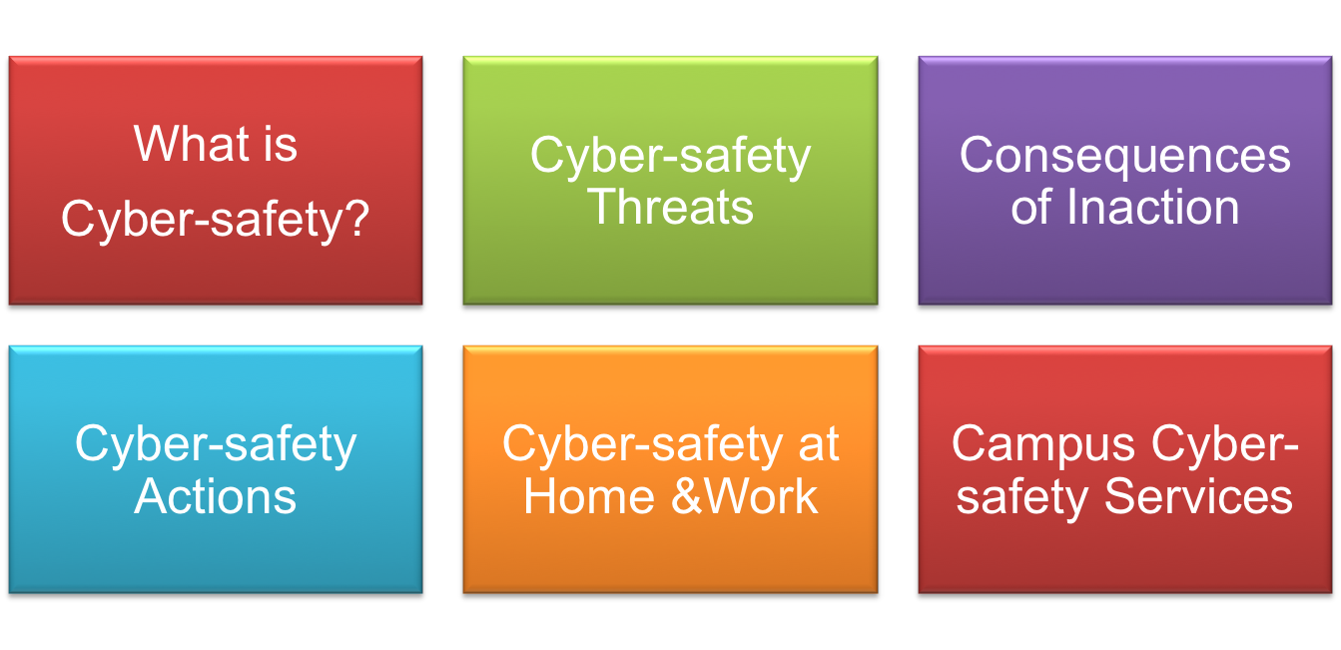
INTRODUCTION
This tutorial provides some basic information and practical suggestions for protecting your personal information and computer from cyber-attacks. Cyber-safety topics covered include:
70

Slide 71


What is…
WHAT IS CYBER-SAFETY?
Cyber-safety is a common term used to describe a set of practices, measures and/or actions you can take to protect personal information and your computer from attacks.
At UC Davis, we have the Cyber-safety Program policy, PPM 310-22, (http://manuals.ucdavis.edu/ppm/310/310-22.htm) which establishes that all devices connected to the UC Davis electronic communications network must meet certain security standards.
As part of this policy, all campus units provide annual reports demonstrating their level of compliance.
Further, there are services in place to help all students, faculty and staff meet the cyber-safety standards. Specific information about these services is provided in this tutorial.
UC Davis Mrak Hall
71

Slide 72

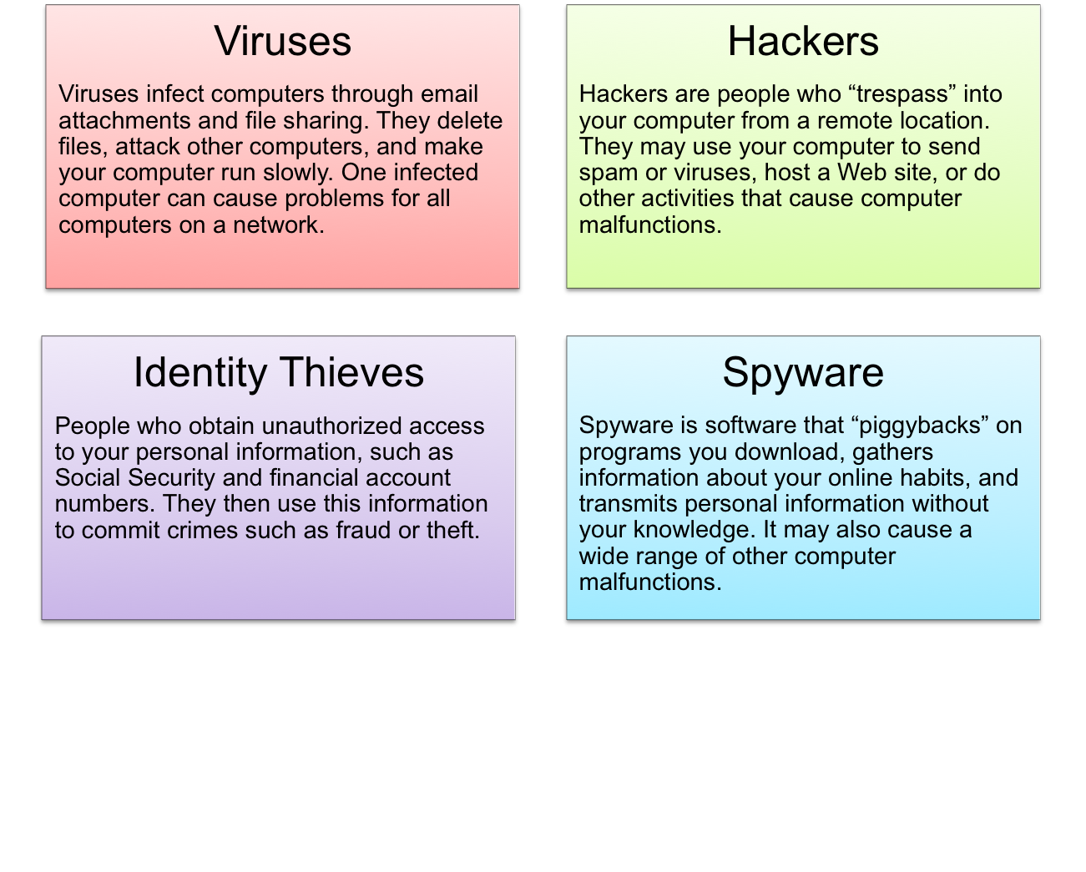
Threats
CYBER-SAFETY THREATS
First, let’s talk about some common cyber-safety threats and the problems they can cause . . .
72

Slide 73

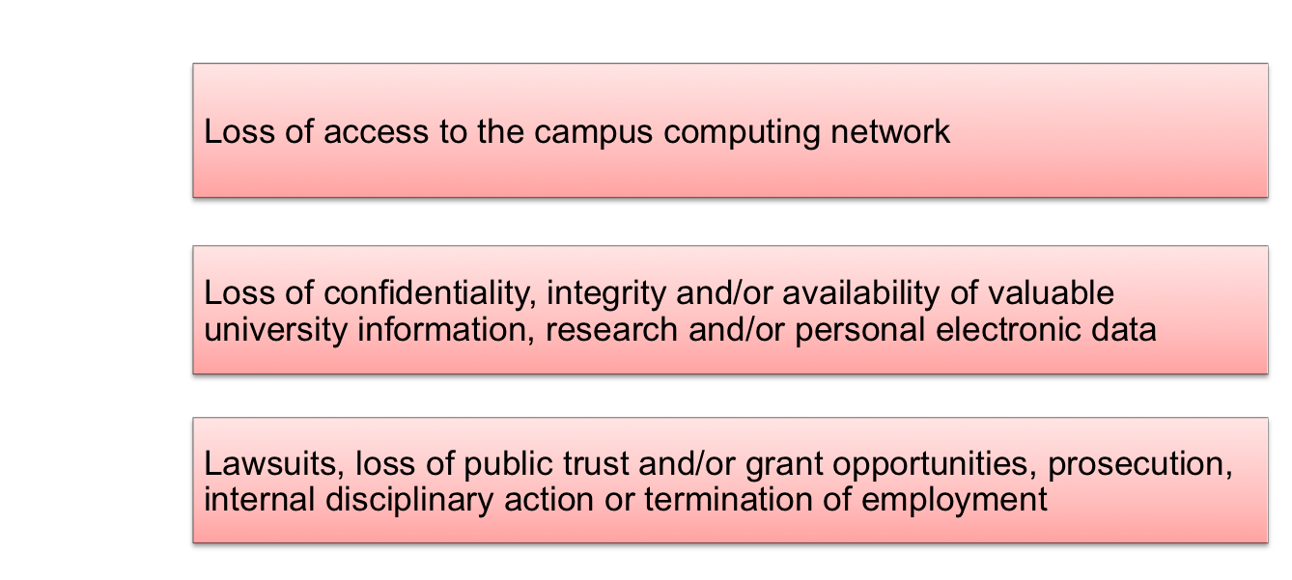

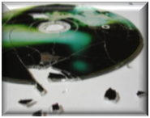
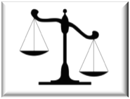
Consequences
CONSEQUENCES OF INACTION
In addition to the risks identified on the previous slide, as part of the UC Davis community
you may face a number of other consequences if you fail to take actions to protect
personal information and your computer. Consequences include:
73

Slide 74

Actions
CYBER-SAFETY ACTIONS
The following slides describe the top seven actions you can take to protect personal information and your computer. These actions will help you meet the UC Davis Cyber-safety Program policy standards.
By implementing all seven of these security measures, you will protect yourself, others, and your computer from many common threats.
In most cases, implementing each of these security measures will only take a few minutes.
You can find more about cyber-safety on the UC Davis Computer Security Web site (http://security.ucdavis.edu/).
74

Slide 75

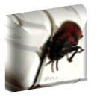
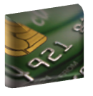



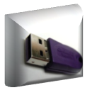
TOP SEVEN CYBER-SAFETY ACTIONS
Additional information about each of the actions below is provided on slides 8-14. Faculty and staff should work with their technical support coordinator before implementing these measures.
1. Install OS/Software Updates
2. Run Anti-virus Software
3. Prevent Identity Theft
4. Turn on Personal Firewalls
5. Avoid Spyware/Adware
6. Protect Passwords
7. Back up Important Files
75

Slide 76
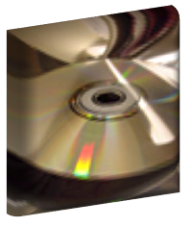






Install OS/Software Updates
Updates-sometimes called patches-fix problems with your operating system (OS) (e.g., Windows XP, Windows Vista, Mac OS X) and software programs (e.g., Microsoft Office applications).
Most new operating systems are set to download updates by default. After updates are downloaded, you will be asked to install them. Click yes!
To download patches for your system and software, visit:
    Windows Update: http://windowsupdate.microsoft.com to get or ensure you have all the latest operating system updates only. Newer Windows systems are set to download these updates by default.
    Microsoft Update: http://www.update.microsoft.com/microsoftupdate/ to get or ensure you have all the latest OS and Microsoft Office software updates. You must sign up for this service.
    Apple: http://www.apple.com/support
    Unix: Consult documentation or online help for system update information and instructions.
Be sure to restart your computer after updates are installed so that the patches can be applied immediately.
76

Slide 77
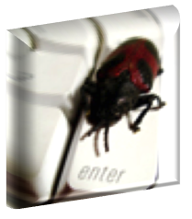





Run Anti-Virus Software
To avoid computer problems caused by viruses, install and run an anti-virus program like Sophos.
Periodically, check to see if your anti-virus is up to date by opening your anti-virus program and checking the Last updated: date.
Anti-virus software removes viruses, quarantines and repairs infected files, and can help prevent future viruses.
UC Davis students, faculty and staff can get Sophos for their work and home computer for FREE on the Internet Tools CD (available from IT Express in Shields Library).
Sophos can also be downloaded for free from the UC Davis Software License Coordination Web site (https://my.ucdavis.edu/software/).
77

Slide 78
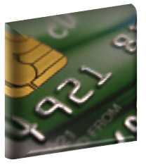




Prevent Identity Theft
Don't give out financial account numbers, Social Security numbers, driver’s license numbers or other personal identity information unless you know exactly who's receiving it. Protect others people’s information as you would your own.
Never send personal or confidential information via email or instant messages as these can be easily intercepted.
Beware of phishing scams - a form of fraud that uses email messages that appear to be from a reputable business (often a financial institution) in an attempt to gain personal or account information. These often do not include a personal salutation. Never enter personal information into an online form you accessed via a link in an email you were not expecting. Legitimate businesses will not ask for personal information online.
Order a copy of your credit report from each of the three major credit bureaus-Equifax, Experian, and Trans Union. Reports can be ordered online at each of the bureaus’ Web sites. Make sure reports are accurate and include only those activities you have authorized.
78

Slide 79

Turn on Personal Firewalls
Check your computer's security settings for a built-in personal firewall. If you have one, turn it on. Microsoft Vista and Mac OSX have built-in firewalls. For more information, see:
    Mac Firewall
    (docs.info.apple.com/article.html?path=Mac/10.4/en/mh1042.html)
    Microsoft Firewall (www.microsoft.com/windowsxp/using/networking/security/winfirewall.mspx)
    Unix users should consult system documentation or online help for personal firewall instructions and/or recommendations.
Once your firewall is turned on, test your firewall for open ports that could allow in viruses and hackers. Firewall scanners like the one on http://www.auditmypc.com/firewall-test.asp simplify this process.
Firewalls act as protective barriers between computers and the internet.
Hackers search the Internet by sending out pings (calls) to random computers and wait for responses. Firewalls prevent your computer from responding to these calls.
79

Slide 80



Avoid Spyware/Adware
Spyware and adware take up memory and can slow down your computer or cause other problems.
Use Spybot and Ad-Aware to remove spyware/adware from your computer. UC Davis students, faculty and staff can get Spybot and Ad-Aware for free on the Internet Tools CD (available from IT Express in Shields Library).
Watch for allusions to spyware and adware in user agreements before installing free software programs.
Be wary of invitations to download software from unknown internet sources.
80

Slide 81
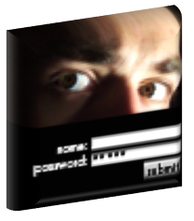





Protect Passwords
Do not share your passwords, and always make new passwords difficult to guess by avoiding dictionary words, and mixing letters, numbers and punctuation.
Do not use one of these common passwords or any variation of them: qwerty1, abc123, letmein, password1, iloveyou1, (yourname1), baseball1.
Change your passwords periodically.
When choosing a password:
  Mix upper and lower case letters
  Use a minimum of 8 characters
  Use mnemonics to help you remember a difficult password
Store passwords in a safe place. Consider using KeePass Password Safe (http://keepass.info/), Keychain (Mac) or an encrypted USB drive to store passwords. Avoid keeping passwords on a Post-it under your keyboard, on your monitor or in a drawer near your computer!
81

Slide 82
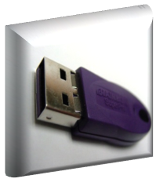
Back Up Important Files
Reduce your risk of losing important files to a virus, computer crash, theft or disaster by creating back-up copies.
Keep your critical files in one place on your computer’s hard drive so you can easily create a back up copy.
Save copies of your important documents and files to a CD, online back up service, flash or USB drive, or a server.
Store your back-up media in a secure place away from your computer, in case of fire or theft.
Test your back up media periodically to make sure the files are accessible and readable.
82

Slide 83

Home
CYBER-SAFETY AT HOME
Physically secure your computer by using security cables and locking doors and windows in the dorms and off-campus housing.
Avoid leaving your laptop unsupervised and in plain view in the library or coffee house, or in your car, dorm room or home.
Set up a user account and password to prevent unauthorized access to your computer files.
Do not install unnecessary programs on your computer.
Microsoft users can download the free Secunia Personal Software Inspector (https://psi.secunia.com/), which lets you scan your computer for any missing operating system or software patches and provides instructions for getting all the latest updates.
83

Slide 84
Work
CYBER-SAFETY AT WORK
Be sure to work with your technical support coordinator before implementing new cyber-safety measures.
Talk with your technical support coordinator about what cyber-safety measures are in place in your department.
Report to your supervisor any cyber-safety policy violations, security flaws/weaknesses you discover or any suspicious activity by unauthorized individuals in your work area.
Physically secure your computer by using security cables and locking building/office doors and windows.
Do not install unnecessary programs on your work computer.
84

Slide 85

Campus Services
CAMPUS CYBER-SAFETY SERVICES
UC Davis offers services and software to protect the campus network
against cyber-safety attacks. These include:
Services | Software
Campus email virus filtering Campus firewall services Email attachment filtering Vulnerability scanning Intrusion prevention system | Free anti-virus software: Sophos Anti-virus Free encryption software: Pointsec for PC Free change management software: Tripwire
Additional information about these and other campus cyber-safety services, visit http://security.ucdavis.edu.
85

Slide 86
The Internet
Defined as, The global communication network that allows almost all computers worldwide to connect and exchange information.
Over 3 billion people (40% of the earth’s population) use the internet
Growing by the second
Ellen

Slide 87
The Internet continued
Over 8.7 billion machines are connected to the internet
1.7 billion internet users are in Asian
The first webpage was created on August 6th 1991

Slide 88
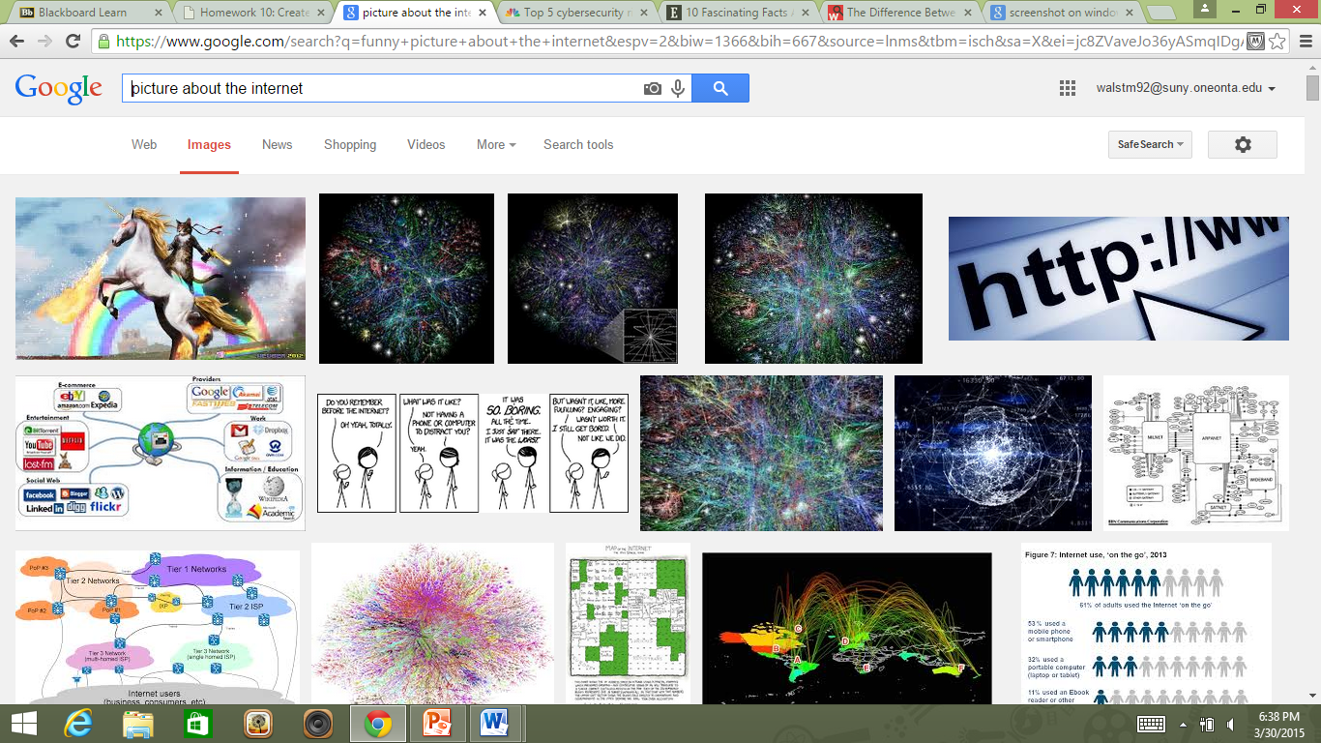

“Picture about the internet”
“The internet has been a boon and
a curse for teenagers.” – J.K. Rowling

Slide 89
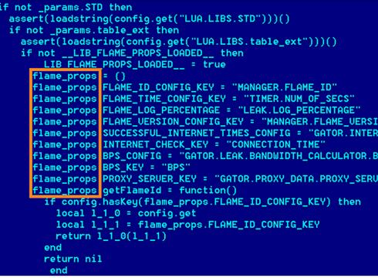
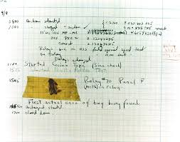
The first webpage ^
The first computer virus for the Apple II to infect floppy disks^
The first computer “bug” a moth that got caught in the Harvard Mark II computer on September 3rd, 1947^
Shot of the “Flame” virus that went through the middle east a few years ago^

Slide 90
Cybercrime statistics
Cyber attacks cost globally between $375 - $575 billion annually
Over 800 million people had their identity stolen globally in 2013 alone
The government notified 3,000 companies alone in 2013 that they had been hacked
The most expensive hack was worth over $1 billion
Identities stolen in 2013 by country
Turkey | US | Korea | China | Germany
54 mil | 40 mil | 20 mil | 20 mil | 16 mil

Slide 91
Cyber Security Importance
Cost as % of GDP
Many cybercrimes can be prevented or stopped before real damage has begun with knowledge and vigilance.
The U.S government allocates $13 billion every year since 2010 on cyber security alone
Over $76.9 billion is projected spending on cyber security in 2015

Slide 92
What is cyber security?
the body of technologies, processes and practices designed to protect networks, computers, programs and data from attack, damage or unauthorized access. Its main purpose it to protect the computer and its’ users.

Slide 93
Most common ways for cyber attacks to occur
Socially engineered trojans
Unpatched software
Phishing attacks
Network traveling worms
Advanced persistent threats

Slide 94
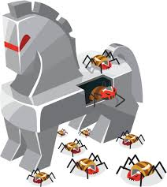
Socially engineered trojans
the most common type of attack
It is when a malicious party of hackers compromises an innocent website and has users on the website then download files that contain the Trojan virus

Slide 95
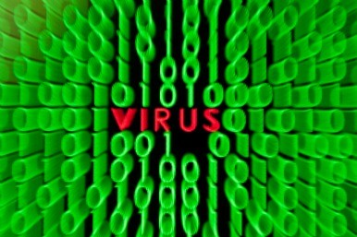
Unpatched software
second most common form
software (most commonly java, adobe reader, and adobe flash) has an area of the program that is vulnerable to attacks using the program as a messenger for the hackers to get into the victims devices.

Slide 96
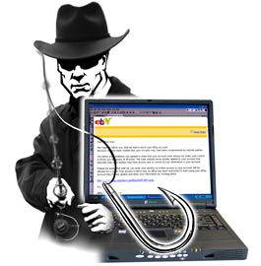
Phishing attack
email attacks that look like regular emails but are actually spam that contain links asking for confidential information
They are hard to tell apart since they look so much like regular emails
around 70% of emails are spam

Slide 97
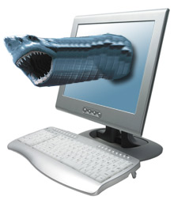
Network Traveling Worms
attacks that are similar to the old time viruses hidden in emails
Much more hidden then they were in the past

Slide 98
Advanced persistent threats
hackers send multiple phishing attacks to employees in a certain company
they then get a hold of the companies information about themselves and customers

Slide 99
Common misconception
No, not all attacks are “viruses” as most everyday people think
The correct term for program damaging a computer is Malware
Malware
viruses
worms
spyware

Slide 100
Malware
Defined as software that is intended to damage or disable computers and computer systems
Malware is a blanket term with different branches stemming off of it such as viruses, spyware, worms etc.
Best way to prevent them is being educated on what each is

Slide 101
Viruses
Is a piece of code that is capable of copying itself and typically has a detrimental effect, such as corrupting the system or destroying data
It runs when the computer user runs the infected program
The virus then replicates and infects other programs
Worms are similar except they don’t need to connect to a program and almost always effect the network

Slide 102
Spyware
Used to “spy” on the user and steal important information
After it infects a device, it sends back information from the host to the creator
A lot of the time the hackers are trying to get information about credit cards or individuals themselves

Slide 103
Ways to Prevent a Cyber Attack
Make a long, unique password
Don’t use the same password
Apply software updates
Make sure websites are secure before you give information
Don’t log into public computers with your information
Back up your personal files

Slide 104
1) What is defined as, software that is intended to damage or disable computers and computer systems?
Malware
2) Around how much money do cyber attacks cost annually?
$375-575 billion

Slide 105
CYBER-SAFETY BASICS QUICK QUIZ
True or False? Viruses can be transmitted via email, email attachments or IM.
People who seek out your personal information and then use it to commit crimes are called:_____________________
Which of the following are ways to help prevent identity theft. (Check all that apply.)
        __A. Never send personal information via email or instant messages.
        __B. Always send personal information via email or instant messages.
        __C. Lock my office door.
        __D. Don’t tell anybody my name.
True or False? Iloveyou2 is a good password. Why or why not?
Which anti-virus program is available to all UC Davis students, faculty and staff for free?________________________
I just downloaded a free program online and now my computer is running very, very slowly. Which of the following most likely happened?
        __A. I didn’t install the program properly.
        __B. I didn’t have enough space on my hard drive for the new program.
        __C. I downloaded spyware and/or adware, too.
        __D. Someone snuck in while the program was downloading and changed my password.
___________________help prevent your computer from responding to pings (calls) from hackers.
8. To fix problems with my operating system and/or application software, I should install __________________.
Answers on next slide . . .
105

Slide 106
QUICK QUIZ ANSWERS
True
Identity thieves
A and C are correct. D would probably help too, but seems a bit extreme!
False. Iloveyou2 is a very common password.
Sophos Anti-Virus is free to UC Davis students, faculty and staff.
C. It’s most likely that you downloaded spyware and/or adware.
Firewalls
OS and/or software updates (patches)
How did you do?
8-7 correct: Fantastic! You can help write the next quiz!
6-5 correct: Good. You can help write the next quiz, but we’ll check it for accuracy . . . just in case.
4-3 correct: You might want to review the material for the questions you missed.
106

Slide 107
REFERENCES
https://isc.sans.edu/presentations/first_things_first.html
Mcafee
Business Insider
Securityweek
107

